Slide 1

How we started, and how you can too
Kristin Zaitz
Co-Founder, Mothers for Nuclear

Slide 2
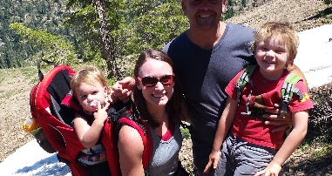
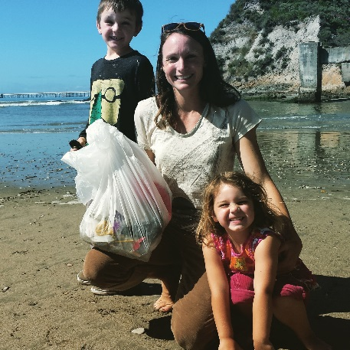
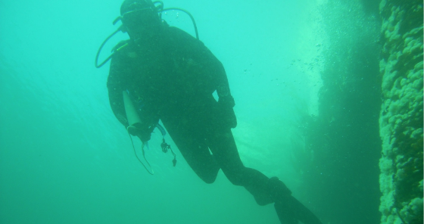
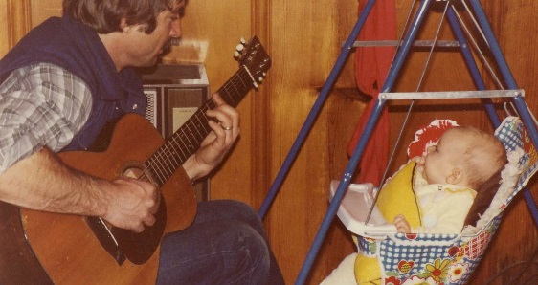
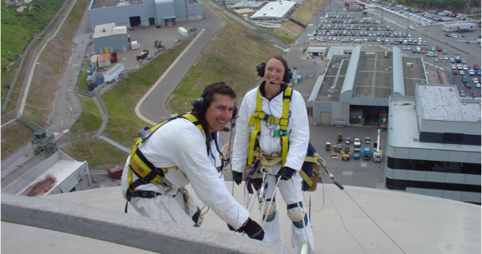
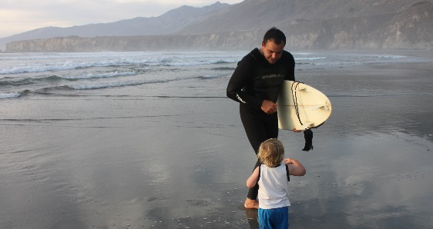
I Changed My Mind About Nuclear When I Discovered How it Aligns with My Values

Slide 3
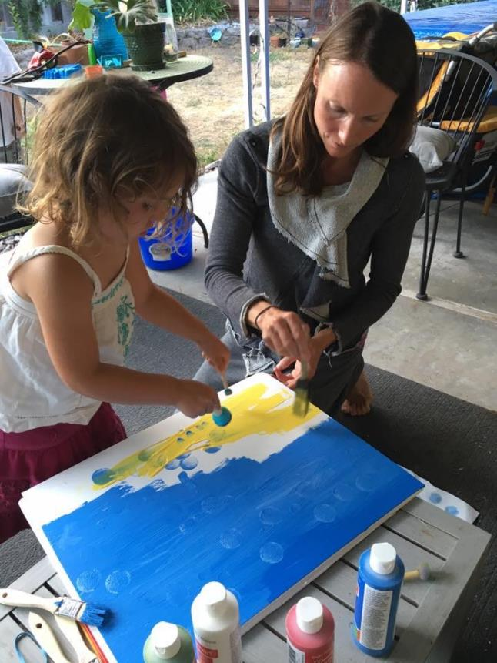
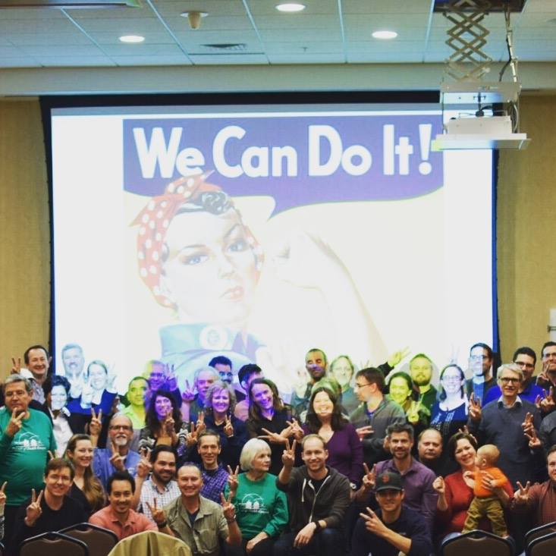
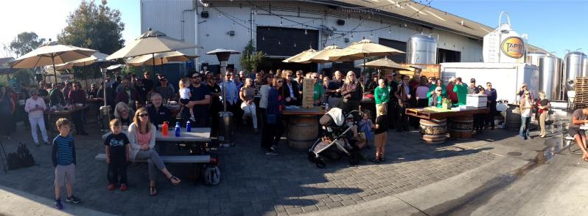
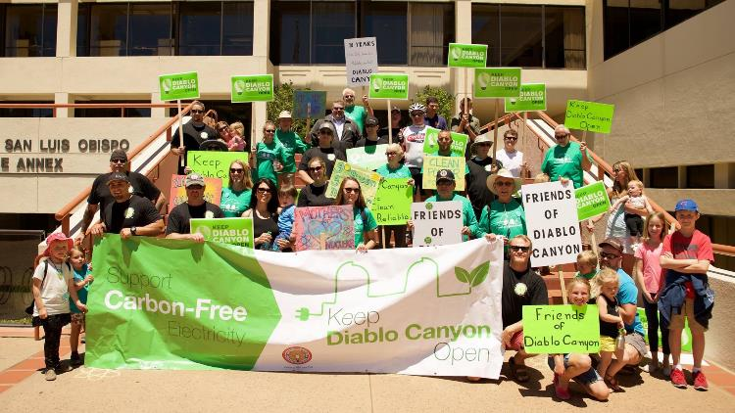
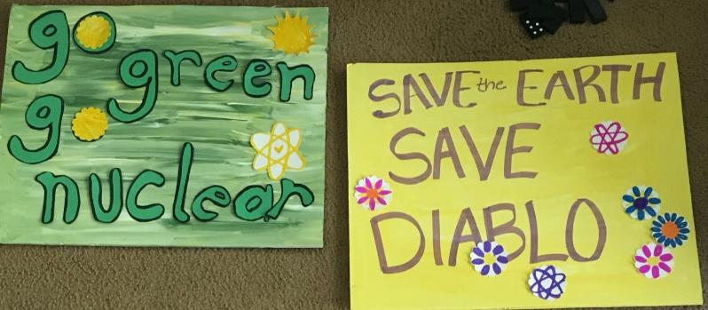
Team up with others who share your purpose

Slide 4
Feelings Matter!
Save Nuclear
Policy
Political support
Public support for nuclear energy

Slide 5
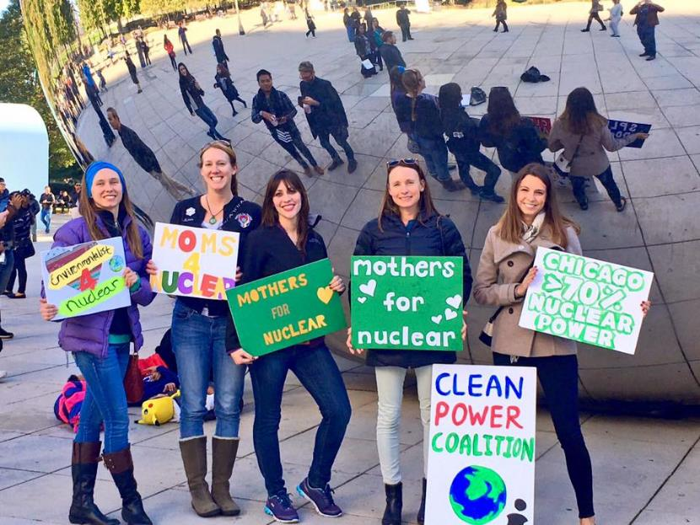
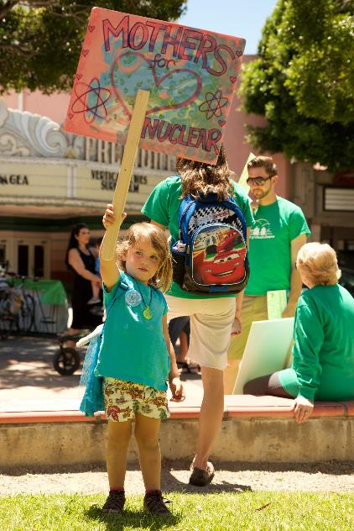
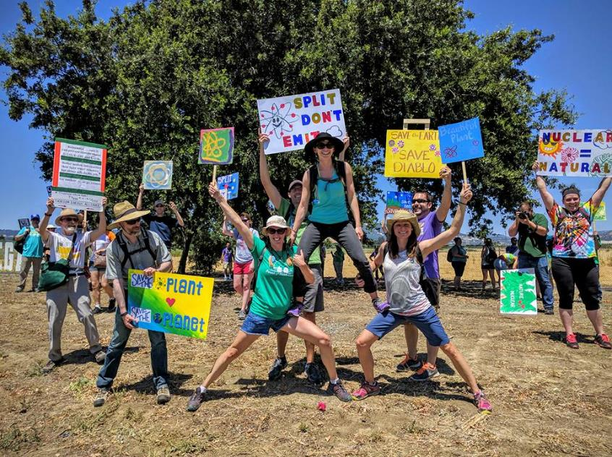
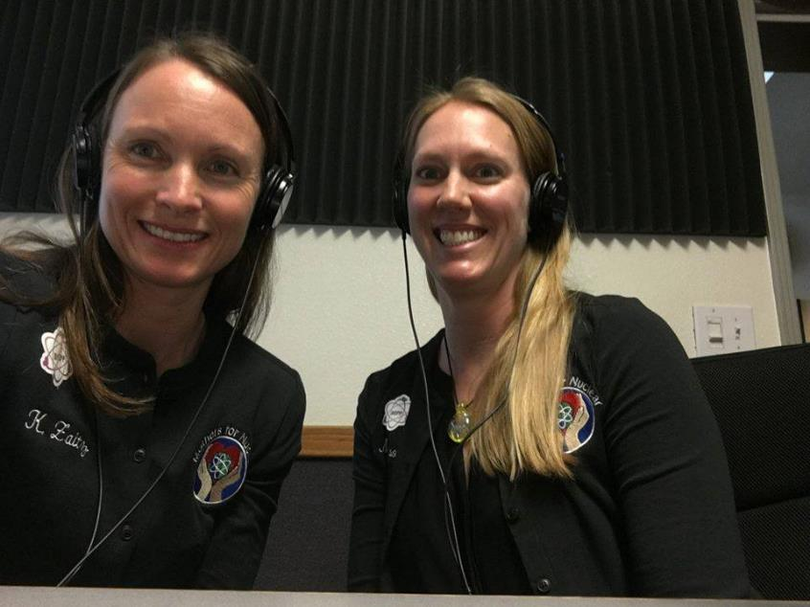
What can we do? LOTS
Website, blog & personal stories. Facebook. Twitter. Instagram. Video. Radio. Op-Ed’s. TV interviews. Travel. Speak in schools, clubs, community groups. State-level and national-level political advocacy. Pro-nuclear marches. Pro-nuclear rallies. Letter-writing campaigns. Mixers. Building advocacy networks. Have fun!

Slide 6
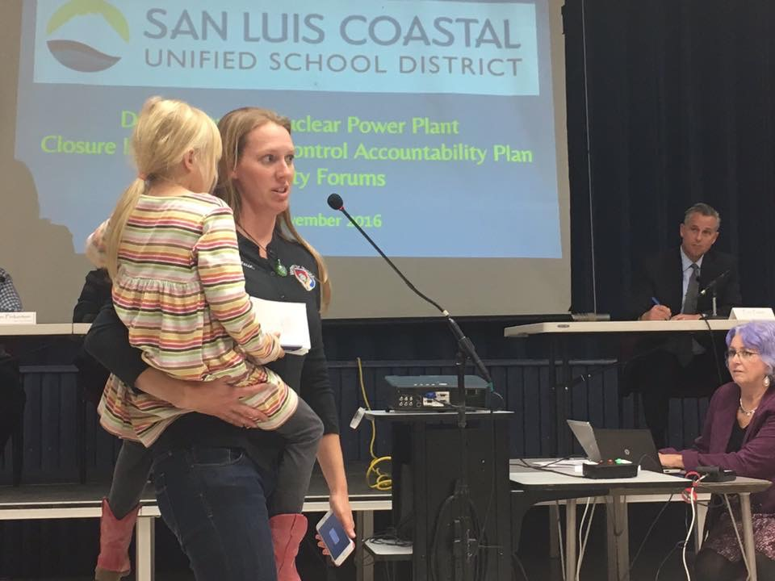
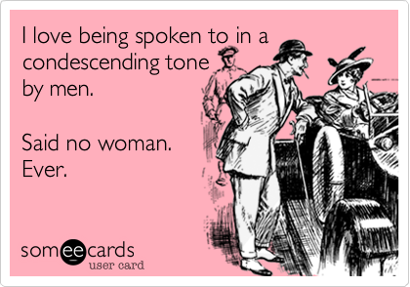
Men in suits using Acronyms and big words doesn’t do it for everyone

Slide 7
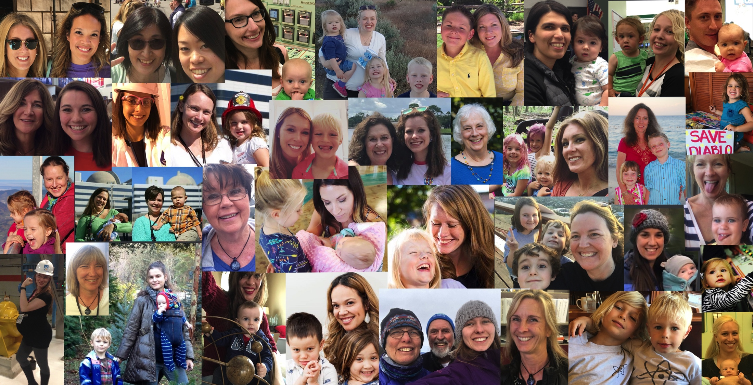


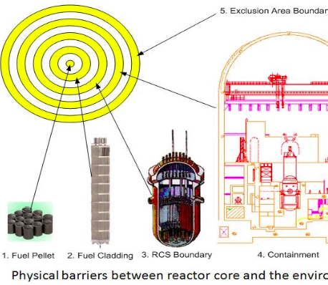

Slide 8
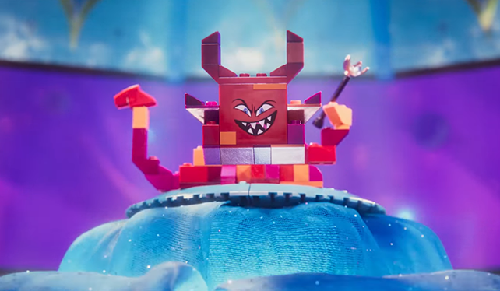
Lego Movie 2 & How Not TO Frame An Issue
Queen Watevra Wa-Nabi: Here's some other adjectives people use to describe me, "Un-duplicitous", "un-malicious", "un-conniving", "un-nasty"!
Lucy: You're just adding "un" to words that describe you.
Queen Watevra Wa-Nabi: Who, me? I'm Queen Watevra Wa-Nabi! The most least evil person you'll ever meet!

Slide 9
Make it Personal. Tell your story. Tell your “why”

Slide 10
What Have We Learned?
Get clear on your purpose
Find a friend
Advocacy works when you build partnerships, not empires
Don’t wait for perfection, jump in now
Keep at it

