Slide 1
An Outreach Model:
Modular and Simple
2016
Jill Donaldson
Outreach Coordinator, BMPC-Pennsylvania
July 12, 2016
Notes:
My name is Jill Donaldson and I am the Outreach Coordinator of the BMPC Pennsylvania WIN chapter at the Bettis Laboratory. I’m presenting our Outreach model that we’ve done many times since initiation in 2009. I’m sharing it here because it’s easy and well-defined. It’s the type of program that a small chapter could do. Even if your chapter is not currently doing outreach activities, you could take one or more of these modules to try it out. It offers a simple approach without need for the team to meet much beforehand.

Slide 2
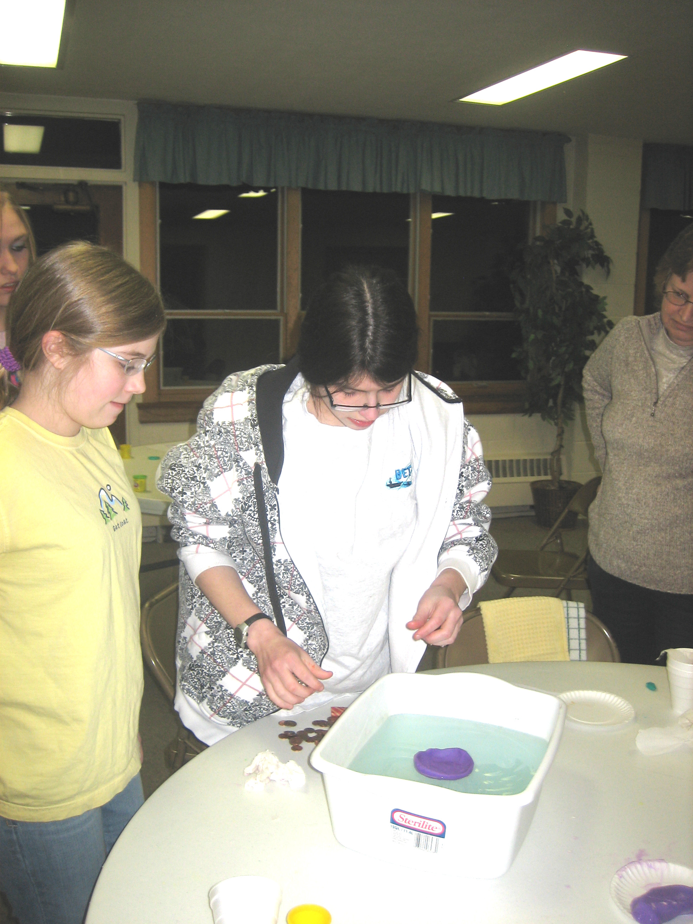
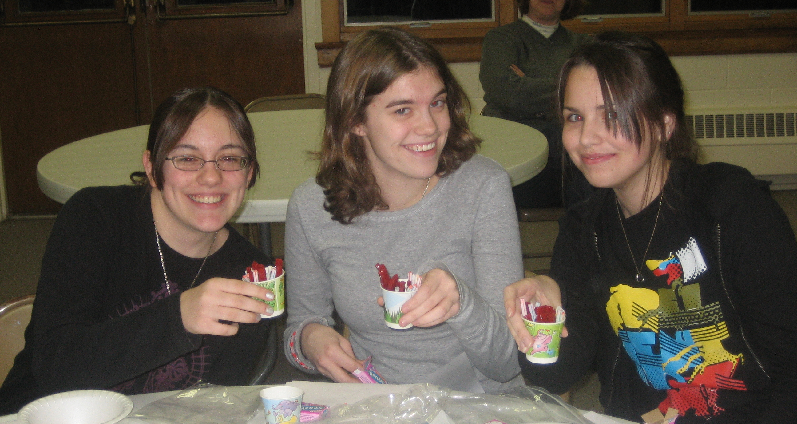
Where’d it Start?
Initially based on a Cadette Girl Scout Badge
  (“Build a Better Future” with Skill Builders,
  Technology, and Career Exploration portions)
Type | Title
Quick Intro | Intro to radiation and nuclear power (marshmallow isotopes)
Skill Builder | “Tour” a nuclear power plant
Skill Builder | Compare different types of naval ships
Technology | Items invented in last 25 yrs by women
Technology | Recent (10 years) developments in nuclear plant design and operation (ALARA)
Career Exploration | Discuss engineering and science careers
Career Exploration | Engineers contribution to advancing nuclear medical technology
Notes:
I was a Girl Scout leader. And an engineer (well, I’m still an engineer). My troop was a group of freshmen and sophomores. When I took over as our WIN Chapter Outreach Coordinator, I had a vision of doing a badge that would build on my experience in scouting and my engineering. I planned to test it on my own troop first. I developed a two meeting format that modified the Cadette engineering badge (“Build a Better Future”) to have a nuclear theme. Since my troop already volunteered regularly at the Science Center overnight events, I could check off the Service requirement and focus on the other badge requirements. We successfully completed the badge in two meetings in Spring of 2009. Here are a couple of pictures. The photo on the left is Tara, Rachel and Sarah with candy reactors. On the right you can see Lauren and Molly design ship hulls with Play Doh to carry the maximum number of pennies. The badge format set us up to do “modules.”

Slide 3
Modular
Badge requirements led to a modular approach:
  Allows incorporation of new volunteers without a large time commitment
  Can be tailored for available time (dropping or adding sections)
  Allows easy revision of portions of the program autonomously by volunteers
Notes:
After the first run of the program, the advantage of a “modular” outreach program was apparent. It’s easy to dump the parts that don’t work, easy to re-work portions that sort of work, and easy to delegate portions to individuals who can then work autonomously to improve them (I encourage personalization!). I have found that new volunteers can be easily “salted” in to the module approach. I provide a “this is what was done in the past” packet. I explain the context of their module (when it occurs and what earlier modules it builds upon) and I reassure them that it’s only 10 or 15 minutes. That seems to really be the hook. People are fine taking material and putting together a pretty defined 10-15 minute presentation. It is not intimidating. I also reassure folks that we have lots of first timers (we had 29 volunteers participate in 9 different events with our BMPC-Pennsylvania outreach in 2015 – about half volunteered for the first time in 2015!).

Slide 4
Current Program
Module | Goal/Activity
M&M Half-Life | Introduce the idea of radioactive decay Roll M&Ms, Chart the results
Commercial Power Cycle | “Tour” a nuclear power plant Act out the three isolated water loops of a PWR
Candy Reactors | Learn the parts of a nuclear reactor Build it with straws, Dots, Nerds, Twizzlers and 7-Up
Natural Exposure | Find out about sources of radiation in your everyday life. Guess the relative amounts of common contributors
Occupational Exposure | Present ALARA principles: time, distance and shielding With Cheetos as radioactive material, avoid contamination
Medical Radiation | Talk about nuclear medicine applications Look at rapid prototypes, CAT scans. Reconstruct an orange.
Career Discussion | Discuss engineering careers (usually expanded for high school students to discuss college choices)
Notes:
We found that the two meeting format initially tested was more time than most scouts or school groups wanted. Typically now I promote the program as 1 to 1-1/2 hours with six modules. Maybe 2 hours if a career and college “panel” is requested (as with high schools usually). I encourage volunteers to revise or expand their portions. I’m going to talk about each of these modules separately. I am also careful to point out to girl scouts and boy scouts that our program does not meet a badge criteria. It’s more a nuclear science show-and-tell rather than a nuclear science lecture series. I’ve had high school physics teachers disappointed (and not host) and younger scout leaders thrilled (and then host and pass our info along to others). Right now we are getting mostly 4th, 5th, 6th grade Girl Scout troops.

Slide 5
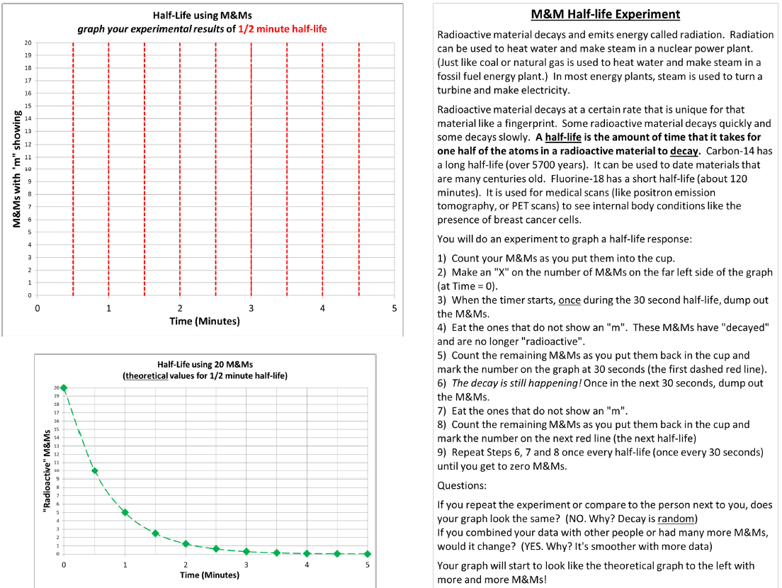
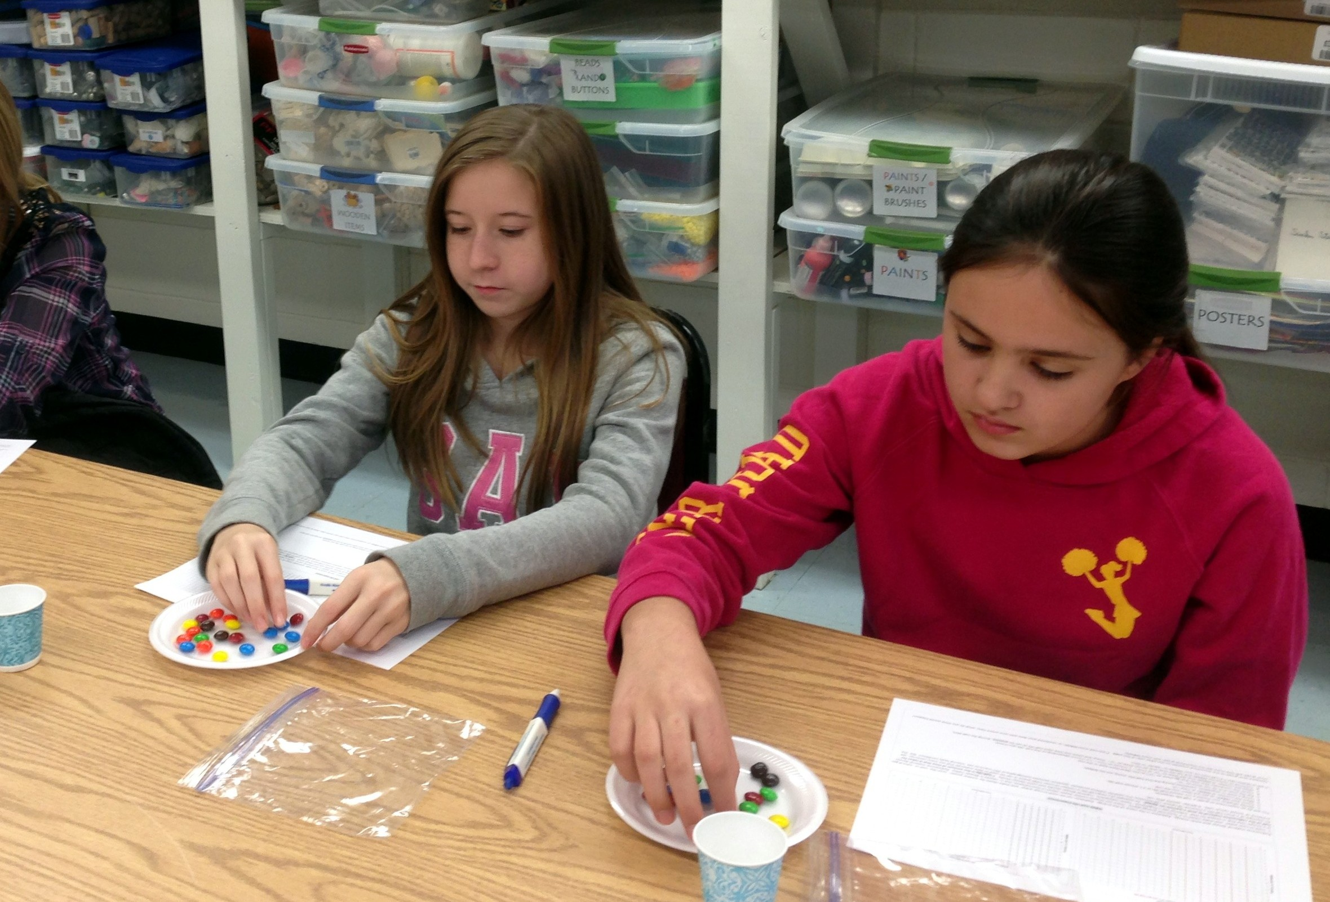
M&M Half Life
20 M&Ms and cup in a baggie, plate, pen
(Also has been used as a booth activity)
Notes:
Initially, the first module was marshmallow nuclei, explaining radioisotopes by changing the number of protons. We found that either kids knew about protons, neutrons and electrons and they were bored, or kids didn’t know about atoms and it was way too complicated. The marshmallows got sticky and messy. And it seemed like most kids didn’t like to eat the colored marshmallows anyway. So we shifted to M&M half life. Really, this is a statistical exercise. In each module I try to define one takeaway as a goal. In this module, the takeaway is “radioactive material decays.” A second point, which is usually what the kids seem most interested in, is that when you do a random experiment, your graph is different than your neighbor’s, but if you combine a bunch of tests, the curve gets smooth.
It’s important to remove the blank M&Ms without the “m.” Eat them or place back in the Ziploc for afterward, because you occasionally get an M&M that’s blank on both sides and if you’re re-rolling the blanks instead of eating the blanks, you’ll never decay to zero. We have also done this activity twice as a booth activity at an Elementary School Science Night. The sheet is written with instructions so it could be done independently.
We have found that 20 M&Ms is about the right number for a 10-15 minute exercise and it’s also about what you get in a Fun Size package (though those are usually 17-19 pieces). We buy large bags and pre-count them into Ziplocs of 20.

Slide 6
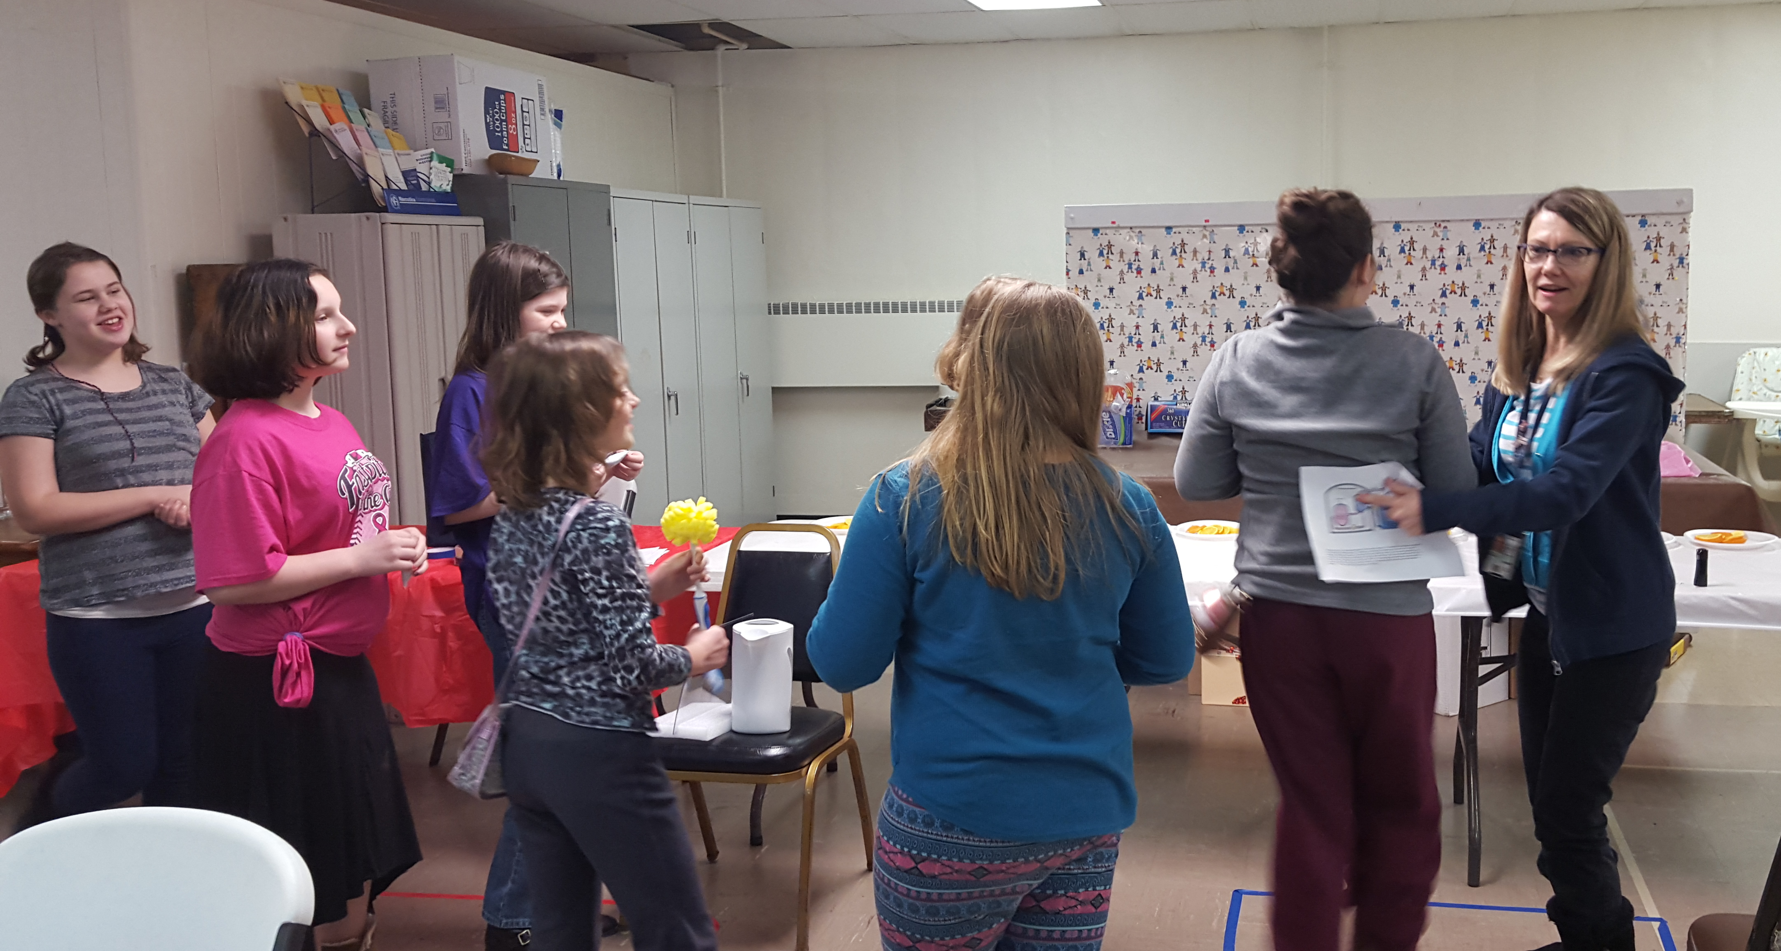
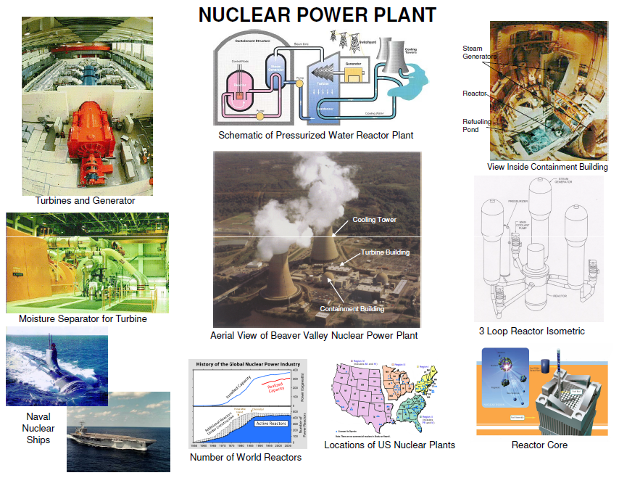
Nuclear Plant Tour
Handout includes an aerial photo of Beaver Valley (see next slide):
Small Containment Building (with the whole primary loop)
Larger Turbine Building (making the electricity)
Huge Cooling Tower (look at that STEAM cloud)
Notes:
The nuclear plant tour began as part of the Girl Scout Badge, but has been a great module ever since we got the kids into the action. It is also a portion of the American Nuclear Society patch program. By the way, we do not do the American Nuclear Society patch program because there’s one pretty difficult requirement. The “build your own cloud chamber” item was a little too much for us. Instead we have bought “fun patches” that just say “Math! Science! FUN!”. They are small and pink and less than a buck. Girl Scouts love them. It is not a badge, so it goes on the back of the vest or sash, but any age can wear it (Daisies, Brownies, Juniors, Cadettes, Seniors, Ambassadors). School groups aren’t very interested in patches and we have a reversible pocket screwdriver as another giveaway, so the school kids still get some swag. The swag comes at the end though, so back to the program. We use a handout (we also have a poster-size version of the handout). We briefly mention our connection to nuclear. We work for the Naval Nuclear Propulsion Program (small photo, lower left in handout). The advantage of naval nuclear power is that submarines can remain submerged (not using oxygen for diesel engines) and that aircraft carriers can remain deployed (not requiring fuel replenishment while underway) However, the focus of this module is the PWR commercial nuclear power cycle. We start with the aerial view of the Beaver Valley PWR in the center of the handout. We talk about the major components in the plant (there are supplemental photos around the edges of the handout). We point out the containment buildings, turbine buildings and cooling towers. The cartoon schematic introduces the fluid flow path. We introduce the concept of separate loops of water. You’ll see the two major parts of the nuclear plant tour on the next two slides – the aerial photo of Beaver Valley and the kids acting out the loops.

Slide 7
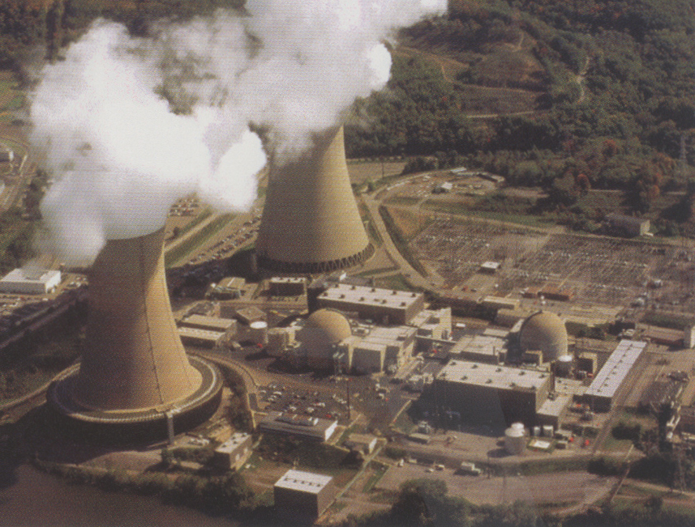
Nuclear Plant Tour
Small containment buildings
(entire primary loop!)
[Sister plants are the norm!)
Turbine buildings
(here’s where the work is!
electricity is being generated)
Cooling towers
(STEAM! From the river water as it rains down through the air)
Notes:
Here’s the aerial photo of Beaver Valley (we got it off the internet). You could easily personalize this to your own local nuclear power plant. It is a great tool to show the relative sizes of the primary loop, secondary loop and river loop. The size of the containment building is highlighted and we talk about “sister” plants being the norm (Girl Scouts love that sister plant idea). We talk a bit about how the entire primary loop, which contains ALL the radioactivity is inside the containment building which is built to withstand a plane crashing right into it. It has three foot thick concrete walls. Then we point out the turbine buildings, which is where steam turns a turbine to create electric energy. The steam is doing the work by turning the turbine. Then the secondary water has to be cooled down so that it can be used again. It is cooled down by travelling through a condenser that has river water. Then the river water falls through the air to cool down. The cooling tower is where the river water if falling through the air. We stress that there is no burning in a nuclear plant. A coal plant will burn coal to heat water into steam then the steam turns a turbine and the it’s a lot like the nuclear plant. But the first part in a coal plant needs a much larger building than the containment building and that building makes a lot of smoke from the coal burning. Smoke is air pollution. Steam is not air pollution. Nuclear energy is “green energy” because it does not make any smoke. Now we act out the parts of the nuclear plant!

Slide 8
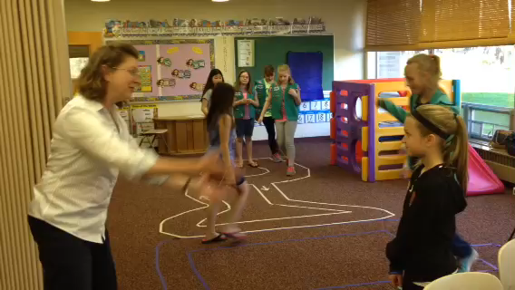
Nuclear Plant Tour
Notes:
Here you can see Sharon as she’s putting the last girls into the river water loop. (watch video). We usually set the tape down on the floor before we start the program. Notice there are three colors of tape. The river loop is not really a loop, it’s more of a channel along one side of the room.
So first, one kid is the reactor (they may get a handwarmer or a flashing light to indicate they’re making the power). A couple more kids are the primary loop water. They circle the reactor getting warm. More kids, like 4 or 5, indicating more water volume than the primary loop, are the secondary water loop. They also do a twirl at the turbine (a wide spot in the loop) – “doing the work.” After they flip, they pass next to the river loop. All remaining kids (hopefully several more than four or five, like 7 or 8 or more, line up to pass by the secondary loop cooling it off (they can wiggle and do some jazz hands as they fall through the cooling tower after cooling off the secondary loop – a.k.a. the cooling tower dance). Again, more kids in the river loop indicate the larger water volume than the secondary. This activity has worked out great because every kid is up and involved.
The key takeaway items from the nuclear plant tour are: there’s no smoke from a nuclear plant and there’s steam coming out of the cooling towers.

Slide 9
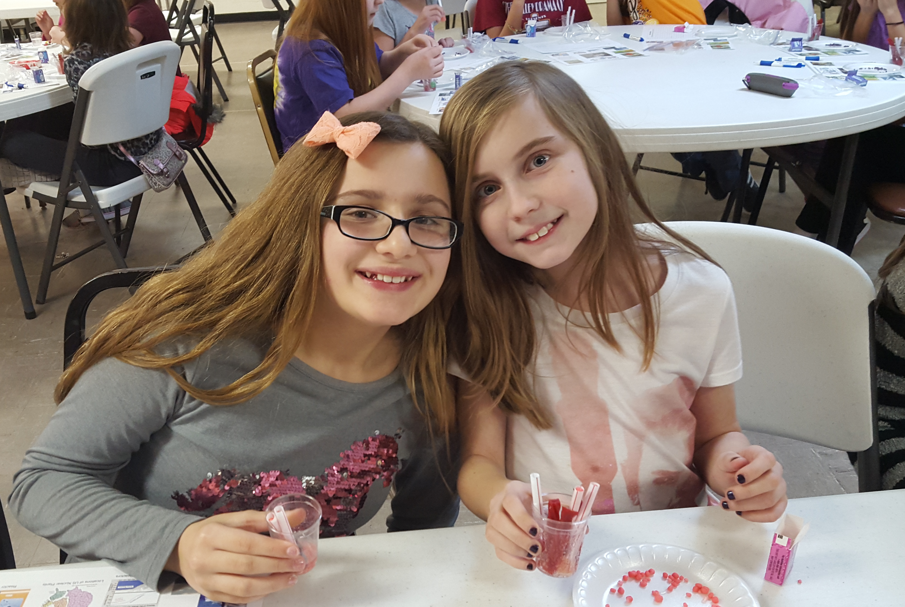
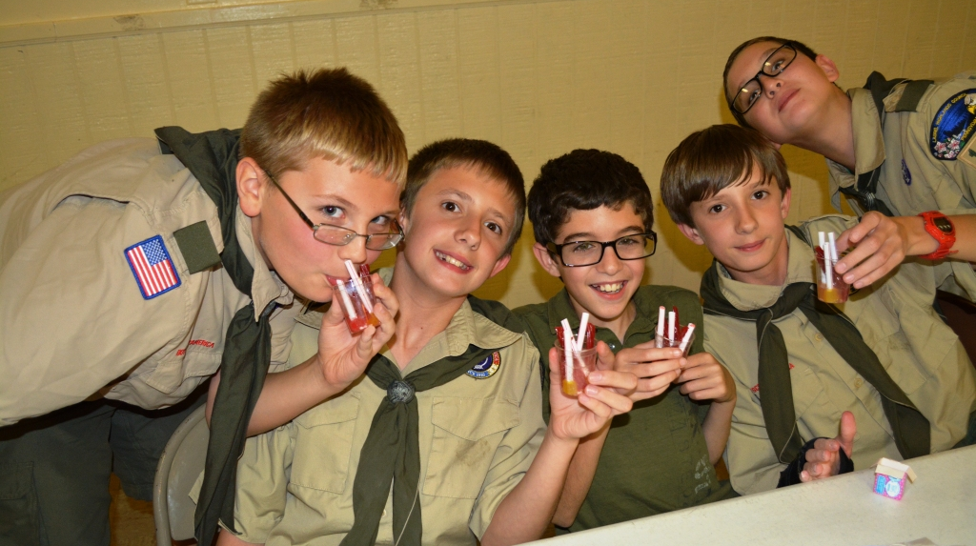
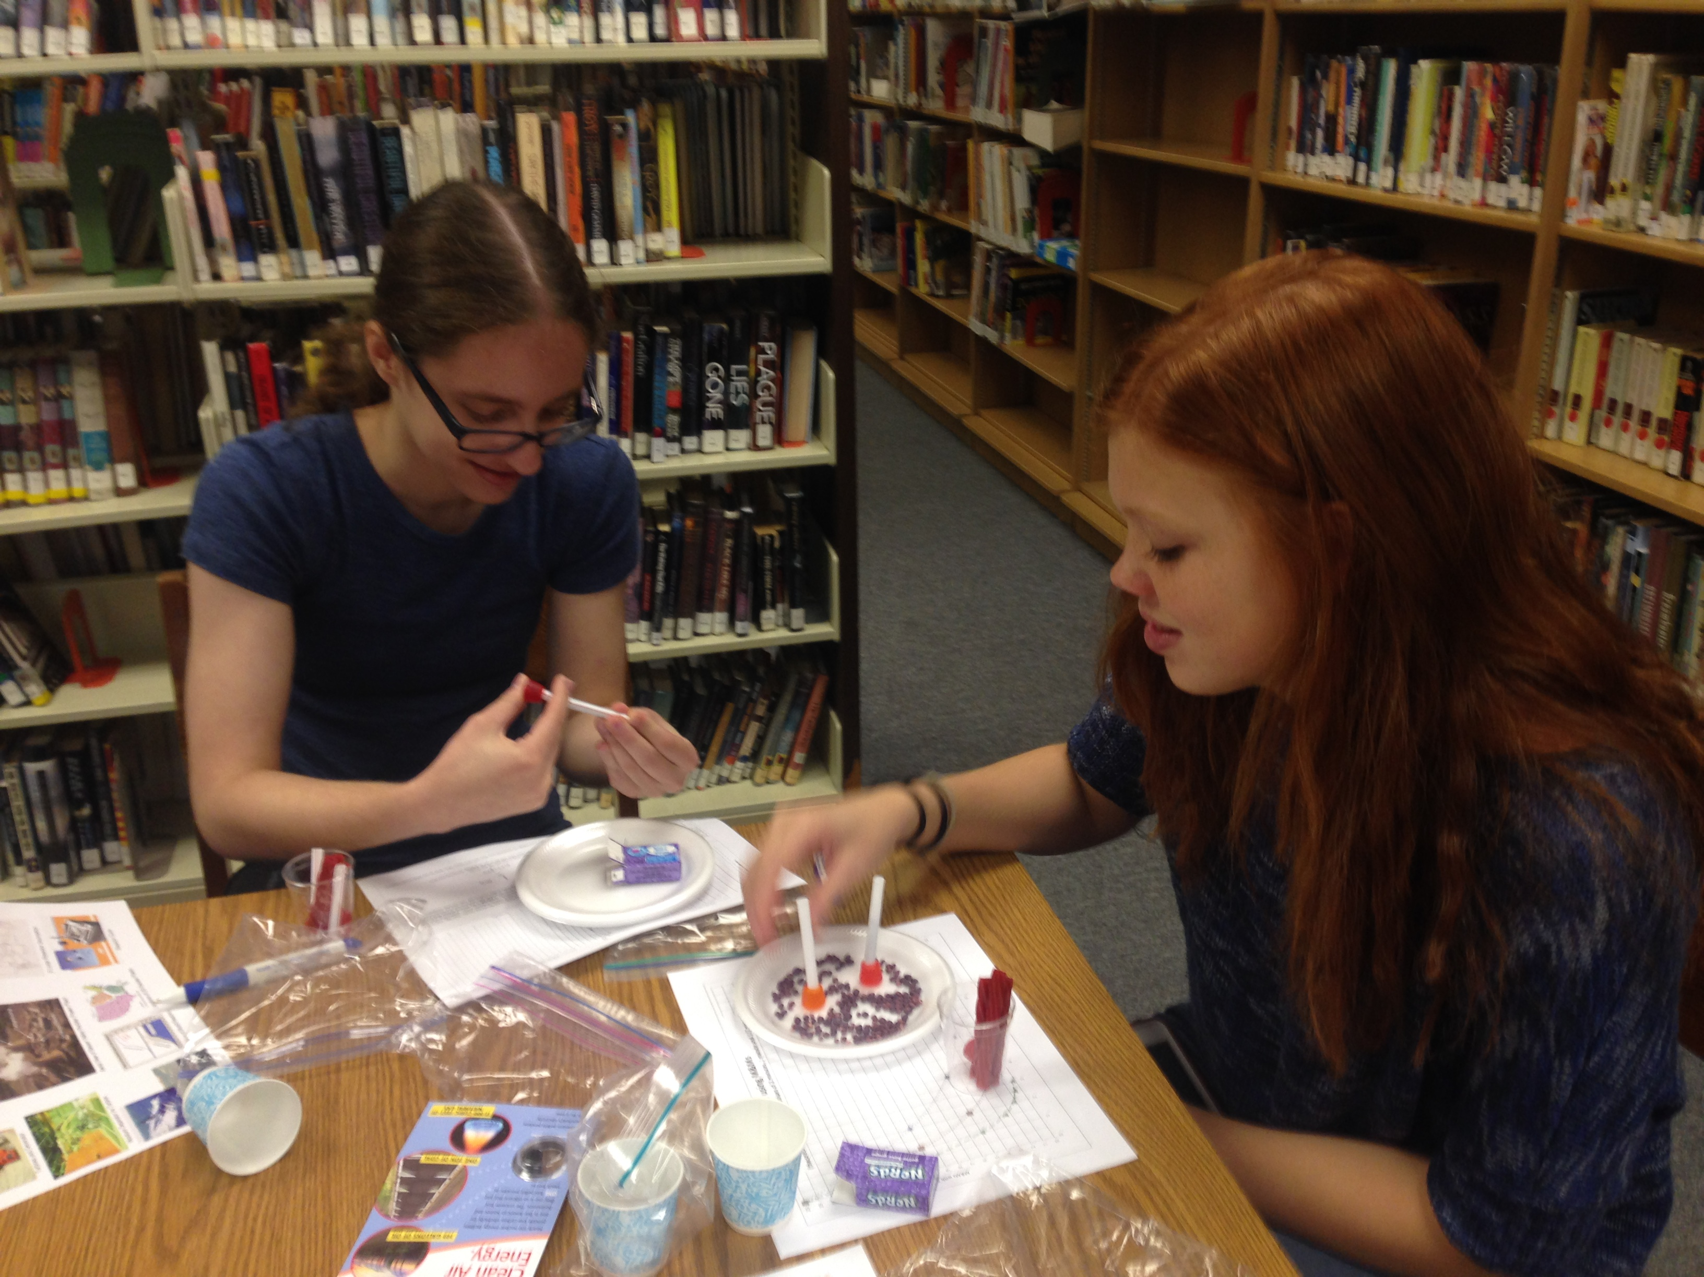
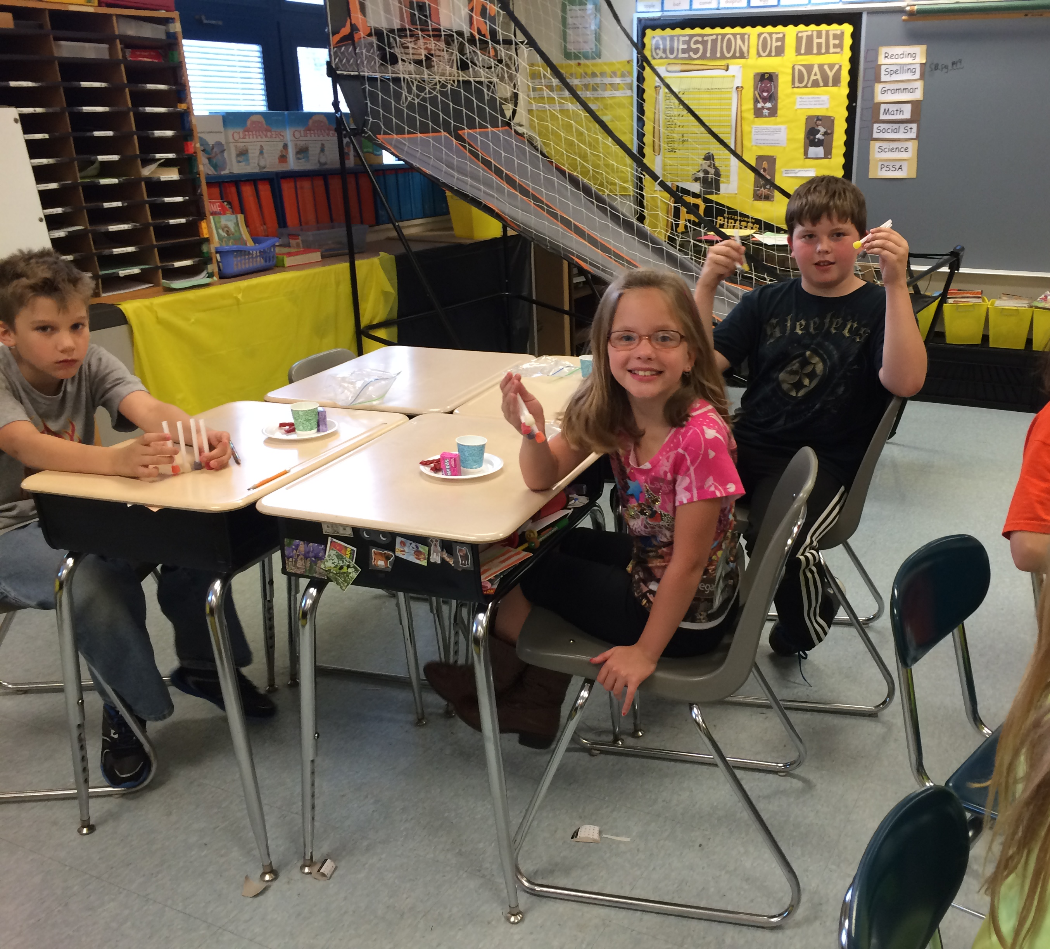
Candy Reactors
A popular activity with all ages. We package sets of supplies in kits in a Ziploc (3 Dots, 3 straws, 1 Nerds box, 1 Twizzler cut in thirds, 1 cup – plus about 1 2L of 7up for each 20 kids).
  Plug straws with Dots (cladding)
  Load with Nerds (fuel pellets)
  Place in cup (reactor vessel)
  Add Twizzlers (control rods)
  Add 7-Up (reactor coolant)
Notes:
After the Nuclear Plant tour, we build the candy reactors. We use the Nuclear Science Week “sample” fuel pellet card from NEI (to show size) during this part of the program. We also cite some figures and have the kids guess how long commercial nuclear power fuel rods are (12 feet), how many fuel rods in a fuel assembly (264 rods in each fuel assembly), how many fuel assemblies in a (commercial) core (average in a reactor is 193) and how many control rods in a (commercial) core (average is 24). We save all the leftover reactor candy for Q&A and trivia at the end of the program (I can tell you right now – the leftover 7-up is a huge hit!). When we build the reactor we step through the different reactor parts. First, the reactor vessel (the cup), then we load our fuel rods, where the Nerd fuel pellets are contained inside the straws which are cladding. We talk about how the cladding contains the fuel after it decays. We add the Twizzlers and talk about how the control rods absorb neutrons like sponges, making less available to heat up the water. We have the kids move the Twizzlers up and down, talking about the power will change. The takeaways from candy reactor are: there are lots of fuel pellets in lots of rods and control rods are neutron sponges that adjust the power in nuclear reactors. Finally, we add our reactor coolant (the 7-Up). Our lessons learned include: marshmallows float, you need to use Dots or something heavy to plug your cladding straws; normal supermarket bendy straws are too small for Nerds, you need to go to the catering supply store for the wide diameter straws (but then you’ll have enough for forever); Nerds never go bad, but Dots, Twizzlers and 7-Up are best bought close to the event date; clear cups make for better reactor vessels (again, these are at the catering supply store); it’s best to have a cake plate to dump your Nerds onto for loading the fuel, it also works for 7-Up overflow (grown-ups should pour the 7-Up, and a little goes a long way, it works well to have a small pitcher or measuring cup so multiple grown-ups can pour the 7-Up); if you give students more than three straws it takes way too long to load them; if you only have three fuel assemblies, it doesn’t make any sense to have more than that number of control rods (hence three Twizzler sections). Nerds can be hard to find – more and more they are in movie candy boxes (not very suitable for this activity) and candy mixes (with other Wonka Fun Size items). Don’t wait until the last minute to find them.

Slide 10
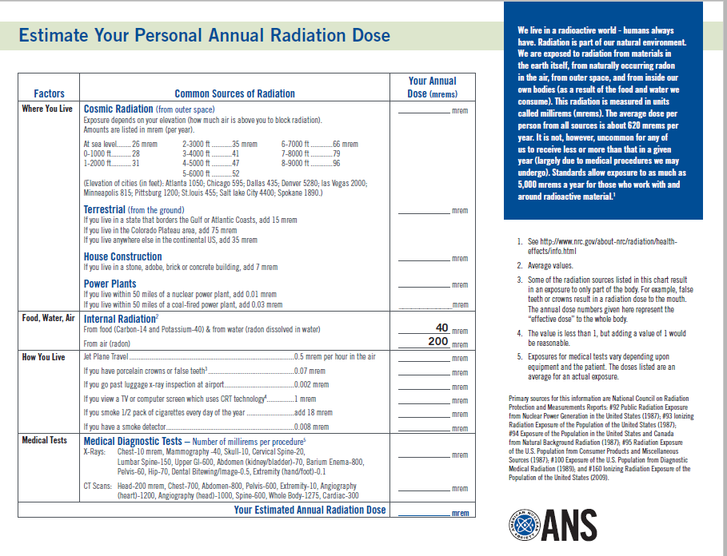
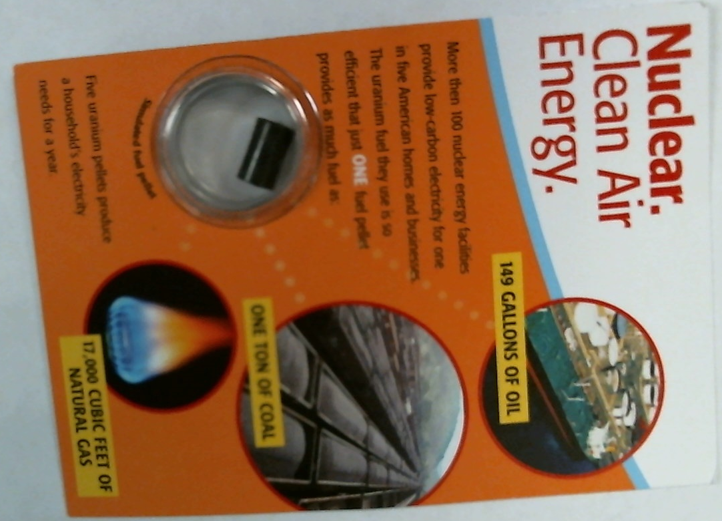
Natural Radiation
Kids get an item and guess which exposure level.
The personal annual exposure sheet is given afterward.
We’ve recently changed to the new (2009) ANS form.
Food
Living by a nuclear power plant
Air
200
40
5
0.01
A cross country flight
Notes:
After candy reactors, we go to Natural Radiation exposure. We briefly discuss the fact that there are lots of natural ways to get radiation exposure. The amount that you get from these natural sources varies. We have kids brainstorm about sources, then an item is passed out to each kid. Balloons (representing exposure from air), a banana (representing food), a paper airplane (representing a cross country flight) or one of the NEI sample fuel pellets (representing living near a nuclear power plant). The kids get in “teams” with the same items. Four signs (table tents) are available with different exposures (200, 40, 5 and 0.01 mRem). Kids decide with their team which exposure level to select for their item. After selection, the teams are asked why they chose. We then give the actual exposures (200 for air that you breathe, 40 for food, 5 for the airline trip and 0.01 for living by the nuke plant). Afterward, we hand out the ANS calculation sheet. If kids are high school age, and have their own phones/calculators and we have sufficient time, we may do the calculations on the sheet or discuss some of the details. The takeaway we’re after is “radiation is all around you and the local nuclear plant gives you less radiation than a lot of other typical items.”

Slide 11
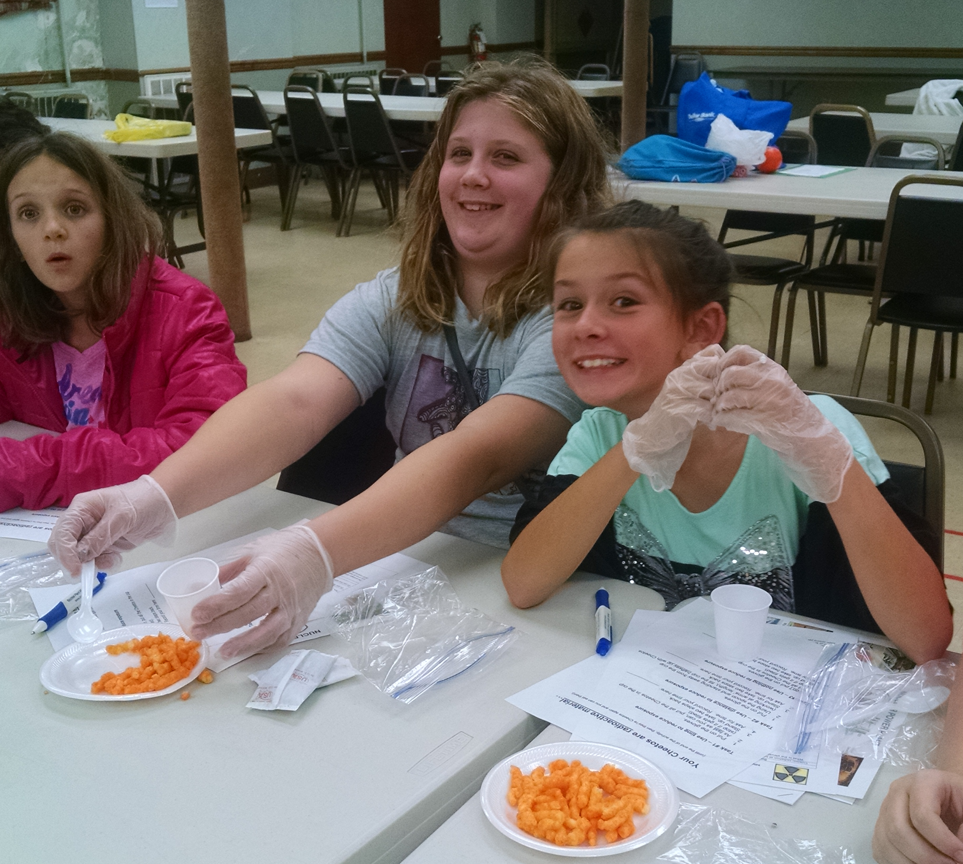
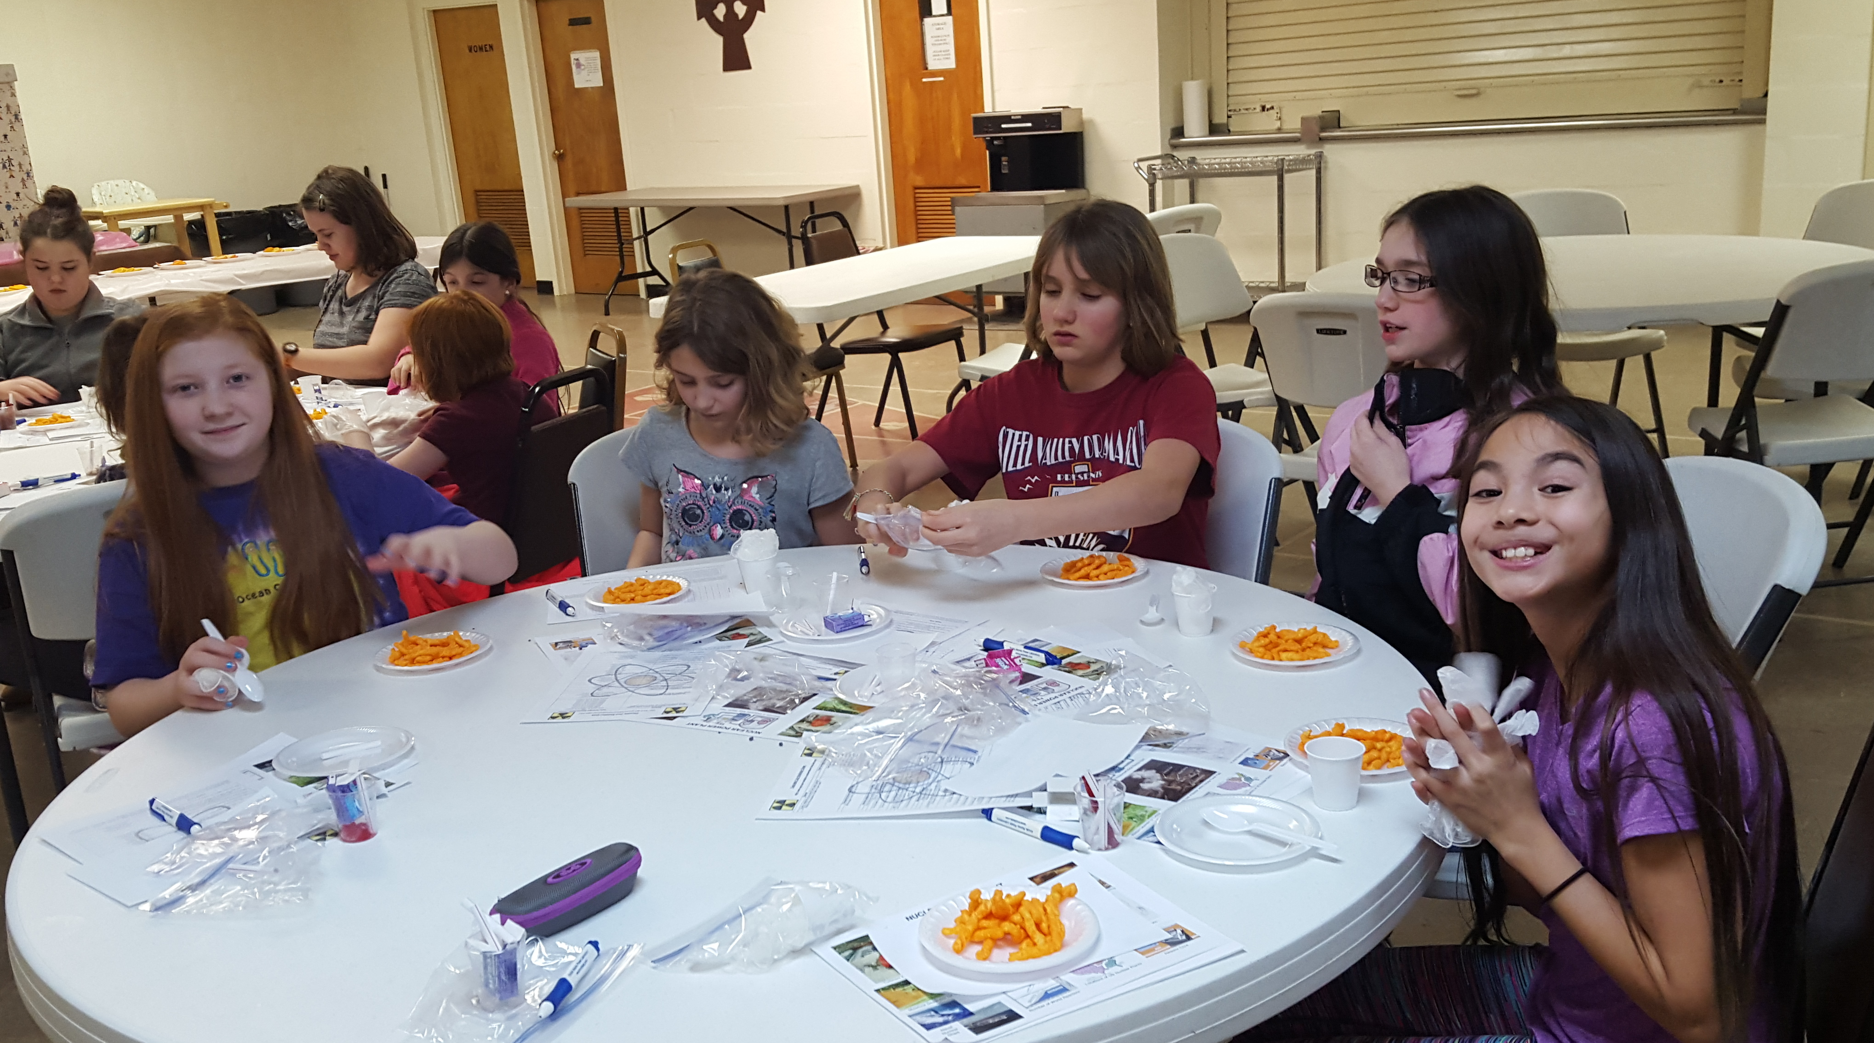
Occupational Exposure - ALARA
Team #1: Put on the gloves, then fast as you can put the Cheetos in the cup
Team #2: Put on the gloves, then working at arms’ length with the spoon, put the Cheetos in the cup
Team #3: Fast as you can, with no gloves, put the Cheetos in the cup
Notes:
Little did we know how much kids like Cheetos. Plus, they’re a great way to demonstrate the concept of contamination spread. I mean, as soon as I say it, you know what I mean, right?!? We lead into this part by saying “OK, now you know about natural radiation exposure. People who work with nuclear material get occupational exposure, meaning that they get exposure at work from the nuclear materials that they work with. We always try to minimize occupational exposure. Our principle is ALARA – As Low As Reasonably Achievable.” As the speaker shows Anti-C clothing and goes on to discuss how contamination is “nuclear material in places that you don’t want it” – the helpers pass out a direction sheet (face down), a handful of Cheetos on a plate (often we sort of crush them onto the plate to make a good bunch of Cheetos dust), and Ziplocs that contain a Dixie cup, a spoon and a set of food handling gloves (again – you’re back at the catering supply store, plus you can also use a couple of the food handling gloves for distributing the Cheetos onto the plates). The speaker tells the kids that when it’s time to “GO” and they flip their sheet and follow the instructions. (The speaker keeps track of time). At the end, discuss the time it took to complete the task and have teams hold up their hands (“Team #1, hold up your hands”). Discuss the importance of reading the directions and how the task would be faster and there would be less exposure and less contamination if they learned the directions before being near the “radioactive material.” We finish by saying that in the real world, ALL these methods are used to make sure we keep exposure ALARA. We plan jobs to minimize time. We work with tools to be at a distance. We use shielding, like Anti-Cs.

Slide 12
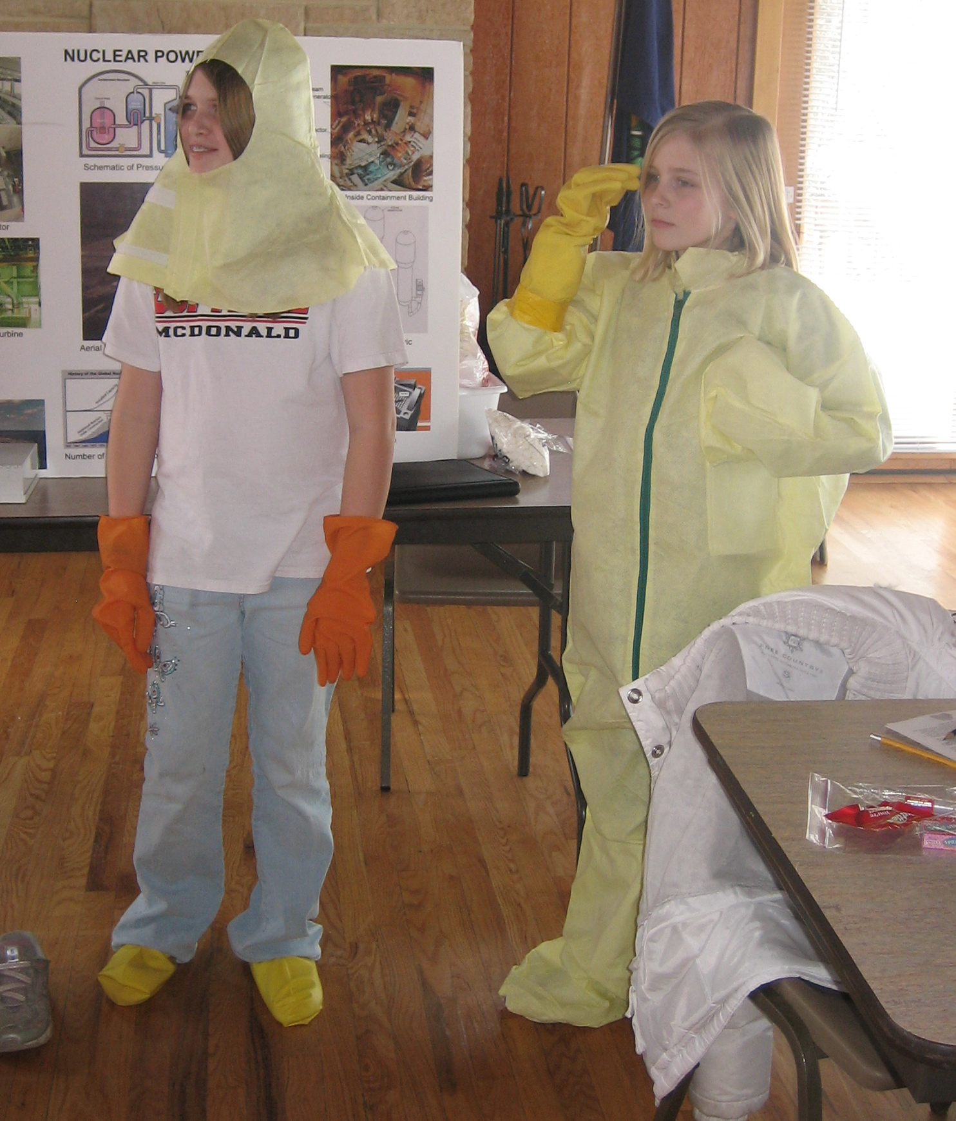
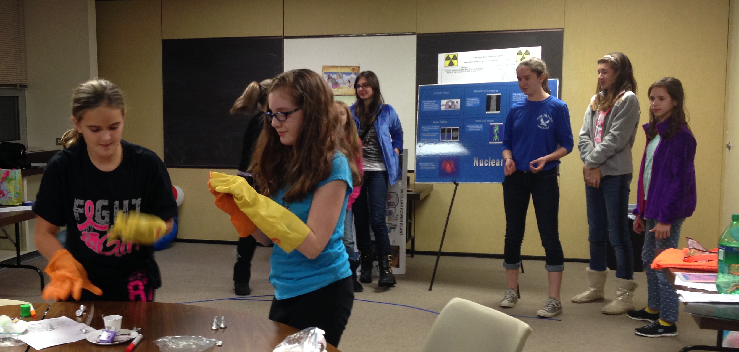
Occupational Exposure
(alternate activity)
Focus on Anti-Cs
Dress out kid(s) as an example
Have a relay race to unwrap Hershey Kisses while wearing Anti-C gloves
Notes:
Before we did the Cheetos for ALARA – we used to focus on the use of Anti-Cs. We would dress a kid out and talk about how Anti-Cs kept radioactive material from becoming radioactive contamination. We would acknowledge that working in Anti-Cs was harder, but it was worth it to keep exposure ALARA. We’d finish out with a relay race between two teams where the kids would unwrap Hershey Kisses while wearing Anti-C gloves (which was made all the harder because our Anti-C gloves are freebies from trade shows so they’re all right-handed). We like the Cheetos activity better because it shows the time-distance-shielding concept. Also, it works with a wider audience. Relay races tend to be very popular with the elementary age kids but not the other kids. It also got the kids more wound up than the Cheetos.

Slide 13
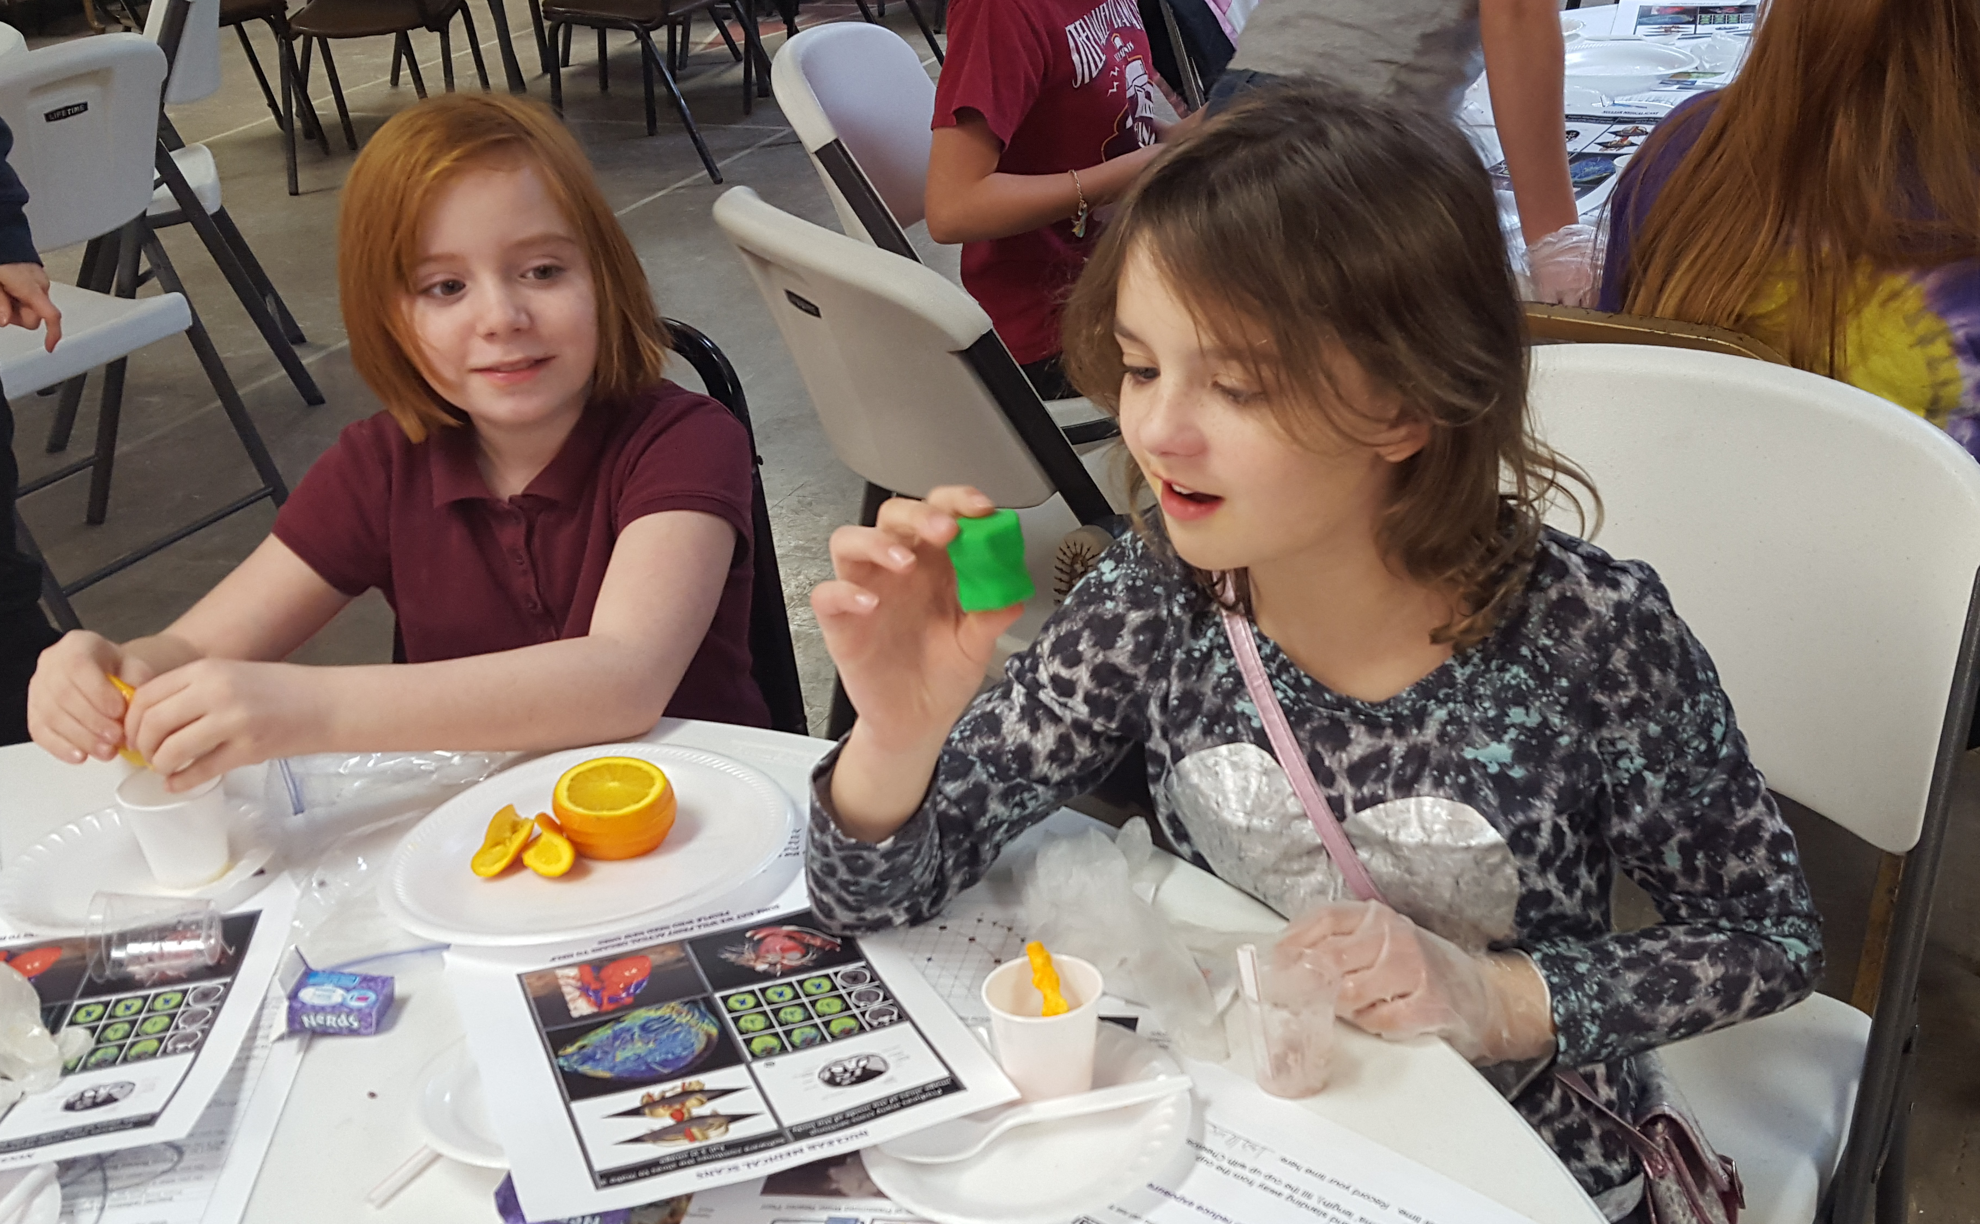
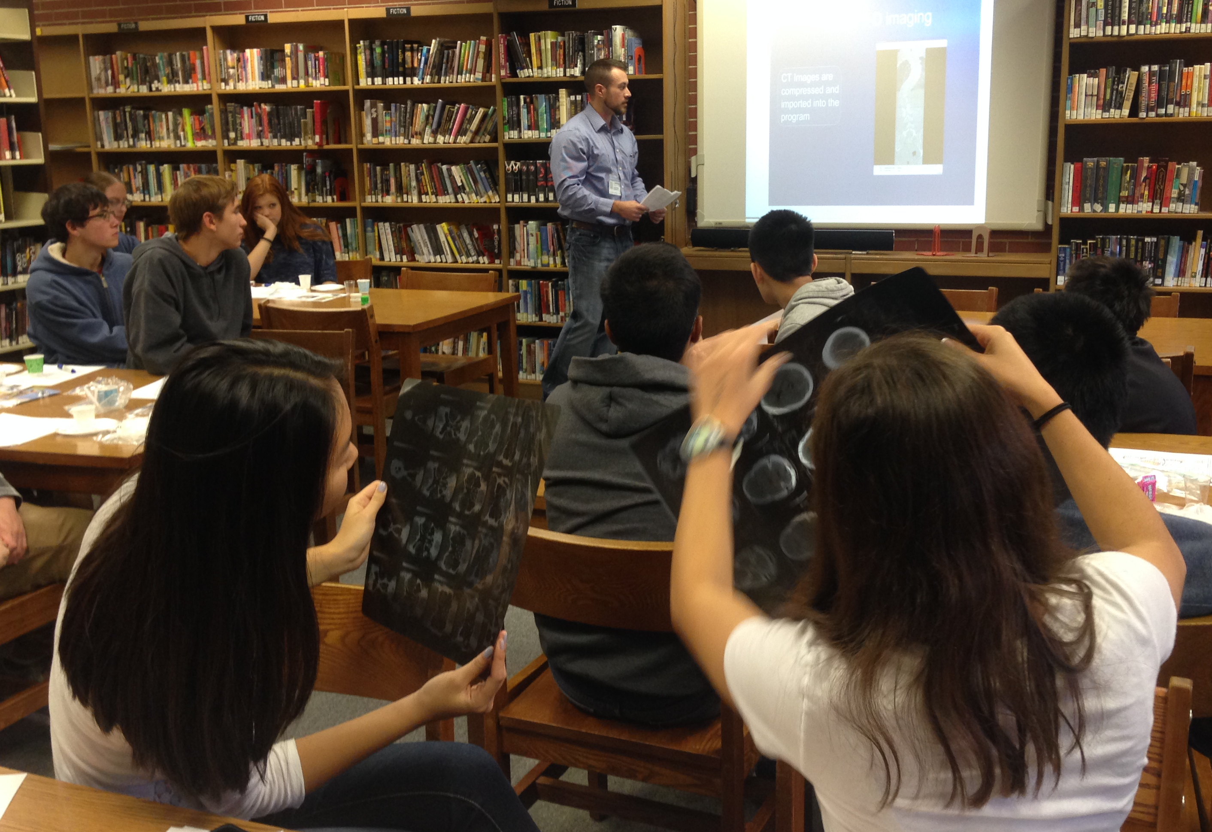
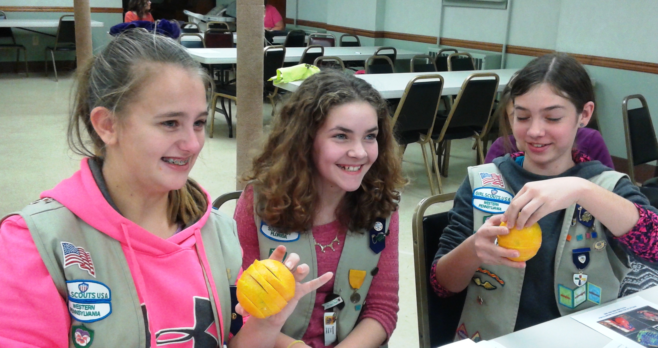
Nuclear Medicine
3D printing and rapid prototyping
(Kids reconstruct an orange after they look at CAT scan films to get the “slice” idea).
Notes:
Although we don’t work with Nuclear Medicine, it was part of the original Girl Scout badge and we found that the kids were really interested in it. Originally we talked about rapid prototyping that surgeons could use in conjunction with CT scans to generate models to practice surgical techniques. Now, with the advent of 3D printing, kids are even more interested. We talk about CT scanners and how they use x-rays to create pictures of the interior of your body. Colors can be assigned to different densities because radiation passes through each type of item a little differently. Different densities can show where bones, versus blood, versus muscle exist. After passing around CAT scan films and a couple small plastic rapid prototype items (and pointing out the layers in the plastic rapid prototype items), we give groups of two or three kids an orange that has been sliced into 5 or 6 pieces. The look at each side of the slice and see how it varies. They reconstruct the orange. We talk about how models can make for faster and safer surgery because the doctors can plan and practice effectively.

Slide 14
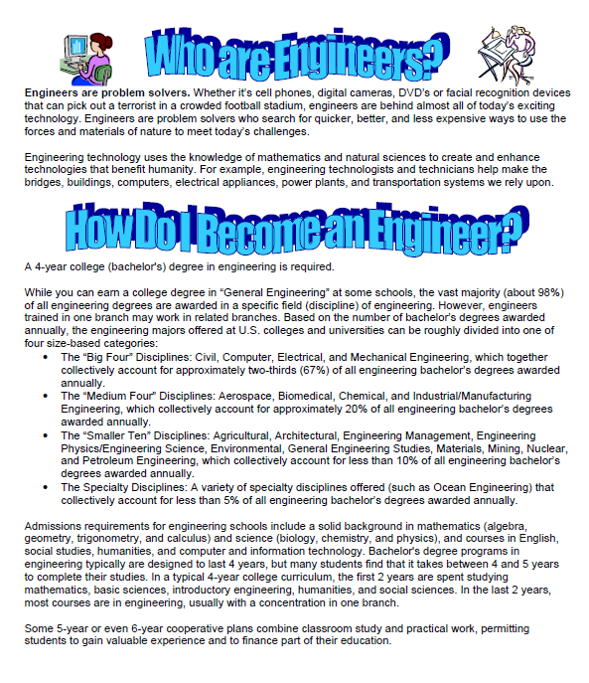
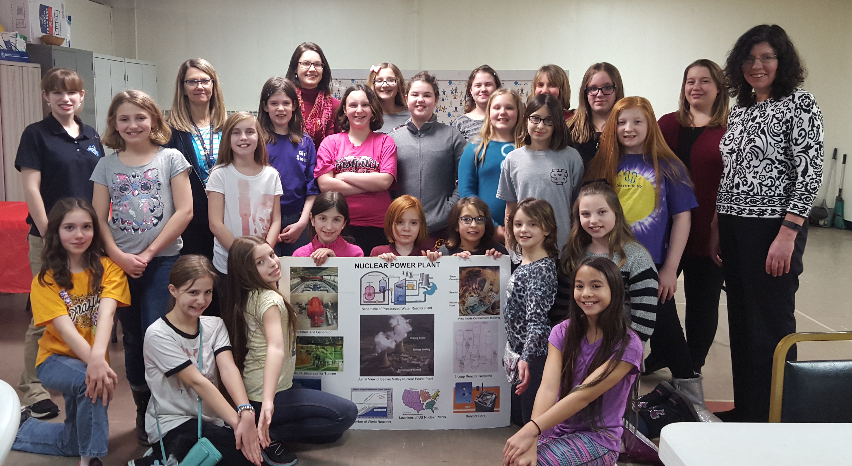
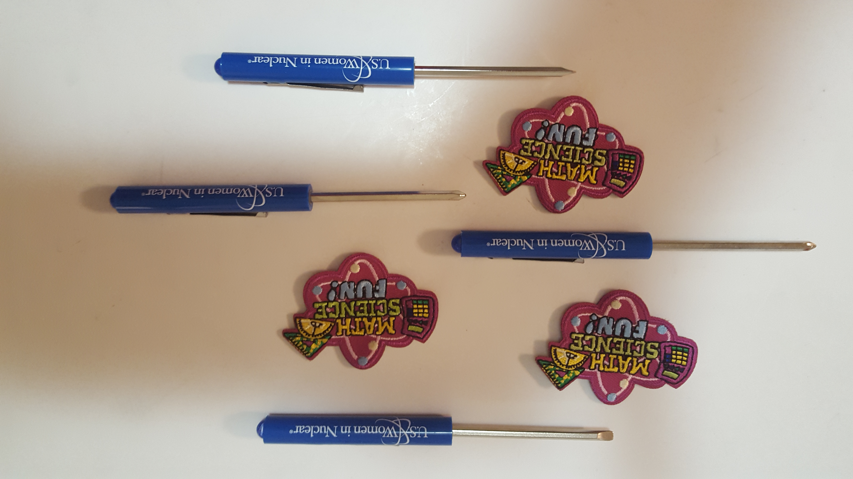
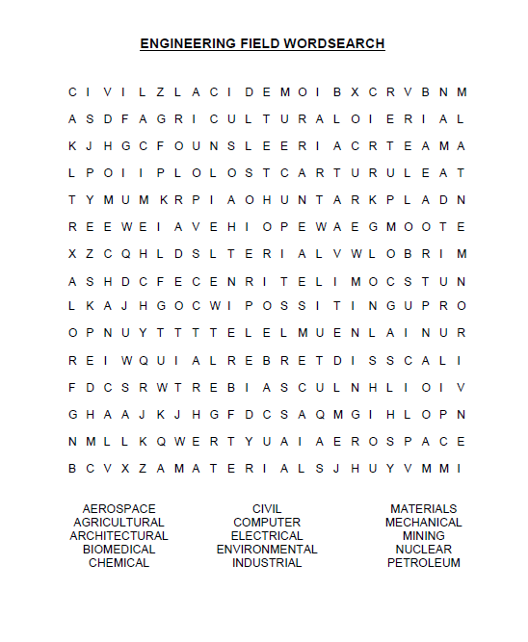
The Finale
Notes:
We close with a discussion of engineering careers. We used to start with introductions and the engineering handout, but it seems to be a good topic to combine with the Q&A portion at the end. We have a simplified engineering handout for elementary kids that has a word search (the word search is WAY popular and fills some time while kids wash their hands after the oranges). For older kids we talk more about college choices and stress the need to take lots of science and math in high school. We talk a little about the type of things we do at work, solving problems, resolving technical requirements, doing computer models, lots of different things. We have a short quiz (like one or two questions by each module leader) to give away the extra supplies (Dots, 7-up, Cheetos, Twizzlers, Nerds) and review the program content. Answer a question, get your choice of the leftovers. We end with swag for everybody – fun patches if it’s a Girl Scout troop and pocket reversible screwdrivers for all groups. So, in summary, this model is not perfect, and we keep changing it. I hope that if you need a little push to get more outreach activities in your chapter, or start outreach in your chapter, the ideas here can help you make that into a reality. I tell the volunteers – especially the young women engineers and scientists – you’re doing half the job by showing up! It is important to get lots of different faces, ages, backgrounds and personalities of women scientists and engineers in front of young women. We want the girls to see an engineering or science career as something they could definitely choose to do. We want them to see women they can relate to. Even with small groups, I try to have a different person for each module – lots of variety! All the materials I’ve presented (including the handouts and this powerpoint describing the program) are available. I can send them by Email. Thanks! And Good Luck!

