Slide 1
Girl Scout “Get to Know Nuclear”
October 27,2018
UTK WIN Chapter
Notes:
Introduce yourself:
+Talk about courses you’ve taken at point of degree progression
+Talk about internship experience
+ what’s next: summer work and graduation

Slide 2
Atoms
e⁻
p⁺
n
n
p⁺
e⁻
Notes:
Ask students to
identify what the charge of each of the parts of the atom are (see next slide)
What is this atom?
Answers appear on the next slide

Slide 3
Atoms
Helium
Characteristics:
2 Protons
2 neutrons
2 electrons
e⁻
p⁺
n
n
p⁺
e⁻

Slide 4
Atoms
MASS NUMBER “A”
p⁺
Protons have a large mass and a positive charge.
42
He
n
Neutrons have a large mass and no charge.
ELEMENT SYMBOL
e⁻
Electrons have a very small mass and a negative charge.
ATOMIC NUMBER
“Z”

Slide 5
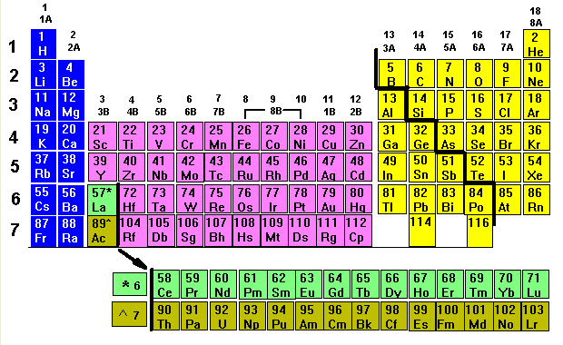
Periodic Table
Notes:
Use the periodic table to organize elements.
Who can tell me what the darker green colored set of elements are?
Actinides – 89 to 103 are part of the rare earth metals – all radioactive ; most commonly naturally occurring is Uranium –
What is special about the actinides? – they are radioactive and decay

Slide 6
238
U
92
Uranium 238
Notes:
Most naturally occurring of actinides
Has 92 protons and 92 electrons – U238 is naturally occurring and has 238-92 = 146 neutrons

Slide 7
Isotopes
Isotopes = atom with the same atomic number (Z) but different mass numbers (A)
Same number of protons means the same number of electrons – so they undergo the same chemical reactions
But they have a different number of neutrons – so they typically exhibit very different nuclear behavior

Slide 8
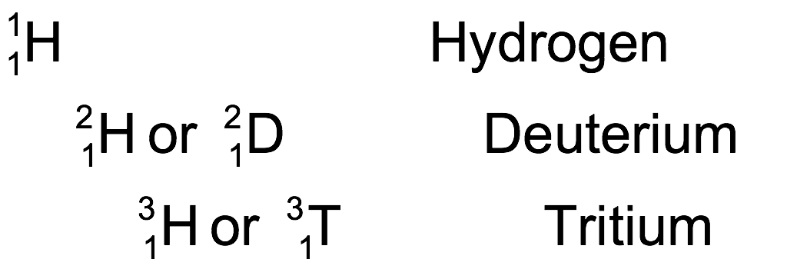
Isotopes
Notes:
Which of these are isotopes? Deuterium and Tritium.
Ask if anyone knows another name for Deutrium (heavy water).
If tritium is important at a plant, you can say it is produced at a nuclear plant but this one is dependent on your audience, time available in the presentation and other materials covered (if tritium is covered later then important).

Slide 9
Fact or Myth
The mass (or energy) of a nucleus exactly equals the sum of the protons and neutrons?
Notes:
Fact or Myth (True or False) question
Answer on next slide

Slide 10
Fact or Myth
The mass (energy) of an nucleus exactly equals the sum of the protons and neutrons?
Myth: The mass of an atom is slightly less than the mass of its constituent protons and neutrons. The binding energy comprises the remaining energy difference.
Notes:
Ask what is binding energy (discussion on next slide)

Slide 11
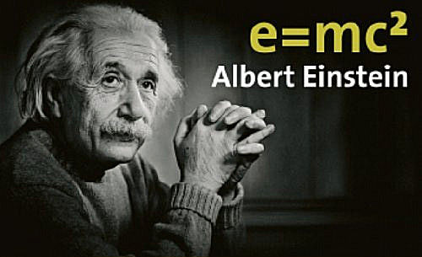
How does a nucleus stay together?
Binding Energy “glues” the nucleus together and overcomes the electromagnetic force
Mass difference between the atom and its constituent parts is directly proportional to the binding energy

Slide 12
Stable vs Unstable Atom
Stable atoms are in a preferential energy state
Unstable isotopes emit energy to reach a more stable state
Unstable isotopes (radioisotopes) occur naturally or can be produced through engineering processes
Notes:
At a macro scale, the energy state of the atom –
If you have a ball, drop it in front of the students and make an analogy between 1) the conversion of an unstable isotope to a stable isotope with the emission of energy and 2) the conversion of gravitational potential energy from an unstable location to a stable location.

Slide 13
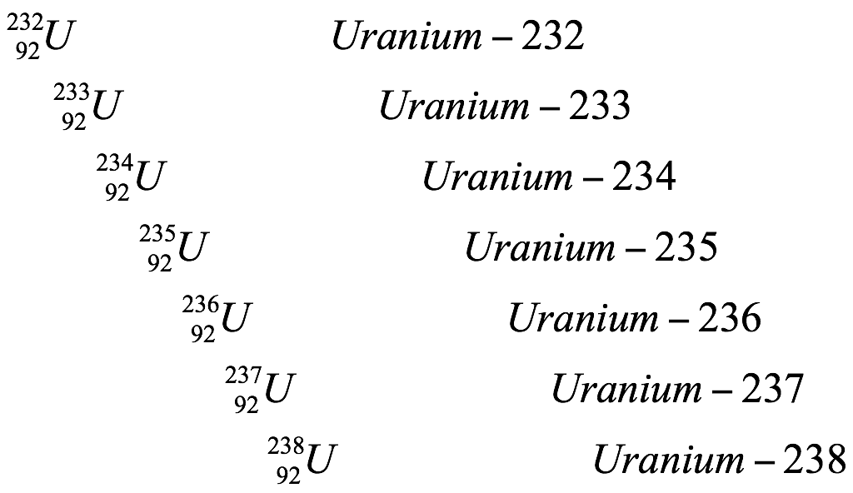
Uranium
Notes:
Talk about uranium in the terms of unstable and stable radioactive isotopes. Short explanation. Also state that we want U-235 for nuclear fuel.
Mining Uranium - it consists of about 99.3% uranium-238 or U-238 (U238), 0.7% uranium-235 or U-235 (U235), and < 0.01% uranium-234 or U-234 (U234).
U-235 is what we call fissionable. Ask what fissionable means… see answer on next slide.

Slide 14
What is Nuclear Fission?
If the nucleus of a heavy atom (such as Uranium) absorbs a neutron, the nucleus can become unstable and split.
This is called NUCLEAR FISSION.
Neutron
Uranium
Nucleus

Slide 15
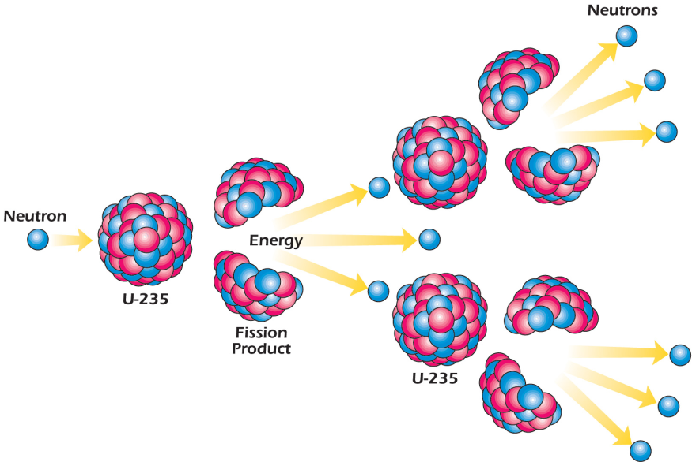
Fission: A nuclear chain reaction
Notes:
Point out that as the atoms fission, the number of neutrons available to cause other atoms to split increases. One fission releases 2 to 3 neutrons, when some of these neutrons hit other U-235 atoms, each split atom releases 2 to 3 more neutrons.
The lighter-weight atoms of new elements are called fission products in this illustration.
Remind students that in Lesson 2 they learned about heat energy. Ask them: What does heat energy have to do with making electricity? Answer: Heat is used to heat water, produce steam, turn turbines that are connected to generators that create electricity.

Slide 16
Uranium Fission Reaction
²³⁵U + ¹n = ¹³⁹La + ⁹⁵Mo + 2 ¹n + Energy
Energy released is due to change in binding energy
Momentum transfer causing atomic vibration that leads to heat
Fission products will continue to decay, producing more energy, until stable state is reached
Energy is released as radiation (alphas and betas and gammas ‘Oh my’)
Fission Products
Notes:
What actually comes out of the uranium reaction?
Example reaction -> Lanthinum and molyndonm are example fission products will get 2 or 3 neutrons ->
Charts for the most likely fission products -> Energy from recoiling atoms, gamma rays, non recoverable energy in form of neutrinos + energy from decay of fission products
Internal friction from fission products moving around like a paper clip bending back and forth heats up.
Bumper cars -> mv2 and that energy must go somewhere…
Many reactions possible and depend on quantum mechanics

Slide 17
Let’s Build a Nuclear Power Plant

Slide 18
Heat Energy from Fission
ELECTRICITY
Let’s Build a Nuclear Power Plant
Notes:
How do we use the heat energy generated from fission?
How do we turn it into something useful that can power our lights?
How do we generate electricity? Need relative motion between electric conductors (wires) and BIG magnets ---

Slide 19
Turbine/
Generator
Heat Energy from Fission
ELECTRICITY
Let’s Build a Nuclear Power Plant
Notes:
How does a turbine generator work?

Slide 20
Turbine/
Generator
STEAM
Heat Energy from Fission
ELECTRICITY
Let’s Build a Nuclear Power Plant
Notes:
How do you complete the cycle?

Slide 21
Turbine/
Generator
STEAM
Heat Energy from Fission
ELECTRICITY
COLD WATER
Condenser
Pump
Let’s Build a Nuclear Power Plant

Slide 22
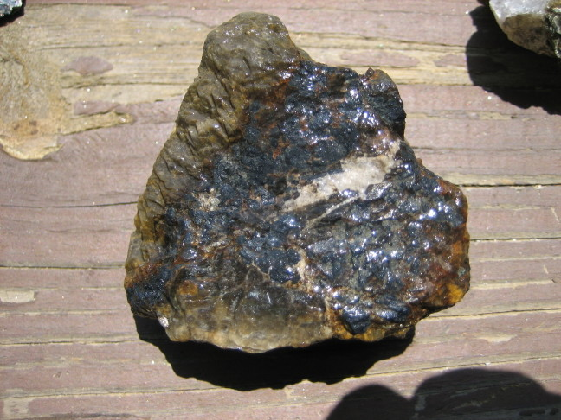
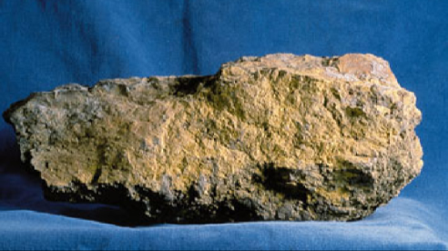
What does Uranium look like?
Natural Uranium …..
Is a dense, heavy metal.
Is found in ordinary rocks and soil around the world.
Is ~1% U-235 (fissile), ~99% U-238 (not fissile)
Notes:
Typically, a ton of uranium ore contains 2 to 4 pounds of uranium. A standard dump truck holds about 25 tons.
Do most fuels have to be changed before they can be used? Yes.
Kerosene, gasoline, and heating oil are produced from crude oil by a series of processing steps called refining. Crude oil is refined to produce kerosene, gasoline, and heating oil by fractional distillation or “cracking.” Coal is cleaned and ground to the consistency of talcum powder before it is used in a coal-fired power plant. A distinctive odor is added to natural gas so people can detect its presence.

Slide 23
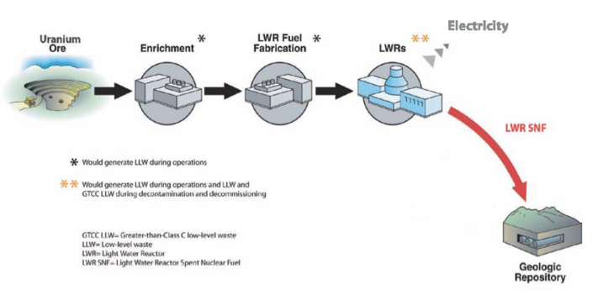
Uranium Fuel Cycle
Electricity
Uranium Mining
Enrichment
Fuel Fabrication
Reactor
Longterm Storage

Slide 24
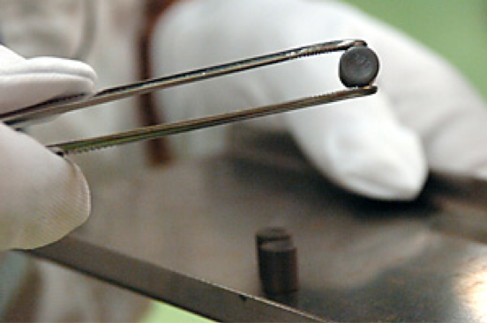
Let’s Build a Nuclear Power Plant
The Uranium is fabricated into ceramic fuel pellets
Notes:
How many pounds of coal do you think a ceramic pellet is equivalent to? 2,200 lbs of coal

Slide 25
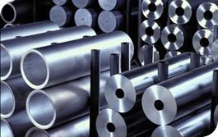
The ceramic fuel pellets are stacked in a column and sealed inside a metallic alloy case to form a fuel rod.
Let’s Build a Nuclear Power Plant

Slide 26
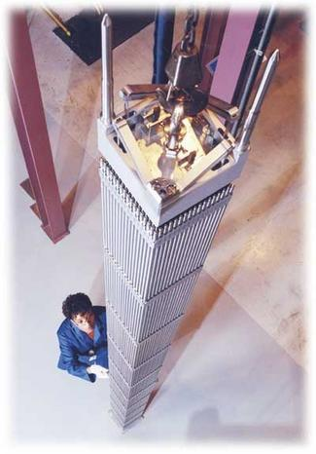
The fuel rods are grouped as a fuel assembly.
Let’s Build a Nuclear Power Plant

Slide 27
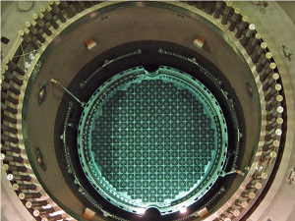
The fuel assemblies are arranged in a larger array called the reactor core
Let’s Build a Nuclear Power Plant

Slide 28
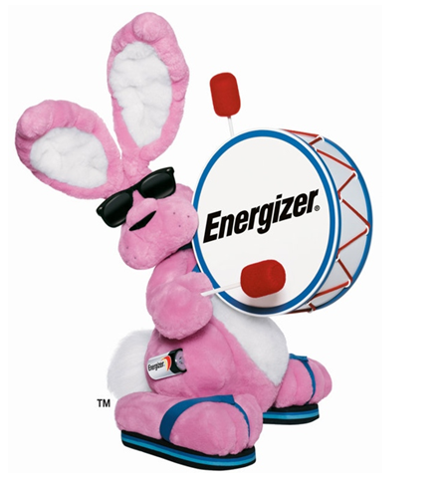
Creating a CRITICAL CONFIGURATION is a balance
Neutron Leakage
Neutron Production
Neutron Losses
Neutron Absorption
Let’s Build a Nuclear Power Plant

Slide 29
Neutron Absorption from
Control Rods
Neutron Leakage
Neutron Production
Neutron Losses
Neutron Absorption
Sub-critical
Let’s Build a Nuclear Power Plant

Slide 30
Neutron Absorption from
Control Rods
Neutron Leakage
Neutron Production
Neutron Losses
Neutron Absorption
Critical
Let’s Build a Nuclear Power Plant

Slide 31
The reactor core is contained in a heavy steel reactor vessel
Let’s Build a Nuclear Power Plant

Slide 32
Turbine/
Generator
STEAM
COLD WATER
Pump
Condenser
Let’s Build a Nuclear Power Plant

Slide 33
Boiling Water Reactor (BWR)

Slide 34
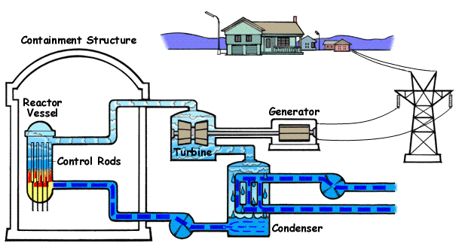
Boiling Water Reactor (BWR)

Slide 35
Pressurized Water Reactor (PWR)
Steam is made in a steam generator rather than in the reactor core

Slide 36
Uranium Fuel Cycle
Electricity
Uranium Mining
Enrichment
Fuel Fabrication
Reactor
Longterm Storage

Slide 37
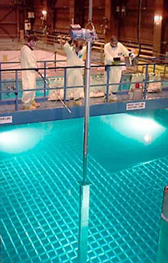
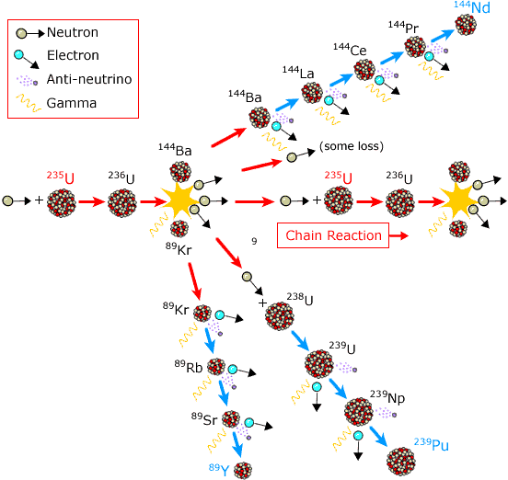
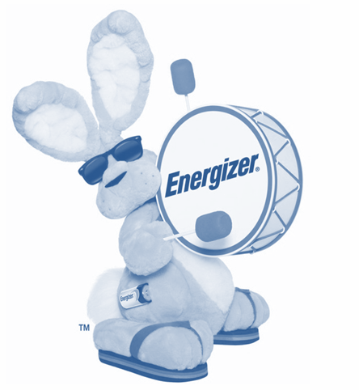
Temporary storage of used fuel
Generic battery
Used fuel is placed in water pools to remove heat caused by radioactive decay of the fission products and to shield against the resulting radiation.
Notes:
Remind students that while the fuel may be subcritical, the “energizer bunny” of reactivity decay is still going.

Slide 38
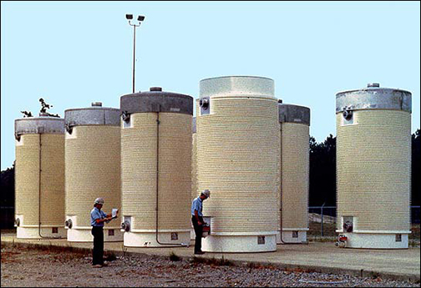
Temporary storage of used fuel
After several years in the water pools, used fuel can be stored in dry casks.
Notes:
Ounce for ounce, coal ash released from a power plant delivers more radiation than nuclear waste in water or dry cask storage. In fact the ash from burning coal at a power plant emits 100 times more radiation into the surrounding environment than a nuclear power plant producing the same amount of energy. Our sources for this statistic are Scientific American “Coal Ash is More Radioactive than Nuclear Waste: By burning away all the pesky carbon and other impurities, coal power plants produce heaps of radiation” December 13, 2007 (http://www.scientificamerican.com/article.cfm?id=coal-ash-is-more-radioactive-than-nuclear-waste); Dana Christensen, an associate lab director for energy and engineering at Oak Ridge National Laboratory; Science, 1978 J.P. McBride and colleagues, ORNL.
Numbers on slide from http://www.nei.org/resourcesandstats/nuclear_statistics/nuclearwasteamountsandonsitestorage/

Slide 39
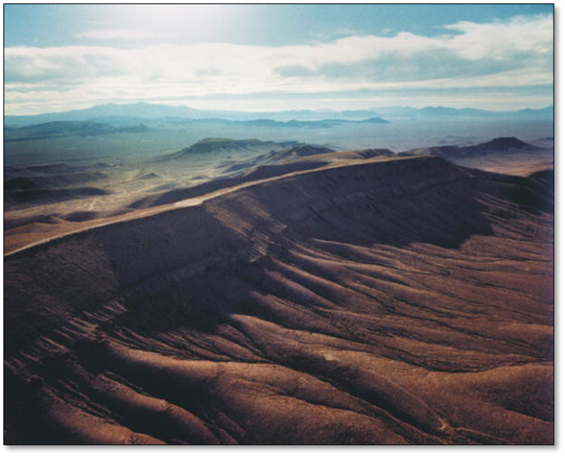
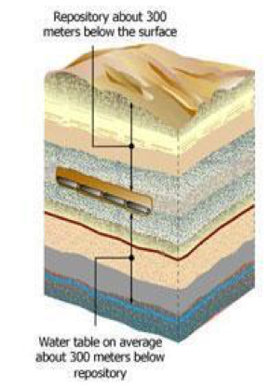
Longterm storage of used fuel
Generic battery
Notes:
Yucca Mountain, a site in Nevada was investigated as a site for a repository, but in 2010, the government stopped funding for that site. A Blue Ribbon Commission was named to discuss new options for nuclear waste management. In 2011, they concluded that permanent disposal is needed and that geologic disposal is the best option. They suggested finding a suitable site where the community wants to host a disposal facility. Also mention attention being given to interim storage sites, which would be like dry storage sites that are at power plants.
300 to 900 meters is roughly equal to 1,000 to 3,000 feet.

Slide 40
What is radiation?
Radiation is the term given to the particles and/or energy emitted by radioactive material as it reaches a more stable state.
Notes:
Summarize the following two sections to transition to radiation:
-We’ve already talked about nuclear reactions, the nuclear fuel cycle, and how nuclear energy produces electricity.
-Now you’re probably all wondering– what about this thing that we’ve heard about called radiation?
Ask students to answer, “What is radiation?” before bringing up the answer on this slide.

Slide 41
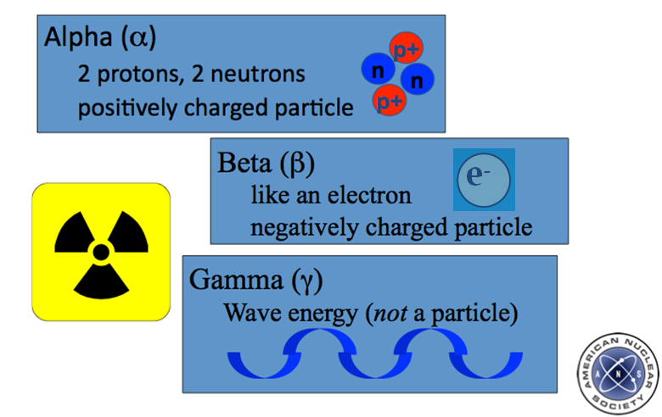
neutrons (¹n)
n
Type of Radiation

Slide 42
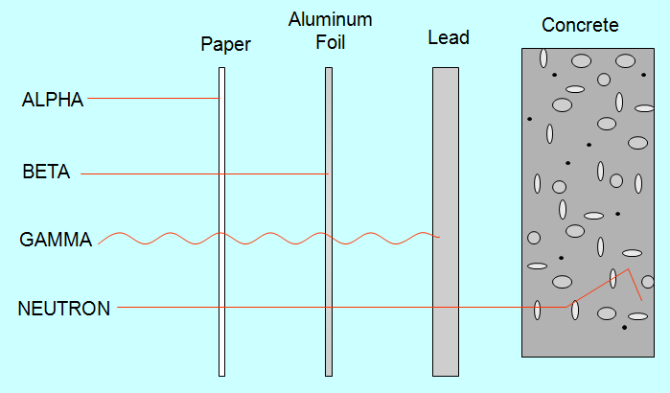
Radiation Shielding
Notes:
Transition: Too much radiation is harmful, so nuclear power plants protect against it two ways.
First way: Physical shielding. Protects workers and the environment. Explain how each radiation type affects our body and how it is shielded.
Alpha – Cannot penetrate skin. Can be shielded by paper, your skin, or clothing.
Beta – Can penetrate skin, but shielded by clothing and best shielded by thing layers of light metal
Gamma – Can pass through human body. Shielded by dense materials like lead, concrete
Neutrons – Can penetrate human body. Shielded by materials containing hydrogen atoms like concrete, water
Source: http://www.nrc.gov/reading-rm/basic-ref/teachers/05.pdf

Slide 43
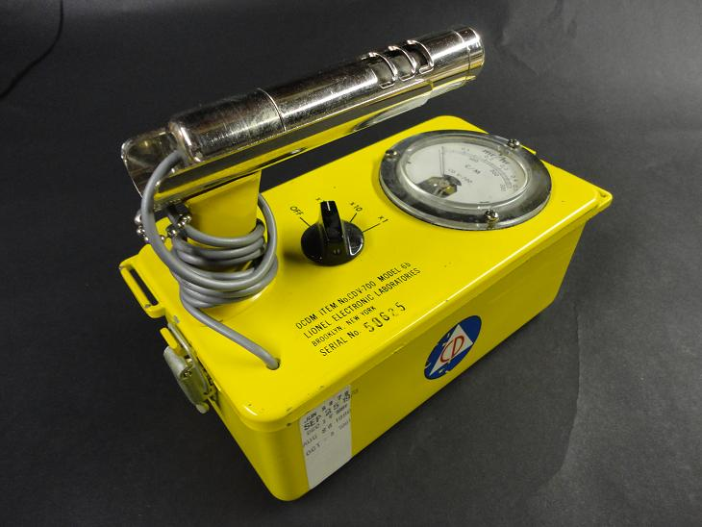
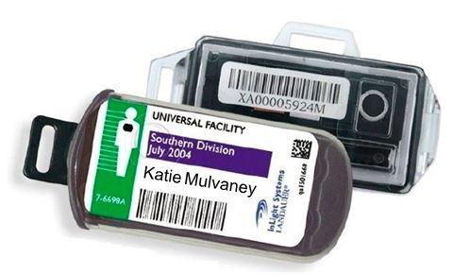
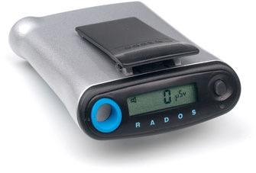
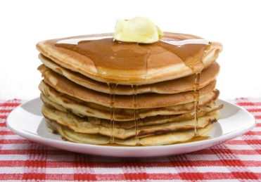
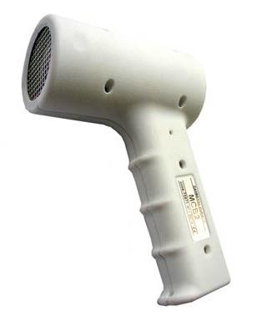
How do we measure radiation?
Fun Fact: Pancake Detector!
Radiation Level
Notes:
Explain that the left photos are devices that workers wear, and the right devices can detect radiation on other objects.

Slide 44
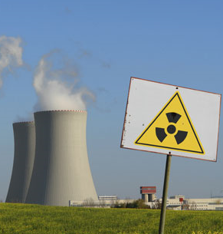
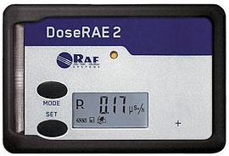
Americans get most of their yearly radiation dose from nuclear power plants.
Fact or Myth?
Notes:
Transition: So what do you (students) think, does the nuclear industry do a good job of protecting the public from radiation? Is this true or false– we get most of our radiation dose from nuclear power plants?

Slide 45
MYTH
Fact or Myth?

Slide 46
Banana Equivalent Dose
Equivalent Number of Bananas Eaten | Radiation Source
1 | Average American’s yearly radiation dose from a nuclear power plant
50 | Dental X-ray
400 | Flight from London to New York
Eating 1 banana = 0.1 μSv = 0.01 mrem
Notes:
Transition: Let’s take a look at how much radiation we get from nuclear plants compared to some other sources we encounter in our everyday lives, such as the following.
I urge caution at using the banana example to a great extreme—for some in the public it seems to trivialize their concern. It does work better for students.
-You get a small dose of radiation from potassium when you eat a banana. The banana equivalent dose tells compares radiation we get from various sources to how many bananas we would have to eat in order to get the same radiation dose.
-Go through the table.
Source: http://www.bbc.com/news/magazine-15288975; http://www.ans.org/pi/resources/myths/docs/myths.pdf

Slide 47
Sources of the Average American’s Radiation Dose in the U.S.
Source of Radiation Dose

Slide 48
Questions?

Slide 49
Cool animations: http://www.nuclearconnect.org/know-nuclear/technology/reactors
Have them calculate their dose: http://www.nuclearconnect.org/wp-content/uploads/2015/10/Radiation-Dose-Chart_web.pdf

Slide 50
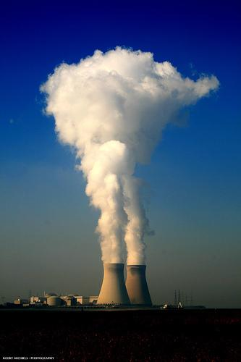
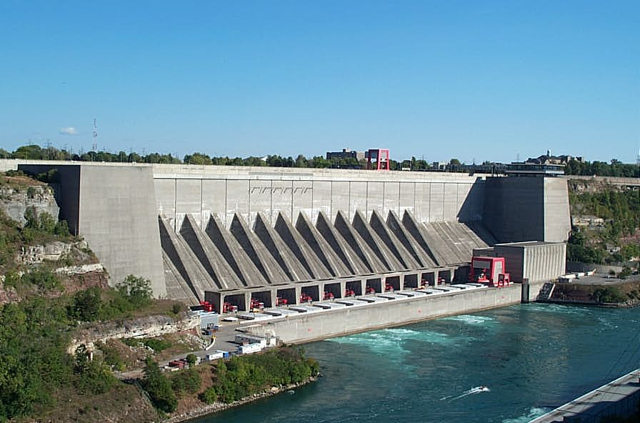
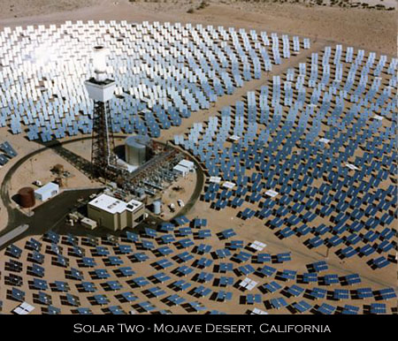
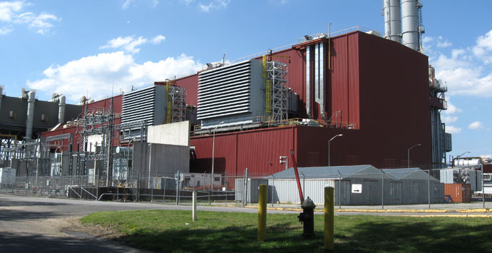
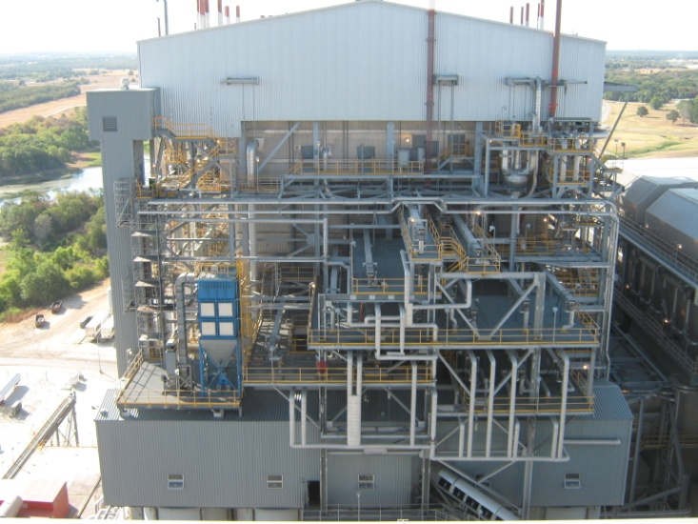
Types of Electric Plants
Notes:
Katie
CC Plant http://www.aecom.com/What+We+Do/Energy/_projectsList/NYPA+Poletti+500+MW+Combined+Cycle+Power+Plant

Slide 51
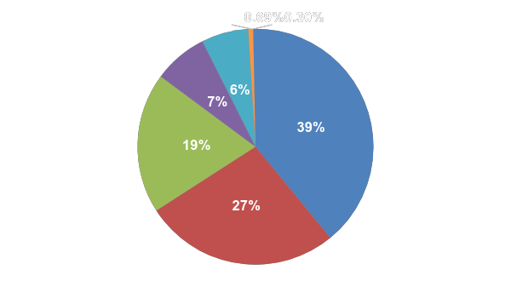
The ELECTRICITY mix…
Blast Furnace/
Waste Gas
Renewables
Petroleum
Hydroelectric
Coal
Nuclear
Natural Gas
Notes:
Briefly discuss each source—note increasing use of natural gas, renewables and anticipated less use of coal.

Slide 52
Where is the closest Nuclear Power Plant?

Slide 53
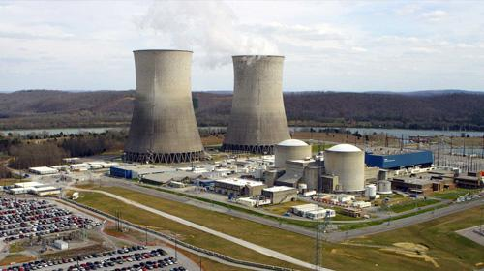
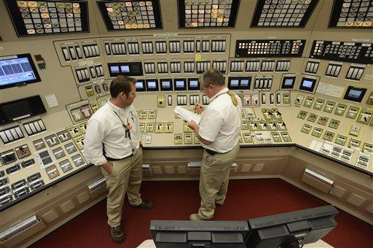
Watts Bar Nuclear Power Plant, Spring City, TN
Notes:
Slide to be replaced based on location where the presentation is given.

Slide 54
Session A:
Half-lives and modeling an atom

Slide 55
Atoms
Helium
Characteristics:
2 Protons
2 neutrons
2 electrons
e⁻
p⁺
n
n
p⁺
e⁻

Slide 56
Atoms
MASS NUMBER “A”
p⁺
Protons have a large mass and a positive charge.
42
He
n
Neutrons have a large mass and no charge.
ELEMENT SYMBOL
e⁻
Electrons have a very small mass and a negative charge.
ATOMIC NUMBER
“Z”

Slide 57
Periodic Table
Notes:
Use the periodic table to organize elements.
Who can tell me what the darker green colored set of elements are?
Actinides – 89 to 103 are part of the rare earth metals – all radioactive ; most commonly naturally occurring is Uranium –
What is special about the actinides? – they are radioactive and decay

Slide 58
Isotopes
Isotopes = atom with the same atomic number (Z) but different mass numbers (A)
Same number of protons means the same number of electrons – so they undergo the same chemical reactions
But they have a different number of neutrons – so they typically exhibit very different nuclear behavior

Slide 59
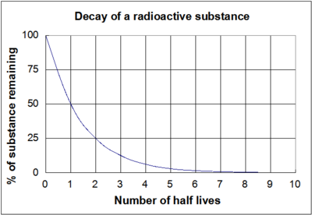
Half-lives
A half-life is the amount of time it takes for half of a material to naturally decay away.

Slide 60
Session B:
Fission vs. Fusion

Slide 61
What is Nuclear Fission?
If the nucleus of a heavy atom (such as Uranium) absorbs a neutron, the nucleus can become unstable and split.
This is called NUCLEAR FISSION.
Neutron
Uranium
Nucleus

Slide 62
Fission: A nuclear chain reaction
Notes:
Point out that as the atoms fission, the number of neutrons available to cause other atoms to split increases. One fission releases 2 to 3 neutrons, when some of these neutrons hit other U-235 atoms, each split atom releases 2 to 3 more neutrons.
The lighter-weight atoms of new elements are called fission products in this illustration.
Remind students that in Lesson 2 they learned about heat energy. Ask them: What does heat energy have to do with making electricity? Answer: Heat is used to heat water, produce steam, turn turbines that are connected to generators that create electricity.

Slide 63
Uranium Fission Reaction
²³⁵U + ¹n = ¹³⁹La + ⁹⁵Mo + 2 ¹n + Energy
Energy released is due to change in binding energy
Momentum transfer causing atomic vibration that leads to heat
Fission products will continue to decay, producing more energy, until stable state is reached
Energy is released as radiation (alphas and betas and gammas ‘Oh my’)
Fission Products
Notes:
What actually comes out of the uranium reaction?
Example reaction -> Lanthinum and molyndonm are example fission products will get 2 or 3 neutrons ->
Charts for the most likely fission products -> Energy from recoiling atoms, gamma rays, non recoverable energy in form of neutrinos + energy from decay of fission products
Internal friction from fission products moving around like a paper clip bending back and forth heats up.
Bumper cars -> mv2 and that energy must go somewhere…
Many reactions possible and depend on quantum mechanics

Slide 64
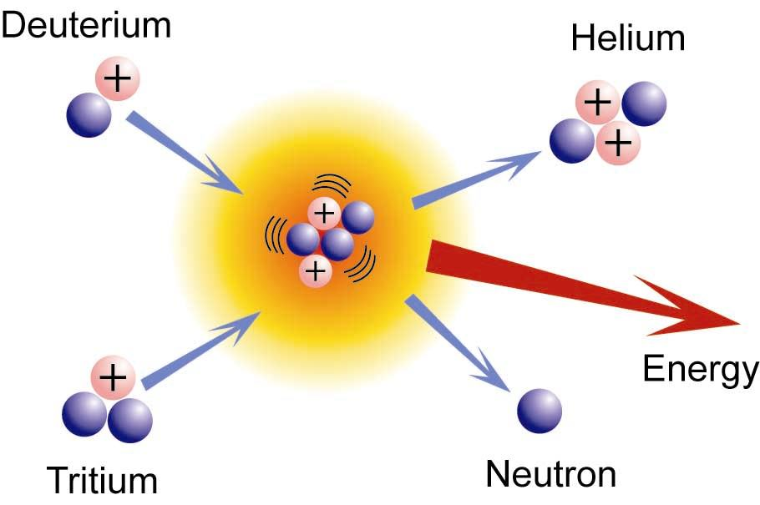
What is nuclear fusion?
When light elements hit each other with enough energy, they have to potential to fusion
$${}^{2}d+^{3}t →^{4}He+^{1}n$$

Slide 65
Session C:
Nuclear Careers

Slide 66
Majors in Physics and Engineering
Physics Major
Academic:
Astronomy:
General:
Engineering
MABE (Mechanical, Aerospace, Biomedical)
EECS (Electrical, Computer, and Computer Science)
Industrial and Systems
CEE (Civil and Environmental)
Biosystems
Materials Science
CBE (Chemical and Biomolecular)

Slide 67
Nuclear Engineering
Nuclear Engineering
Radiological Concentration
Decommissioning & Environmental Minor
Cybersecurity Minor
Materials Science Minor
Industry
Co-op and Internship opportunities
Research
On campus and at a national lab

Slide 68
Before College
Take classes for physics and higher math classes
Earn some credit now with AP classes
ACT/SAT
Extracurricular
Clubs
Boy/Girl Scouts
College Preparations
Notes:
+AP/higher classes-AP Physics, AP Calculus, Trigonometry, Pre-Calculus
ACT/SAT scores- The freshman average scores, around 30 or 1400
Clubs-TSA-engineer club for middle and high school,ACS-American Chemical Society,Science olympiad-competition in certain disciplines
Boy/Girl Scouts- Colleges look for Eagle badges and Gold award

Slide 69
Session D:
Radiation and Radioactivity

Slide 70
What is radiation?
Radiation is the term given to the particles and/or energy emitted by radioactive material as it reaches a more stable state.
Notes:
Summarize the following two sections to transition to radiation:
-We’ve already talked about nuclear reactions, the nuclear fuel cycle, and how nuclear energy produces electricity.
-Now you’re probably all wondering– what about this thing that we’ve heard about called radiation?
Ask students to answer, “What is radiation?” before bringing up the answer on this slide.

Slide 71
neutrons (¹n)
n
Type of Radiation

Slide 72
Radiation Shielding
Notes:
Transition: Too much radiation is harmful, so nuclear power plants protect against it two ways.
First way: Physical shielding. Protects workers and the environment. Explain how each radiation type affects our body and how it is shielded.
Alpha – Cannot penetrate skin. Can be shielded by paper, your skin, or clothing.
Beta – Can penetrate skin, but shielded by clothing and best shielded by thing layers of light metal
Gamma – Can pass through human body. Shielded by dense materials like lead, concrete
Neutrons – Can penetrate human body. Shielded by materials containing hydrogen atoms like concrete, water
Source: http://www.nrc.gov/reading-rm/basic-ref/teachers/05.pdf

Slide 73
How do we measure radiation?
Fun Fact: Pancake Detector!
Radiation Level
Notes:
Explain that the left photos are devices that workers wear, and the right devices can detect radiation on other objects.

Slide 74
Americans get most of their yearly radiation dose from nuclear power plants.
Fact or Myth?
Notes:
Transition: So what do you (students) think, does the nuclear industry do a good job of protecting the public from radiation? Is this true or false– we get most of our radiation dose from nuclear power plants?

Slide 75
Americans get most of their yearly radiation dose from nuclear power plants.
Fact or Myth?
Notes:
Transition: So what do you (students) think, does the nuclear industry do a good job of protecting the public from radiation? Is this true or false– we get most of our radiation dose from nuclear power plants?

Slide 76
MYTH
Fact or Myth?

Slide 77
Banana Equivalent Dose
Equivalent Number of Bananas Eaten | Radiation Source
1 | Average American’s yearly radiation dose from a nuclear power plant
50 | Dental X-ray
400 | Flight from London to New York
Eating 1 banana = 0.1 μSv = 0.01 mrem
Notes:
Transition: Let’s take a look at how much radiation we get from nuclear plants compared to some other sources we encounter in our everyday lives, such as the following.
I urge caution at using the banana example to a great extreme—for some in the public it seems to trivialize their concern. It does work better for students.
-You get a small dose of radiation from potassium when you eat a banana. The banana equivalent dose tells compares radiation we get from various sources to how many bananas we would have to eat in order to get the same radiation dose.
-Go through the table.
Source: http://www.bbc.com/news/magazine-15288975; http://www.ans.org/pi/resources/myths/docs/myths.pdf

Slide 78
Sources of the Average American’s Radiation Dose in the U.S.
Source of Radiation Dose

Slide 79
Calculate your dose!

