Slide 1
Careers in the Nuclear Industry
Speaker Name
Speaker Title and Date

Slide 2
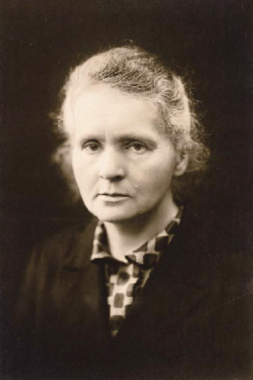
Marie Curie
In 1898, she discovered the first radioactive elements (Po and Rd)
Helped develop medical x-rays
First woman to win a Nobel Prize in Physics

Slide 3
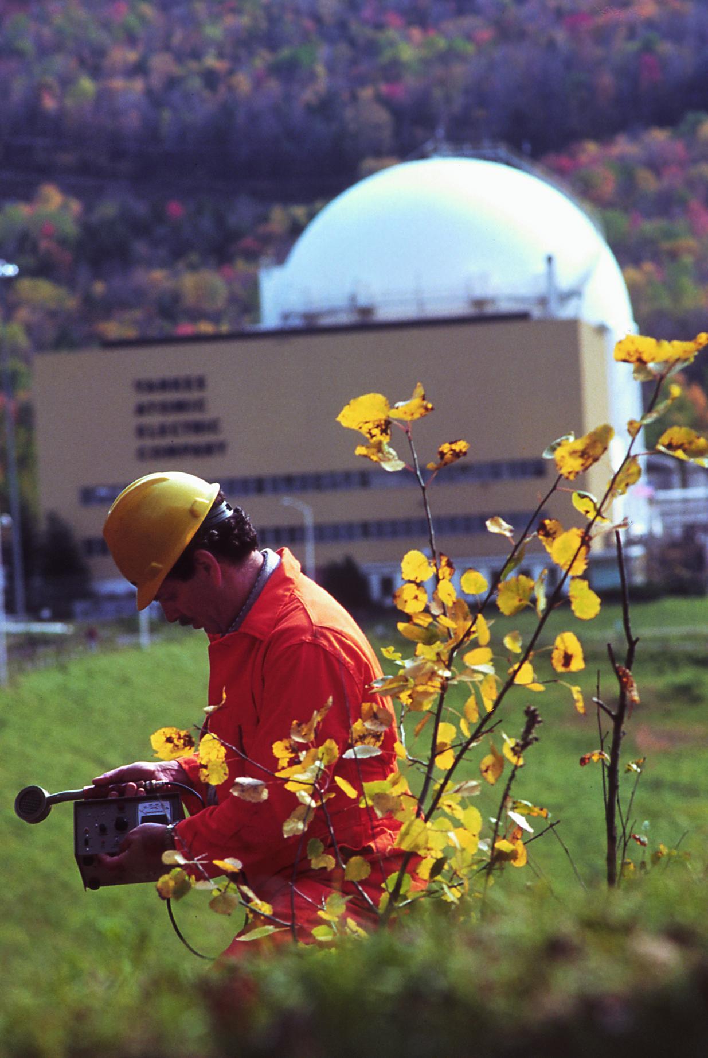
Careers
Utility
  Engineers
  Radiation Physics (Dose Monitoring)
  Licensing
Nuclear Energy Institute
  Public Communications and Advocacy
Nuclear Regulatory Commission
  Regulation and Licensing
Lawyers

Slide 4
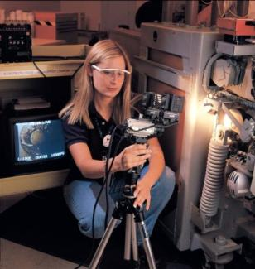
Careers
Medical Physics
  Oncology
  Technician
Academia
  Professor
  Researcher

