Slide 1
https://www.amazon.com/dp/B0014C680E/ref=dv_web_wtls_list_pr_5
Notes:
SNL Skit – Will Ferrell (Blue Oyster Cult)
10:08 – 15:54 (5 mins, 46 secs)
What did you think about Will Ferrell’s character? Are there traits or qualities that he displays that you admire?

Slide 2
The Cowbell Concept
Overcoming self-doubt to bring your boldest self to your biggest challenges
Notes:
What did you think about Will Ferrell’s character? Are there traits or qualities that he displays that you admire?

Slide 3
Objectives
The Psychological Effects of Self-Doubt and Confidence
What Matters to You (Your Authentic Self)
How the Body Shapes the Mind
Fake It Until You Become It

Slide 4
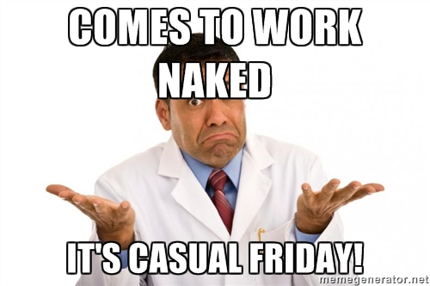
That time when you went to work naked…
Notes:
Ok, so this might have only happened to you in your dreams. At least I hope!
But we have all had that time when we felt completely vulnerable or exposed.
What happens to us in those moments? Physically & Emotionally?
Vocal Cords & Diaphragm Constricts making Voice thin & tight
Personal story…
I was looking for my next opportunity. I had planned to take the advice that I had given so many other employees. Look for experiences that will broaden your skills set. Look for that “stretch assignment”, I used to say!
So, I took the job at a new site, not really knowing anyone except a couple of HR peers. I started from ground zero… As the weeks and months passed, I didn’t recognize myself I felt like a fraud. What was I doing in this job, this was not my expertise. I led myself to believe that no feedback was negative feedback.

Slide 5
The Psychological Effects of Feeling Exposed
Feeling Powerless Impairs Thought
Powerlessness Makes Us Self-Absorbed
Powerlessness Prevents Presence
Notes:
Bullet #1 - Research shows that in pressure filled situations, when we are distracted by thinking about possible outcomes for our performance, our skills become measurably diminished. The feeling that you might go “blank” or that you are not firing on all cylinders
Bullet #2 – So we turn inward and become keenly focused on our words, actions, and our perceptions of how others are responding to us.
Bullet #3 - We just don’t have enough intellectual bandwidth to perform at our best while simultaneously critiquing our performance. Therefore, we can’t be full present.
Bullet#2 – Personal Story – When I was struggling with confidence in my new role, I turned to a close friend and advisor for help. I was near tears on the phone telling her about how I think I had made a mistake and recalled meetings that I had with the SVP and PM where I would go through my ideas and plans, but never got the affirmation that I was looking for. There were no pats on the back….
As I blabbered on, she stopped me and said with a very stern voice that she felt that I was being a narcissist. I was stunned that she would say that but realized she was right. I shouldn’t need validation from others to know my own self-worth.

Slide 6
The Benefits of Feeling Self-assured
It Can Protect Us
It Can Connect Us
It Can Liberate Our Thinking
It Can Synchronize Us
It Can Incite Action
It Can Make Our Actions More Effective
Notes:
Liberate – While feeling powerless impairs our thinking, feeling confident (powerful) improves Decision Making & Creativity b/c it Less Susceptible to Outside Pressures and Expectations.
Protect – Research has shown that feeling powerful acts as a buffer against negative emotions. Thicker Skin against judgement, rejection, stress, and even physical pain.
Connect – Confidence makes us approach vs. avoid. If we our self-assured and trusting of ourselves, we can more easily build trusting relationships with others.
Synchronize – We behave as our most authentic self
Incite – We become more Proactive and feeling of being In Control – Being Lucid, Calm and Not Dependent on the Behaviors of Others
More Effective – Power Positively Affects Performance when the Pressure is On

Slide 7
Believing & Owning Your Story
What 3 words best describe you as an individual?
What is unique about you that leads you to your happiest time and best performance?
What are your signature strengths and how can you use them?
Notes:
Create a handout for this activity
Do I ask for 2 volunteers to share their answers?
Ask – why did I have you go through this exercise?

Slide 8
Self-Affirmation Works!
It is NOT reciting generic one-liners to yourself
It is NOT boasting or self-aggrandizement
It IS reminding ourselves about what matters to most to us, what are our values, and by extension, who we are.
Notes:
When we ground ourselves in truth of our own story, we become less dependent on looking for the approval of others and even get comfortable with their disapproval.
Before heading into a situation where you may be challenged, you can reduce your anxiety levels by reaffirming the parts of your most authentic best selves. When we feel safe with ourselves, we become less defensive and more open to feedback, in turn, making us better problem solvers.
This all grounded in hundreds of studies that examined the effects of performing self-affirmations before high-stress situations - For example, one group of researchers tests the adrenaline of students before and after mid-term exams. Students who had done self-affirmation exercises before the exams showed no change in their adrenaline levels, but the other group of students had a significant rise of adrenaline over the weeks leading up to the exams.

Slide 9
Three Components of Leadership Presence
LEADERSHIP PRESENCE
Words
Vocal Tone
Body Language
Notes:
INTERESTING STUDY –
A Harvard Business School, Lakshmi Balachandra, studied 185 entrepreneur speeches presos if there was any common themes or traits in those that succeeded in getting the funding from venture capitalist.
FINDINGS – The strongest predictor of success was not the person’s credentials or content, but the presenters level of confidence, comfort, and passionate enthusiasm. These characteristics came through mostly through mostly in nonverbal ways – vocal qualities, gestures, facial expressions, and body language.
Through our confidence, comfort, passion and enthusiasm we are signaling something more powerful than words.

Slide 10
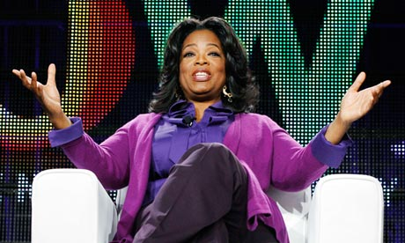
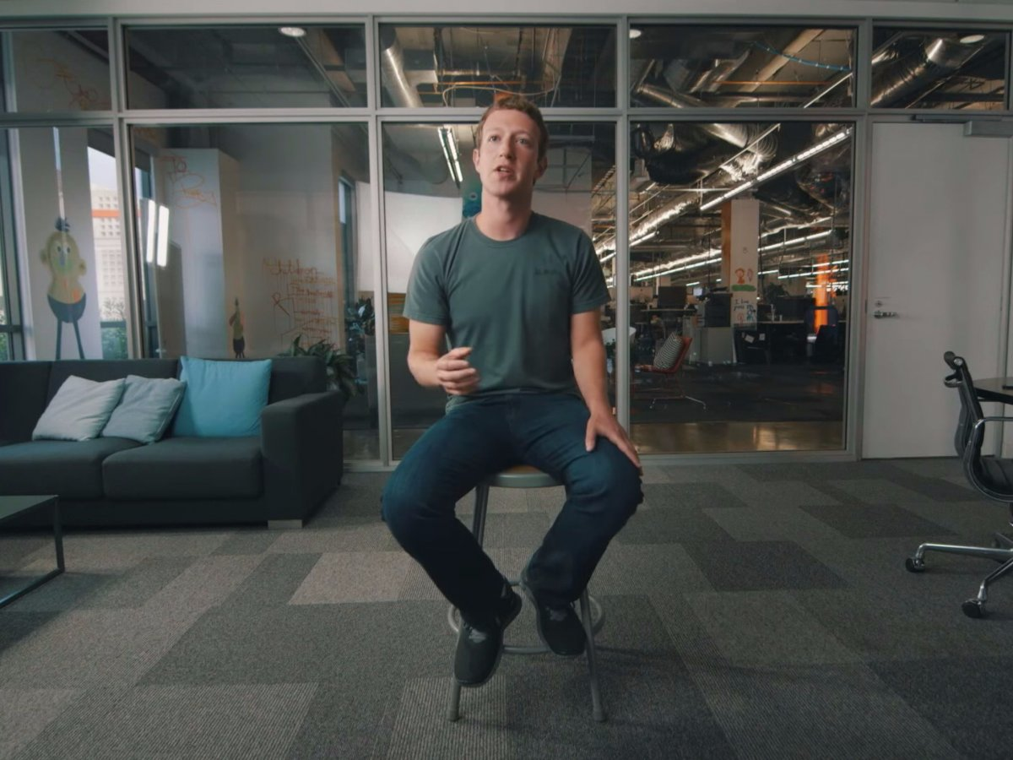
Body Language Boldness
Notes:
Would you describe Oprah’s or Mark Zuckerberg’s demeanor in these picture?
What make him seem that way from just a picture?
What are some of the non-verbal behaviors you have witnessed in people how exude confidence or power?
- Initiate Handshakes
Make More & Longer Eye Contact
Use Broader Gestures
Have Open and Erect Posture
Lean Forward
Orient the Body & Head Towards Others
Be Animated & Self Assured in the Physical Expression
- Finger Steepling - Subtle sign that we are confident and unwavering in our thoughts and trusting in ourselves

Slide 11
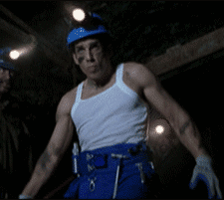
Walking & Talking with Confidence
Walking
Chin up, Shoulders Back, Expansive Movements
Look others in the eye & acknowledge them
Talking
Speak slowly
Avoid “I” and “me”
Eye Contact
Notes:
Walking
When we feel powerful, self-assured we expand our bodies. It is a sign of power and confidence to others.
We walk with a longer stride, we move our arms freely, and a more pronounced vertical head movement. Powerless walking much more restrictive. We have shorter strides, little arm movement and virtually a stationary head.
Talking
- When people speak slowly they run the risk of being interrupted by others or afraid to pause. By speaking slowly, you indicate that you don’t fear being interrupted. This shows confidence and openness.

Slide 12
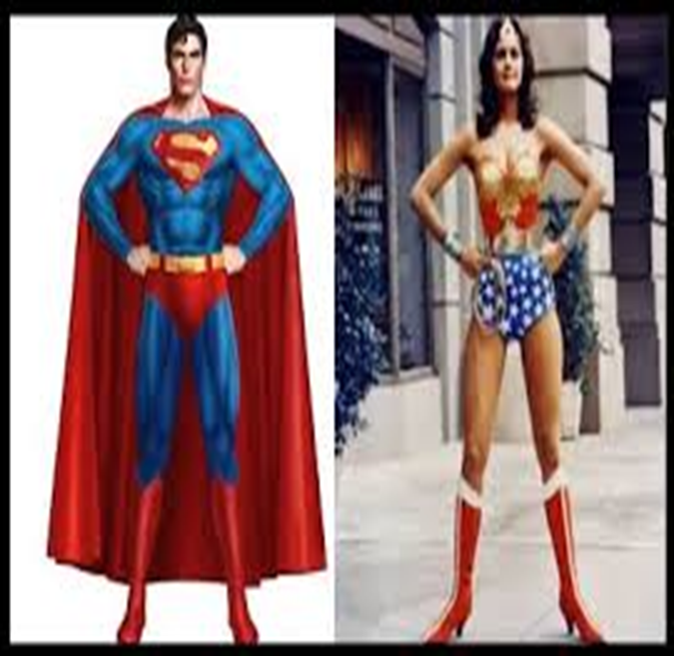
Becoming a Star(fish)…What?
Mindful Body Awareness
Expansive Body Postures
Horizontal Space
Control Your Breathing
Notes:
Group Action: Take a second right now to focus on your breath: Inhale Quickly and slowly exhale. One more time: Inhale for 2 secs and exhale for 5. Do you notice anything? Slow exhalation triggers your psyasympathic nervous system which:
Decrease your blood pressure
Increases your HRV
Psychologically controlled breathing:
Reduces Anxiety and Depression
Improves Optimism, Emotional Control & Pain Management.
Power Posing
Holding a sign expansive pose has a direct impact on our confidence & anxiety. Saliva sample collected before and after power posing – 19% increase in testosterone & 25% decrease in cortisol (stress hormone)
Low power posing 10% decrease in testosterone & 17% increase in cortisol

Slide 13
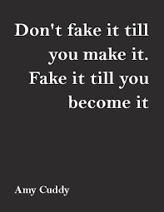
Self-Nudges
Don’t Freak Out, Get Pumped Up!
Find Compassion for Yourself
Dress for Success
Notes:
Reframe your anxiety into excitement. Switch your mind from thinking about everything can go wrong to all the positives that can come out of you speaking/presenting/problem-solving. Research has shown that by doing there are compounding returns.
The more excited you become before a high pressure situation, the happier & more successful you become.
Think about your future self.
Dress for the role.
So, these things are not the fairy dust that will remove all self-doubt from you. However, if by doing these things inspires you to take action, to approach rather than flee, you will begin to create new moments of success and build upon your confidence.

Slide 14
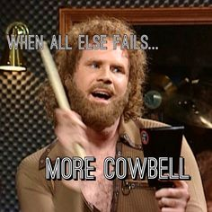
Gene’s Gems
Find Your Passion
Own It
Determine Your Direction
Trust Yourself

