Slide 1
Keeping You Plugged In
Speaker Name
Speaker Title and Date

Slide 2
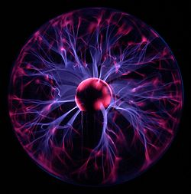
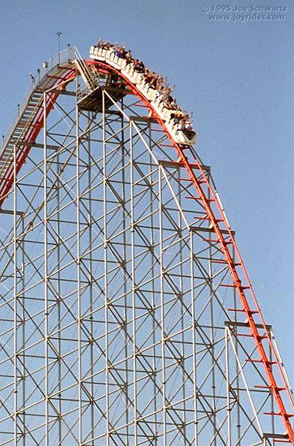
Energy
Energy is the ability to do work
  Potential: stored energy
    Gravity
    Mechanical Energy
    Chemical reaction
    Nuclear reaction
  Kinetic: energy of motion
    Moving Object
    Electromagnetic (Radiant)
    Thermal
    Electrical Energy
Notes:
Potential: Energy durring to position (due to gravity)
Kinetic: Energy of motion
Electromagnetic energy is energy from radiation like solar power

Slide 3
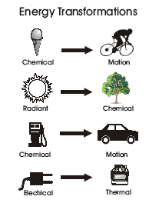
Energy cannot be created or destroyed, but it changes form.
Notes:
Talk about how when you each chemical energy is converted to kinetic enerty
Plants turn radiant energy into chemical energy

Slide 4
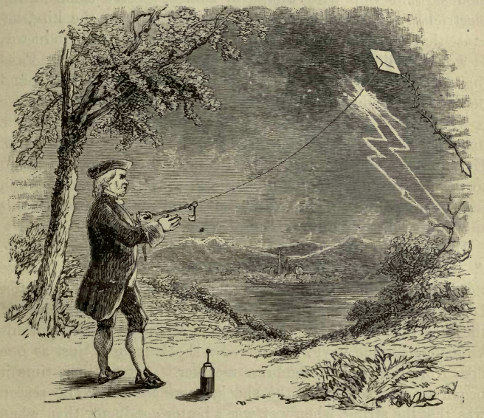
Benjamin Franklin
Don’t fly a kite during a lightening storm
Notes:
Electrical Energy is moving electrons….

Slide 5
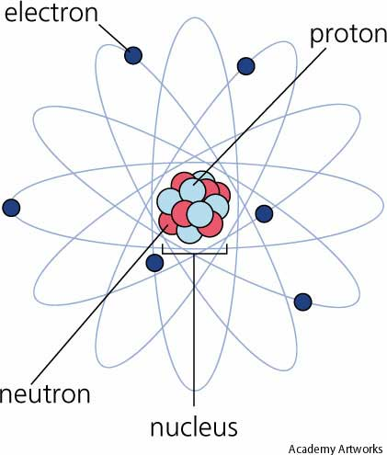
The Atom
Electrical Energy is moving electrons
Nuclear Energy is breaking apart the nucleus

Slide 6
What year did Benjamin Franklin fly his kite in the lightening storm?
  1752
Who Invented the Light Bulb?
  Joseph Swann holds the patent for the light bulb. Thomas Edison is credited with inventing the commercial light bulb.
What year was the patent for the light bulb issued?
  1878
In 2005, what percentage of single-family homes have a clothes washing machine?
  95%
Notes:
http://www.eia.gov/kids/energy.cfm?page=us_energy_homes-basics

Slide 7
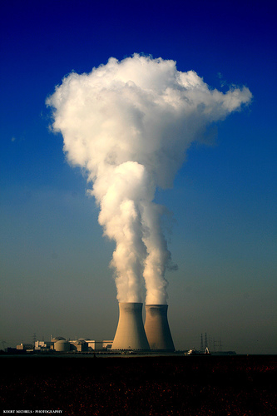
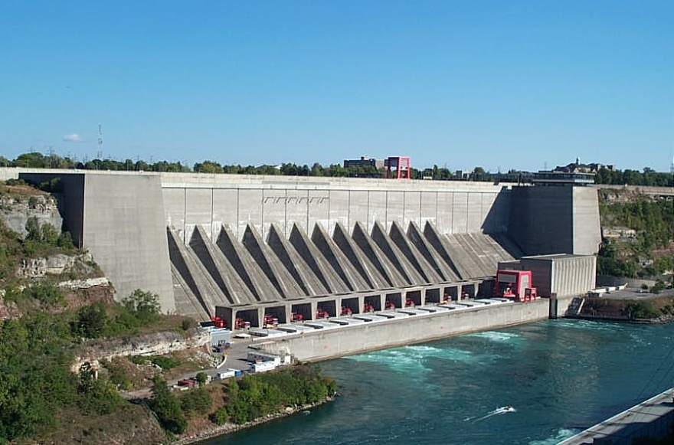
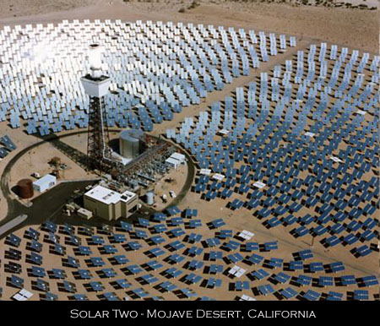
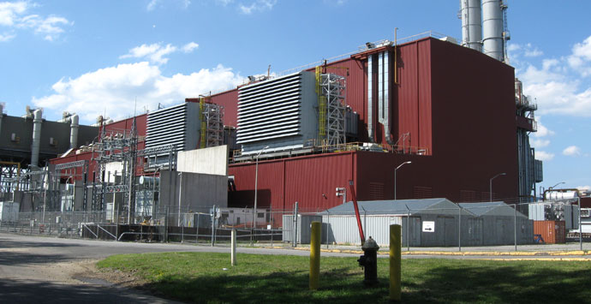
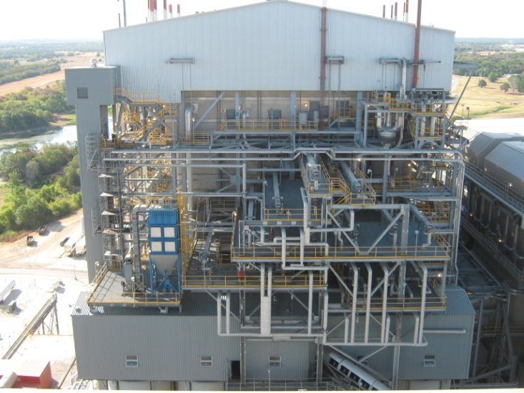
Types of Electric Plants
Notes:
CC Plant http://www.aecom.com/What+We+Do/Energy/_projectsList/NYPA+Poletti+500+MW+Combined+Cycle+Power+Plant

Slide 8
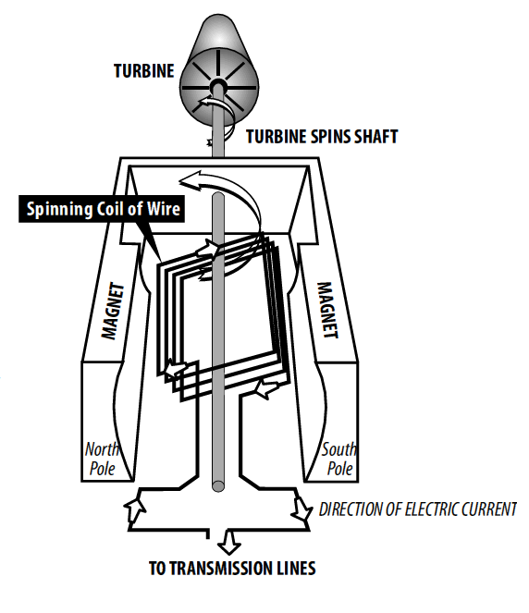
What is electricity?
Electricity is moving electrons.
Take a coil of wire.
Put it between a big magnet.
Turn the wire coil.
The magnetic field will cause the electrons in the wire to begin to flow. This type of device is called a generator.
Notes:
Coil: http://www.jantzen-audio.com/html/coils.html

Slide 9
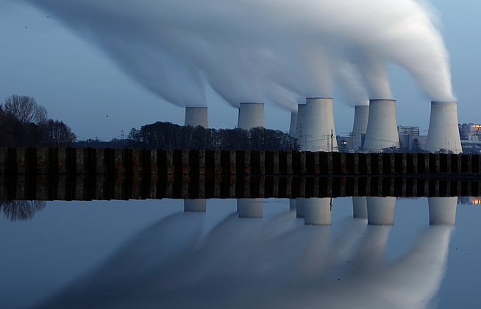
How do steam power plants work?
Notes:
Pic http://knowledge.allianz.com/?840/generate-energy-at-home

Slide 10


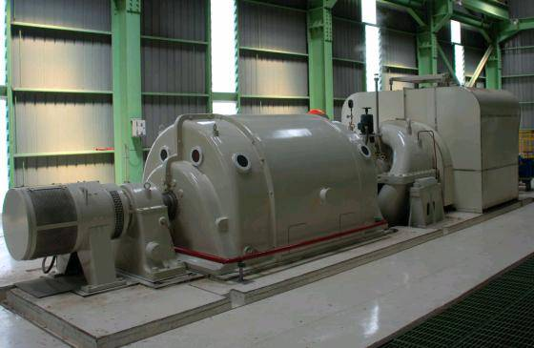
Steam
The energy in the steam from a tea kettle can spin the blades of a pin wheel
Imagine the steam inside of a power plant turning the blades of a giant turbine which spins the shaft of a huge generator

Slide 11
Turning Water into Steam without a Tea Kettle
Solar-Thermal Power Plant
  Sunlight is reflected using mirrors to heat water
  Water turns to steam
  The steam turns the turbine
Notes:
Solar thermal

Slide 12
Turning Water into Steam without a Tea Kettle
Fossil-Fueled Power Plant
  Coal, gas or oil is burned to heat water in a boiler
  Water turns to steam
  The steam turns the turbine

Slide 13
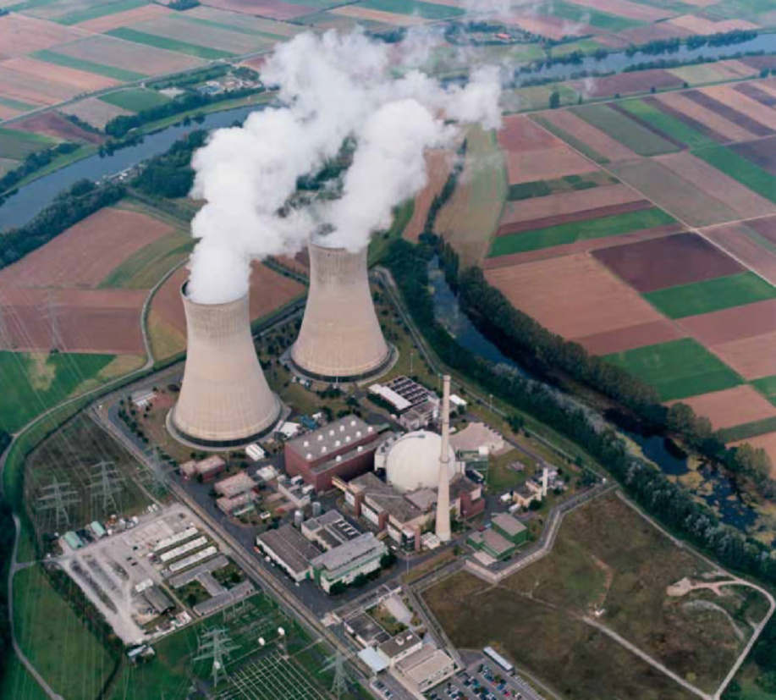
Turning Water into Steam without a Tea Kettle
Nuclear Power Plant
  Nothing is burned
  Heat created by splitting atoms (nuclear reaction)
  Heat turns water into steam
  The steam turns the turbine

Slide 14
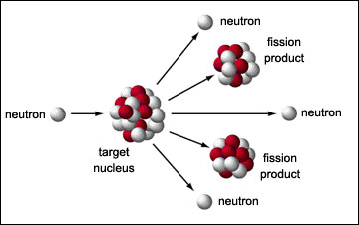
What is Nuclear Energy?
Nuclear energy is the energy released by reactions within the nuclei
Splitting Atoms = Fission
Notes:
This is an opportunity to do a demonstration- before you start, place a hula hoop on the floor or draw a circle with tape.
Ask for 3 volunteers: one volunetter will be the neutron in the nucleus (standing in the middle of the hula hoop); another volunteer will be the orbiting electron running around the hula hoop; the third volunteer will “fission” with the “neutron” in the nucleus and both will run out of the nucleus as fission products.
See outreach library for full write up/instructions.

Slide 15
Basics of a Chain Reaction
A sequence of reactions that keeps going
  Dominos
  Telephone
Nuclear chain reaction caused by neutrons hitting an atom
Notes:
The closest nuclear power plant is Calvert Cliffs Nuclear Power Plant.
Balloon exercise- have all of the participants take a balloon, hold it high and stand close. You will throw up one balloon and when it hits one of the participants, they throw up their balloon, and this continues resulting in a chain reaction.
Then ask how do you stop a chain reaction? For a nuclear power plant, you use control rods. Have one adult be a control rod and try to know down all of the balloons that are thrown in the air 3 seconds after the initial chain reaction starts.
See outreach library for full write up/instructions.

Slide 16
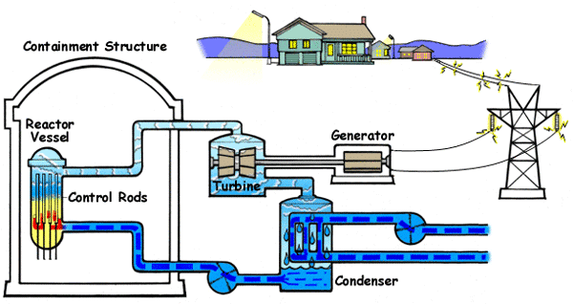
Power Cycle
Notes:
BWR Pic (NRC Student’s corner): http://www.nrc.gov/reading-rm/basic-ref/students/reactors.html

Slide 17
What is Radiation?
Radiation is energy leaving an object
Radiation is a part of everyday life, it occurs in nature
Dose at a nuclear facilities (power, research, or medical) is as low as reasonable achievable (ALARA)
Notes:
Chance to do the radioactive decay/half life exercise with the M&Ms. See outreach library for full write up.

Slide 18
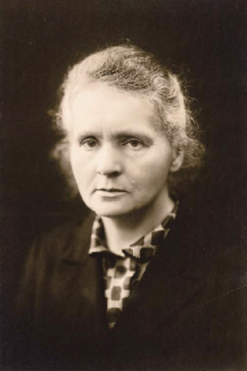
Marie Curie
In 1898, she discovered the first radioactive elements (Po and Rd)
Helped develop medical x-rays
First woman to win a Nobel Prize in Physics

Slide 19
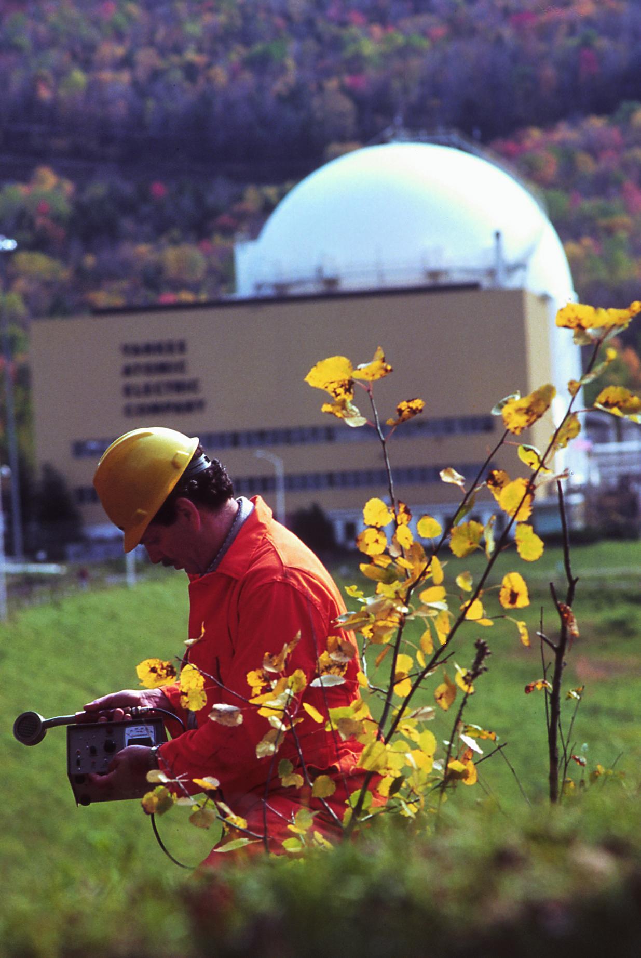
Careers
Utility
  Engineers
  Radiation Physics (Dose Monitoring)
  Licensing
Nuclear Energy Institute
  Public Communications and Advocacy
Nuclear Regulatory Commission
  Regulation and Licensing
Lawyers

Slide 20
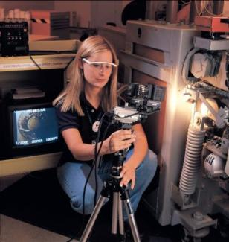
Careers
Medical Physics
  Oncology
  Technician
Academia
  Professor
  Researcher

Slide 21
References
ans.org
nei.org
eia.gov/kids
hps.org

