Slide 1
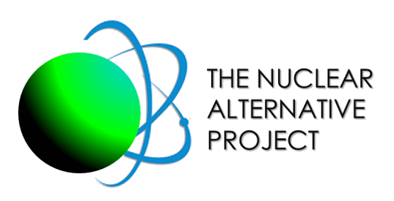
“To change public perception towards emerging nuclear energy technologies.”

Slide 2
ABOUT US
The Nuclear Alternative Project is a
501 c3 pending
Network of engineers within the US nuclear industry
Working to change public perception towards nuclear energy
Focused on educating the general community about next generation of nuclear reactors via community-based participatory strategies.

Slide 3
ABOUT THE FOUNDERS
Ed specializes in earthquake engineering and structural reliability of nuclear power plants.
Thommy has dedicated his career to the quality improvement of electro-mechanical systems for nuclear power systems.
Jesús is structural engineer who has been exposed to every phase of the design process of nuclear facilities.
Jesabel has dedicated her career to design strategies intended to connect community programs with corporate and organizational objectives

Slide 4
CHALLENGES VS OPPORTUNITY
Challenges
Negative Perception of traditional Nuclear technologies.
Lack of connection with the general population.
Misunderstanding of how to market Nuclear Energy as a feasible alternative.
Lack of knowledge of Nuclear Energy in the community
Opportunity
New, Safer, cleaner and smart nuclear technology.
Community based participatory approach.
Best practices in marketing and branding.
Education and Awareness thru community engagement.
Notes:
INVOLVES DE COMMUNITY
CREATES TRANSPARENCY AND TRUST TO THE NUCLEAR FIELD.
MARKETING AND BRANDING = WILL HELP TO TRANSFER THE NUCLEAR KNOWLEDGE FROM THE INDUSTRY TO THE COMMUNITY

Slide 5
NAP STRATEGIC PLAN
Our mission consists of four main phases:
Team Mobilization – In Progress
Engage the public
Create market demand
Position as a collaborative agent

Slide 6
TEAM MOBILIZATION
The initial step in the execution plan consists of making The Nuclear Alternative Project recognizable among the nuclear and technological community. This will in turn create the followers, internal discussions and market branding.
Social Media
Facebook
Twitter
LinkedIn

Slide 7
ENGAGE THE PUBLIC
Bring a team of volunteers and staff gathered from our first phase into direct contact with the community.
Create awareness on the existence of that ideal energy source –modern nuclear technology
Community Influencers
Well known technique
Our tool to change perception about nuclear energy

Slide 8
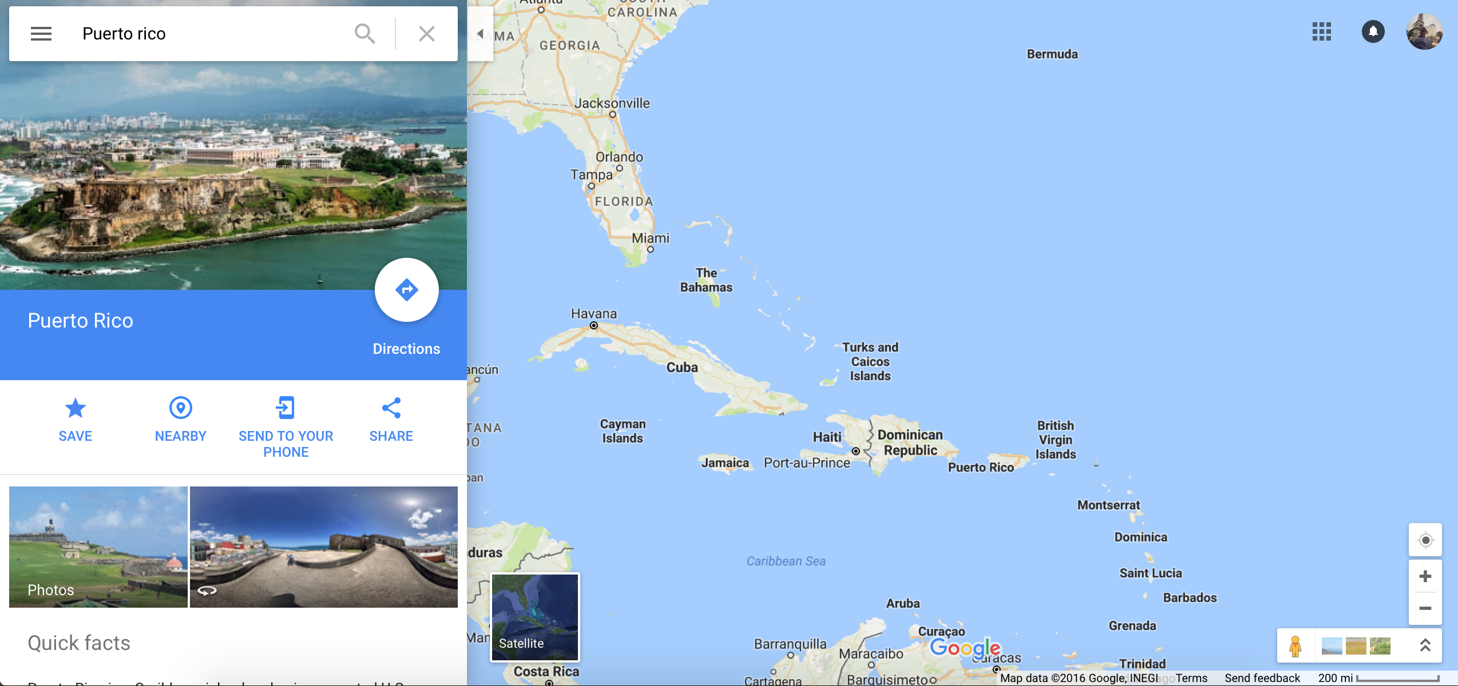
FROM IDEA TO ACTION (PUERTO RICO EXAMPLE)

Slide 9
FROM IDEA TO ACTION (PUERTO RICO EXAMPLE)
Nuclear Energy As An Alternative
Can develop a new industry in Puerto Rico
Can actively engage Puerto Rican engineers in the nuclear industry
One of the main challenges are the fears and myths
The Nuclear Alternative Project
Engages expert engineers from the diaspora
Educates and engages the general community through community participatory approaches
Helps to bring hope, transparency and trust

Slide 10
GET INVOLVED WITH THE NAP
Notes:
Share Ideas :

Slide 11
GET CONNECTED
NAP website
http://www.nuclearalternativeproject.org
Notes:
Share Ideas :

