Slide 1

Know Your Strengths
Strengths Finder 2.0
Kimberly Perry, Ph.D., PCC
Kath Kunz

Slide 2
Professional Development Workshop
Know Your Strengths with StrengthsFinder 2.0
Wednesday, July 26, 2017 from 8:00 – 3:00
Workshop Prework Reminder
Complete your online Strengths Assessment using the code inside your the StrengthsFinder 2.0 book by Tom Rath.
Bring your list of Top 5 Strengths to the workshop with your StrengthsFinder 2.0 Book.

Slide 3
Professional Development Workshop
Know Your Strengths with StrengthsFinder 2.0
Wednesday, July 26, 2017 from 8:00 – 3:00
Workshop Prework Reminder
Did you complete your online Strengths Assessment using the code inside your the StrengthsFinder 2.0 book by Tom Rath?
Did you bring your list of Top 5 Strengths to the workshop?
Did you bring your StrengthsFinder 2.0 Book?

Slide 4
Know Your Strengths
Strengths Finder 2.0
Kimberly Perry, Ph.D., PCC
Kath Kunz

Slide 5
Safety, Housekeeping & Ground Rules
Safety minute
Cell phones on vibrate
We will take 15 min breaks hourly
Lunch break will be a full hour
Everything is Confidential
Everyone Participates
Listen First
Stay Focused
Be flexible / open to new perspectives
Respect each other’s time: Start class and return from breaks on time
Notes:
A few housekeeping Reminders and Ground Rules to follow while we are together today
Cell phones on vibrate
We will take 15 min breaks hourly
Lunch break will be a full hour
Acknowledge that all members are responsible for keeping to the ground rules
– if anyone notices that we are not following the ground rules, please guide us back to them (without being accusatory)

Slide 6
Work on ourselves first!
1. Engaged
2. Enabled
3. Sustainable
By Ed Halpin CNO of PG&E
US Women in Nuclear Conference Opening Plenary
Notes:
In the wise words of Ed Halpin, CNO of PG&E at our conferences opening plenary on Monday
“Work on ourselves first! - “Be engaged, enabled to ensure success”
by Ed Halpin, CNO of PG&E at our Opening Plenary on Monday
This workshop is all about working on you!
improving your engagement – by knowing your strengths
Enabling you to succeed by investing time, practicing what you are talented at
Ensuring sustainability by being successful at everything you do!

Slide 7
Agenda
After this session you will be able to
  Describe what a “Strength” is
  Utilize your Strengths and leverage them more effectively
  Apply how to play to your strengths
  Devise an action plan to put your strengths into ACTION

Slide 8
Table Introductions
Your Name
Your Station
Title
#1 Strength
Notes:
We will start with small group table introductions at your table.
To get you started Kim & Kath will introduce themselves using this outline Take 30 sections each to introduce yourselves at your table
Kim:
Susquehanna Nuclear (Talen Energy)
Leadership Development Manager
My #1 Strength is Individualization

Slide 9
Do you ever wonder?
Why you do what you do?
Why you make certain choices?
Why you do what you do?
Why you like certain things?
Why you are better at some things than others?

Slide 10
There is a reason……
It’s your talents

Slide 11
Gallup
Who has heard of Gallup and what are they known for?
  More than 75 years studying human behavior
A targeted project on strengths was studied for over 30 years
Dr. Donald Clifton, Ph.D. and Tom Rath with a team of Gallup scientists created the online Clifton StrengthsFinder Assessment to measure the prevalence of 34 talent themes in individuals

Slide 12
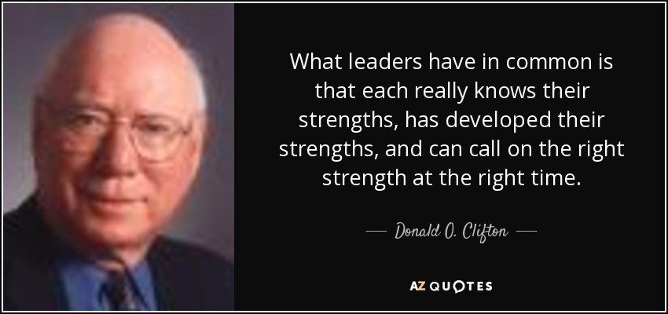
Notes:
For decades, the Clifton StrengthsFinder assessment has helped people excel. From top business executives and managers to salespeople, nurses, teachers, students, pastors, and others, more than 12 million people have realized the benefits of leading with their strengths.
In 2001, Gallup introduced the world to the original Clifton StrengthsFinder assessment in Now, Discover Your Strengths. The book became a New York Times bestseller and sold nearly 2 million copies. Its author and creator of the Clifton StrengthsFinder, former Gallup chairman Dr. Donald O. Clifton (1924-2003), was named the Father of Strengths-Based Psychology by the American Psychological Association.
Strengths are the unique combination of talents, knowledge, and skills that every person possesses. People use these innate traits and abilities in their daily lives to complete their work, to relate with others, and to achieve their goals. But most people don’t know what their strengths are or have the opportunity to use them to their advantage.
People who do focus on their strengths every day are six times as likely to be engaged in their jobs. They are more productive too, both individually and in teams. And they are more than three times as likely to say they have an excellent quality of life.
Discovering and developing your strengths positions you to do what you do best every day. Discover yours today!

Slide 13
How many people are truly engaged at work?
10 million workers surveyed worldwide on engagement
At work, I have the opportunity to do what I do best every day?
______________ % Strongly agree?
Notes:
We heard yesterday only 13% are truly passionate about their work.
Answer: 33%

Slide 14
WIIFM
For the 33% who do have the opportunity to focus on their strengths every day are Engaged Workers who are….
  6 times as likely to be engaged in their jobs
  3 times as likely to report having an excellent quality of life
  People who use their strengths every day have greater productivity
What is the cost to the organization for the 67% of disengaged workers?
Notes:
Answers – extra $ spent training and re-training, inefficiency costs etc., redoing jobs, costly mistakes.

Slide 15
The Anatomy of a Strength
Is a strength good?
What are some qualities of a strength?
In more technical terms
  a strength is the ability to consistently produce a nearly perfect positive outcome in a specific task
Who do you know who consistently deliver a nearly perfect performance in a specific task?
How did these people get there?
Notes:
Qualities of a strength – a strength always delivers, gets the job done right, you can count on it.
Who delivers a nearly perfect performance – A waiter who is one step a head of your needs, a hotel clerk who makes your hotel stay a pleasure, a customer service rep who quickly wins over an upset customer, a salesperson who consistently builds long term loyalty in client relationships.
These people are performing with a strength
H

Slide 16
How did their strengths develop?
A strength requires talent

Slide 17
What is a Talent?
Help us understand who we are
  They describe us
  They influence our choices
  They direct our actions
  They explain why we are better at some things than others
  They help us filter our world

Slide 18

The wonderful thing about talents is that they hold great potential for us.
It is through our talents that we tap into our greatest potential for success!
Notes:
Here is how!

Slide 19
We often take our most powerful talents for granted, and many of us may not be fully aware of them
Have you ever discovered a strength you never knew you had?

Slide 20
How did their strengths develop?
A strength requires talent
Strength develops from investment
  Thinking about how we can add our current knowledge and skills to our talents
  What new knowledge and skills we need to be even more effective
  Through practice using them every day
  It’s the investment of skills, knowledge, and practice that propels us to strength
    The ability to consistently produce a specific positive outcome

Slide 21
What is the difference between…..
Talent
  A naturally occurring pattern of thought, feeling or behavior that can be productively applied
Strength
  The ability to consistently produce a positive outcome through near-perfect performance in a specific task
To finish with strength you have to start with talent
Lets look at it another way - as a mathematical equation

Slide 22
Talent
Skills
Knowledge
Experience
Intention
Strength
Skill – the basic ability to move through the fundamental steps of a task, Skill can be acquired through formal or informal training.
Knowledge – what you know. Knowledge can be acquired through formal or informal education,
Intention - we invest in our talents through…
Practice – the time spent working, exercising, and applying your skills, knowledge, and talent to achieve proficiency
Strength – the ability to consistently produce a positive outcome through near-perfect performance in a specific task.
Notes:
Skill – Filmable behavior – it is teachable
Knowledge – information
Experience – practice, modeling behavior,
Intention – altruistic – the will to do something

Slide 23
Power and Edge
People’s talents give them a unique power and edge.
Talents represent their innate power and potential.
Today is all about appreciating and claiming the particular genius of his or her dominant themes.

Slide 24
Signature Themes
The basic language of talent
A category of talents
  Each StrengthsFinder theme comprises many talents
Strengths develop when you tap into your talents and intentionally invent ways to apply them to accomplish tasks or reach desired outcomes
Gallup research into talents and success have shown that the talents most related to potential for success can be grouped into 34 themes

Slide 25
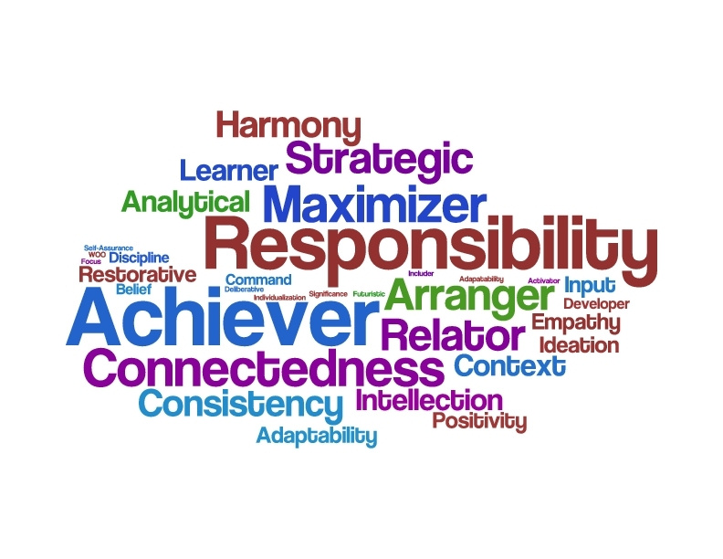
StrengthsFinder 2.0
Notes:
In 2007, Gallup published StrengthsFinder 2.0 and unveiled the new and upgraded version of its popular assessment.StrengthsFinder 2.0 instantly became a Wall Street Journal, Businessweek, and USA Today bestseller. The book has sold more than 4 million copies to date and was named Amazon's bestselling book of 2013.
#1 Best seller on Amazon in Business Management
Measures the presence of talent in 34 general areas or themes – Top 5 Strengths

Slide 26
StrengthsFinder Guiding Principles
Signature Themes are neutral
Themes are not labels
Lead with positive intent
Differences are an advantage
People need one another

Slide 27
Top 5 Signature Themes
Based on your answers to the StrengthsFinder assessment
This report presents your FIVE most dominant themes of talent, in rank order
Your top 5 themes provide a lens or filter through which you see the world and others
They influence how you interact with the world and the people in it
Of the 34 themes measured these are your top 5

Slide 28
Themes
Themes link to each other
  Two people can have the same strength, but based on the order of their other strengths, it can mean two very different things
This is strictly a developmental tool, not an assessment tool
  Cannot predict (assess) someone’s success in a role based on profile
  Utilization of the tool can improve a person’s performance and sense of achievement by leveraging what they do best.
The tool doesn’t tell you whether or not you should be in your role
  How can you use your strengths to be even better in your current role and in your career/life in general?

Slide 29
Talent as a Filter: A New Idea
One person might immediately see the big picture and understand how the idea fits into the overall scheme of things
Another person may closely examine the idea, identifying details about the idea and think about how it could be executed

Slide 30
Your Signature Themes

Slide 31
34 Strengths Themes
Achiever Activator Adaptability Analytical Arranger Belief Command Communication | Competition Connectedness Consistency Context Deliberative Developer Discipline Empathy | Focus Futuristic Harmony Ideation Includer Individualization Input Intellection Learner | Maximizer Positivity Relator Responsibility Restorative Self-Assurance Significance Strategic Woo
Who are you? Which themes are most dominant?
Notes:
Don’t need them all – its who you are!

Slide 32

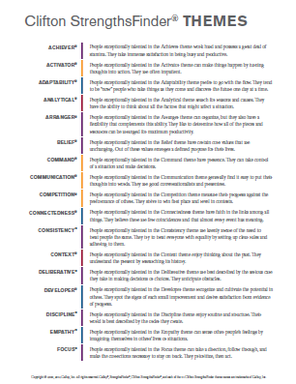
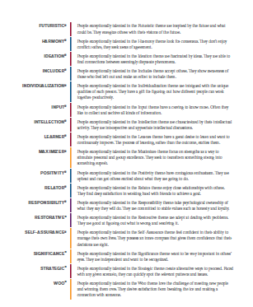
Signature Themes Handout
As you watch these short clips take note on this handout:
Read the description
Watch the video
  Is this theme in your top 5?
  Does this theme REALLY resonate with you?
Notes:
Handout SF 34 strengths definitions
Does this sound like you?
Is it in your top 5?

Slide 33
Woo

Slide 34
Positivity

Slide 35
Communication

Slide 36
Achiever

Slide 37
Activator

Slide 38
What kind of activities are you naturally drawn to?
What energizes you?

Slide 39
Deliberative

Slide 40
Maximizer

Slide 41
Context

Slide 42
Focus

Slide 43
Ideation

Slide 44
What kind of activities frustrate you or drain you?

Slide 45
Learner

Slide 46
Strategic

Slide 47
Belief

Slide 48
Empathy

Slide 49
What kind of activities do you pick up quickly?
Learning

Slide 50
Developer

Slide 51
Individualization

Slide 52
Break – 15 Min

Slide 54
Signature Themes Handout
As you watch these short clips take note on this handout:
Read the description
Watch the video
  Is this theme in your top 5?
  Does this theme resonate with you?
Notes:
Handout SF 34 strengths definitions
Does this sound like you?
Is it in your top 5?

Slide 55
Restorative

Slide 56
Harmony

Slide 57
Command

Slide 58
Discipline

Slide 59
What takes you longer to do, even if you know how to do all the steps?
Learning

Slide 60
Input

Slide 61
Significance

Slide 62
Adaptability

Slide 63
Analytical

Slide 64
Competition

Slide 65
What activities do you seem to automatically know the steps that need to be taken?
Flow

Slide 66
Intellection

Slide 67
Futuristic

Slide 68
Relator

Slide 69
Self-Assurance

Slide 70
Includer

Slide 71
During what activities do have you had moments of subconscious excellence when you thought, HOW did I do that?
Glimpses of excellence

Slide 72
Arranger

Slide 73
Responsibility

Slide 74
Connectedness

Slide 75
Consistency

Slide 76
BREAK

Slide 77
What activities give you a kick either while doing them or immediately after finishing? When can I do that again?
Satisfaction

Slide 78
What surprised you?
Knowing your top 5 themes
  Was there a theme missing?
Why only give me 5?
Why not all 34 so I can work on those that are my weaknesses?

Slide 79
Strengths Based Development

Slide 80
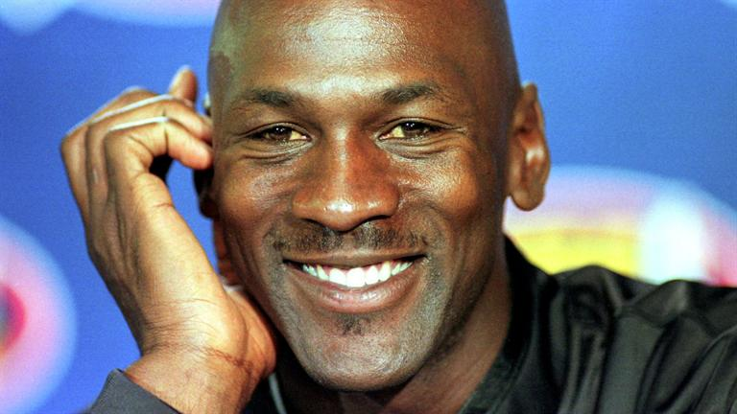
Notes:
https://www.youtube.com/watch?v=hXdj8scRdFE
Michael Jordon on Practice
Lets take a look at 1 famous example
Ask: Would you all agree that Michael Jordan is a talented athlete? Answer: Yes
Ask: How many sports has Michael Jordan played?
Basketball, Baseball and golf – Baseball was his first love – which was he best at? Answer: Basketball – Had the raw talent to be outstanding, but not so with baseball or golf
If I had great equipment – practiced 4 hours a day, went to basket ball camp – being an NBA star wasn’t in the cards….Why is that?

Slide 81
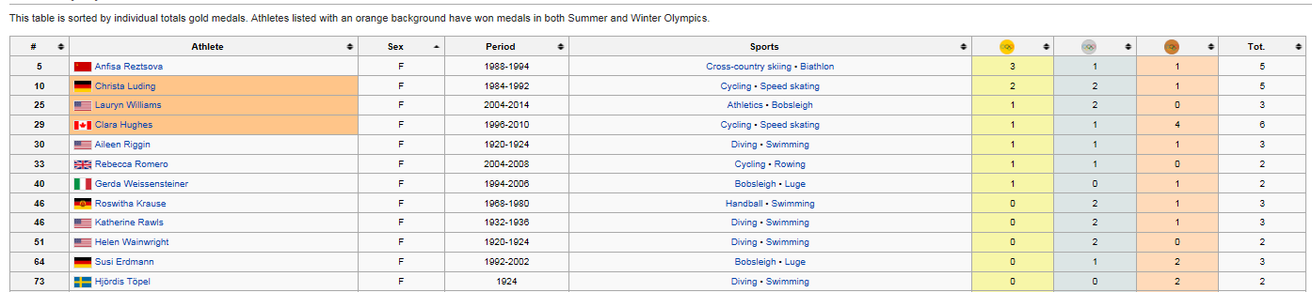
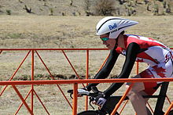
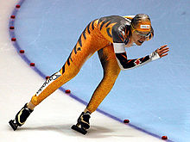
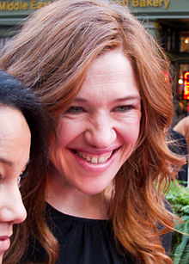
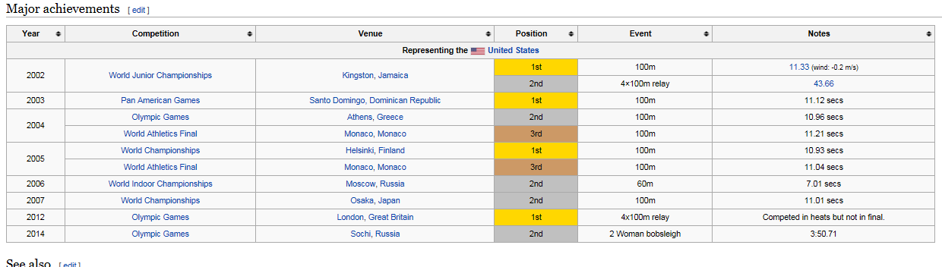
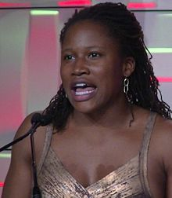

Slide 82
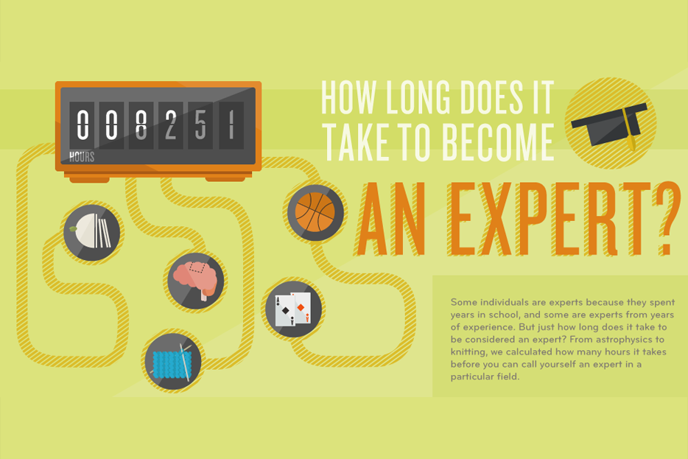

Slide 83
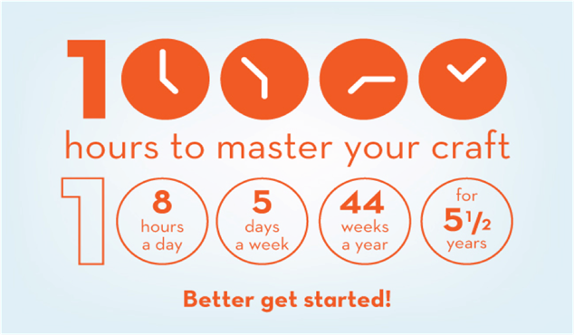

Slide 84
Conventional Approach to Development
Maintain each person’s strengths and work on fixing their weaknesses
Most, if not all, behaviors can be learned.
The best in a role display the same behaviors
Weakness fixing leads to success
Identify Improvement Areas
Develop an Improvement Plan
Notes:
Is it better weakness to be mediocre
Or

Slide 85
Strengths Based Approach to Development
Focus on each person’s strengths and manage around weaknesses
Only some behaviors can be learned (skills and knowledge).
The best in a role deliver the same outcomes using different behaviors
Weakness fixing prevents failure,; Strengths building leads to success.
Identify Talents
Develop Strengths

Slide 86
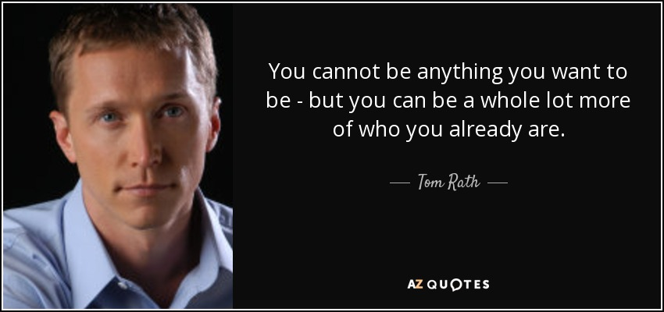

Slide 87
People Working in their Strengths Zone….
Look forward to going to work
Have more positive than negative interactions with co-workers
Treat customers better
Tell their friends they work for a great company
Have more positive, creative and innovative moments

Slide 88
Good vs. Great
What is the difference between someone who is good at something vs. someone who is truly excellent?
  The difference is actually very slight
  Excellence comes from making small number of more appropriate choices
    Example: Struggling sales person vs a great one might be 3 extra calls each week or two emotional signals picked up during a call or presentation. Or one more fact tossed in at just the right moment – Emotional Intelligence.
    Highly engaged manager vs average manager – Simply a few more questions asked or a few more moments listening
  Subtle refinements in what we already have = excellent performance

Slide 89

Excellence
Requires an awareness, practice and expertise
Study your dominant themes and figure out how they combine to create a strength
How your strengths contribute to your success
A small shift in emphasis from one talent to another may be all you need to leap from

Slide 90


Slide 91
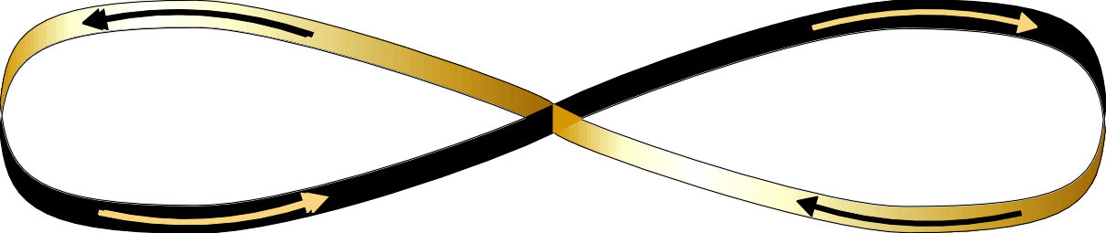
A Quantitative View of Strengths
Staying in the Productive Zone
To Maximize Our Productivity
Doing Too Little
(Blind side)
Doing Too Much
(Excess)
Least Preferred
Strengths
Most Preferred
Strengths
Do Just Enough
Do More
Confirm
Do Less
Extend
Moderate
Notes:
91

Slide 92
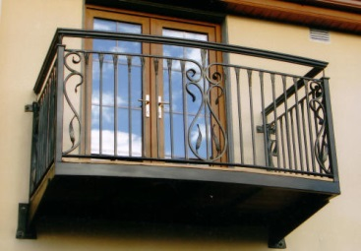

Balconies and Basements of a Strength Theme
Notes:
Review Balcony and Basement Pdf

Slide 93
Signature Themes in Action - Reflection

Slide 94
BREAK

Slide 95
Human Graph
Learning from Each Other

Slide 96
Human Graph – Step 1
Items you need:
  A pen
  A list of your top 5
Around the room you will find all 34 Talent Themes Signs in alphabetical order
Stand in front of your #1 Talent
  Print your name on the sign and put a 1 next to it
  As a group discuss how you use this talent at work

Slide 97
Human Graph – Step 2
Before you move, look who is standing by your #2 Talent
  You have a talent in common
Stand in front of your #2 Talent
  Print your name on the sign and put a 2 next to it
  As a group discuss how you use this talent at work

Slide 98
Human Graph – Step 3
Before you move, look who is standing by your #2 Talent
  You have a talent in common
Stand in front of your #3 Talent
  Print your name on the sign and put a 3 next to it
  As a group discuss how you use this talent at work

Slide 99
Human Graph – Step 4
Before you move, look who is standing by your #2 Talent
  You have a talent in common
Stand in front of your #4 Talent
  Print your name on the sign and put a 4 next to it
  As a group discuss how you use this talent at work

Slide 100
Human Graph – Step 5
Before you move, look who is standing by your #2 Talent
  You have a talent in common
Stand in front of your #5 Talent
  Print your name on the sign and put a 5 next to it
  As a group discuss how you use this talent at work

Slide 101
Team Profile – Greatest Talents
Count the number of names written on the Talent sign you are currently standing at
  5 Talents with the highest number of people
If we were an intact team what would we be great at?

Slide 102
Team Profile – Least Represented Talents
Count the number of names written on the Talent sign you are currently standing at
  5 Talents with the lowest number of people
If we were an intact team what would we not be so good at?
Who on our team is good at that particular Talent?

Slide 103
Four Domains of Team Strengths Handout
Executing | Influencing | Relationship Building | Strategic Thinking
Achiever Arranger Belief Consistency Deliberative Discipline Focus Responsibility Restorative | Activator Command Communication Competition Maximizer Self-Assurance Significance Woo | Adaptability Connectedness Developer Empathy Harmony Includer Individualization Positivity Relator | Analytical Context Futuristic Ideation Input Intellection Learner Strategic
Notes:
Have participants turn to PDF document SF Worksheet 2a and 2b
Have participants circle their strengths on 2b and answer the questions

Slide 104
Your Unique Contribution to the Team
Circle your top five signature themes
Answer the 4 questions

Slide 105
Lunch – 1 Hour
Notes:
Prep for Talent Map Activity
Distribute cards ½ the room Kath’s 2 decks, the other half the room Kim’s deck

Slide 106
Talent Mapping
A deeper dive into your talents

Slide 107
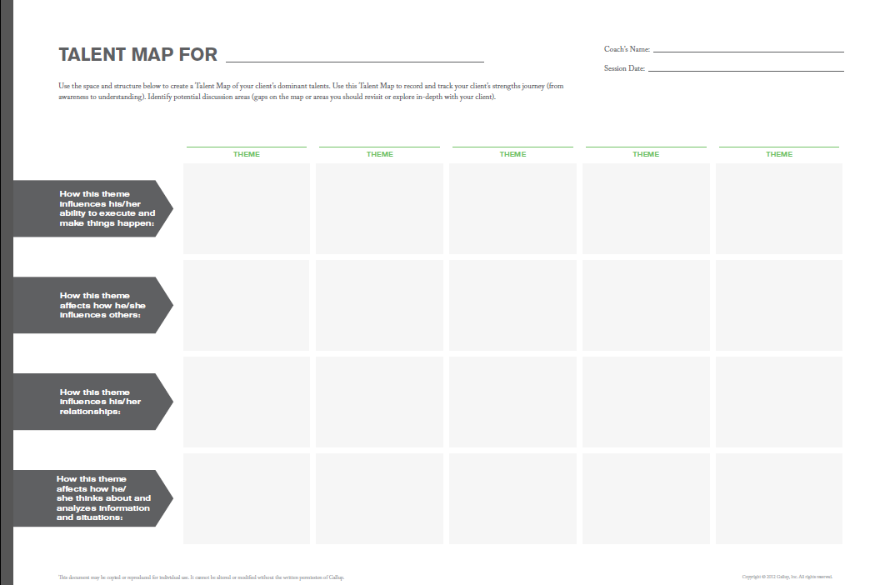

Slide 108
Appreciate each of your dominant themes more deeply with Talent Map
For each theme answer the 4 questions on your talent map
Using Resources:
  StrengthsFinder Book
    First paragraph Talent description
    Ideas for Action
  Your Signature Themes Report
  Theme Insights Cards
  Raise your hand – Kim/Kath Resource Guide
Then complete 4 questions on the Action Plan Handout
1 hour

Slide 109
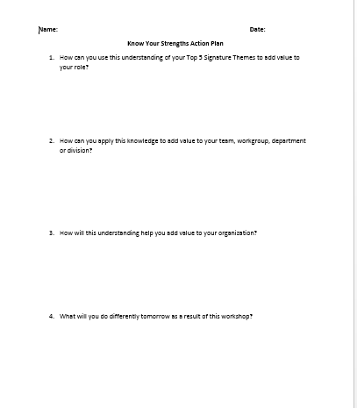
Action Plan Handout

Slide 110
BREAK
Notes:
Prep the room for the a Picture = 100 words Activity

Slide 111
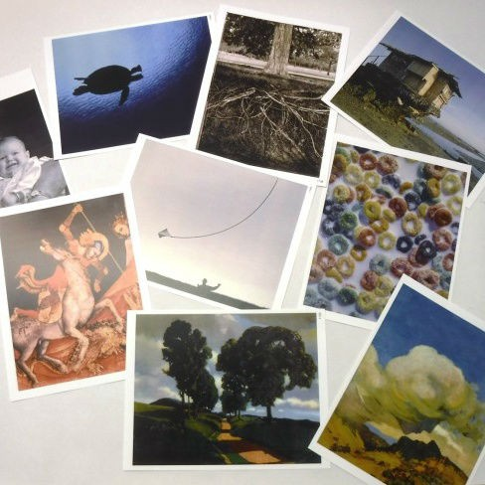
Activity: A picture is worth a thousand words
There are 250 Images around the room
Select 1 image that best represents how you use all 5 Signature Themes to create a meaningful impact
Be prepared to explain your selection
  How are your Signature Themes represented in this picture?
Notes:
20 min for walk about – Put up 15 min tonesetter
Split 80 into 2 groups
Kath take half – Round robin on the question on the slide – 1 min per person
Kim take half - Round robin on the question on the slide = 1 min per person

Slide 112
Notes:
Insert 15 min Tonesetter 04 – add in 5 min if they need more time
Sort in front of the room or the back (40 each – or stickers their packets or 2 circles depending on the size of the room.

Slide 113
Activity: A picture is worth a thousand words
There are 250 Images around the room
Select 1 image that best represents how you use your Signature Themes to create a meaningful impact
Be prepared to explain your selection
  How are your Signature Themes represented in this picture?
Notes:
20 min for walk about – Put up 15 min tonesetter
Split 80 into 2 groups
Kath take half – Round robin on the question on the slide – 1 min per person
Kim take half - Round robin on the question on the slide = 1 min per person

Slide 114
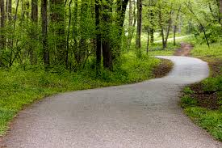
A Picture is Worth 5 Strengths
Notes:
From the deck of images choose 1 image which represents your 5 strengths

Slide 115
The more you think about your talents, the more you will notice how they contribute to your strengths

Slide 116
The more you notice a connection, the more aware of the potential for even greater success

Slide 117
Your Journey has Just Begun
You don’t have to become a different person to be successful
You don’t have to be all things to all people
You can’t be everything you want to be, but you can be more of who you are
You can learn how to be a better version of you

Slide 118
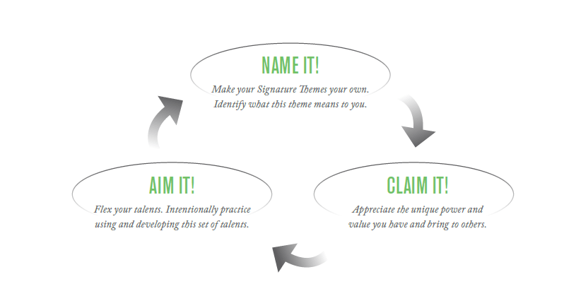
What’s Next?

Slide 119
Appreciating Your Strengths
Know your Talents
  Dominant theme(s)
Value your talents and assume responsibility for using them
Relive your successes to help you develop your strengths
  When was the first time you recognized that strength
Practice your talents so they become strengths
Share your talents with your Manager
Display your top 5 Signature Themes – picture frames for everyone
How can I use this theme today?
Extra Help is available via a Strengths Coach

Slide 120
Learn, Explore and Stay Connected
Join CliftonStrengths (StrengthFinder) on Facebook
Subscribe to Twitter Feed @StrengthsFinder
Gallup’s YouTube Channel: Gallup Strengths Center
Additional online assessments are available for $9.99 at www.gallupstrengthscenter.com
StrengthsFinder 2.0 book
Strengths Based Leadership Book

Slide 121


Slide 122
Q&A
Kimberly Perry
Susquehanna Nuclear
Talen Energy
Kimberly.Perry@Talenenergy.com
Office: 570-542-1734
Cell: 610-216-3035
Kath Kunz
Diablo Canyon Power Plant
kmn1@pge.com
Office: 805-545-4065
Cell: 805-540-8634

