Slide 1
Summary of NEA Report
Gender Balance in the Nuclear Sector
NEA No. 7583, OECD 2023

Slide 2
Human Resource Survey: 96 organizations in 17 countries
Public Opinion Survey: 8000 women in 32 countries
Notes:
Some of us participated in the Public Opinion Survey, back in 2021.

Slide 3
Women are:
24.9% of the nuclear workforce in NEA Countries
Only 20.6% of STEM workforce
18.3% Sr Leadership Roles (compared to 27.7% lower and 25.7% middle mgmt)
Paid less than men
Notes:
It appears that the U.S. didn’t supply data

Slide 4
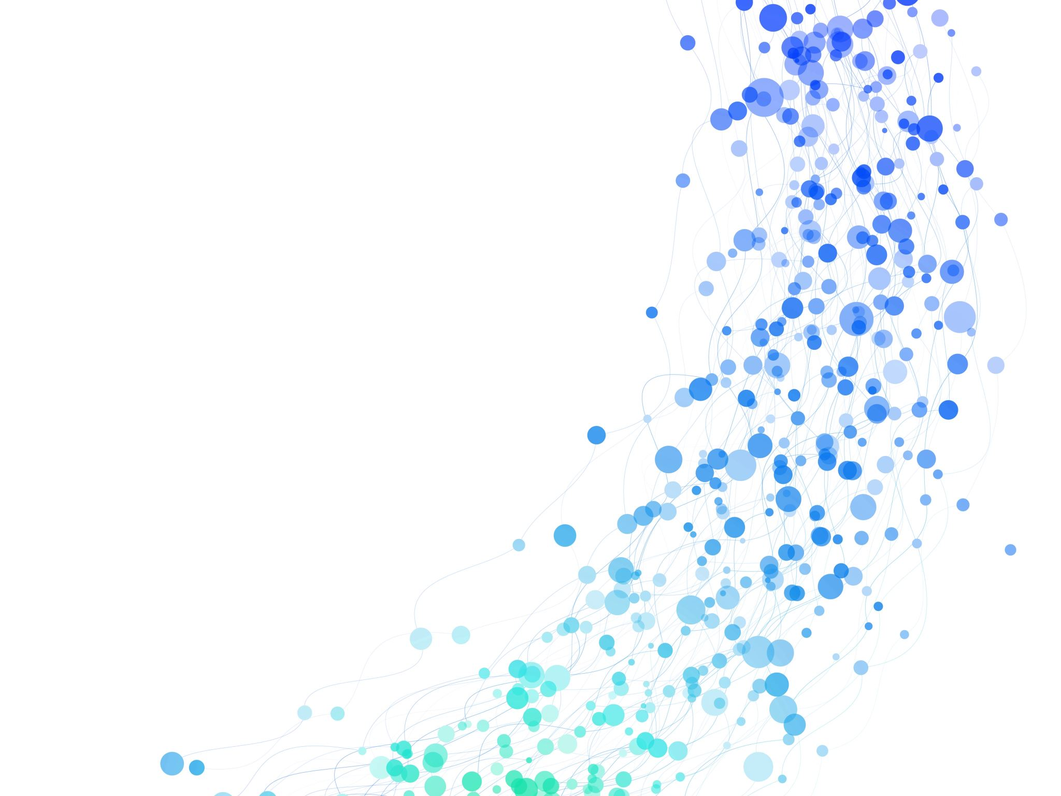
Your Company
As of date:
-> XX% female across the fleet, all job categories
Notes:
Your HR Business Partner should have this data. It would be interesting to compare specific sites’ data if you have a fleet chapter

Slide 5
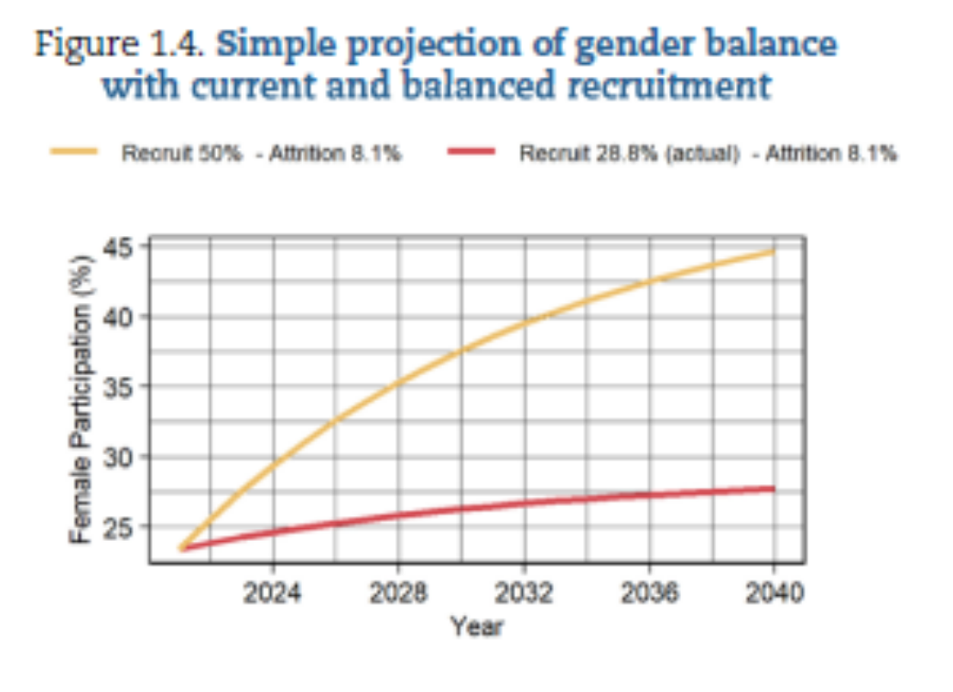
Women are 28.8% of new hires
STEM 24.6%
Non-STEM 40.7%
Promotion rate 27.1% but clustered in non-STEM roles
Women constitute 23.9% of the 8.1% attrition rate and current trends indicate women leave the leadership pipeline while in the lower levels of the organization
Notes:
This data is from the report.

Slide 6
Lack of female leaders and low visibility of women
On-call and shift work are not woman-friendly
>70% agree that pregnancy and family obligations negatively impact their careers in the nuclear sector
64.8% experience stereotyping, microaggressions, unconscious bias
Perceptions that jobs in nuclear are for men
57.4% say there are institutional barriers to retaining and promoting women
Notes:
Shift-work isn’t really Family-Friendly, but have greater impact on single-parent homes
How many of you leave work and step into family duties like cooking dinner?
44.7% of respondents reported sexual harassment in the workplace (personal or 2nd hand accounts)
Menopause generally not regarded as having a negative career impact (fig. 3.34, 3.35) -> many responses were ambivalent
Unfavorable impact -> caregivers for grandchildren and older relatives (fig. 3.33)

Slide 7
ATTRACT
women into the nuclear sector
RETAIN
& support women in the workforce
ADVANCE
& develop women as leaders
Resulting Policy Framework:
Notes:
Can you see how these align to our new strategic objectives?

Slide 8
U.S. WIN Strategic Objectives
Attract a diverse workforce to pursue professions and trades in the nuclear sector
Foster a culture of inclusion and belonging that retains a diverse workforce in the nuclear sector
Create professional development and networking opportunities for career advancement
Inspire advocacy and public support for the advancement of nuclear energy and technology.

Slide 9
ATTRACT
Public Communications
Normalize women in STEM
Showcase women’s leadership and contributions
Make the case for why gender balance is a benefit
Educational Pipeline
Increase outreach efforts at local schools
Focus on encouraging young girls to pursue STEM
Gender-balanced recruitment and hiring
Targeted communications and recruitment

Slide 10
RETAIN
Address
Address impacts of Family obligations
Support flexible work schedules
Communicate parental/family leave policies and encourage their full use
Eliminate
Eliminate harassment and build inclusivity
Provide training
Encourage male counterparts to mentor
Assess
Assess gender impacts of policies and programs
Regularly check/adjust career development programs
Notes:
Important note: Encourage male counterparts to mentor and be involved in your chapter!

Slide 11
Advance
Sponsor female future-leaders
Encourage use of GROW, NEXTUp, NEXTSteps, and NEXT
Develop
Access to career development programs for those interested
Development-focused sessions and book clubs
Enhance
Showcase accomplishments
ADVANCE

Slide 12
Going forward, we will strive to
Attract,
Retain, and Advance!
Notes:
Point to Juliann’s WINning Edge article

