Slide 1
Speaker
Annette Carrier
Manager, Customer Experience (CX) Strategy
Arizona Public Service (APS)
Moderator
Bonnie Bryant
Director, Fleet Production
Entergy

Slide 2
If you were an animal,
which animal would you be and why?

Slide 3
Your Personal Brand is your Promise of Value

Slide 4
We all have personal brands.
The question is this … is your brand developed
by design or by default?

Slide 5
Brand Truth
vs
Brand Perception
Your personal brand is what people say about you when you’re not in the room.
- Jeff Bezos

Slide 6
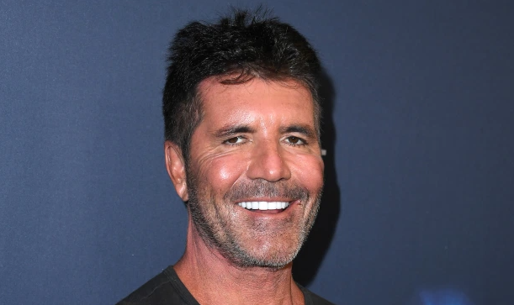

Slide 8
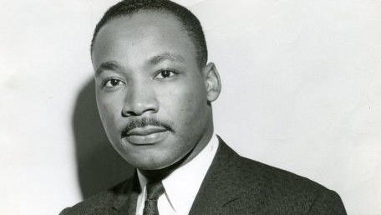

Slide 9
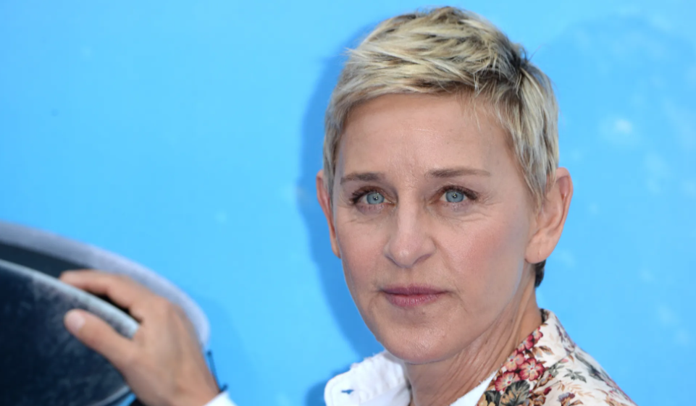

Slide 10
YOU?
10

Slide 11
We are the CEO of our own company: Me, Inc. To be in business today, our most important job
is to be head marketer for the
brand called “YOU”.
- Tom Peters, The Brand Called You
11

Slide 12
Define Your Brand
Develop Your Narrative
Manage Your Brand
The Journey
12

Slide 13
Personal brands are created from the inside out as a reflection of who you are, not who you want to be.
13

Slide 14
Defining Your Brand Through self-reflection
What do you pride yourself on?
What qualities set you apart?
What values matter to you the most?
What do you stand for?
What are you passionate about?
What really offends or disappoints you?
14

Slide 15
Defining Your Brand Through association
If you were a car, what kind of car would you be and why?
If you were an animal, which animal would you be and why?
If you were a color, which color would you be and why?
If you were a doctor, what kind of doctor would you be and why?
15

Slide 16
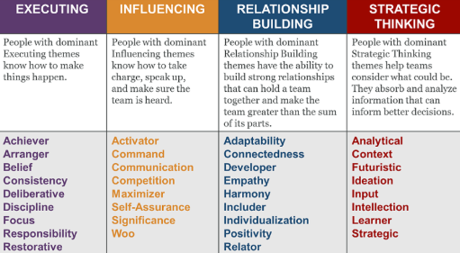
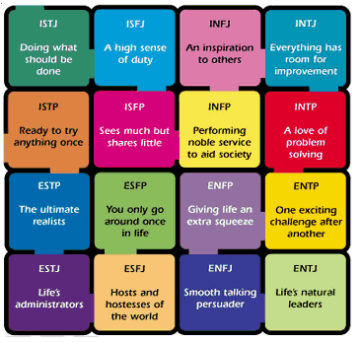
Defining Your Brand Through assessment tools
C
D
S
I
DISC
StrengthsFinder
Myers-Briggs
16

Slide 17
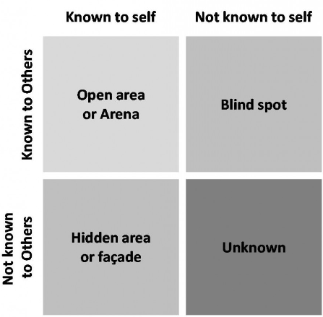
Defining Your Brand Through the eyes of others
Ask someone you trust who will be honest with you…
What’s their impression of you – the good, the bad and the ugly?
What your core competencies are?
What five adjectives they would use to describe you?
Johari Window
17

Slide 18
Personal Brand Examples
18

Slide 19
Personal Brand Examples
I have a knack for getting people to row in the same direction.
19

Slide 20
Personal Brand Examples
I excel when operating behind-the-scenes
and supporting others. I am an
absolute team player
who thrives on
collaboration.
20

Slide 21
Personal Brand Examples
I see hope in all things. I create a safe environment for individuals to be themselves and am committed to bringing out the best in them. I am solutions-oriented and persistent in driving for results. I value new ideas, inclusion, tenacity, purpose and passion. I believe in doing the right thing.
Optimistic
Dedicated
Open Minded
Passionate
Problem Solver
21

Slide 22
Define Your Brand
Develop Your Narrative
Manage Your Brand
The Journey
22

Slide 23
Develop Your Narrative
It’s more than what you do
How You’re Different
Who You Are
What You Do
Keep these tips in mind
Be authentic … if you can’t back it up, don’t say it
Be concise … if you can’t say it in 30-60 seconds, it’s too long
Be relevant … give the listener a reason to care and remember
23

Slide 24
Self-Presentation
Develop Your Narrative
There’s nothing wrong with self-promotion
is not
Self-Boasting
24

Slide 25
Define Your Brand
Develop Your Narrative
Manage Your Brand
The Journey
25

Slide 26
Manage Your Brand
Why is this important? For you!
26

Slide 27
Manage Your Brand
Why is this important? For your team!
Just ask
27

Slide 28
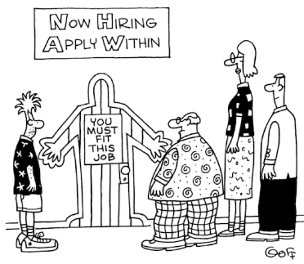
Manage Your Brand
Why is this important? For your next opportunity!
28

Slide 29
Manage Your Brand
Actions speak louder than words
Show. Don’t tell.
29

Slide 30
Manage Your Brand
You’re doing it every day
Every job
Every project
Every conversation
Every meeting
Every interaction
Every email
Every text
Every action
Every reaction
Every facial expression
Every everything!
30

Slide 31
A strong, clear personal brand allows others to understand your value proposition, form credible opinions about you, assess you as “a fit” and ultimately connect with you. - Harvard Business Review, March 2014
31

Slide 32
I’m All In! Now What?
32

Slide 33
I’m All In! Now What?
Create a purpose statement
33

Slide 34
I’m All In! Now What?
Create a personal portfolio
Should reflect …
Who I am (definitely)
What my purpose is (definitely)
How I think (recommended)
What I’ve accomplished (optional)
Tips …
Exercise self-expression and creativity
Leverage your resources (leader, mentor, sponsor)
Visit the U.S. WIN Professional Development Library or contact the U.S. WIN Professional Development Committee at uswinpd@gmail.com
34

Slide 35
Thoughts/Questions
35

Slide 36
36

Slide 37
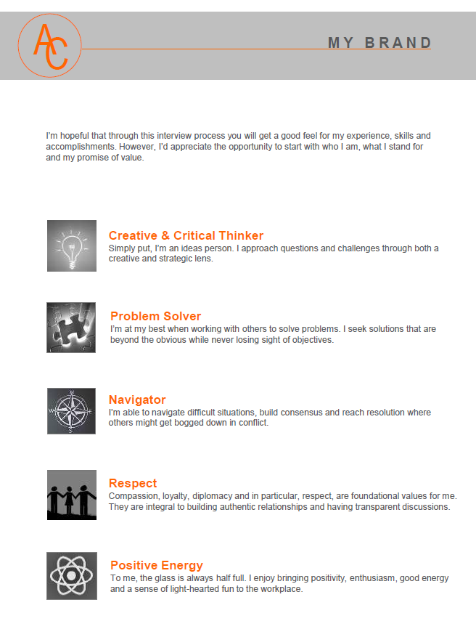
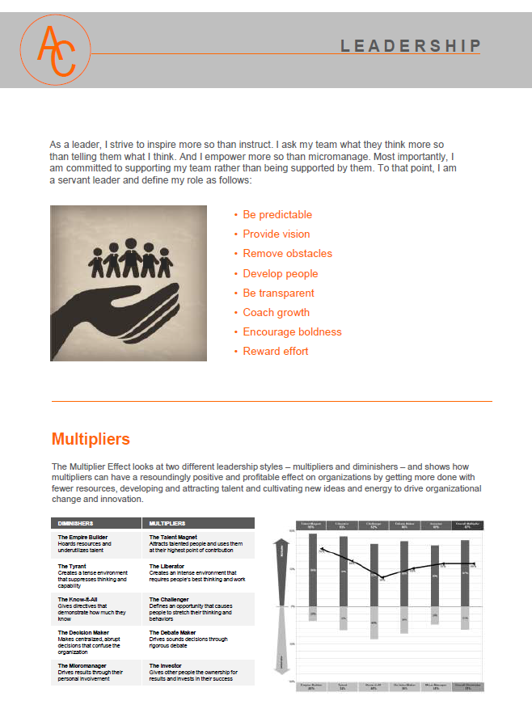
37

Slide 38
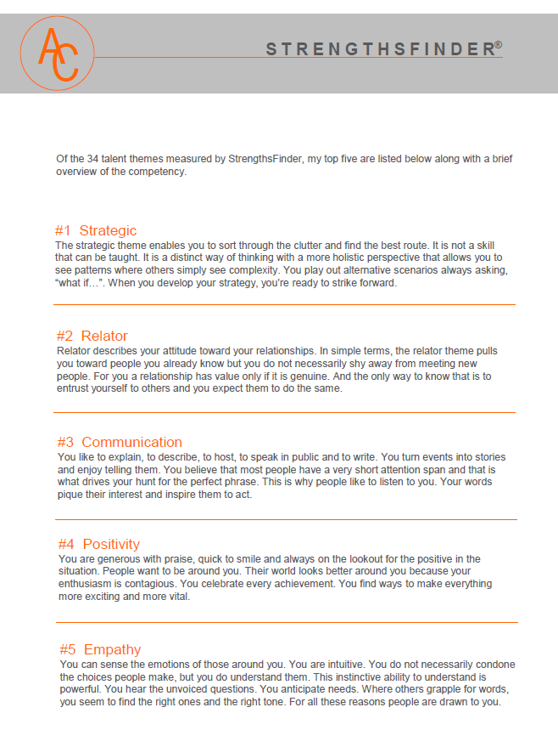
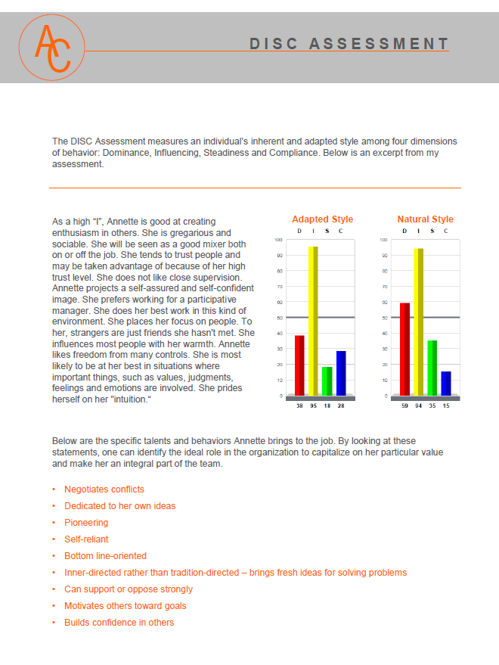
38

Slide 39
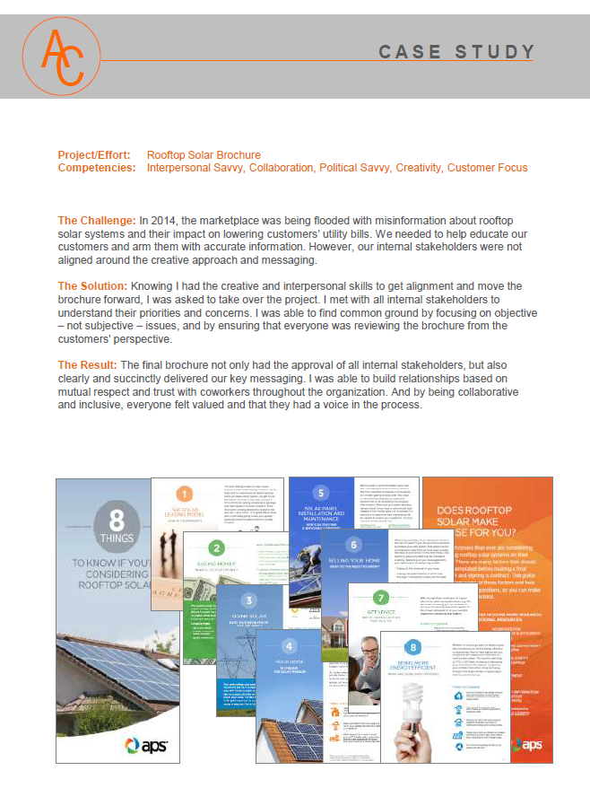
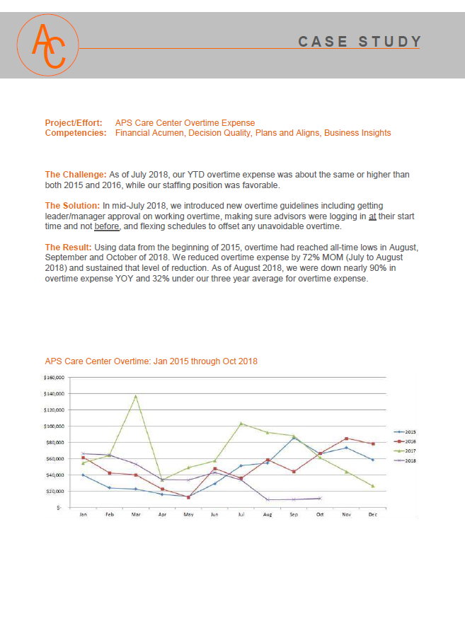
39

Slide 40
Thank You!
40

