Slide 1
Spring Meeting – May 2023
“The Power of Relationships”
Notes:
Reminder to state the session(s) will be recorded

Slide 2
Welcome, Safety Minute
Notes:
NEXT, GROW, and WIN DEI

Slide 3
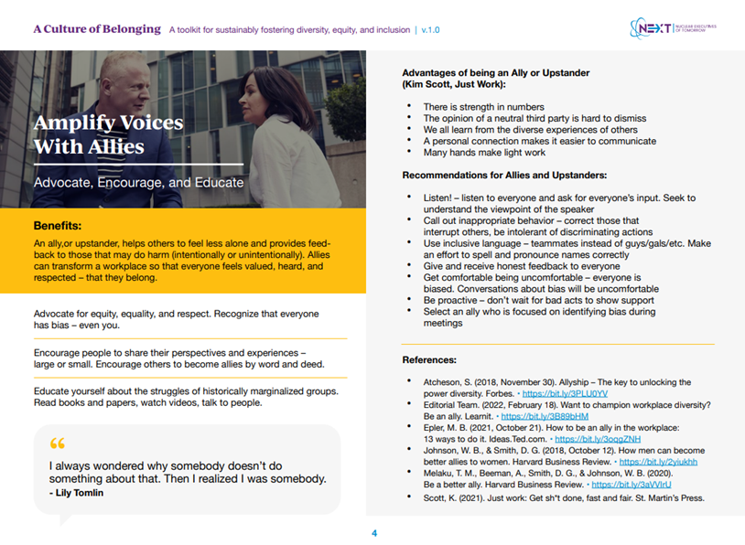
DEI Moment: A Culture of Belonging
Toolkit developed as the capstone project of the NEXT22 Cohort
Designed for sustainably fostering diversity, equity, and inclusion
Divided into five parts to be used as posters, handouts, discussion starters, etc.
Notes:
https://www.winus.org/wp-content/uploads/2022/07/NEXT_A-Culture-Of-Belonging_v1.pdf?swcfpc=1

Slide 4
@nukeboss_uswin Overview
Mentoring Moment
Notes:
https://www.instagram.com/nukeboss_uswin/?hl=en

Slide 5
Panel Discussion and Q&A: The Power of Relationships
Kimberly Cook-Nelson
Executive Vice President, Nuclear Operations and Chief Nuclear Officer, Entergy Nuclear
Kimberly Harshaw
Executive Vice President and Chief Nuclear Officer, South Texas Project Nuclear Operating Company
Moderator: Angie Howard

Slide 6
Coffee Break

Slide 7
Mentor and Mentee Discussion:
Learning Through GROW
Donna Philbeck (Mentor)
Waste Estimating Manager
EnergySolutions
TeShania Bey (Mentee)
Waste Certification Specialist
Savannah River Nuclear
Moderator: Price Collins
Notes:
Donna: 25+ years in energy field (Lockwood Greene/CH2M Hill, Shaw/CBI/ WECTEC); Estimate fossil fuel and nuclear
TeShania: Savannah River since 2008; Volunteer leader for SRN community involvement; Diverse leadership roles both professionally and privately

Slide 8
Grow Mentor Program Experience Highlights: “It takes two to make a thing go right” – Rob Base
Sharing: Shared past experiences; we talked through how we handled each, what we’d do next time and learned from each other
Honey Do’s: Documented goals and created an action item list to achieve goals
Support: Offered advice, support and guidance in challenging moment(s) at work
Connected: shared our actual family and friends (SRN WIN Christmas party, Philbeck daughters met TeShania!)
Two-way street to success for both of us

Slide 9
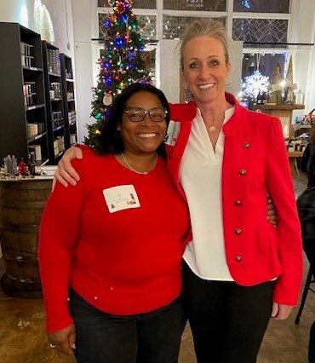
TeShania and Donna meeting in person!

Slide 10
Closing
Please continue to work with your program point of contact for One-on-Ones/feedback sessions
Feedback is vital to program success

Slide 11
Spring Meeting – May 2023
“The Power of Relationships”
Notes:
Reminder to state the session(s) will be recorded

