Slide 1
Celebration of Asian American and Pacific Islander Heritage Month

Slide 2
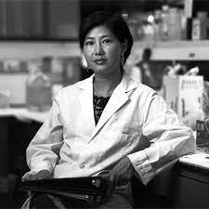
Dr. Flossi Wong-Staal
https://www.youtube.com/watch?v=CCh2d-Hi9Hs

Slide 3
Josephine Jue
Chinese-American computer programmer and mathematician
Best known for being the first Asian-American woman working in NASA, where she worked for 37 years
Worked as a compiler for the Space Shuttle program and also worked for Apollo 11.
Chief of NASA's Software Engineering Laboratory (SEL) in 1975.
Best known for development, implementation and maintenance of the HAL/S system during the Space Shuttle program.

Slide 4
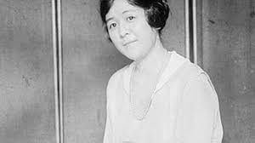
Dr. Kazue Togasaki
Kazue was born in 1897 in San Francisco, California.
Kazue retired from medicine when she was 75 – 40 years after she started her own practice after her internment.
The San Francisco Examiner named Kazue one of its Most Distinguished Women of 1970.
Kazue died in 1992. She was 95.
https://www.youtube.com/watch?v=xEXW153g2wI

Slide 5
Roseli Ocampo Friedmann
She was a Filipino-American microbiologist and botanist
Around the mid-1970s, together with her husband Imre Friedmann, she travelled around the world to study algae and other microorganisms. One of the places they visited was the Ross Desert in the Dry Valleys region of Antarctica, which was thought to be lifeless as a result of a lack of snow and ice. However, the couple discovered microorganisms, known as cryptoendoliths, that could tolerate the cold and come back to life in the summer. Ocampo-Friedmann managed to culture these microorganisms in the laboratory and NASA recognized the research as supporting the theory that microscopic life could exist on Mars because it has similar environmental conditions as Antarctica. In her lifetime, Ocampo-Friedmann collected over 1,000 types of microorganisms from extreme environments worldwide.

Slide 6
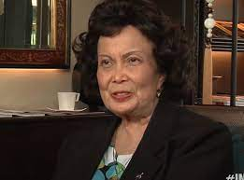
Angelita Castro-Kelly
https://www.youtube.com/watch?v=LB9tDu10iIA

Slide 7
Sau Lan Wu
Chinese American particle physicist and the Enrico Fermi Distinguished Professor of Physics at the University of Wisconsin-Madison.
Recently, her team located at the European Organization for Nuclear Research (CERN), using data collected at the Large Hadron Collider (LHC), was part of the international effort in the discovery of a boson consistent with the Higgs boson.
https://www.youtube.com/watch?v=xFWYp7cvLnM

Slide 8
Thank you for attending!! All photos and videos from google

