Slide 1
Pi is Women’s Work: Celebrating Women in Mathematics

Slide 2
Let’s meet the women featured in the video
Katherine Johnson
Emma Haruka Iwao
Vi Hart
Eugenia Cheng
Mary Laycock
Pamela Harris

Slide 3
Katherine Johnson
In 2015, President Barack Obama awarded Johnson the Presidential Medal of Freedom.
In 2016, she was presented with the Silver Snoopy Award by NASA astronaut Leland D. Melvin and a NASA Group Achievement Award.
In 2019, Johnson was awarded the Congressional Gold Medal by the United States Congress.
In 2021, she was inducted posthumously into the National Women's Hall of Fame.
She had 3 daughters, six grandchildren and 11 great-grandchildren.

Slide 4
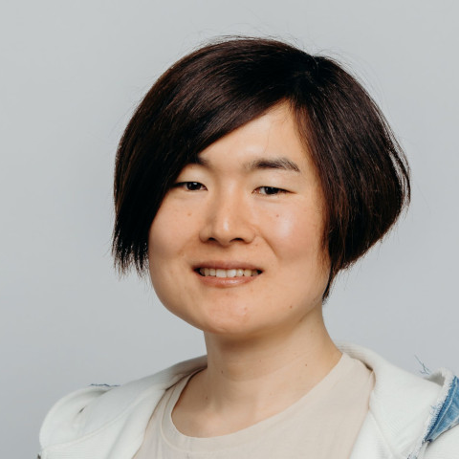
Emma Haruka Iwao
As a child in Japan, Iwao became interested in pi.
She was inspired by Japanese mathematicians, including Yasumasa Kanada.
She studied computer science at the University of Tsukuba, where she was taught by Daisuke Takahashi.
She was awarded the Dean's Award for Excellence in 2008, before starting graduate studies in computing.
Her master's dissertation considered high performance computer systems.

Slide 5
Vi Hart
Hart is the child of mathematical sculptor George W. Hart
Hart received a degree in music at Stony Brook University
Hart won the 2018 Communications Award of the Joint Policy Board for Mathematics for "entertaining, thought-provoking mathematics and music videos on YouTube that explain mathematical concepts through doodles".

Slide 6
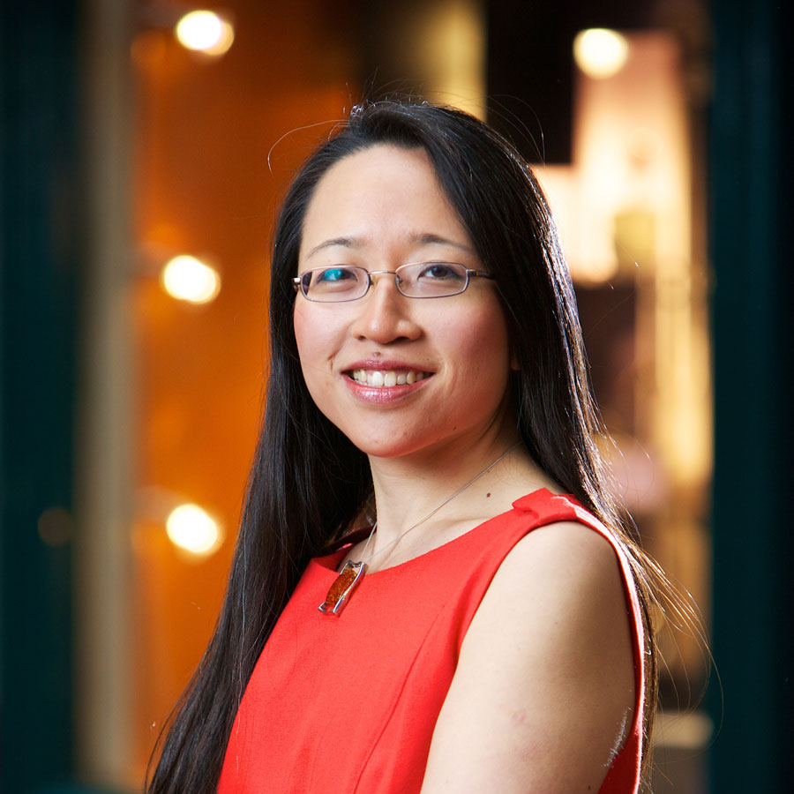
Eugenia Cheng
British mathematician and concert pianist.
Her interest in mathematics stemmed from a young age thanks largely to her mother who made mathematics a part of life.
She writes a column called Everyday Math for The Wall Street Journal.
As of 2020, Cheng is a scientist-in-residence at the School of the Art Institute of Chicago, where she teaches mathematics to arts students.

Slide 7
Mary Laycock
The teacher encouraged my talent in arithmetic and she and my daddy taught me algebra so I could transfer after Christmas into the ninth grade at Murphy High School in Mobile, Alabama.
I wrote a perfect algebra 1 mid term and later graduated from Murphy High School as valedictorian and the only girl in the class with four years of mathematics.
At Judson [College] I held onto the dream of a Math Major and teaching high school mathematics. Only one other girl and I majored in math. We studied together. She did all her work algebraically and I did mine geometrically. When we came up with the same answer, we knew we were correct and we learned by sharing our approaches with each other.
In those days, 1937, girls were discouraged from majoring in math since the men got all the good math jobs. My response was, “Not if you are really good at it!”

Slide 8
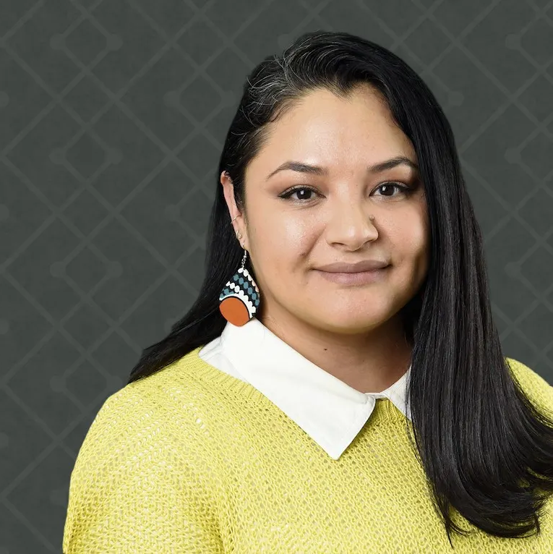
Pamela Harris
Harris first emigrated with her family from Mexico to the United States when she was 8 years old.
They returned to Mexico, before eventually settling in Wisconsin when Harris was 12.
Because she was undocumented, she could not attend university. Instead, she studied at the Milwaukee Area Technical College, where she earned two associate degrees in two and a half years.
After she married a US citizen and her immigration status changed, she transferred to Marquette University, where she obtained a bachelor's degree in mathematics.
She went on to complete her master's degree and in 2012 a PhD at the University of Wisconsin-Milwaukee.
She is currently an associate professor at the University of Wisconsin-Milwaukee in Milwaukee, Wisconsin

Slide 9
Thank you
https://www.exploratorium.edu/video/pi-womens-work-celebrating-women-mathematics
https://www.youtube.com/watch?v=cmskjWp6Dpc

