Slide 1
Amazing Women in Engineering
Celebrating Black History Month and Engineers Week

Slide 2
Aprille Ericsson-Jackson
Aprille Ericsson-Jackson is a Howard-educated American aerospace engineer. She is best known for her work which helped spacecrafts to stabilize and maintain their positions when in space.
Ericsson-Jackson was born in Brooklyn, New York, on April 1, 1963. After attending a high school in Cambridge, Massachusetts, she earned her Ph.D. from Howard University. This feat made her the first black female scientist to earn a Ph.D. in mechanical engineering from this institution.
She has been instrumental in designing and developing systems that are used in spacecraft today.
Pioneers In Science: Aprille J. Ericsson - YouTube

Slide 3
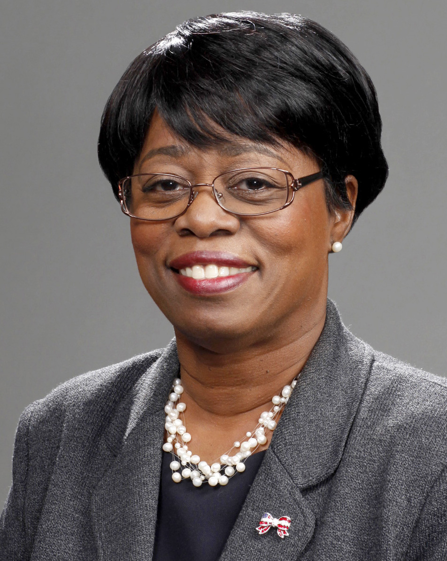
Wanda M Austin
Austin was born in The Bronx
She earned a bachelor's degree in mathematics from Franklin & Marshall College, a master's degree in systems engineering and mathematics (1977) from the University of Pittsburgh.
In 1988, she earned her doctorate (PhD) from the University of Southern California, with a dissertation entitled, "Understanding Natural Language in the Application of System Dynamics Modeling."
In December 2017, Austin co-founded MakingSpace, Inc., a leadership and STEM (science, technology, engineering, and math) consulting firm, and continues to serve as the CEO
Wanda M. Austin- 2012 Horatio Alger Award Recipient - YouTube

Slide 4
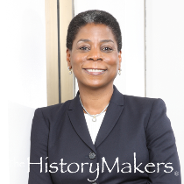
Burns was raised by a single mother in the Baruch Houses, a New York city housing project
She went on to obtain a bachelor of science degree in mechanical engineering from Brooklyn Polytechnic Institute in 1980 and a master of science in mechanical engineering from Columbia University a year later.
Burns is mostly known for being the CEO of Xerox from 2009 to 2016, the first among black women to be a CEO of a Fortune 500 company, and the first woman to succeed another as head of a Fortune 500 company.
She additionally was Xerox's chairman from 2010 to 2017
Ursala M. Burns
Ursula Burns On Distinguishing Herself To Become First Black Woman To Run Fortune 500 Company | TIME - YouTube

Slide 5
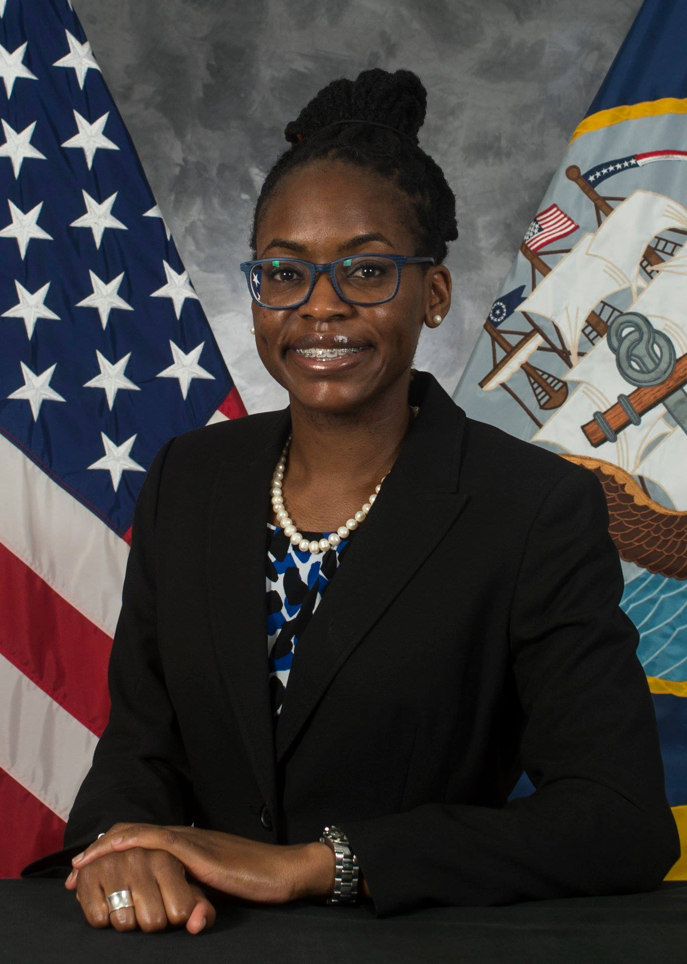
Krystle Z. McClain
And a Master of Engineering in Environmental Engineering.
She is a registered Professional Engineer
2019 Black Engineer of the Year Award Professional Achievement in Government category.
She earned a Bachelor of Science in Chemical Engineering.
Career Advice from a Professional Achievement Award Winner – US Black Engineer About Us – Stem Sync
Notes:
No video available

Slide 6
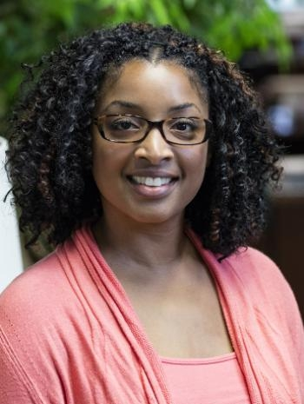
Clarice E. Phelps
Clarice Phelps was raised in the state of Tennessee
Her interest in chemistry began during her childhood when she was given a microscope and encyclopedia-based science kit by her mother.
Phelps completed a Bachelor of Science degree in chemistry from Tennessee State University in 2003. From 2016 to 2020, Phelps earned a M.S. in Mechanical Engineering through the nuclear and radiochemistry program at the University of Texas at Austin. As of 2021, Phelps is a Ph.D. student in the nuclear engineering program at University of Tennessee
American nuclear chemist researching the processing of radioactive transuranic elements at the US Department of Energy's Oak Ridge National Laboratory (ORNL).
https://www.youtube.com/watch?v=G_cYSAZVSPs
https://www.ted.com/talks/clarice_phelps_how_i_claimed_a_seat_at_the_periodic_table

Slide 7
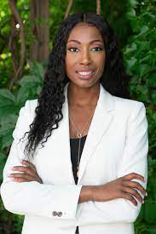
Aisha Bowe
Bowe grew up in the United States in a working-class family. Her father immigrated from the Bahamas. Her father was a taxi driver in Ann Arbor, Michigan
Her high school guidance counselor recommended that she become a cosmetologist…she instead focused on math!
Bowe completed her undergraduate degree in aerospace engineering in 2008, and master's degree in space systems engineering in 2009
Aisha is founder and CEO of STEMBoard, a company that solves technology challenges for government and private-sector clients.
NASA Aerospace Engineer Empowers Unrepresented People To Pursue Engineering Careers - YouTube

Slide 8
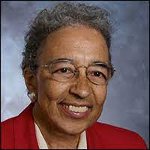
Yvonne Y. Clark
Yvonne was born in 1929 in Houston, Texas and raised in Louisville, Kentucky.
As a child she had a love for building and fixing things but was not allowed to take mechanical drawing class at school because she was a girl.
She graduated from high school at age 16 and spent the next two years studying at Girls Latin School in Boston.
Clark then became the first woman to earn a degree in mechanical engineering from Howard University.
https://www.youtube.com/watch?v=63JiVcG21F0
Notes:
She took an aeronautics class in high school and joined the school's Civil Air Patrol, where she learned to shoot and had flying lessons in a simulator
In 1945 she graduated from high school at age 16 and spent the next two years studying at Girls Latin School in Boston. Clark then became the first woman to earn a degree in mechanical engineering from Howard University, where she was a cheerleader and the only female in her class of almost entirely returned World War II veterans.^{[5]} After she graduated in 1951 she found that "the engineering job market wasn't very receptive to women, particularly women of color".^{[4]}
First woman to receive a mechanical engineering degree from Howard University (1951)
First African American woman engineer hired at Frankford Arsenal Gage Lab (1951)
First African American member of the Society of Women Engineers (1952)
First African American woman engineer hired at Radio Corporation of America (RCA) in the electronic tubes division (1954)
First woman engineer hired as an instructor at Tennessee State University (TSU) (1955)
Inspired SWE’s public anti-segregationist stance at the annual conference in Houston, TX to enable Y.Y.’s full participation (1957) [Forty years later (1997), SWE held another annual conference in Houston, TX where Y. Y. received an apology for her treatment in 1957, a plaque, and a key to the city. At that same conference, Professor Clark was honored as SWE’s Distinguished Engineering Educator.]
Earned her Professional Engineer (P. E.) license (1960)
Worked summers as an aerospace engineer at NASA Marshall Space Flight Center where she resolved Saturn V rocket booster engines’ hot spot issues (1960s)
First woman appointed Department Head of the TSU Mechanical Engineering Department and served this capacity for two terms and a total of 11 years
Worked summers at NASA Houston (Johnson Space Flight Center) developing the moon rock samples container that Neil Armstrong used to transport rocks back to Earth
First African American woman engineer hired at the Ford Motor Company Glass Plant (Nashville) (1971)
First woman to graduate from Vanderbilt University with a M.S. degree in engineering management (1972)
Featured in an article about women in engineering in the July 1973 issue of Mechanical Engineering magazine

Slide 9
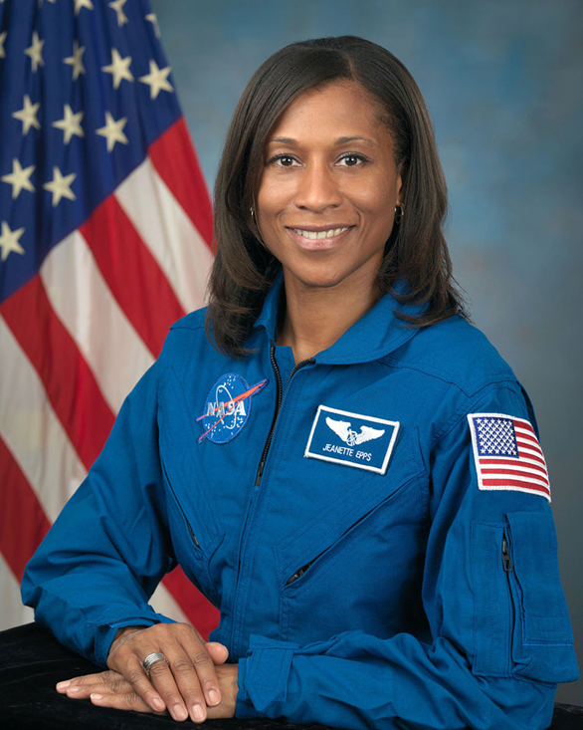
Jeanette Jo Epps
Jeanette Epps was born in Syracuse, New York, one of seven children born to Henry and Luberta Epps, Mississippians who moved to Syracuse as part of the Great Migration.
Epps received both her M. S. and Ph.D degrees in aerospace engineering from the University of Maryland, where she was part of the rotor-craft research group and was a NASA GSRP Fellow.
Her research was focused in the area of materials engineering, which included comprehensive testing of composite swept-tip beams, comparison of analytical models with experimental results for shape memory alloys, and use of shape memory alloy actuators for tracking helicopter rotor blades in-flight
In 2017, NASA announced that Epps would be assigned as a flight engineer to the International Space Station , becoming the first African American space station crew member, but on January 16, 2018, NASA announced that Epps had been replaced by her backup Serena M. Auñón-Chancellor, but that Epps would "be considered for assignment to future missions".[24] The reason for Epps' removal was not stated.
Astronaut Jeanette J. Epps: Sisters Empowering Sisters - YouTube
Notes:
https://www.washingtonpost.com/news/speaking-of-science/wp/2018/01/22/nasa-pulled-this-astronaut-from-a-space-station-crew-her-brother-blames-racism/

Slide 10
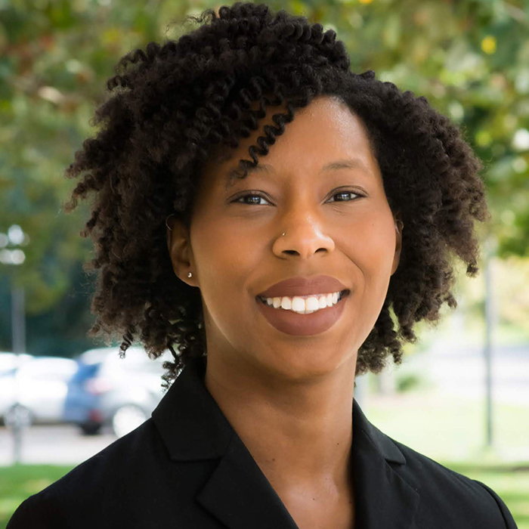
Ciara Sivels
Sivels is from Chesapeake, Virginia. She attended Hickory High School.
Sivels was originally interested in culinary arts, but took an Advanced Placement class in chemistry and became interested in science
In 2019, Sivels was chosen to be one of the 125 national American Association for the Advancement of Science IF/THEN Ambassadors
She was the first black woman to earn a Ph.D. in nuclear engineering from the University of Michigan.
https://www.youtube.com/watch?v=jD99wHC6Njc
Notes:
During her graduate studies, Sivels was one of three black women completing their PhD. She engaged with the Detroit Pre-College Engineering Program, supporting high school students from minority backgrounds.^{[14]} She also founded the Women in Nuclear Engineering in Radiological Sciences group at UoM

