Slide 1
What is Electricity?
DC WIN – Mason Crest Elementary
Nuclear Science Week 2022

Slide 2
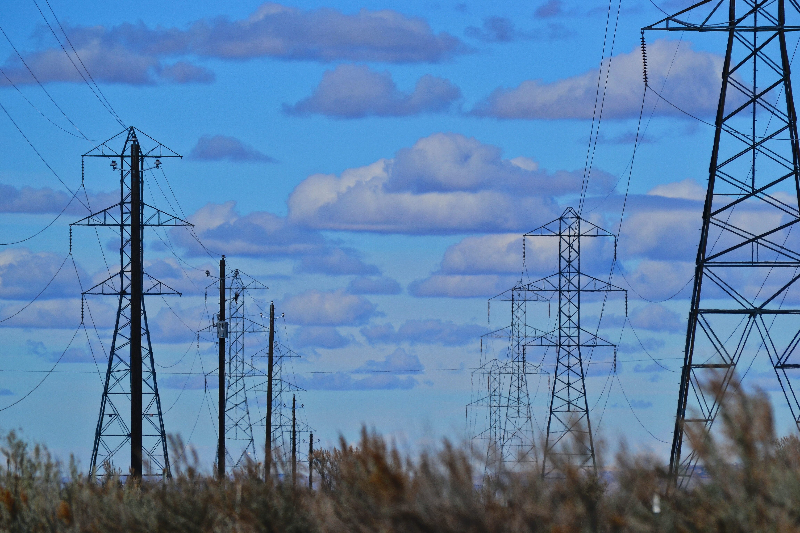
Table of Contents
Introduction
Electricity: The Energy We Need
What is Electricity Made of?
Nuclear Energy
Questions?

Slide 3
Introduction

Slide 4
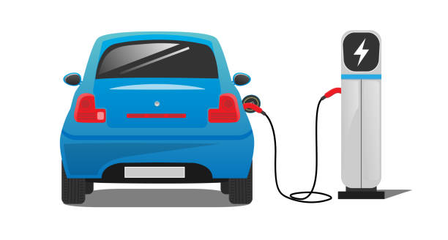
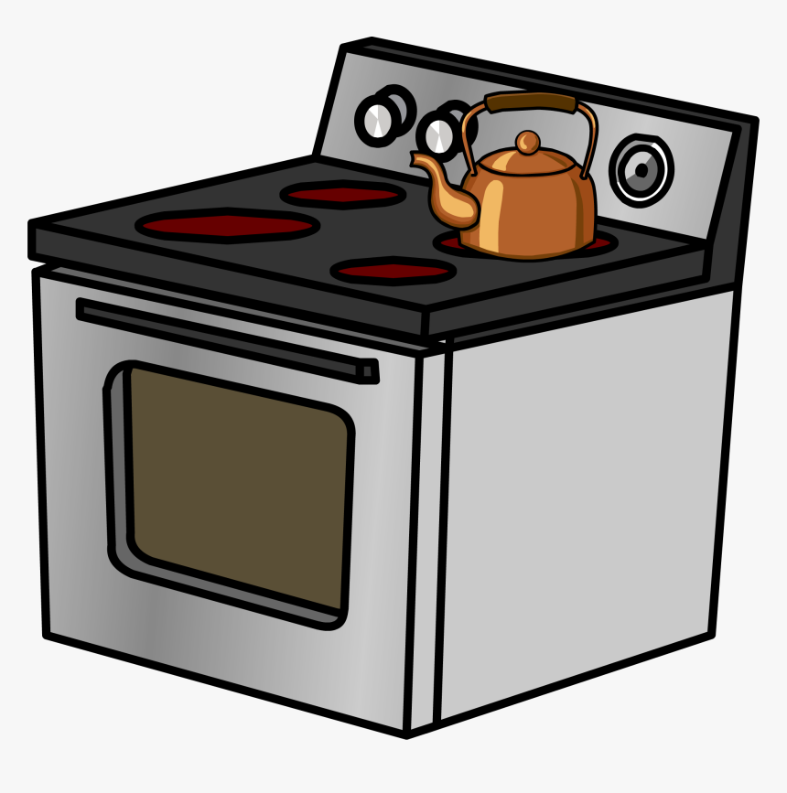
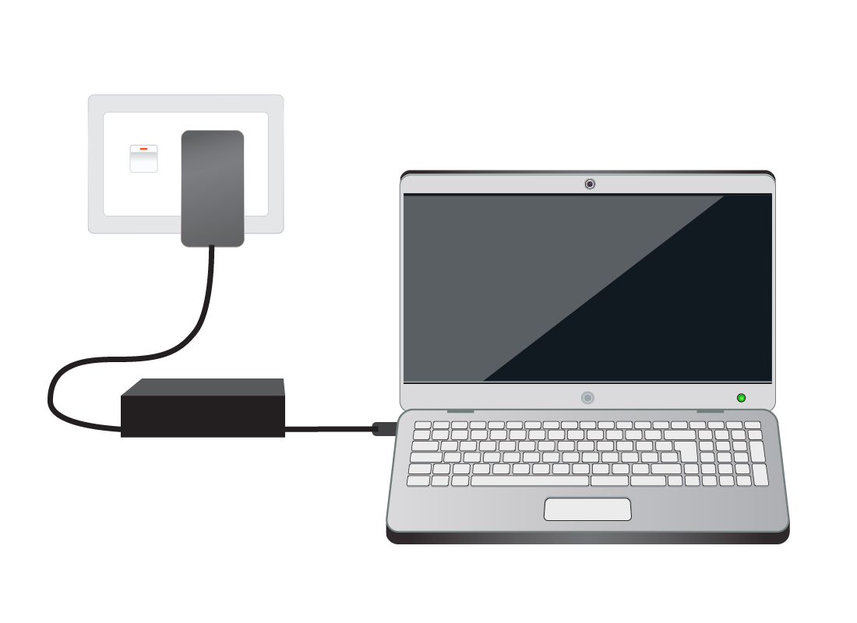
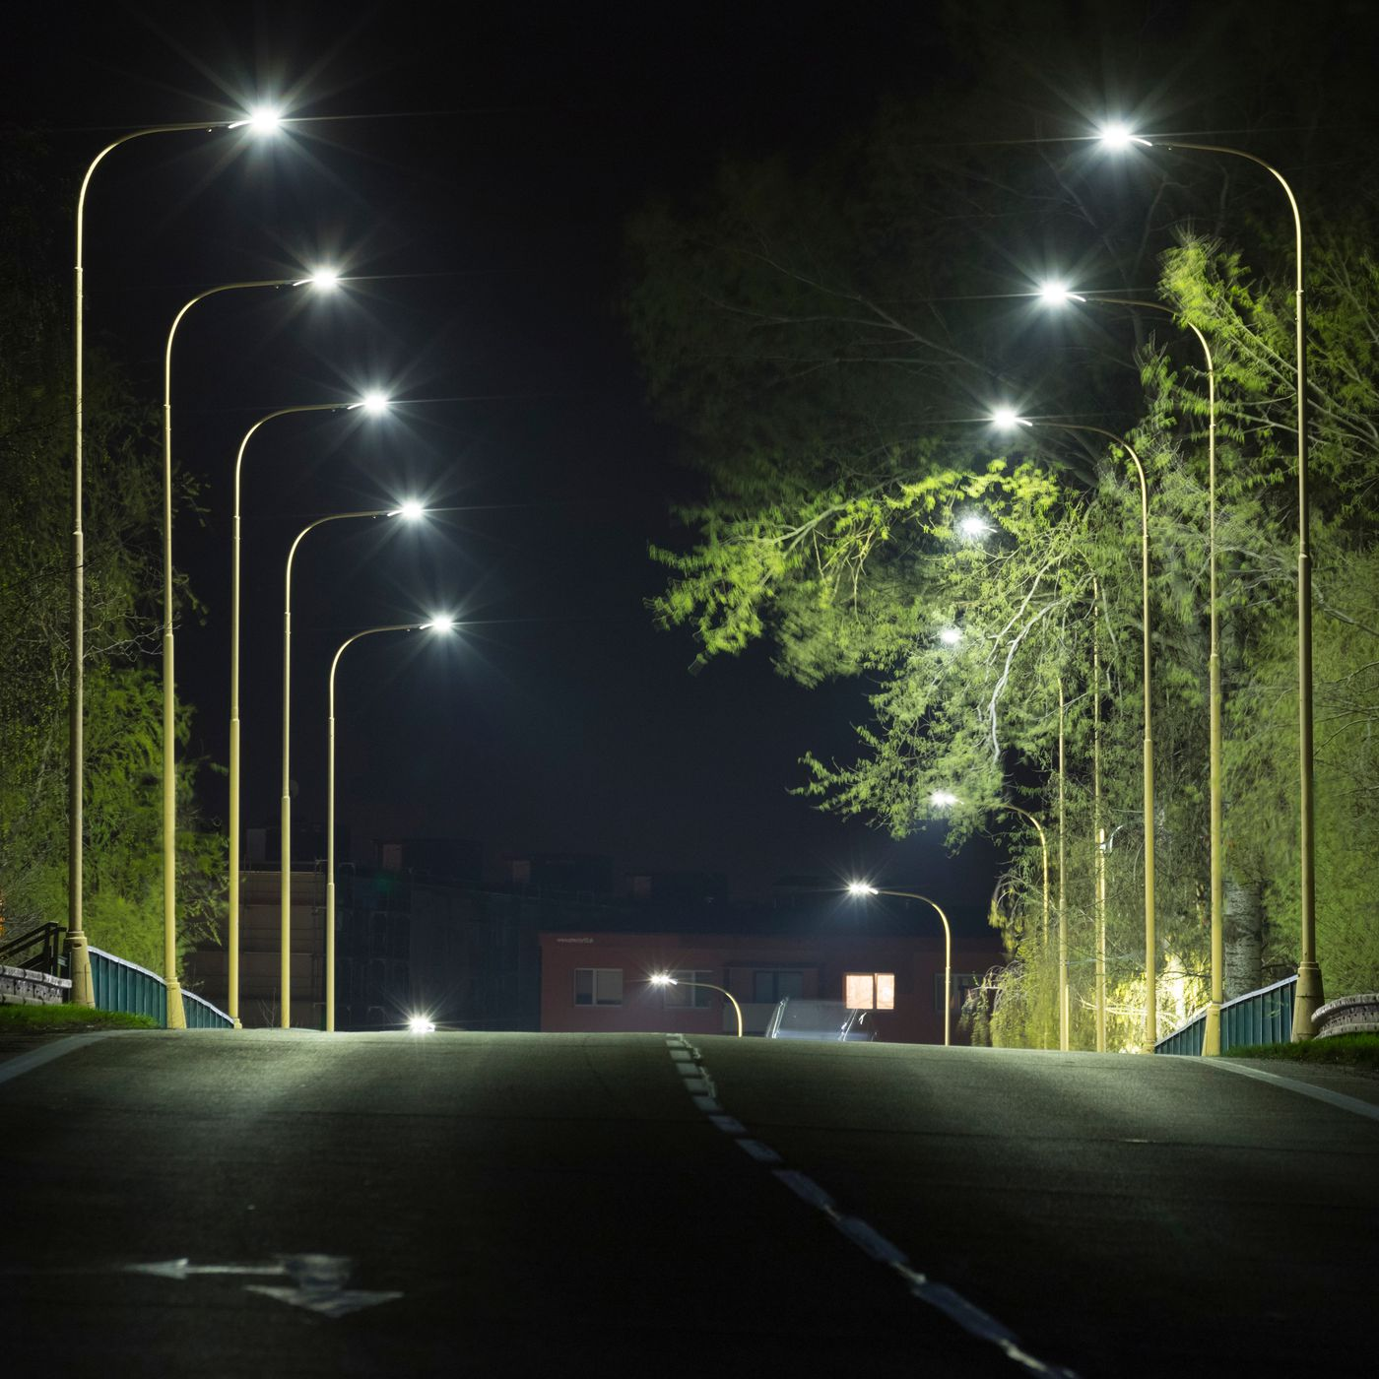
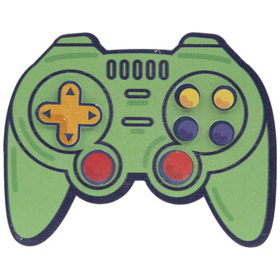
Welcome Future Nuclear Scientists and Engineers!
You will learn about electricity and how it powers our lives!
You will learn how machines make electricity!
You will build machines that make electricity!

Slide 5
Electricity: The Energy We Need

Slide 6
What is Energy?
We just learned that electricity is a kind of energy.
Energy is the power to put enough force on something to change it.
Energy exists all around us and even inside of us!

Slide 7
Types of Energy
Mechanical
Nuclear
Thermal
Chemical
Light (Radiant)
Electrical

Slide 8
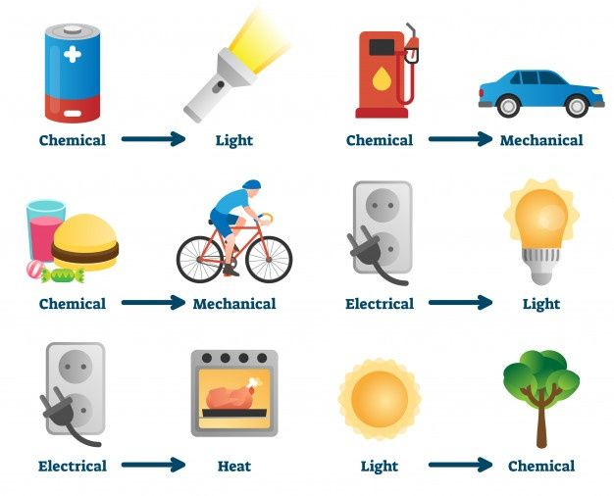
Changing Energy
Energy is not created or destroyed; only changed

Slide 9
What is Electricity Made of?

Slide 10
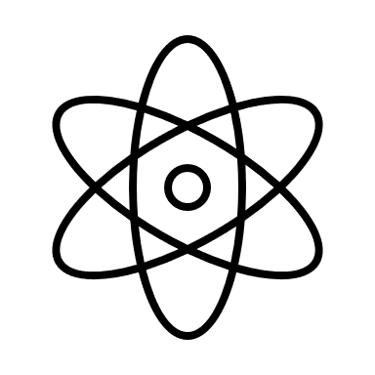
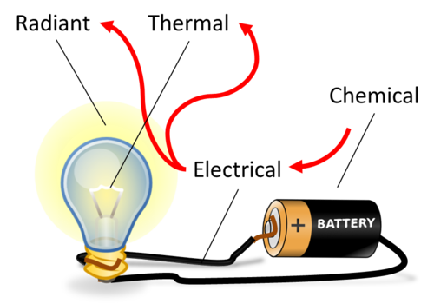
Understanding Electricity: What is It To You?
Atom
Electron
Not connected
Not connected
Connected!

Slide 11
Activity #1: Let’s Power Stuff!
Try to power an equipment:
Light motor (Project 1),
Fan (Project 2)
Horn (Project 6)
What happens when you switch direction of an equipment? What does it mean?
Red light / Yellow light (Projects 4 and 5)
Can you combine equipment? What do you notice?
Light and sound (Project 7)

Slide 12
Activity #2: How Does Electricity Move?
Try to make a circuit with:
Your body
Your friends
What happens when you add objects to your circuit? Why is that?
What about other stuffs? Water?

Slide 13
Activity #3: How Do You Make Electricity?
Can you make the clock work with a lemon? What does it mean?
Try other fruits / vegetables. Why do some work and others don’t?
Can you think of other ways to make electricity?

Slide 14
Nuclear Energy

Slide 15
The Smallest Thing
Atoms are the smallest piece of an element.
Atoms are made of protons (+), neutrons (0), and electrons (-).
The number of protons in an atom determines the kind of element.

Slide 16
Nuclear Power Plants
Nuclear power plants use a chain reaction to boil water to make steam
The steam is used to make a machine move, which generates electricity

Slide 17
Fusion: Makes Energy by Combining Atoms

Slide 18
Questions?

