Slide 1
General Session
October 2022
Notes:
Reminder to state the session(s) will be recorded

Slide 2
Why are we here?
Understand the program
Review program participant expectations

Slide 3
Program Charter
Mission
Vision
Achieve professional growth and leadership development through empowering relationships.
Provide knowledge and tools for mentees and mentors to be successful in leveraging relationships that foster career growth for individuals in the nuclear energy and technology fields. Develop solid relationships, interpersonal skills and business knowledge to drive organizational effectiveness and efficiency.

Slide 4
U.S. WIN GROW Mentorship Board
Margie Barnes: Duke Energy,
Corporate Functional Area Manager – Operations
Audrey Brown: DTE Energy, Senior Nuclear Instructor
Price Collins: Duke Energy, Nuclear Fuels Engineer
Angie Howard: Howard-Johnson Associates, President
Kath Kunz: PG&E, Nuclear Project Manager (Retired)
Miriam Matthews: Rensselaer Polytechnic Institute, Student
Summer Sims: Savannah River Site,
Project Controls Engineer- Project Management Construction Services
Dr. LaKisha White: INPO, Assistant Department Manager – Infrastructure Services
Sponsor: Margie Barnes (U.S. WIN Steering Committee)
Sponsor: Angie Howard (U.S. WIN Steering Committee)

Slide 5
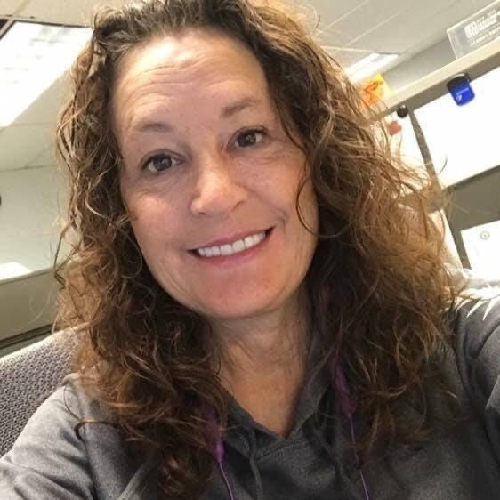
Who’s paired with who?
Pairings
GROW Sub-Group Liaison
Kadena Simpkins – Pam Reed
Denise Long – Stacey Hamm
Tianni Pierner – Summer Simms
Brandy Wark – Heather Winn
Alexus Hancock – Aimey Tregre
Audrey Brown

Slide 6
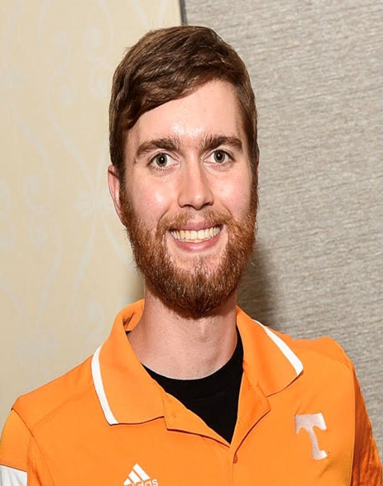
Who’s paired with who (cont.)?
Pairings
GROW Sub-Group Liaison
Hannah Moss – Laura Ekern
Danielle Dunigan – Juliann Edwards
Sophie Gutner – Carol Barajas
Amber Olbon – Leah Crider
Adrianna Luperico – Savannah Fitzwater
Price Collins

Slide 7
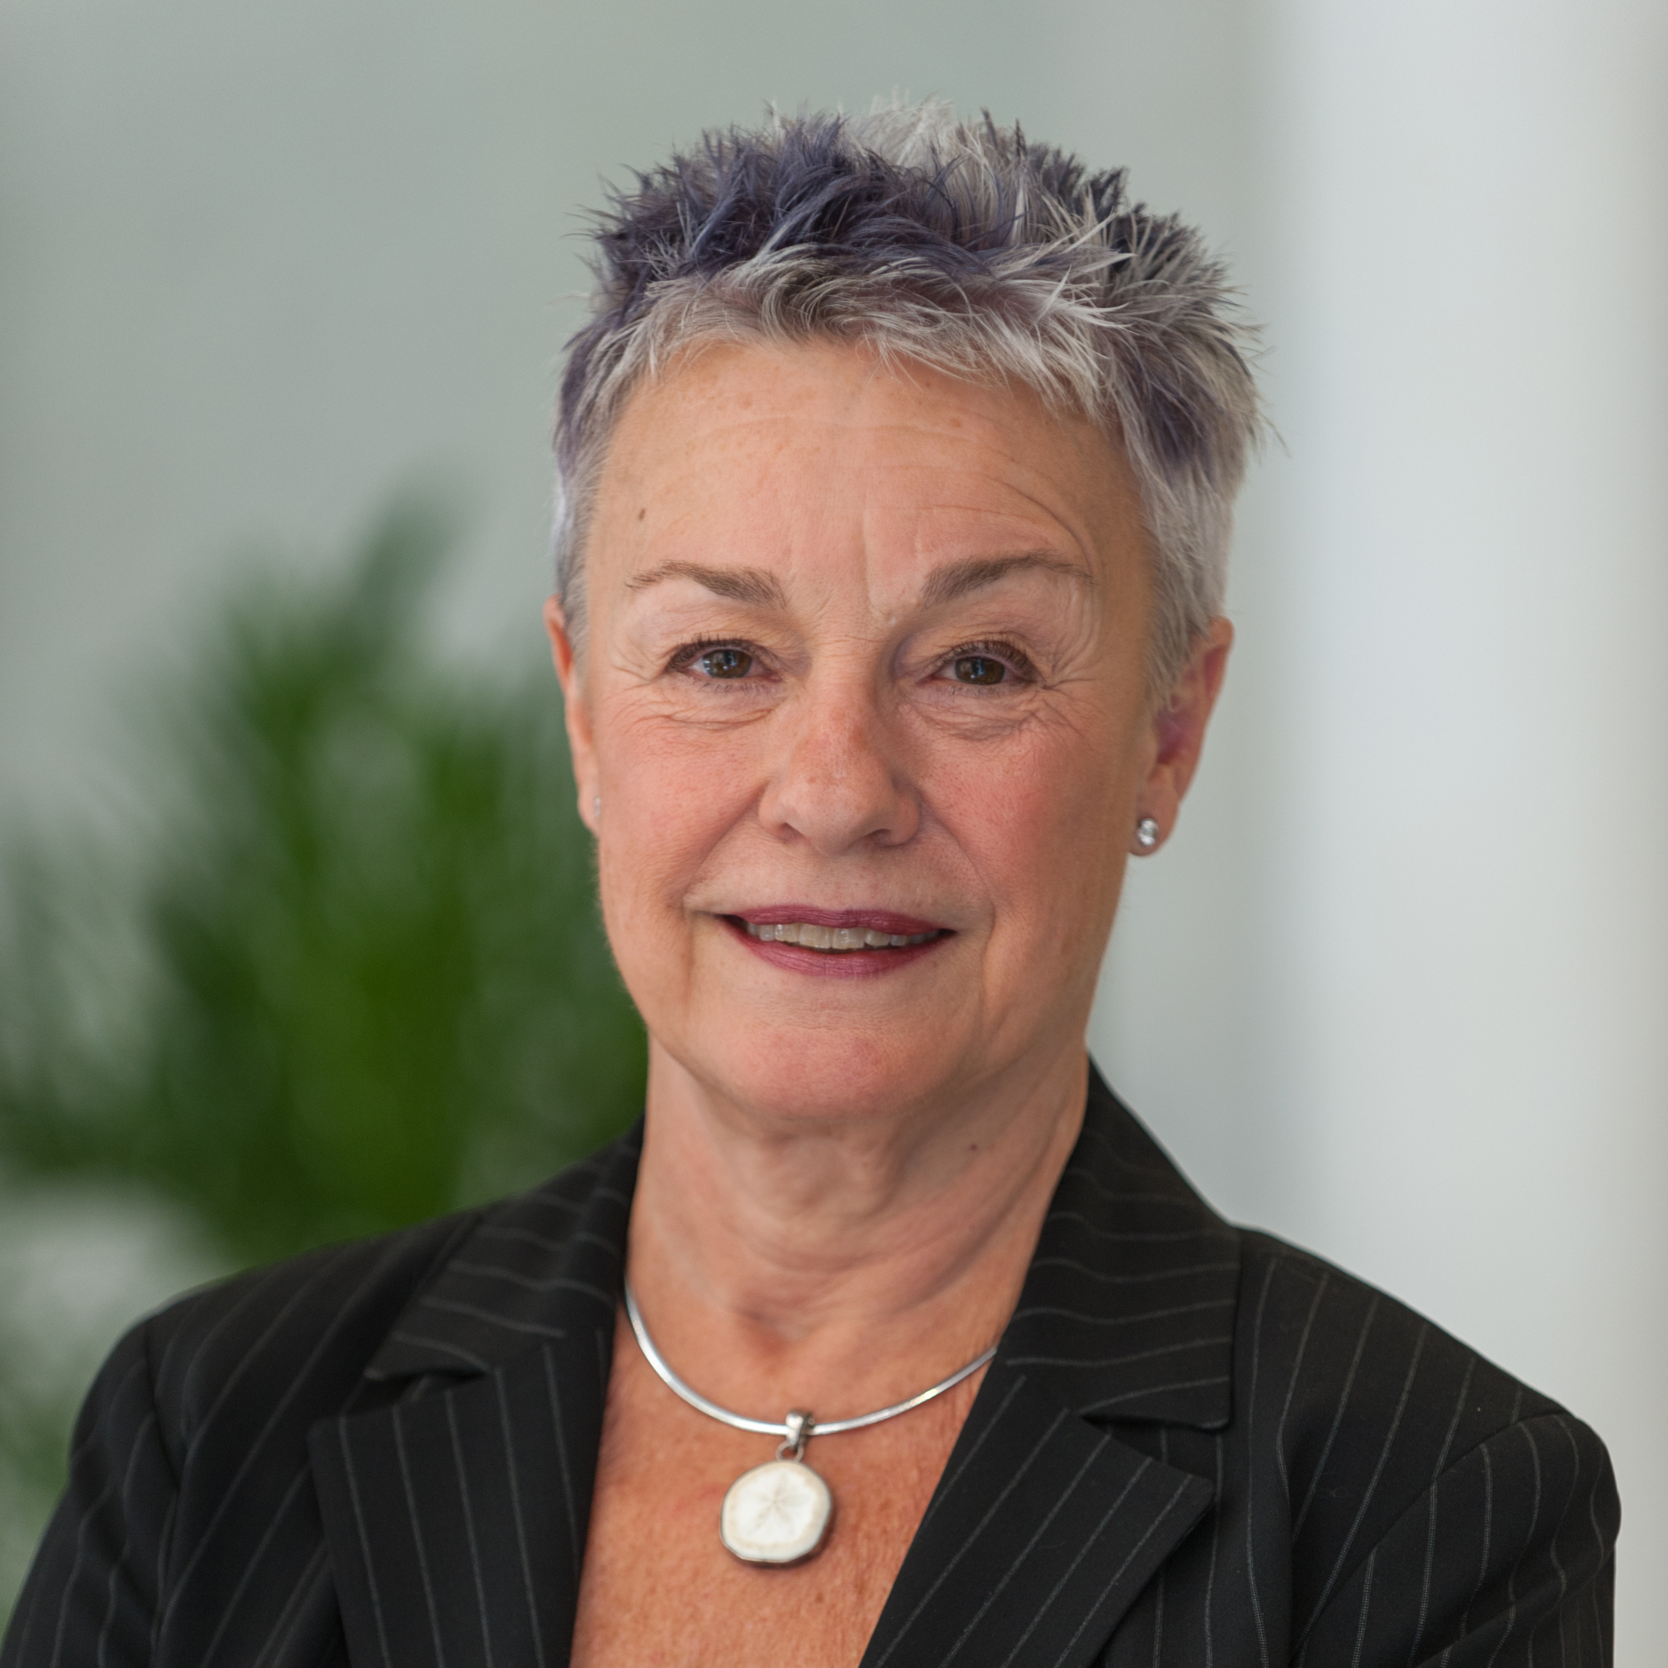
Who’s paired with who (cont.)?
Pairings
GROW Sub-Group Liaison
Karina Amsden – Mary Love
Savannah Tranchell – Greg Cameron
Emma Derr – Karen Williams
Alexis Schlotterback – Christine Csizmadia
Tiera Cate – Cristina Reyff
Angie Howard

Slide 8
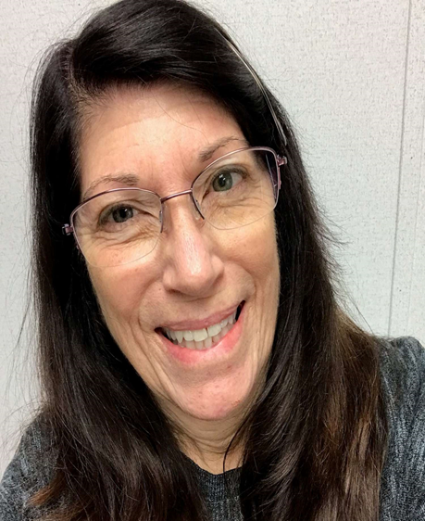
Who’s paired with who (cont.)?
Pairings
GROW Sub-Group Liaison
Crystal Slavens – Lisa Zurawski
Ju-Yuan Yeh – Carl Golightly
Ashley Ansolabehere – Maureen Zawalick
Brenda Garcia
Kath Kunz

Slide 9
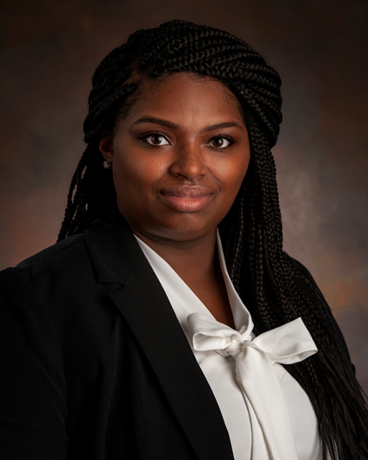
Who’s paired with who (cont.)?
Pairings
GROW Sub-Group Liaison
Joy Travis – Susan Baier
Hannah Pell – Lori Kelley
Xiaolan ‘Clair’ Song – Rebecca Oberlander
Summer Simms

Slide 10
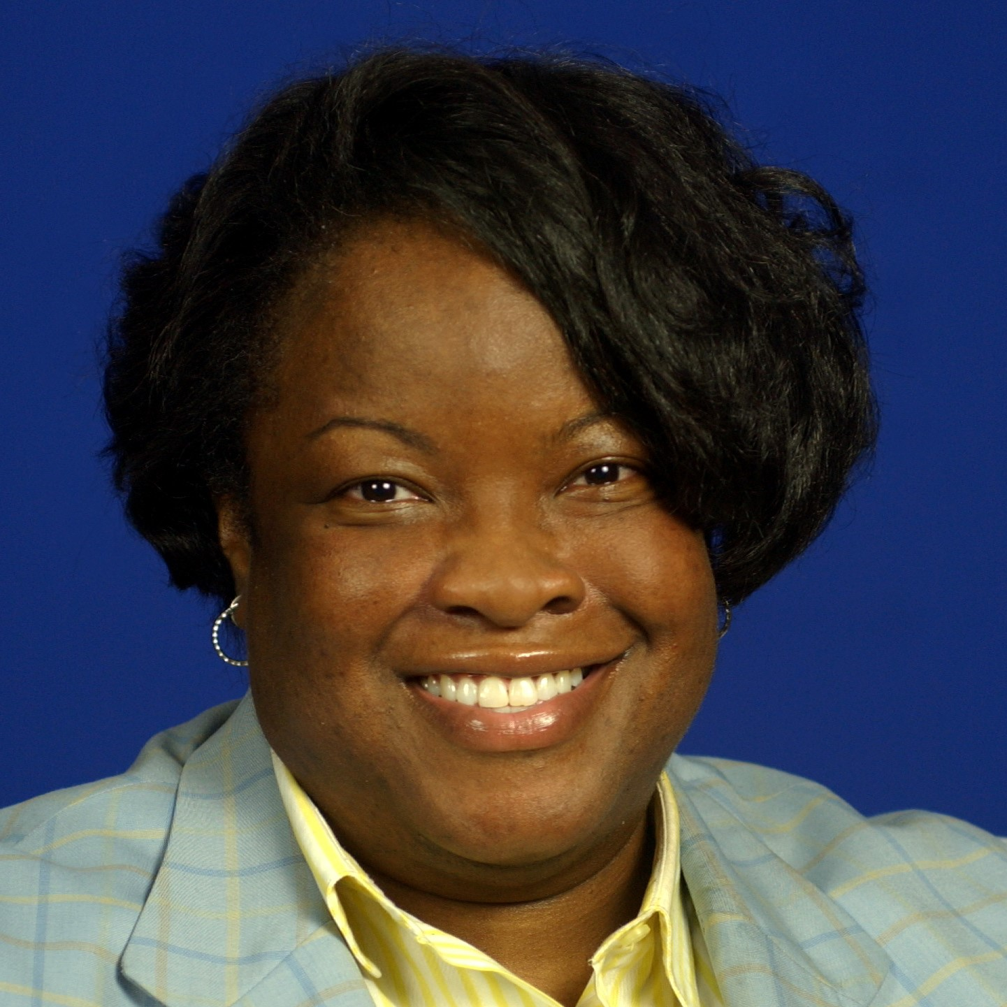
Who’s paired with who (cont.)?
Pairings
GROW Sub-Group Liaison
Taylor Bland – Donna Jacobs
TeShania Bey – Donna Philbeck
Catherline Kemmerlin – Valencia Flowers
Afreen Ali – Amanda Donges
Emily Tomlinson – Renee Meeks
LaKisha White

Slide 11
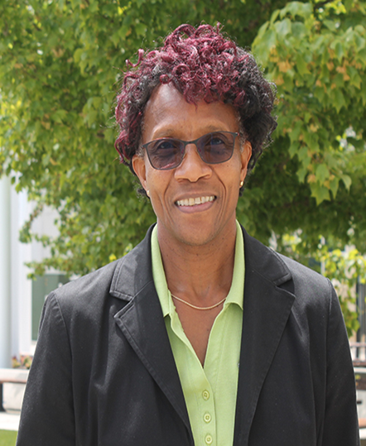
Who’s paired with who (cont.)?
Pairings
GROW Sub-Group Liaison
Sophronia Dorch – Jacqueline Stevens
Crystal Currie – Sylena Smith
Shawna Hughes – Nicole Flippin
Margie Barnes

Slide 12
What is GROW Mentorship?
The mentoring process is designed to promote career planning, job enrichment, and the guidelines for professional advancement.
Successful mentoring programs are recognized when they are mutually beneficial to both the Mentor and Mentee.
It is not a promotion guarantee.
Notes:
The U.S. WIN Mentoring program is a partnership designed to provide a forum for the exchange of knowledge, talents, material, and insights in a combined effort to nurture and enhance professional growth. The mentoring program will provide the mentees and mentors with the necessary tools to be highly successful in leveraging relationships that foster career growth for individuals in the nuclear energy and technology fields. The participants in the program also develop solid leadership and interpersonal skills.

Slide 13
The program was conceived in 2019, with the pilot carried out 2021-2022
The Program IS
The Program IS NOT
A compliment to any company mentoring or ‘emerging leaders’ program
Development for how to mentor and how to be mentored
Formal, yet flexible
Focused on personal and professional development
Monthly time commitment
A forum for sharing and learning
A replacement for any company mentoring or ‘emerging leaders’ program
A program where minimal commitment can be applied
Focused only on fun, and not personal and professional development

Slide 14
Short Video: The overlooked art of receiving feedback
Notes:
https://www.youtube.com/watch?v=jJVBMVllBww

Slide 15
Program Tips: Relationship and Behaviors
Imagine the mentoring experience you desire - commit to make it happen
"BE HERE NOW“
Have realistic expectations - share them with your mentor/mentee
Understand your role
Be receptive to learning - it's a two-way street
Get out of the office - take a real lunch (if possible, w/ proper COVID-19 precautions, if in close geographic proximity)
Celebrate success! Find ways to share successful moments together

Slide 16
Program Tips: Meeting Tips and Roles
Plan ahead now - create a schedule for meetings
Treat meetings as a priority
Prepare for every meeting
Mentees:
Set objectives
Bring a list of topics
Update on your follow-ups
Make a plan of action for the next meeting
Mentors:
Review prior meeting
Bring resources to meeting (e.g. books, workshops)
Takeaways from every meeting
Mentees: Document your meetings - write your ideas down
Mentors: Be sure to follow-up on your commitments

Slide 17
Time Commitment
12-months, w/ a minimum commitment of 1 hour per month with your mentor/mentee
This does not include time to prep for meetings/review materials/etc.
Monthly touchpoints with your subcommittee team lead
Three full program meetings
Flexibility will be essential for this to succeed!

Slide 18
General Discussion
Feedback is essential for program health and moving forward
We would like input on a communications platform (WhatsApp, Slack, etc.)
Notes:
Bring up to participants to speak up if they feel a pairing is not going well/time commitments/job changes

Slide 19
Questions?
We will now split up into Mentor specific and Mentee Specific sessions
The Mentees will stay on this meeting, and the Mentors will join their specific meeting
We will NOT be rejoining a combined meeting afterwards.

