Slide 2
Resume Building for Success
Michelle Gilchrist, Palo Verde Human Resources Manager
Sarah Schroeder, Palo Verde Human Resources Talent Acquisition Leader
Dru Barisich, Palo Verde Leadership Training & Development Program Manager

Slide 3
Reflecting & Discussion
When is the last time you updated your resume?
Are you familiar with your company’s core competencies?
Are you familiar with your company’s interviewing process?

Slide 4
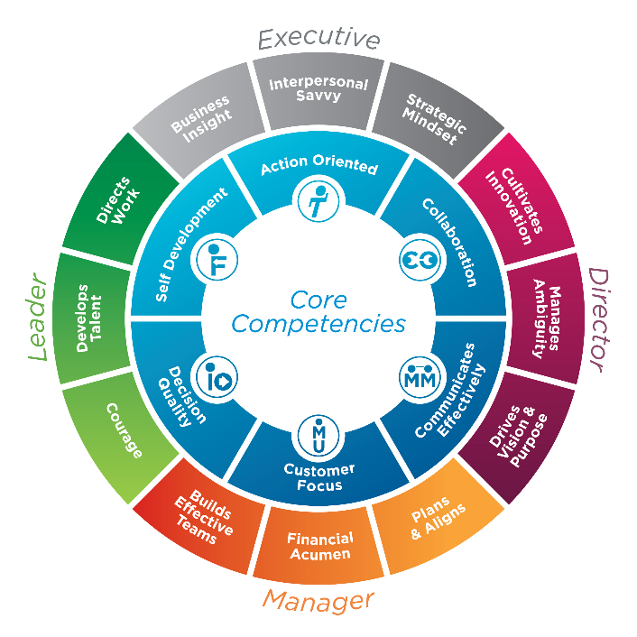
APS Competency Framework
Why are “Competencies” important to building an effective Resume?
Notes:
The APS Competency Framework has 6 core competencies and an additional 3 competencies for each level of leadership for a total of 18 competencies.
Why are “Competencies” important to building an effective Resume?

Slide 5
APS Competency Framework Let’s Play Taboo
Watch
Look
Time
Wrist
Clock
Wear
Notes:
To help you understand how to apply your Company’s Competencies, Values, Principles, etc. we’re going to play the game of Taboo.
The objective of the game is for the Receivers to guess the words (in blue) without the Clue Givers saying the blue Guess Words or black Taboo Words. Clues may be sentences, phrases or single words. The clues may not include any part of the blue Guess Words or black Taboo Words.
For example:
If PAYCHECK is the Guess Word, neither PAY or CHECK can be given as a clue.
If DRINK is a Taboo Word, DRUNK cannot be given as a clue.
Using this card, how do you get your team to say WATCH without saying the Guess Word WATCH or any of the Taboo Words LOOK, TIME, WRIST, CLOCK or WEAR?
A clue might be: When my husband and I go out for a date night, we need someone to OBSERVE the kids. What’s another word for “OBSERVE”

Slide 6
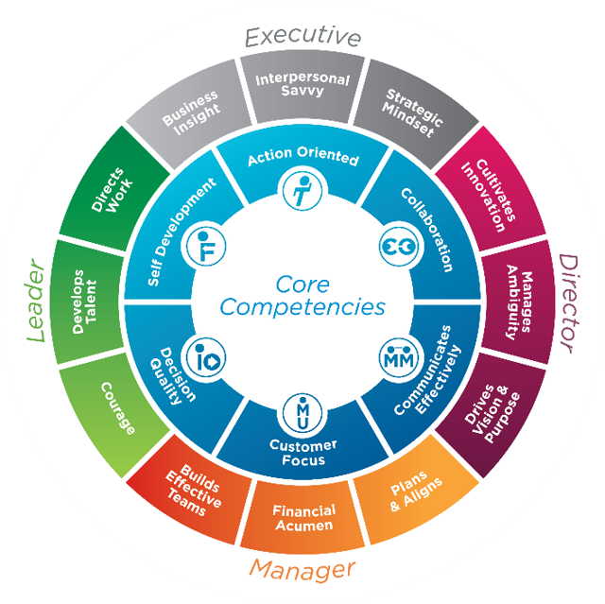
APS Competency Framework Let’s Play Taboo
Action Oriented
Proactive
Aggressive
Ambitious
Practical
Motivated
Notes:
Using the APS Competencies, the objective of this game of Taboo is for the Receivers to guess the Competency Words (in blue) without the Clue Giver saying the blue Competency Words or any of the black Taboo Words.
Rules for this game:
Facilitator (person running the presentation): Sound the buzzer and applause buttons.
Clue Giver:
The clues may be sentences, phrases or single words.
The clues may not include any part of the Competency or Taboo Words. For example:
If the Competency is SELF DEVELOPMENT, the Clue Giver cannot say SELF or DEVELOPMENT or any form of the words, such as DEVELOP.
If a Taboo Word is TRAINING, the Clue Giver cannot say TRAINING or any form of the word such as TRAIN.
Any clue given that has the Competency or Taboo Words will result in the Taboo Buzzer being sounded when clicked on (by the Facilitator).
NOTE: The Taboo Buzzer will always sound when clicked on. It is not animated.
Clue Receiver:
Any answer other than SELF DEVELOPMENT would be incorrect and the Taboo Buzzer would be sounded for any incorrect answers when clicked on (by the Facilitator).
When the correct answer of SELF DEVELOPMENT is given, the Clapping Hands Applause Button would be sounded when clicked on (by the Facilitator).
NOTE: The Clapping Hands Applause will only sound one time after being clicked on unless the animation is duplicated.
Using the APS Competency ACTION ORIENTED for this game:
Clue Giver: Cannot use the Competency Words ACTION ORIENTED, or Taboo Words PROACTIVE, AGGRESSIVE, AMBITIOUS, PRACTICAL, MOTIVATED.
Example Clue: Get things done when needed; takes immediate initiative to start accomplishing tasks; doesn’t hesitate to start working on something; takes on new opportunities with enthusiasm and energy.
Game Winner: First person to come off mute or type the correct answer into the chat wins.
To customize this slide:
Replace the APS Core Competencies graphic with your Company’s Competencies, Values, Principles, etc.
Replace the words in the “Action Oriented” Taboo Card with your own words.

Slide 7
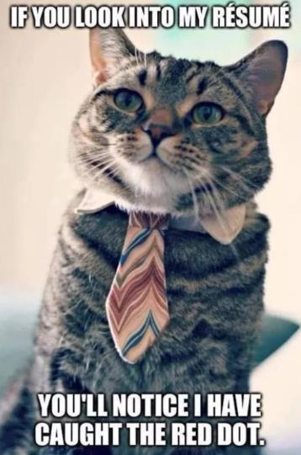
An Effective Resume…
What do you think an Effective Resume looks like?
Source: imgflip.com
Notes:
What do you think an Effective Resume looks like?
Put your thoughts in the chat.

Slide 8
An Effective Resume…
Is concise, accurate account of your experience and qualifications
Makes a positive impact within seconds
Qualifies me for the job
Is easy to scan
Differentiates you from others
Reflects your personal brand
Insights curiosity
Has curb appeal
Showcases accomplishments and results
Shows progression, leadership and initiative
Gets you the interview!

Slide 9
Resume Styles
Candidates seeking a job similar to their previous positions
Students and entry-level candidates
Academic resumes
Creative jobs where a portfolio matters most
Military transitions
Candidates who don’t want to seem overqualified
Seasoned professionals targeting a specific position
Career changes
People with employment gaps
Source: sety.com

Slide 10
Objective vs. Summary
Use an Objective if:
You are starting out or entering the workforce.
You are returning to the workforce after an extended absence.
You are changing careers or industries.
Use a Summary if:
You have several years of experience in the sought-after position.
You have established qualifications.
You have skills matching employer requirements.
Skip both if:
You don’t want one.
You don’t need one for your industry or job.
You have limited resume room to focus on skills and experience.

Slide 14
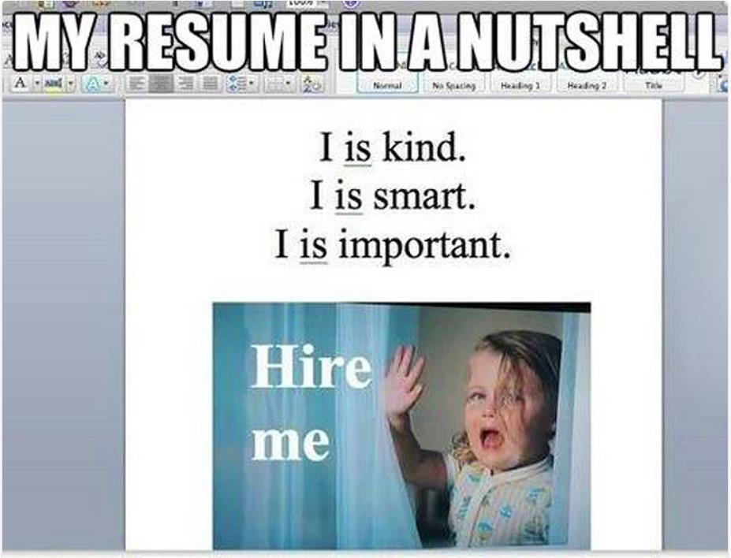
Resume Don’ts
Source: starecat.com

Slide 15
Resume Don’ts
Don’t Steal the Job Description’s Exact Wording
Don’t Include Anything Confidential
Don’t Include Your Picture (or Family Picture)
Don’t Use Clichés or Jargon
Don’t Send it as a Word Document
Don’t Forget to Spell Check

Slide 16
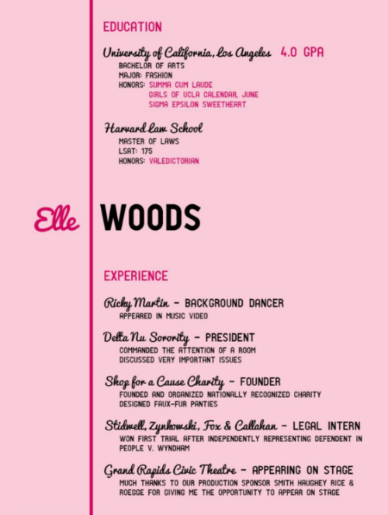
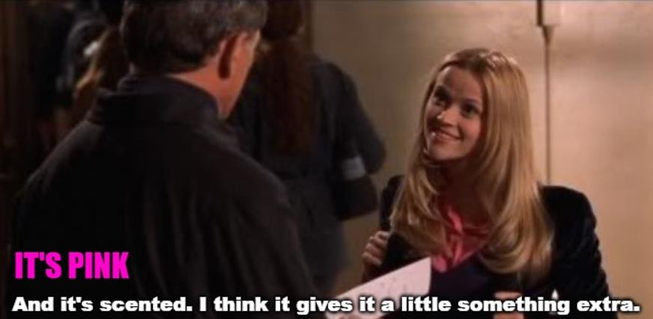
Rate this Resume
Sources: imgflip.com & http://www.caitlincheevers.com

Slide 17
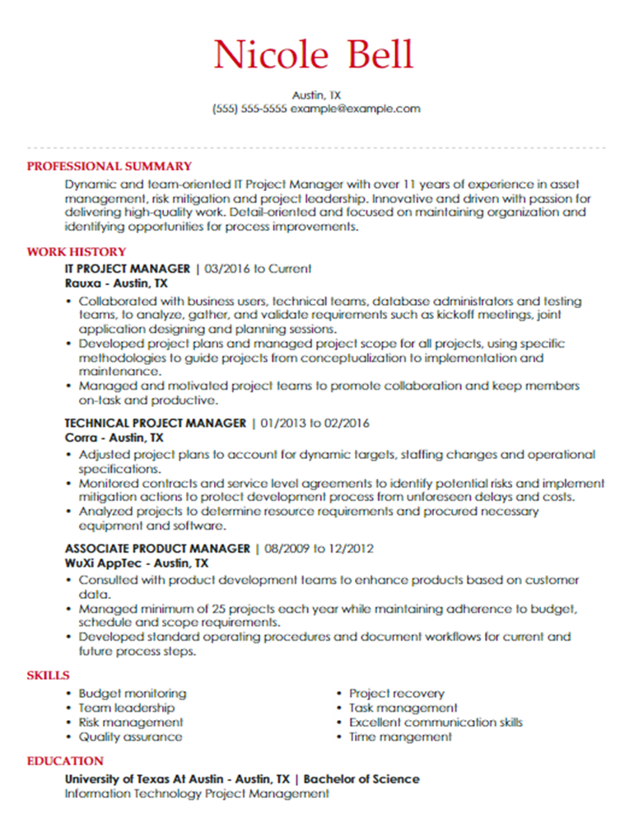
Rate this Resume
Source: livecareer.com

Slide 18
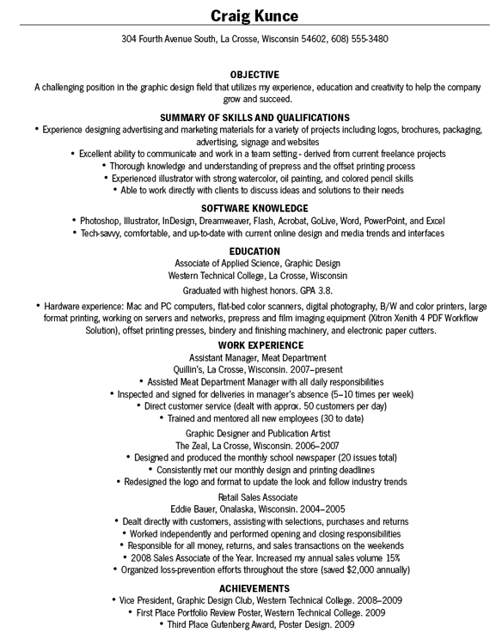
Rate this Resume
Source: craigkunce.com

Slide 19
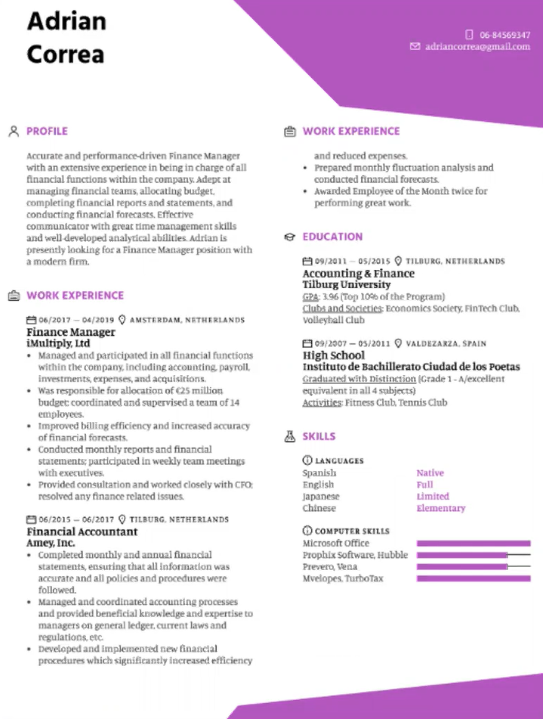
Rate this Resume
Source: https://www.kickresume.com

Slide 20
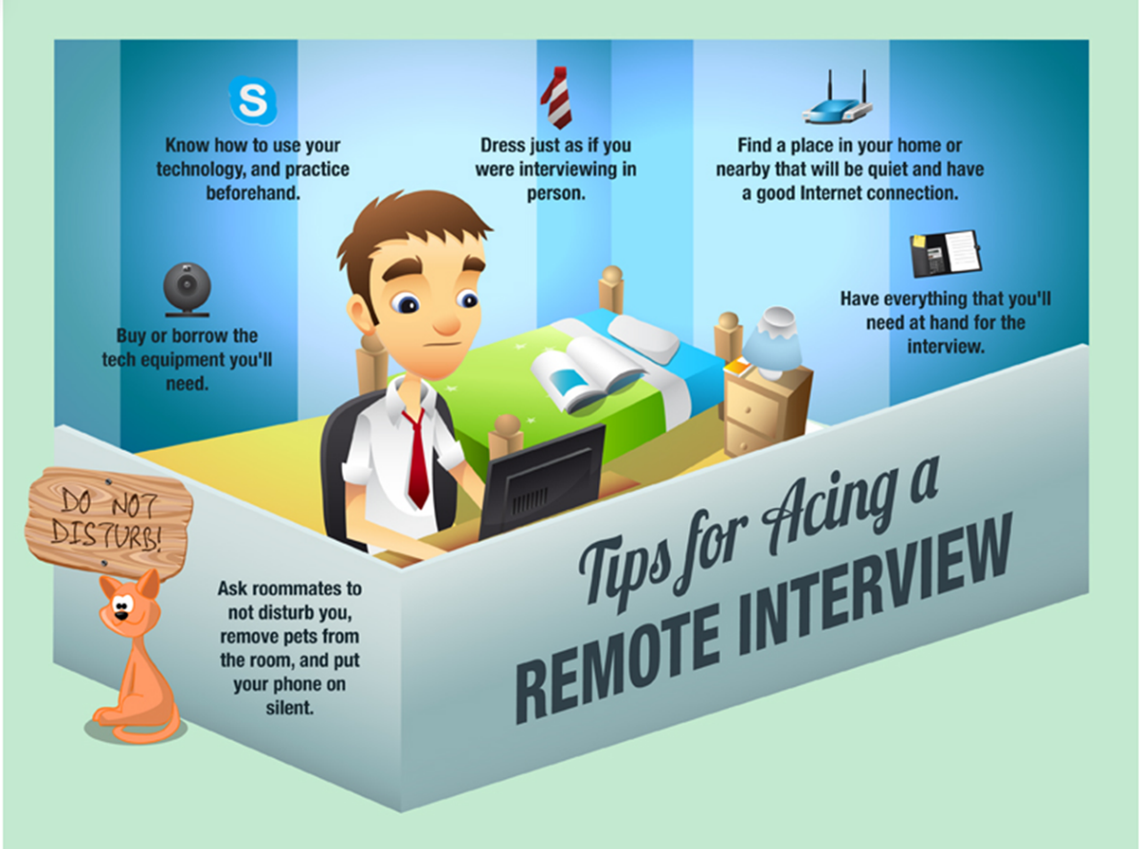
Remote Interviews: The “New” Normal
Source: youtern.com

Slide 21
Thoughts, Comments, Ideas, Aha Moments, Questions?

