Slide 1
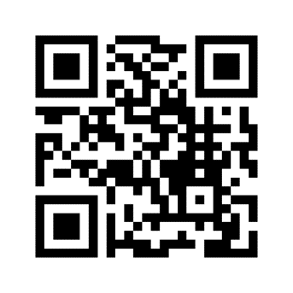
In a few words: What communication skills do you need to development? Or, what scares you about communicating?
Let’s connect.
Notes:
Insert a QR Code or Link to a Word Cloud app such as menti.com or polleverywhere.com.

Slide 2
Design your message
Present to your audience
Run the meeting

Slide 3
Tailor your message
Notes:
Do you want to tell the off the rack – one size fits all – story?

Slide 4
Tailor your message
Notes:
Or do you want a message that’s perfectly tailored to your audience?

Slide 5
Know your customer Who will be there? Who makes the final decision?
Find their style Do a little research Read the room and react
Make it fit Small tweaks, big impact Be ready to make quick cuts
Tailor your message
Notes:
Like your suit, your message should be perfectly tailored to your audience.

Slide 6
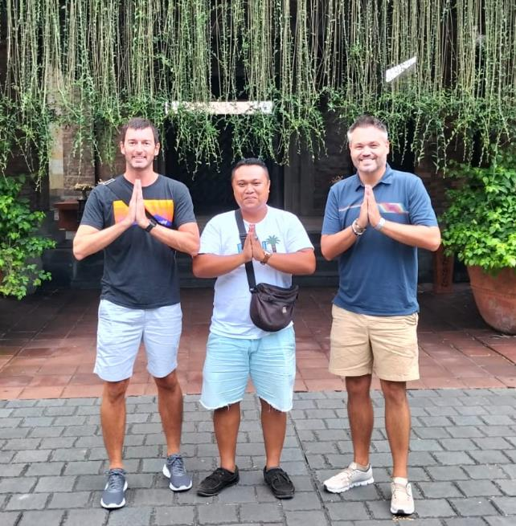
Guide your audience
Notes:
Change the picture. Insert one that expresses your guided tour and tell a story about it.

Slide 7
Choose a destination Where do they want to go? What do they need to see?
Speak their language Introduce new terms and jargon only when you must.
Curate the experience Better to make a few lasting points rather than to overwhelm.
Guide your audience
Notes:
Correlate your guided tour to the audience you’re speaking to.

Slide 8
Host the show

Slide 9
adapt | balance | connect

Slide 10
What did you notice?
Banter and business
Fluid connection to various audiences
Energy + excitement!
Notes, but no script
They can’t all be winners
Notes:
Did your audience see the some of the key connections between the hosts and audience?

Slide 11
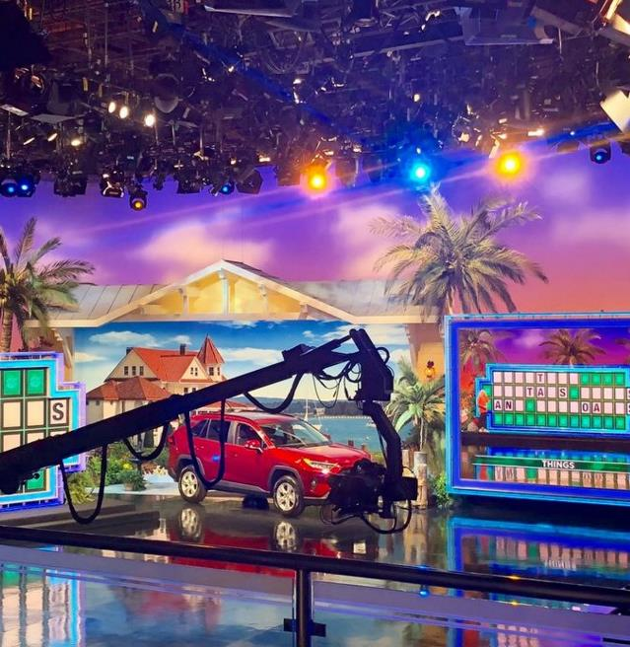
Host the show

Slide 12
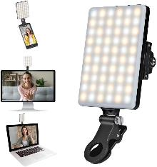
Windows in front of you, not behind
Invest in one of these
Test and adjust camera settings
Lights Camera Actions
Notes:
Invest in the right lighting for virtual meetings. This is a clipon light for your monitor, laptop screen or phone.

Slide 13
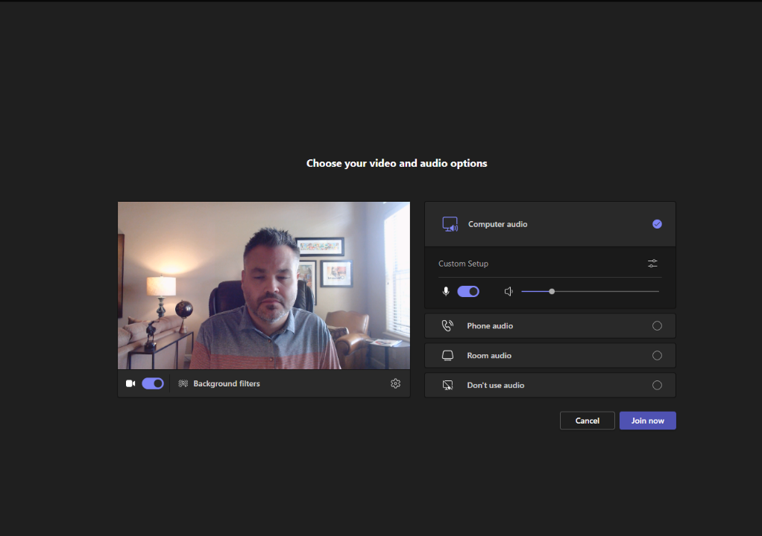
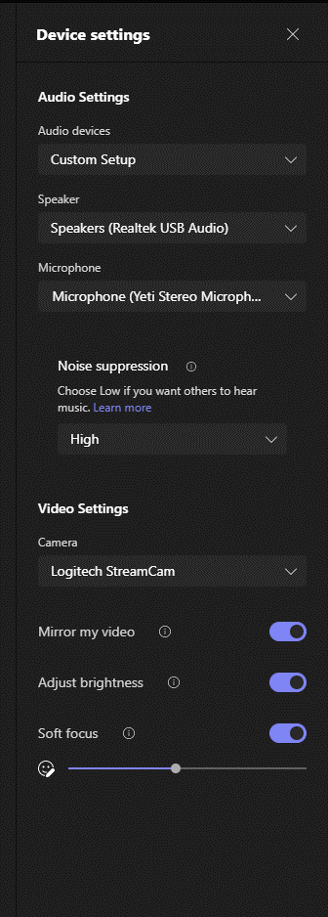
Notes:
Check the settings on your virtual platform to improve the quality of your videos.

Slide 14
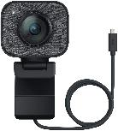
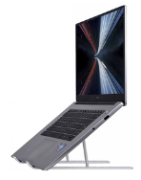
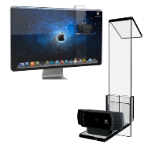
Get a good camera
Lights Camera Actions
Find your best angle
Keep eye contact
Set the scene
Notes:
Invest in a good camera and laptop stand.
Keep eye contact with your audience. If seeing yourself when presenting virtually is a problem, close the platform screen. Your audience can still see you. And if you need notes to present, bring them up on your monitor. Your audience can’t see them.

Slide 15
Notes:
Change the picture to one that represents you and your company.
Talking Points:
It’s time to stop using your virtual platform backgrounds or blurred backgrounds.
We’ve been holding virtual meetings for over 2 years now. We can tell.
So, if you’re working remotely, set up your home office and have a background that shows off your company, your business and your profession.

Slide 16
Need a script? Please, rethink that. Don’t print it out. Put it on the screen. Budget teleprompter!
Nervous? Minimize the meeting. It’ll be like no one is there.
Lights Camera Action

Slide 17
Enough already. Let’s chat.

Slide 18
Enough already. Let’s communicate.

Slide 19
Enough already. Let’s connect.

