Slide 2
Behavior Based Interviewing Techniques for the Candidate and Interviewer
Michelle Gilchrist, Palo Verde Human Resources Manager
Sarah Schroeder, Palo Verde Human Resources Talent Acquisition Leader
Dru Barisich, Palo Verde Leadership Training & Development Program Manager

Slide 3
Reflecting & Discussion
When is the last time you completed an interview?
How did you feel going into your interview?
What worked well and/or could have gone better during your interview?
Do you ask for feedback after the interview process?

Slide 4
Behavior Based Interviews
The best predictor of future performance is past performance.
Qualities of Effective Behavior Based Questions
Focus on abilities and attributes important to job success
Focus on the candidate’s past experiences
Focus on the “you” pronoun; not we or they…
Focus on singular events
Are open-ended
Notes:
In Behavioral Based Interviews the panel wants to know about the candidate’s abilities and attributes, their past experiences, and how they delt with an event.

Slide 5
Behavior Based Interview Questions
Examples:
Tell us about a time when…
Give us an example of…
Describe for us the steps you took to…
Notes:
Behavior based questions are those that focus on how the candidate has handled specific situations and had to apply or utilize certain skills in the workplace. They are used to evaluate the candidate’s responses to competency-based questions, and they also help predict future behaviors - good or bad – so employers can make informed decisions
Source: https://www.persegroup.com/blog/2017/07/4-reasons-to-use-behavioral-interviewing?source=google.com

Slide 6
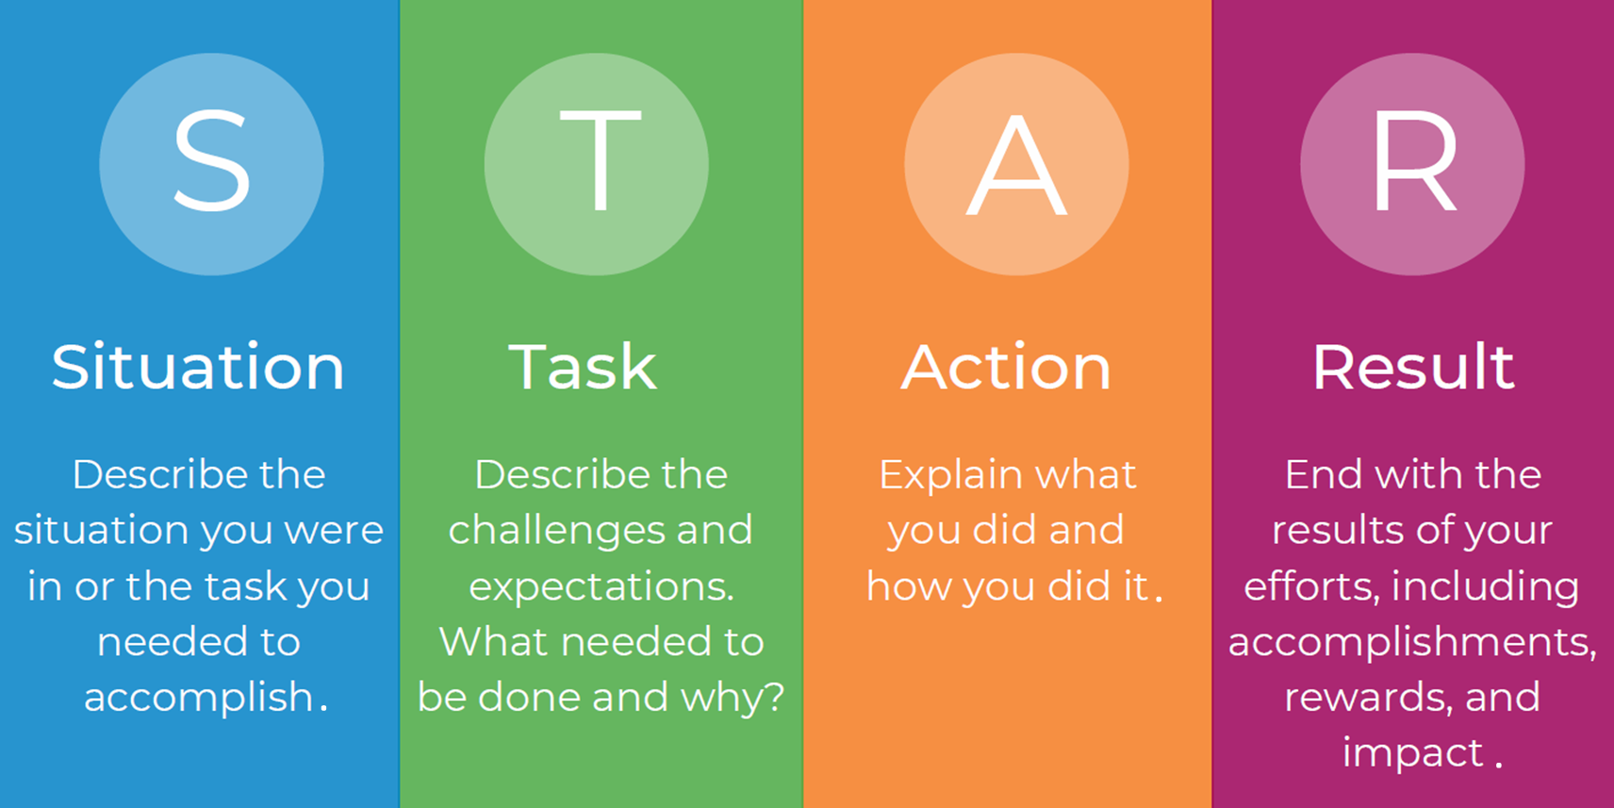
How to Respond to Behavior Based Questions
Successful candidates use the STAR model.
Notes:
Situation/Task. Explains the context, challenge, problem, issue, project, performance objective or opportunity.
Action. What the candidate or his/her team did to solve the problem, move forward with the project or meet the performance objective.
Result. The outcome. Can be quantified using numbers to demonstrate impact (e.g. % improvement, $ saved or generated, measure of progress) or quality response (e.g. identified and corrected design deficiencies that improved effectiveness).
Reflection. What the candidate learned or if he/she could go back would do differently

Slide 7
Definition of a Competency
Observable and measurable behaviors
that contribute to workplace effectiveness
and career success.
Competencies determine how we do our jobs and accomplish our goals.

Slide 8
Korn Ferry Global Competency Framework

Slide 9
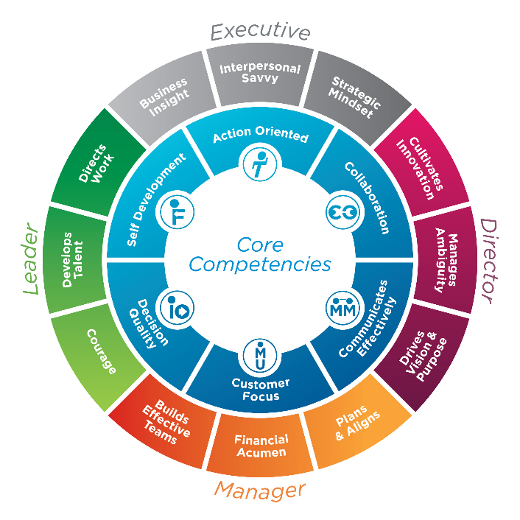
APS Competency Framework
Notes:
Core: Action Oriented, Collaboration, Communicates Effectively, Customer Focus, Decision Quality, Self Development
Leader: Courage, Develops Talent, Directs Work
Manager: Plans and Aligns, Financial Acumen, Builds Effective Teams
Director: Cultivates Innovation, Manages Ambiguity, Drives Vision & Purpose
Executive: Business Insight, Interpersonal Savvy, Strategic Mindset

Slide 10
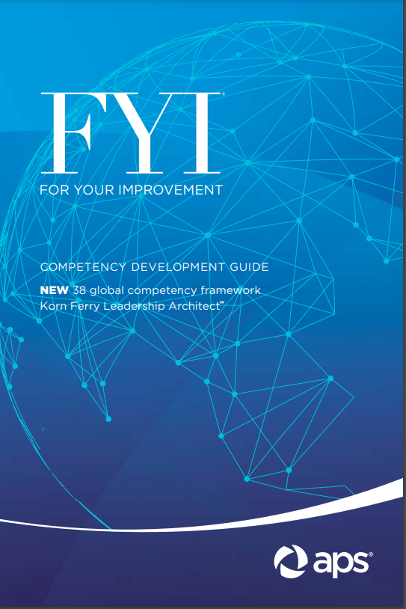
For Your Improvement “FYI” Book

Slide 11
Behavior Based Interview Questions Time to draft your responses using the STAR Model.
Communicates Effectively. Tell me about a time when you read between the lines and were able to shift your behavior based on what the other person needed from you or the situation.
Action Oriented. Describe a situation when you had to take initiative and even go outside the expectations of your role to deliver outstanding results to a customer.
Self Development. Give an example of the best and most helpful piece of constructive feedback you've received in your career.
Collaboration. Tell me about a time you worked to resolve conflict with a peer. How did you approach the situation?
Notes:
10-minute exercise.
Select one of the questions and draft a response in the STAR format.

Slide 12
Notes:
STAR:
- Situation: Describe the situation you were in or the task you needed to accomplish.
- Task: Describe the challenges and expectations. What needed to be done and why?
- Action: Explain what you did and how you did it.
- Result: End with the results of your efforts, including accomplishments, rewards and impact.

Slide 13
Interviewing Challenges Experienced by the Candidate
Time Pressure
Social Expectations
Process and Logistics
Notes:
Time Pressure: All candidates feel the time pressure of responding quickly to the question. The panel knows what you’re going through so take the time to answer the question using STAR. It’s ok to skip it and come back, take a few seconds to collect your thoughts or look at your notes. Behavior Based Interviews are typically an hour.
Social Expectations: Focus on you and the examples (situations/tasks) prepared, not how you think the interviewer wants you to respond. Use your notes. Jot down your thoughts.
Process and Logistics: Understand there is a lot of coordination that goes into scheduling interviews (your schedule, the interviewers’ schedules, who are from a number of different departments, etc.)

Slide 14
Interviewing Challenges Experienced by the Interviewer
Time Pressure
Decision Pressure
Ambiguity
Social Expectations
Process and Logistics
Notes:
Before you even sit down with a candidate and ask your first question, there are a variety of factors that combine to make interviewing a less than easy practice.
Time pressure exists in both the micro and macro sense. On the small scale, the amount of time you have to speak with someone and gather meaningful information is often very limited. On a larger scale, the pressure to fill positions, particularly those that have been open a considerable time, also exists.
Decision pressure is also present. The higher the level the position is, and the higher the salary, the more that the pressure tends to weigh on making a good call.
Ambiguity is a given. You’re not going to learn everything you need or want to know. But by using a standardized, structured approach, you can get much closer to learning what you need to know about candidates. However, you need to be able to deal with loose ends.
Social Expectations, both parties want to look good to the other. Each person in the interview often concentrates on telling the other what they think they want to hear and acting the way they think they’re supposed to act. As a result, a distorted image can form on both sides.
Process and Logistics accompanying interviews can often be a complicating factor – managing schedules, timing of interviews, coordination, and consistency can all be a challenge. Again, a standardized, structured approach is most helpful.

Slide 15
Common Mistakes Made by the Candidate
Lack of preparation
Insufficient data gathering
Making too much of a negative
Overemphasizing the fit
Focusing on irrelevant criteria
Providing too little information
Graphic Source: VectorStock.com
Notes:
Here are some of the areas that candidates tend to veer off track and suggestions to avoid the mistakes:
Lack of preparation: Take the time to review the job description and competencies required and develop your responses using the STAR model. Have enough examples based on the competencies in the job description. Have a mock interview with a friend, co-worker or mentor. If it’s a remote interview, practice the interview in a virtual environment
Insufficient data gathering: Understand the position you are interviewing for. Know the company, department and position leader and interviewers (if possible).
Making too much of a negative: Turn the negative situation into a positive. Apply lessons learned.
Overemphasizing the fit: Make sure you’re not forcing answers or overemphasizing what you think the panel wants to hear.
Not presenting the results: Don’t be too vague or generalize your response. Make sure to not only explain the situation, but how it was resolved.
Focusing on irrelevant criteria: Don’t get hung up on minor parts of the position. Stay focused on your examples and avoid sharing irrelevant (or too much) information.

Slide 16
Common Mistakes Made by the Interviewer
Lack of preparation
Insufficient data gathering
Making too much of a negative
Overemphasizing fit
Focusing on irrelevant criteria
Overweighing first impressions
Providing feedback during the interview
Graphic Source: VectorStock.com
Notes:
Here are some of the areas that interviewers tend to veer off track:
Lack of preparation: Not having clearly defined competencies for the position and an understanding of them, which leads to “winging it. Follow a planned, disciplined, consistent, standardized, interview procedure.
Insufficient data gathering: There may be a number of candidates so it’s important to take good notes.
Making too much of a negative. Avoid getting hung up on the negative. Focus on the lessons learned and how they turned the negative into a positive.
Overemphasizing fit: Avoid focusing on the perceived culture fit. Balance it with other considerations, e.g., behaviors, situations, tasks, results etc.
Focusing on irrelevant criteria. Avoid getting hung up on minor parts of the job (e.g., presentation skills in a mostly internal-focused role).
Overweighing first impressions: Many interviewers make their decisions in the first 3 minutes. Weigh all the information before forming an impression.
Providing feedback during interview: Avoid saying something like “that is a very good example” as it takes away from objectivity and neutrality. At the end of the interview, let candidates know they can ask for feedback after final selection has been made/candidate has accepted the position.

Slide 17
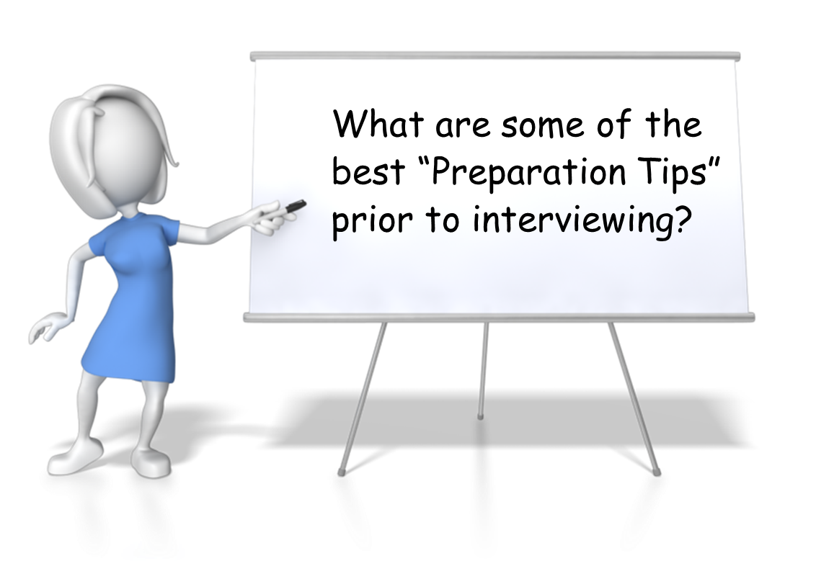
Tips for Preparation

Slide 18
Bad Answers to Common Interview Questions
Source: Workopolis
Notes:
YouTube Video Plays After Click: https://www.youtube.com/watch?v=synPaqlLe0M

Slide 19
Tips for Preparation

Slide 20
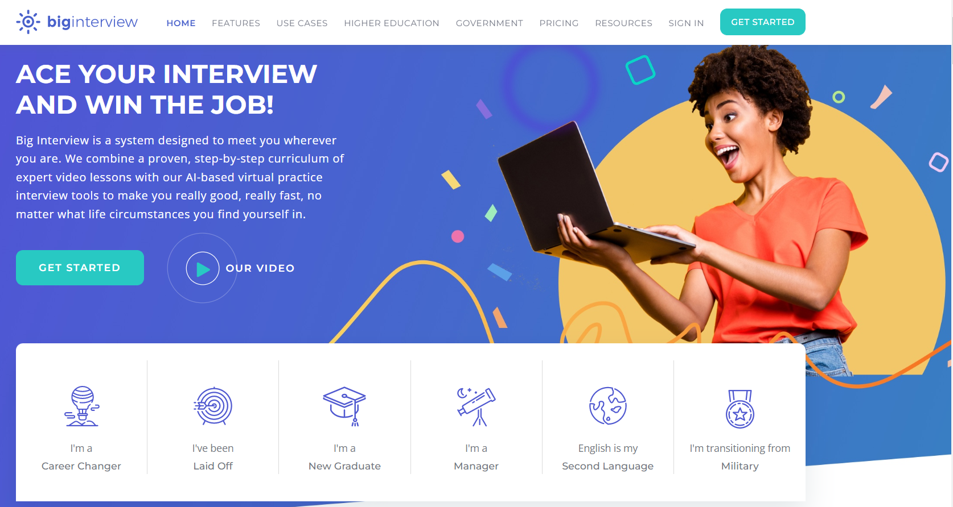
Other On-Demand Resources
Source: Biginterview.com

Slide 21
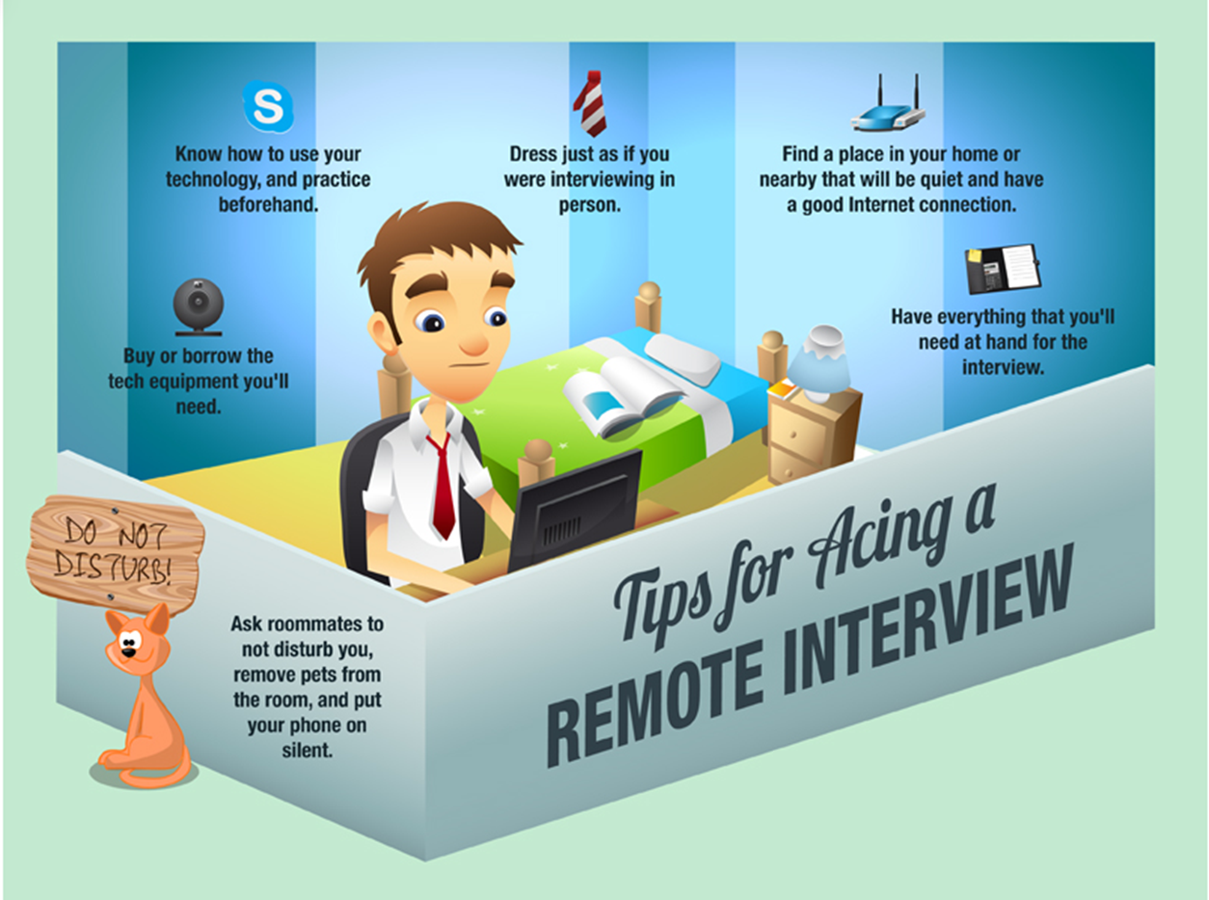
Remote Interviews: The “New” Normal
Source: youtern.com

Slide 22
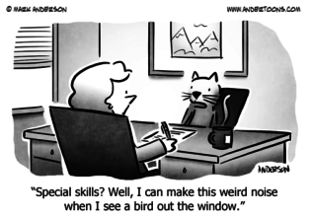
Graphic Source: Andertoons.com

Slide 23
Virtual Interviews
Interviews are conducted using video conferencing.
Test equipment prior to interviewing to ensure camera and microphone work properly.
Use neutral or a virtual background.
Mute your audio when you are not speaking.
Check out Public Speaking in a Hybrid Work Environment in the U.S. WIN Professional Development Library for additional online tools and tactics for interviewing/presenting in a virtual environment.
Notes:
Check out Public Speaking in a Hybrid Work Environment presentation by Greg Cameron, APS Director of Employee Communications, in the U.S. WIN Professional Development Library for additional online tools and tactics for presenting in a virtual environment.

Slide 24
Behavior Based Interview Questions Time to practice your responses using the STAR Model.
Communicates Effectively. Tell me about a time when you read between the lines and were able to shift your behavior based on what the other person needed from you or the situation.
Action Oriented. Describe a situation when you had to take initiative and even go outside the expectations of your role to deliver outstanding results to a customer.
Self Development. Give an example of the best and most helpful piece of constructive feedback you've received in your career.
Collaboration. Tell me about a time you worked to resolve conflict with a peer. How did you approach the situation?
Notes:
Who is ready to share their response to one of the questions in the “STAR” format with the group?

Slide 25
Quest ons?

