Slide 1
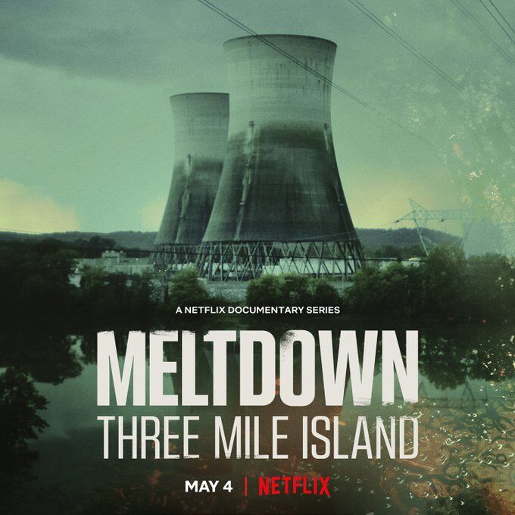
A Professional Development & Networking Opportunity: Hosted by ONS WIN

Slide 2
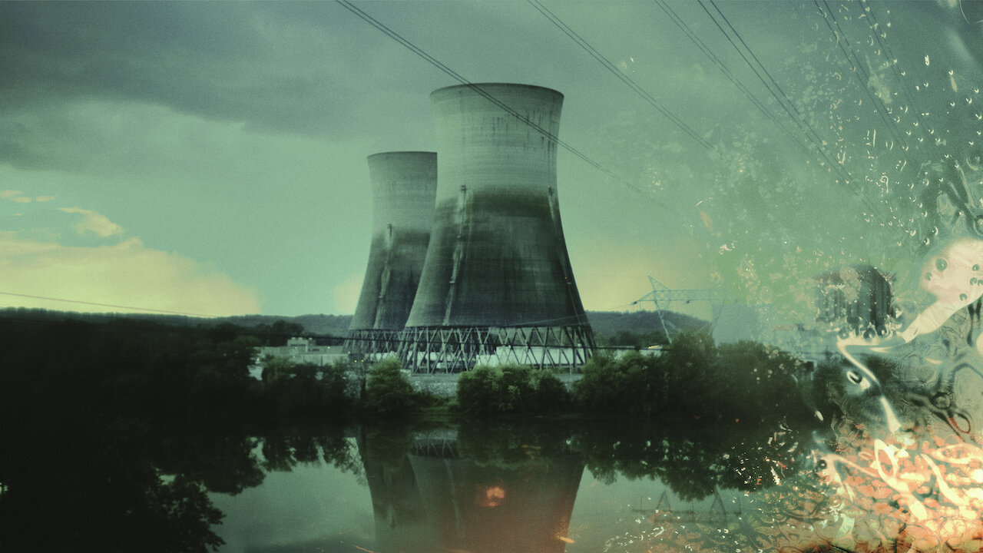
Brief Summary
Unit 2 went online December 1978
On March 28, 1979 at 4 AM, alarms in Control Room started going off – PORV stuck open (closed 2 hours later) https://youtu.be/aSNzgsZOelA
July 1982 - Quick look into the core
Melted upper half of the core

Slide 3
Discussion of Episode 1: “The Accident”
Talking Points:
Unit 1: Online in 1974
Unit 2: Online in December 1978 - Accident March 28, 1979 (Online 3 months)
4AM - Relief valve (PORV) stuck open (2 hours before it was closed)
Similar scenario happened at ONS months earlier
Declared site emergency
Newly elected press secretary did not know what TMI was when he was notified of accident
Metropolitan Edison owned TMI
The China Syndrome (released 12 days before accident) - Has anyone watched it?
Ed Houser - Chemistry Supervisor
Elected to get boron sample - Concentration was low - Where did the boron go?
He incurred a dose of 2.8 Rem
NRC reported off site radiation levels at this time - Now we report if there has been a release during an event
NRC was claiming the dose was "no more than a dental x-ray"
1200 mrem/hr was thought to be evacuation criteria
helicopter detected this level in the air around the reactor building

Slide 4
Discussion of Episode 1: “The Accident”
Questions:
How much radioactivity was released?
What was the noise that the public heard?
What was the pressure spike that the operators saw?
Was there really airborne radioactivity in the control room?
Were they releasing radioactive steam?

Slide 5
Discussion of Episode 2: “Women and Children First”
Talking Points:
Governers orders/Media Recommendation:
Evacuate within 5 miles
Stay indoors within 10 miles
30,000 Rem/Hr in the dome
Management of information
President Carter - Part of the Nuclear Navy
Helped dismantle a reactor - Chalk River Canada
Day 5 he visits TMI to put public at ease
Hydrogen gas bubble formed in reactor
1000 nuclear scientist on site trying to figure this problem out
Harold Denton - NRC guy on site
Dead fish on riverbanks
Ailments:
Some stated they "taste a metallic taste"
Someone stated they threw up "green mucus"
Eye irritation
TMI Alert organized 1977
Interview of:
William Zewe (SRO)
Craig Faust (RO) - Turned off RCPs
Edward Fredrick (RO) - Throttled HPI
July 1982 - Quick look into the core
Melted upper half of the core

Slide 6
Discussion of Episode 2: “Women and Children First”
Dose (rem) | Effects
5-20 | Possible late effects; possible chromosomal damage.
20-100 | Temporary reduction in white blood cells.
100-200 | Mild radiation sickness within a few hours: vomiting, diarrhea, fatigue; reduction in resistance to infection.
200-300 | Serious radiation sickness effects as in 100-200 rem and hemorrhage; exposure is a Lethal Dose to 10-35% of the population after 30 days (LD 10-35/30).
300-400 | Serious radiation sickness; also marrow and intestine destruction; LD 50-70/30.
400-1000 | Acute illness, early death; LD 60-95/30.
1000-5000 | Acute illness, early death in days; LD 100/10.

Slide 7
Discussion of Episode 3: “The Whistleblower”
Talking Points:
Rick - Nuclear Navy
Arrived at TMI in June 1980
Claims he told NRC of the problems with the polar crane
Bechtel – Hired for nuclear clean up
Need to vent Krypton out of reactor
Clean up melted fuel
9ft of contaminated water in the basement
"Get it done no matter what" mentality
Established "milestones"
Wanted to move reactor head - issues with polar crane
PANE = People Against Nuclear Energy
NRC - Lake Barrett
Karen Silkwood → https://youtu.be/nOq5laPllAQ
Billie with GAP (Government Accountability Project)

Slide 8
Discussion of Episode 4: “Fallout”
Talking Points:
"Whistleblowers in the nuclear industry are in danger"
March 22, 1983 - Polar crane lift
Stopped - Suspended cleanup
Falsified safety reports - indictment
Leak rate falsification
Lied the day of - 1:15PM (loud thud) - H2 gas
July 24, 1984 - Lift takes place
Restart vote for Unit 1 on May 29, 1985
1986 - Chernobyl
2011 - Fukushima
2019 - TMI 1 closes

Slide 9
Factoids Learned in Teams Discussion
Operators do have the ability to lock themselves in the CR – Security Event
Amount of radiation to cause mild radiation sickness within a few hours (vomiting, diarrhea, fatigue; reduction in resistance to infection) is 100-200 Rem
NRC had a single phone line to control room
Media was listening to radio traffic
Movies to watch: Atomic Twister, The China Syndrome, Silkwood
Books to read: Midnight in Chernobyl and Atomic Accidents

