Slide 1
U.S. WIN Auxiliary Mentoring Program
Mentor Training
August 2021

Slide 2
Open Question: What do you wish to gain from this program?

Slide 3
Benefits of Being a Mentor
Share your knowledge with an individual and gain exposure to new and differing perspectives.
Develop and improve leadership, management, communication, and personal skills.
Develop confidence in personal performance capabilities.
Personal fulfillment and satisfaction of helping others and contributing to the development of other individuals.
Build and broaden your network and learn from future individuals in the industry.
Supports use and development of key competencies leading to growth.

Slide 4
Behaviors and Best Practices – Positive (+)
Offer support and encouragement to promote a nurturing environment for the mentee.
Share personal experiences with the mentee, the successes as well as the failures, and reveal how the failures were overcome and the lessons learned.
Provide challenges to stimulate thought processes and facilitate action in the mentee.
Allow the mentee to work independently, but be a touchstone.
Determine which methodologies work more effectively with the mentee when assessing his/her endeavors. Critique and give positive reinforcement to motivate and to encourage critical thinking and self-reflection, but always be candid in your feedback.
Be responsible to them, not for them.
Give options rather than directions and take the time to provide guidance.

Slide 5
Behaviors and Best Practices – Negative (-)
Functioning as an expert on all issues. This behavior can project a condescending attitude, which can be an impediment to a good mentor/mentee relationship.
Too much emphasis on a "fun" environment that lends more to developing a friendship than to developing the skills of the mentee.
Motivating the mentee to reach beyond his/her immediate potential and not providing guidance on potential issues that can impact the final results. Directing the skills and activities of the mentee to attain the mentor's perception of what should be done can create animosity and false expectations.

Slide 6
Short Video: The secret to giving great feedback
Notes:
https://www.youtube.com/watch?v=wtl5UrrgU8c

Slide 7
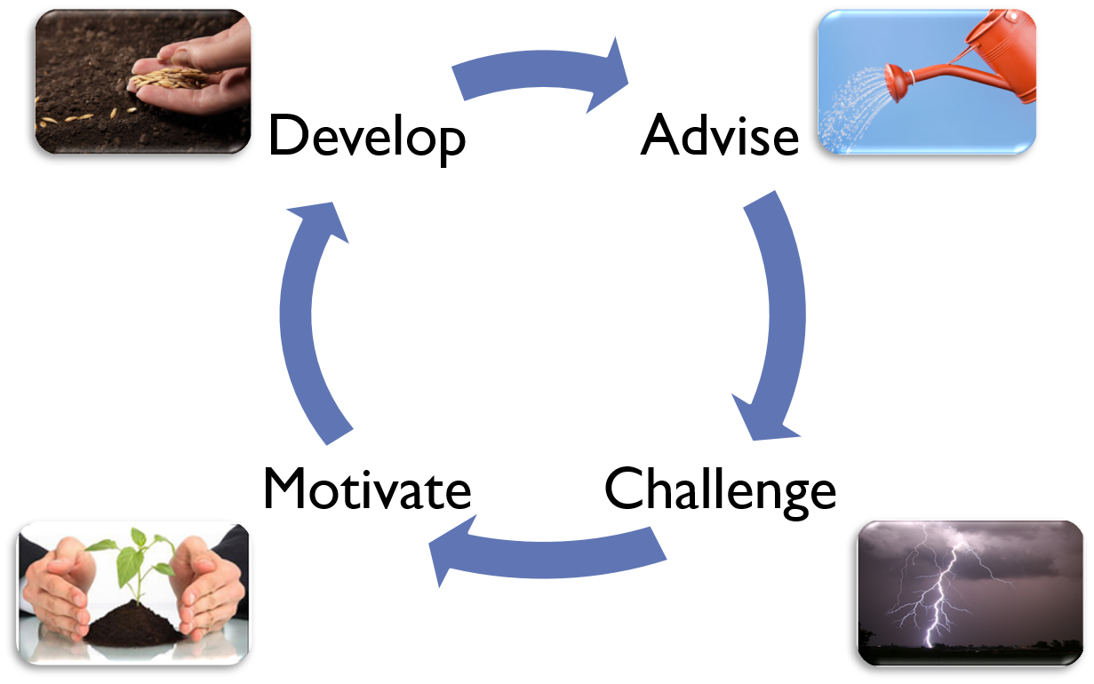
Stages of a Mentoring Relationship

Slide 8
General Mentor Guidelines
Work with your Mentee to schedule meetings to occur on a regular basis and put them on the calendar.
Commit your time to these regular meetings.
Develop the relationship. It is a 12-month commitment.
Gain your manager/advisors support in the program.
Commit to confidentiality and respect for privacy.
Balance delivering information with listening.

Slide 9
General Mentor Guidelines
Be part of an environment where potential and motivation are realized and options are discussed in a positive tone.
Prepare specific goals for your time together.
Don’t just expect results without participation and effort.
Share successes and failures.
Use a step-by-step process to build on accomplishments.
Attend all meetings.
Be engaged and enjoy the process!

Slide 10
Remember: transfer of knowledge is a two-way street. Your knowledge and experience is just as valuable to your mentee, as your mentee’s knowledge and experience is to you!

