Slide 1
U.S. WIN Auxiliary Mentoring Program
Mentee Training
August 2021

Slide 2
Open Question: What do you wish to gain from this program?

Slide 3
Benefits of Being a Mentee
Work with an experienced mentor to understand and learn mutually agreed upon skills from someone who has proven expertise and success.
Establish a personal and a working relationship with a mentor.
Develop confidence in personal performance capabilities.
Have the opportunity to talk openly with an expert about personal and professional challenges, needs, and opportunities for success.
Ability to build a mentoring network community to share best practices and ideas to help enrich each other in the years following the formal experience.
Gain a greater conceptual perspective of organizational and performance issues, career opportunities, and consequences of mentee’s performance.

Slide 4
Behaviors and Best Practices
Positive (+)
Negative (-)
Expressing a genuine interest in professional and personal growth.
Willingness to listen and put to work feedback and coaching from the mentor.
Commit to open communication that accentuates active listening and clear thought.
Demonstrate flexibility in an ever-changing environment.
Demonstrating good time management skills.
Open to trying new ideas and approaches
Excessive focus on creating a ‘fun’ environment that lends more to developing a friendship and not developing skills.
Not taking initiative and relying solely on the mentor’s perception of what should be done.
Reliance on the mentor to drive the program/relationship.
Expectation that completing the program will result in a promotion.

Slide 5
Short Video: The secret to giving great feedback
Notes:
https://www.youtube.com/watch?v=wtl5UrrgU8c

Slide 6
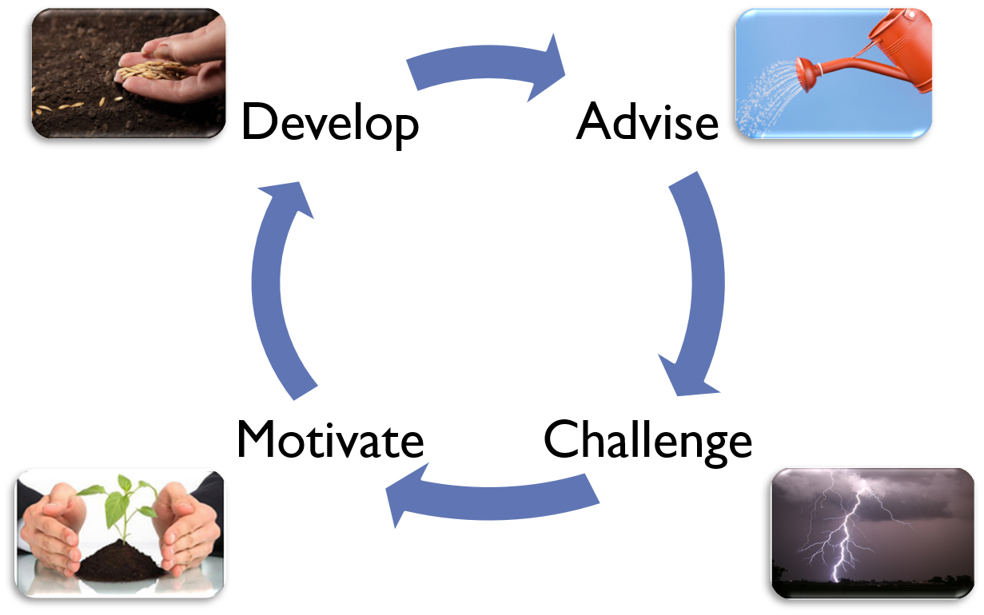
Stages of a Mentoring Relationship

Slide 7
General Mentee Guidelines
Work with your Mentor to schedule meetings to occur on a regular basis and put them on the calendar.
Commit your time to these regular meetings.
Develop the relationship. It is a 12-month commitment.
On-going manager/advisor support in the program.
Commit to confidentiality and respect for privacy.
Balance delivering information with listening.

Slide 8
General Mentee Guidelines
Be part of an environment where potential and motivation are realized and options are discussed in a positive tone.
Prepare specific goals for your time together.
Don’t just expect results without participation and effort.
Share successes and failures.
Use a step-by-step process to build on accomplishments.
Attend all meetings.
Be engaged and enjoy the process!

Slide 9
Remember: transfer of knowledge is a two-way street. Your knowledge and experience is just as valuable to your mentor, as your mentor’s knowledge and experience is to you!

