Slide 1
Introduction to Nuclear Power
October 16, 2020
Presented By Exelon Generation Women In Nuclear
Kennett Square Chapter

Slide 2
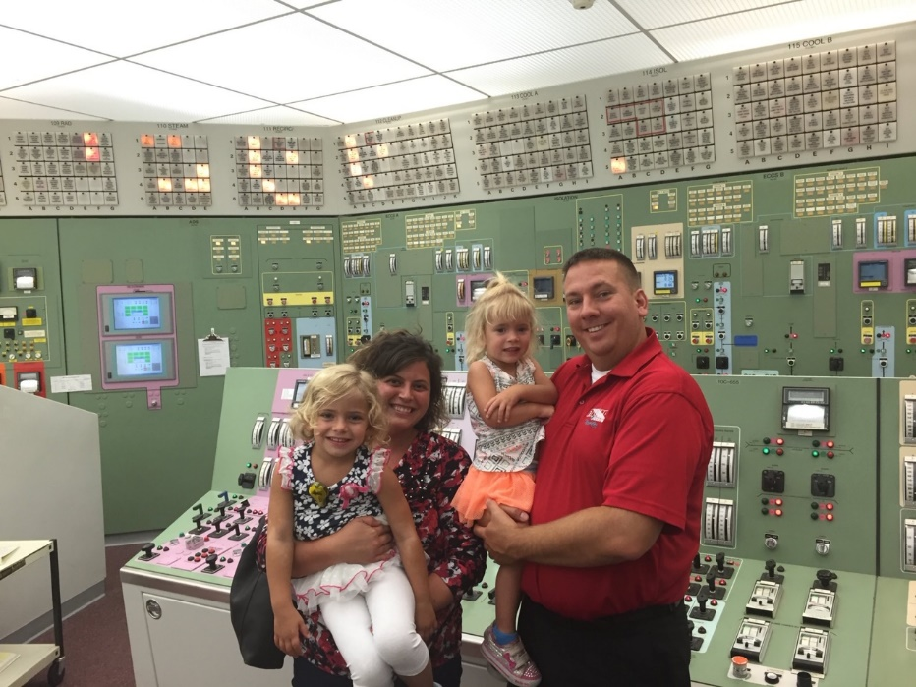
Introductions
Name: Vanessa Myers, PE
Company: Exelon Generation
Current Position: Mechanical Engineer
College: Drexel University
Degree: BS/MS Mechanical Engineering & Mechanics

Slide 3
What We Will Talk About Today
Who is Exelon Generation, and what do we do?
What’s nuclear power, and how does a nuclear plant work?
Career Opportunities
Source:
U.S. EPA

Slide 4
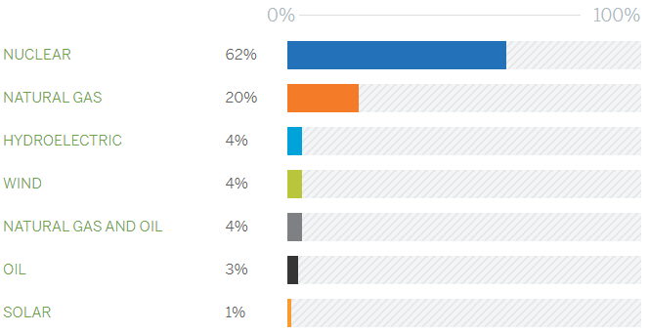
Who is Exelon Generation
Exelon is the largest operator of nuclear power plants in the United States and the third largest in the world.
Zero-carbon emissions (no greenhouse gas emissions)
Generating capacity of 18,700 megawatts from 21 reactors at 12 facilities in Illinois, Maryland, New York and Pennsylvania.
Nuclear produces approximately 158 million megawatt-hours of electricity every year.
In 2019, our nuclear plants had a best-in-class fleet capacity factor of nearly 96%.
Source:
https://www.exeloncorp.com/companies/exelon-generation

Slide 5
What are greenhouse gases?
Gases that trap heat in the atmosphere are called greenhouse gases.
Carbon dioxide enters the atmosphere through burning fossil fuels like coal, natural gas, and oil.
Carbon dioxide is removed from the atmosphere (or "sequestered") when it is absorbed by plants as part of the biological carbon cycle.
Methane is emitted during the production and transport of coal, natural gas, and oil.
Nitrous oxide is emitted combustion of fossil fuels.
Nuclear is clean energy with zero greenhouse gas emissions!
Source:
U.S. EPA

Slide 6
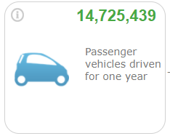
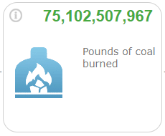
Importance of Nuclear Energy
With the production of 158 million MW-hours of clean electricity every year, Exelon prevents the emission of over 75 million tons of CO2 that would have been generated from fossil fuels.
Equivalent to greenhouse gas emissions from 14,725,439 passenger vehicles driven per year
Equivalent to the CO2 emissions from burning 75,102,507,967 (over 75 billion) pounds of coal
Why does burning a pound of coal yield over two pounds of CO2?
When coal is burned, the carbon in the coal combines with oxygen to form carbon dioxide. One molecule of carbon dioxide is 3.67 times heavier than a molecule of carbon, due to the additional weight of the two oxygen atoms. Coal is not 100 percent carbon: burning a pound of coal emits 2.07 pounds of CO2.
Greenhouse gas emissions from:
CO2 emissions from:
Sources:
U.S. EPA, Greenhouse Gas Equivalency Calculator

Slide 7
Boiling Water Reactor (BWR)
Source:
https://www.nrc.gov/reading-rm/basic-ref/students/animated-bwr.html
Notes:
Image source: https://www.nrc.gov/reading-rm/basic-ref/students/animated-bwr.html
Water boils in the reactor vessel
Reactor steam spins the turbine
Control rods inserted from the bottom
Different layers of containment (primary and secondary)

Slide 8
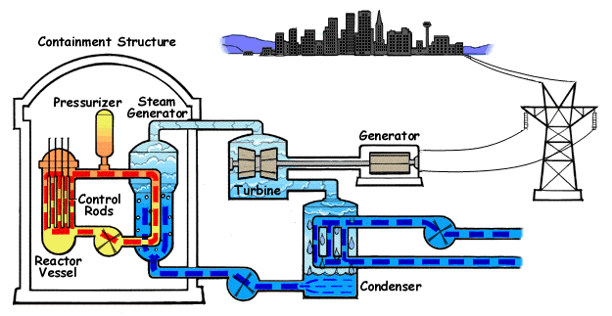
Pressurized Water Reactor (PWR)
Source:
https://www.nrc.gov/reading-rm/basic-ref/students/animated-pwr.html
Notes:
Image source: https://www.nrc.gov/reading-rm/basic-ref/students/animated-pwr.html
Water boils in steam generators instead of in the reactor vessel
Has three loops of coolant flow
The steam that spins the turbine is not radioactive
Control rods inserted from the top
Has a single containment structure

Slide 9
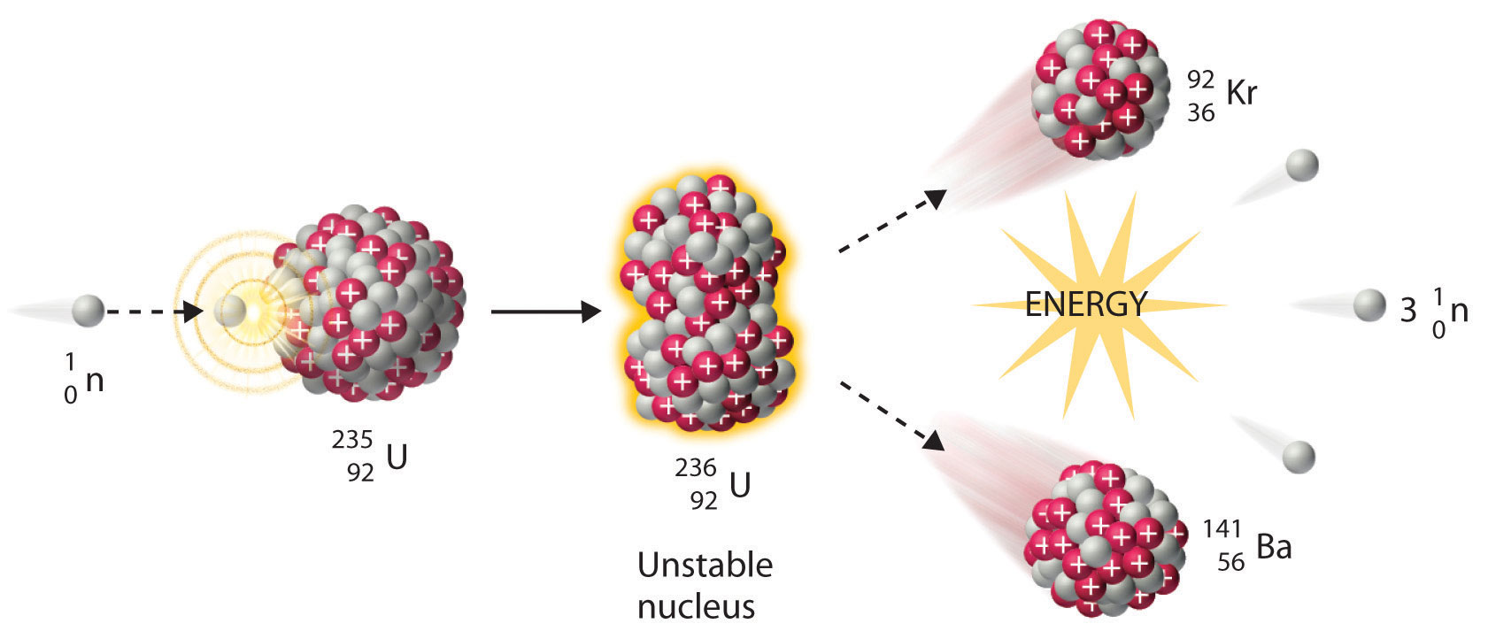
Nuclear Fission
The splitting of atoms releases neutrons => FISSION => creates HEAT in Nuclear Reactors
Heat produces steam
HEAT
Image Source:
http://chemwiki.ucdavis.edu/%40api/deki/files/16111/20.7.jpg
Notes:
http://chemwiki.ucdavis.edu/%40api/deki/files/16111/20.7.jpg

Slide 10
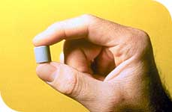
Nuclear Fission
One Fuel Pellet Produces as Much Energy as:
3 barrels of oil
2.5 tons of wood
1 ton of coal
17,000 cubic feet of natural gas
Notes:
http://chemwiki.ucdavis.edu/%40api/deki/files/16111/20.7.jpg

Slide 11
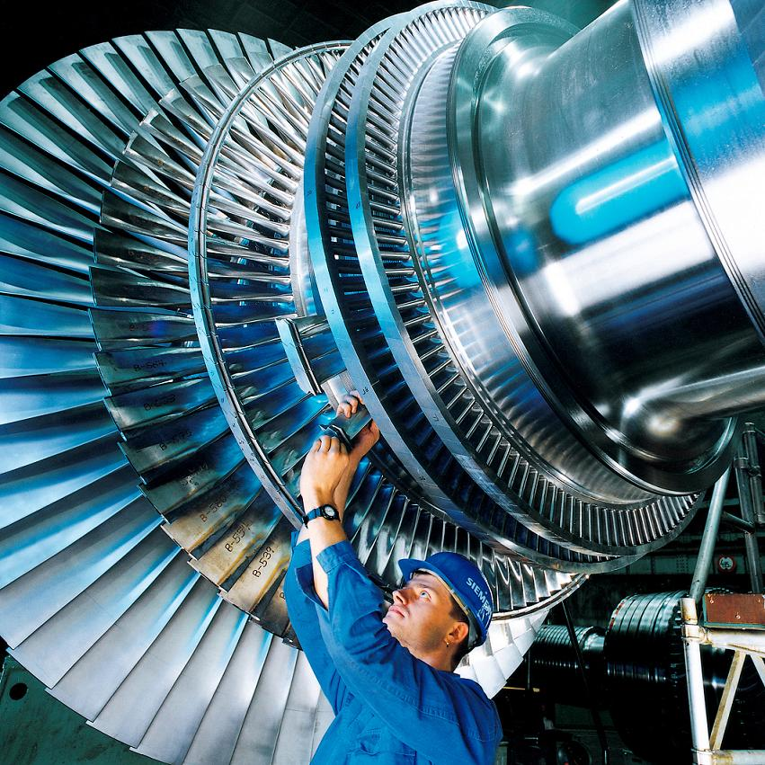
Main Turbine
Convert thermal energy (steam) into mechanical energy (rotation).
Rotating blades housed in a casing that contains the steam generated by the reactor vessel (BWR) or steam generator (PWR).
Exelon Nuclear turbines:
1 High-Pressure turbine extracts energy from the steam directly from the reactor or steam generator
3 Low-Pressure turbines extract additional energy from reheated steam
Connected on a common shaft with the rotor portion of the generator
Image Source:
https://commons.wikimedia.org/wiki/File:Dampfturbine_Laeufer01.jpg
Notes:
Turbine image source: https://commons.wikimedia.org/wiki/File:Dampfturbine_Laeufer01.jpg

Slide 12
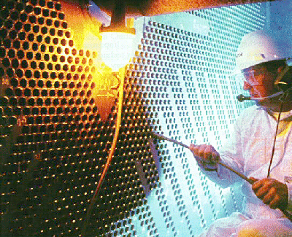
Main Condensers
Steam used to turn the turbine is condensed back to water so that it can return to the Reactor Vessel (BWR) or Steam Generator (PWR) and continue the power cycle.
Heat from the steam is transferred through the Condenser tubes.
Water from the Condenser is cooled using a body of water (river, lake, ocean) or cooling towers.
Not all nuclear plants will use cooling towers.
Many fossil power plants and industrial facilities use cooling towers.
Image Sources:
http://www.nucleartourist.com/areas/turbbldg.htm
Cooling tower image source: https://commons.wikimedia.org/wiki/File:Byron_IL_Byron_Nuclear_Generating_Station_2.jpg
Google Maps
Notes:
Condenser tube sheet image source: http://www.nucleartourist.com/areas/turbbldg.htm
Cooling tower image source: https://commons.wikimedia.org/wiki/File:Byron_IL_Byron_Nuclear_Generating_Station_2.jpg
Lake image: Google Maps

Slide 13
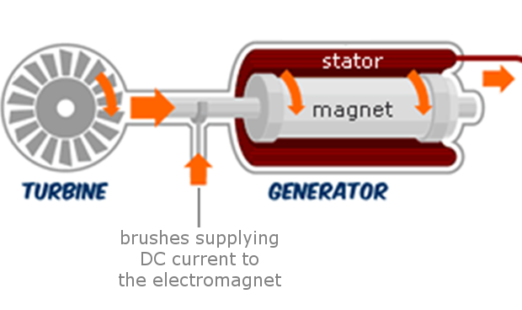
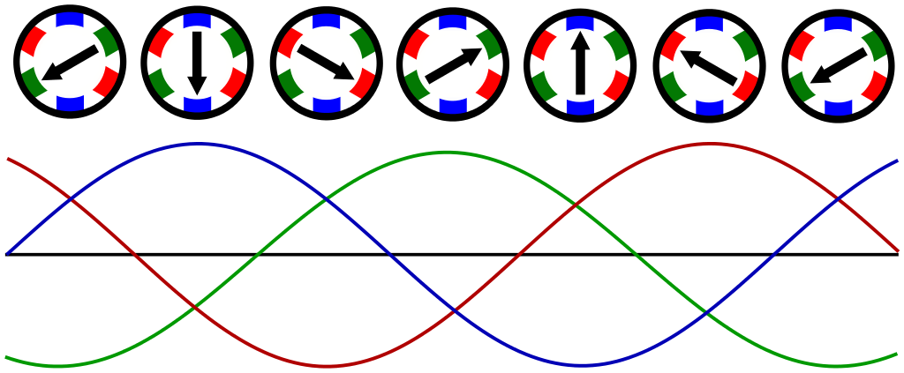
Main Generator
Transforms mechanical energy (rotation) into electricity.
The rotor is connected to the shaft from the turbine and is the rotating magnet.
Electric current is induced in the stator, the stationary conductors inside the generator surrounding the rotor.
Similar to passing a magnet through a coil of wire.
Image Sources:
http://www.learneasy.info/MDME/iTester/tests/10906_Heat_Engines/images/generating_electricity.html
https://en.wikipedia.org/wiki/File:Rotating-3-phase-magnetic-field.svg
Notes:
Turbine/Generator image source (modified): http://www.learneasy.info/MDME/iTester/tests/10906_Heat_Engines/images/generating_electricity.html
3-phase image source: https://en.wikipedia.org/wiki/File:Rotating-3-phase-magnetic-field.svg

Slide 14
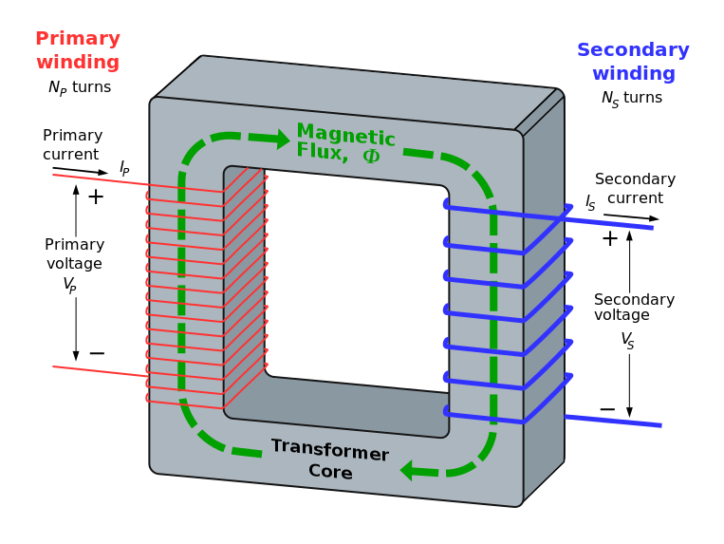
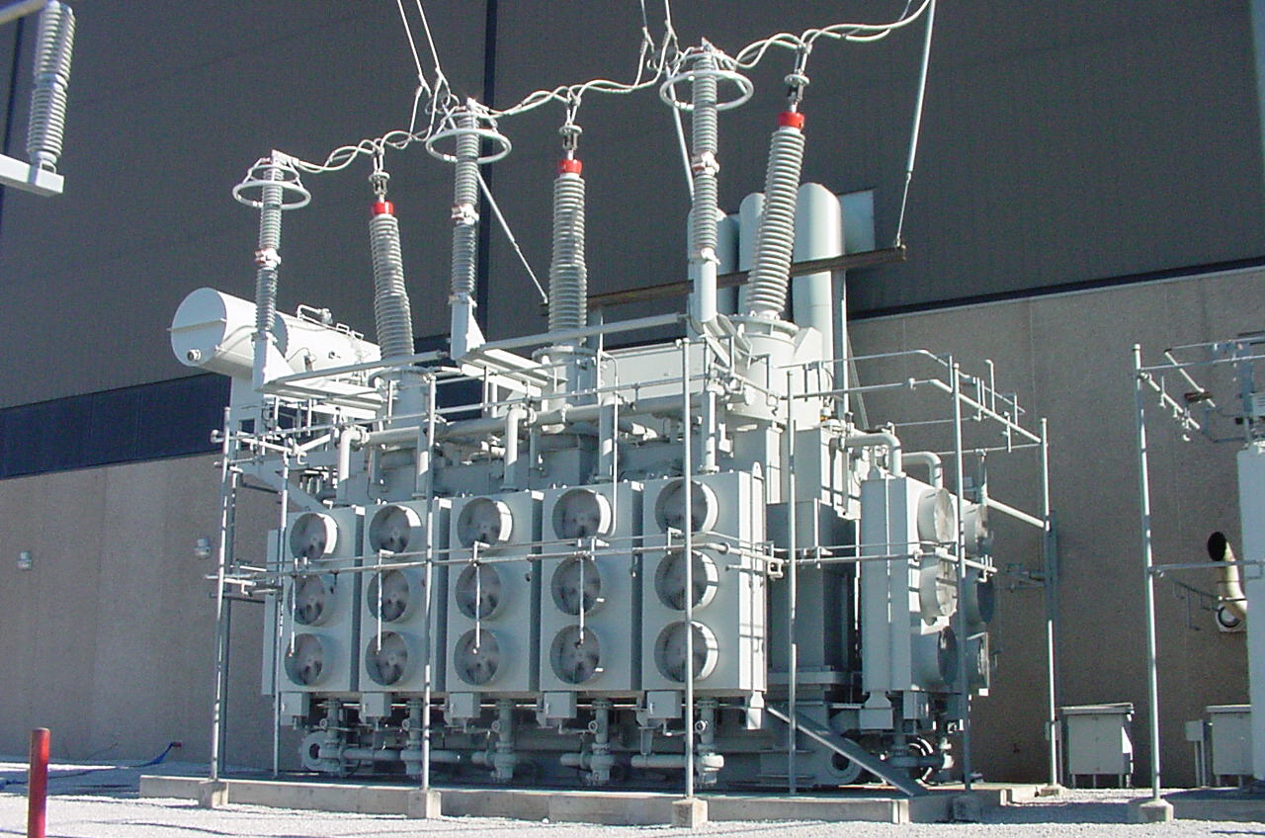
Transformers
The Main Power Transformer steps up the voltage from the generator output for distribution to the electrical grid.
Transformers along the power lines step down the voltage level from a high volage to levels used by various consumers.
Transformers also maintain voltage levels due to voltage loss over the distance of the wires.
Image Source:
Transformer diagram source: https://commons.wikimedia.org/wiki/File:Transformer3d_col3.svg
Notes:
Transformer diagram source: https://commons.wikimedia.org/wiki/File:Transformer3d_col3.svg

Slide 15
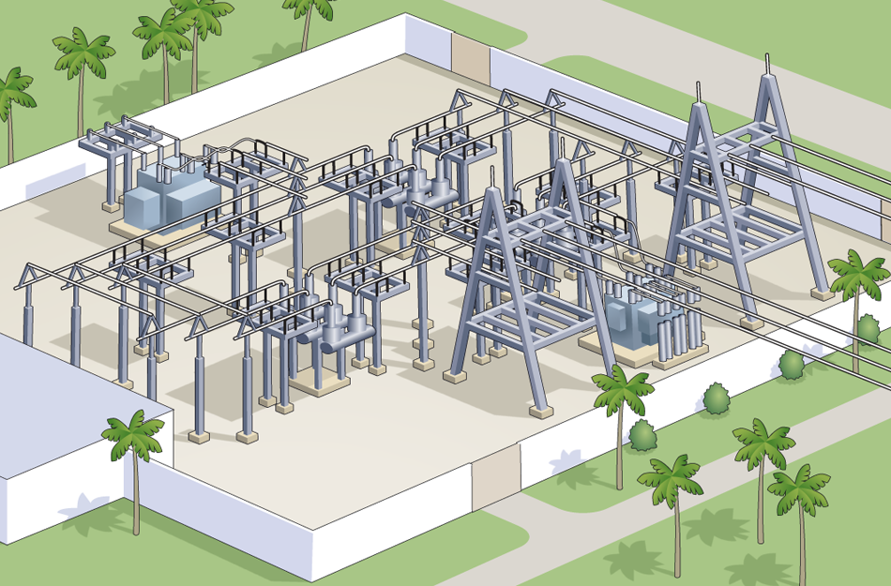
Substations
Maintain the voltage on the high-voltage transmission lines
Decrease voltage for use on residential or commercial loads
Used for the control of electrical distribution
Image Source:
https://commons.wikimedia.org/wiki/File:Transformer3d_col3.svg
Notes:
Transformer diagram source: https://commons.wikimedia.org/wiki/File:Transformer3d_col3.svg

Slide 16
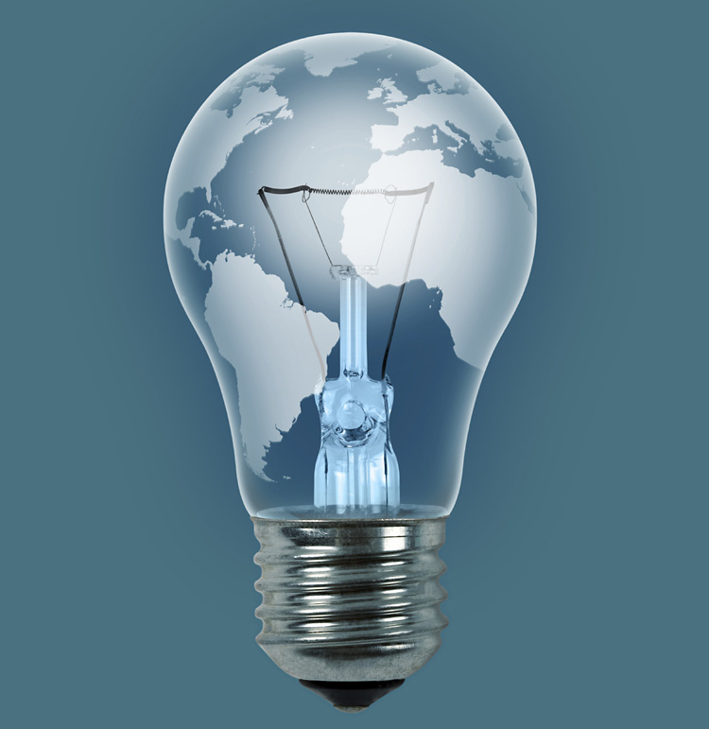
Career Opportunities
Engineering
Civil/structural
Electrical
Materials
Mechanical
Nuclear
Computer
Instrumentation and Control
Fire Protection
Systems
Project management
Professionals
Accountants
Analysts
Business management
Chemists
Document control experts
Health physicists
IT experts
Occupational safety, including radiation safety experts
Plant operators
Statistics/probabilistic risk assessment experts
Training specialists
Technicians and Skilled Trades Workers
Carpenters
Construction trades and related workers
Electricians
Engineering technicians
Heavy equipment operators
Machinists
Maintenance technicians
Millwrights
Pipefitters
Science technicians
Security officers
Welders
Notes:
Transformer diagram source: https://commons.wikimedia.org/wiki/File:Transformer3d_col3.svg

Slide 17
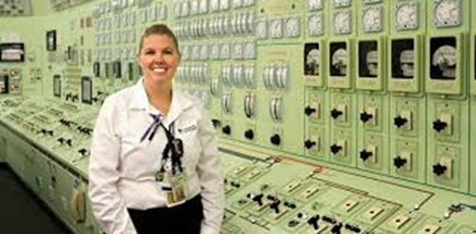
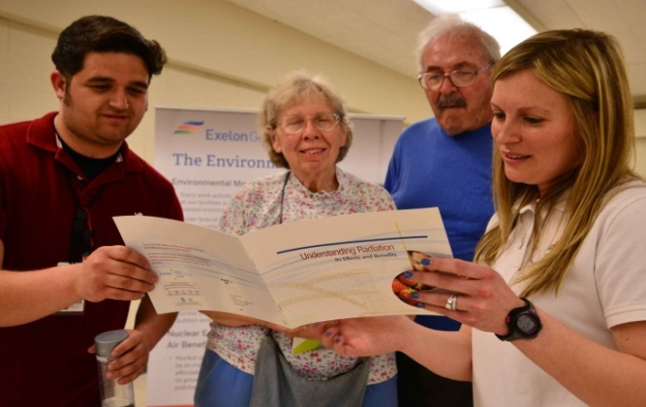
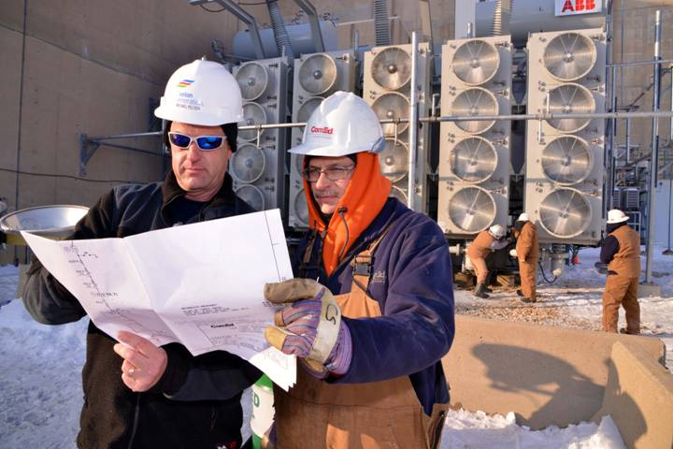
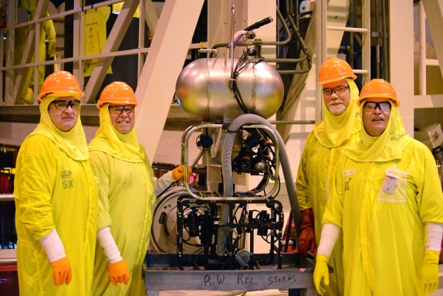
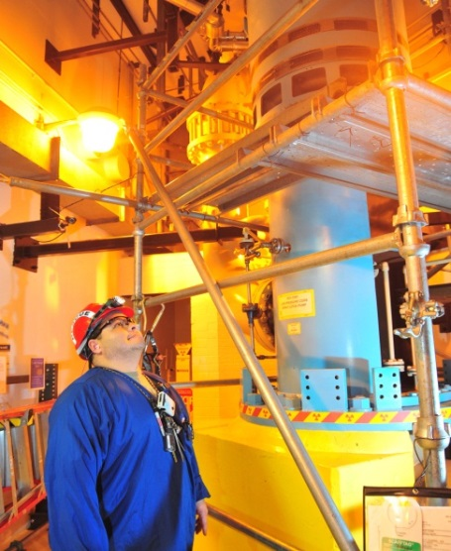
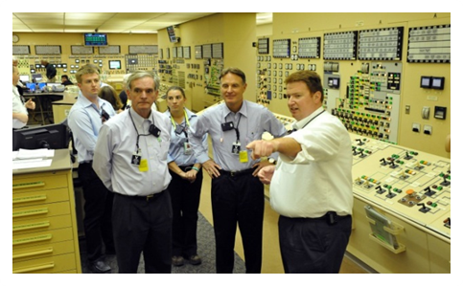
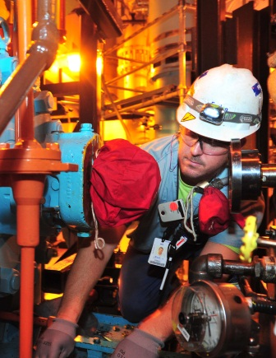
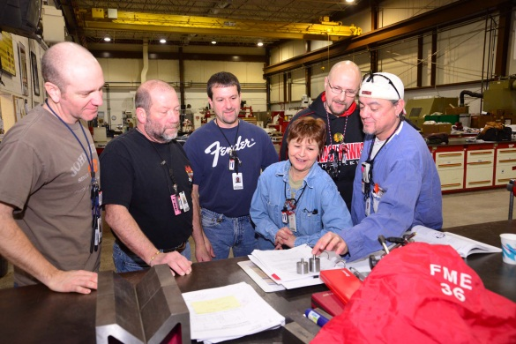
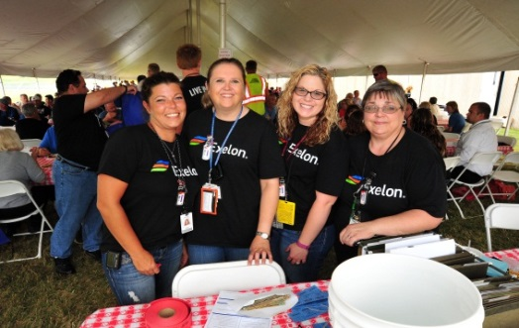
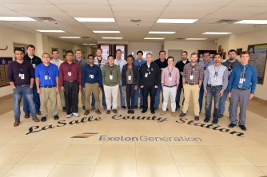
Questions

