Slide 1
Brief Primer on Passive and Active Nuclear Plant Systems
EGMN 456 – Reactor Design and Systems
Price Collins: Exelon Generation
Nuclear Fuels – Fuel Reliabilty Engineer

Slide 2
Why do you think we chose huge power plants with active safety systems in lieu of passive systems?
Notes:
Open for audience participation
Simple answer: $$$$$
Scale of economy was more conducive for big plants
Passive systems for large plants would have not been conducive to cost and building (more concrete, steel, tanks, etc.)

Slide 3
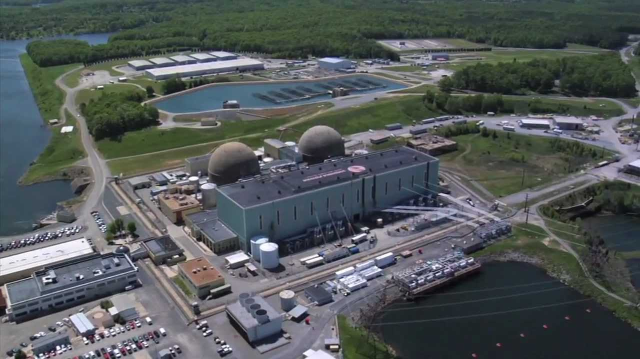
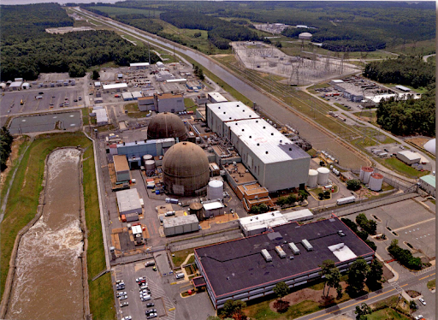
South East VA’s electricity is significantly nuclear
Notes:
Left Picture: North Anna Power Station (1980)
Type: Duel Unit Westinghouse 3-Loop PWR
Size: 2940 MWth/~950 MWe (enough generation for ~850k people/unit)
Location: Louisa, VA (~50 miles Northwest of VCU)
Right Picture: Surry Power Station (1973)
Type: Duel Unit Westinghouse 3-Loop PWR
Size: 2587 MWth/~850 MWe (enough generation for ~750k people/unit)
Location: Surry, VA (~65 miles south east of VCU)

Slide 4
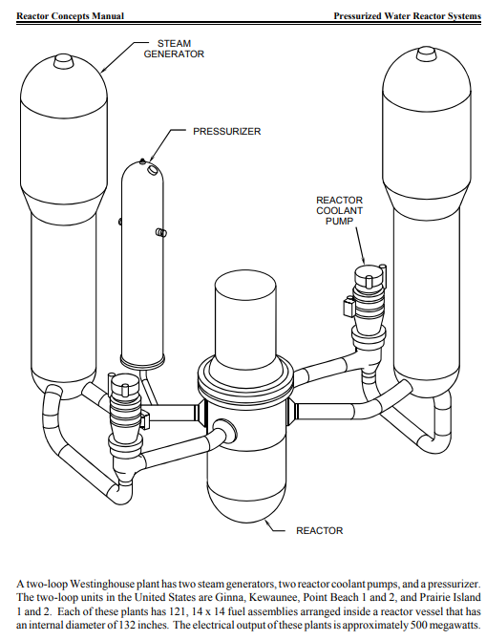
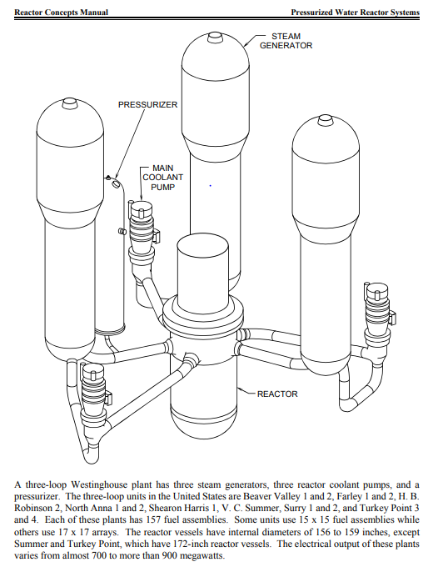
Westinghouse 2-Loops and 3-Loops
Notes:
Note: the listing of reactors in the NRC reference materials are, unfortunately, out of date as multiple units have shut down for primarily economic or large project failures (San Onofre, Crystal River)

Slide 5
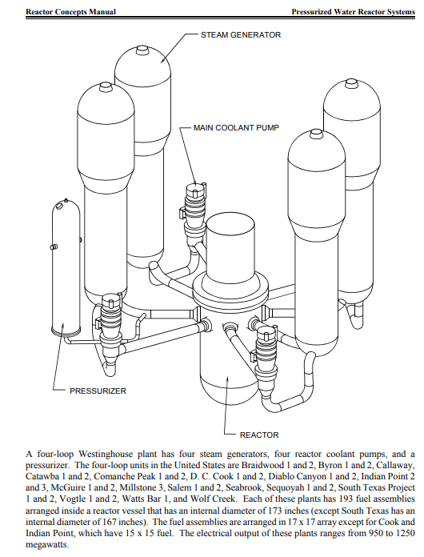
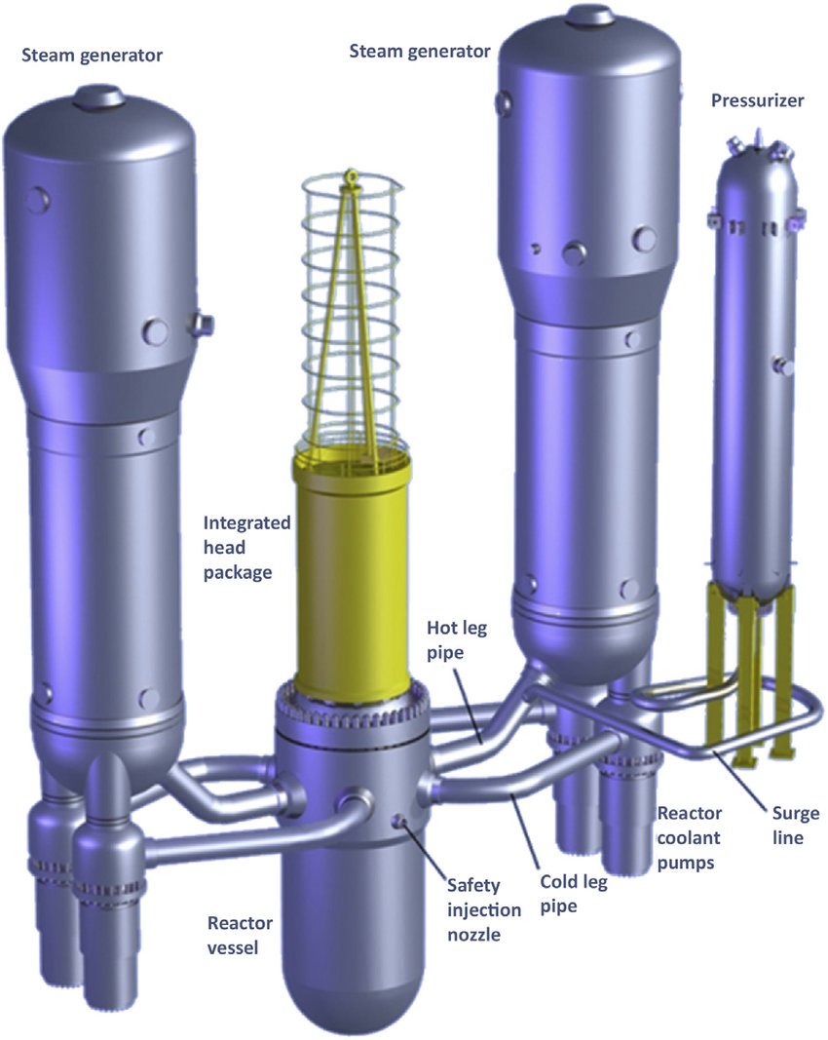
Westinghouse 4-Loop and AP1000
Notes:
Advanced Passive
AP1000 is unique compared to other Westinghouse designs as it has 2 reactor coolant pumps (RCP) per loop as opposed to 1 on ‘standard’ W models
Due in part to how the AP1000 design evolved from the AP600 design and W’s acquisition of Combustion Engineering
CE plants use 2 RCPs/loop

Slide 6
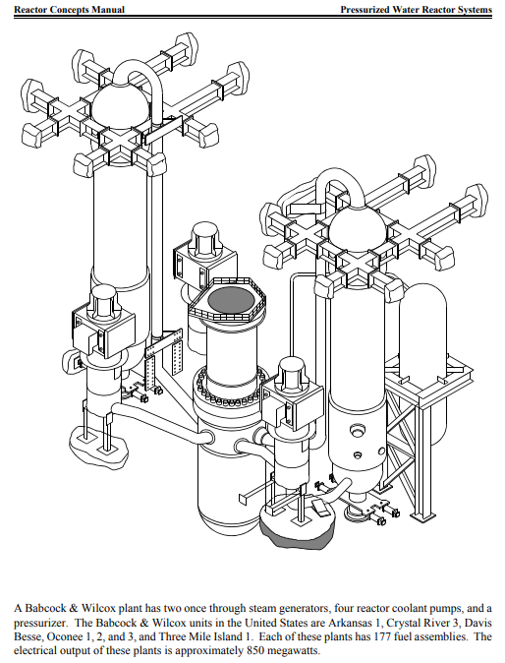
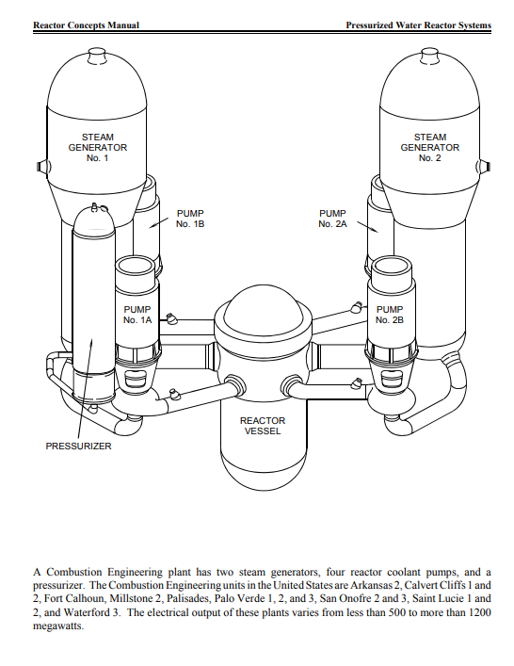
B&W Unit and Combustion Engineering designs
Notes:
CE got into the nuclear business in the 60s as demands for reactors outpaced the foundry capability of Westinghouse and General Electric (BWRs). Before that they made pressure vessels for the fossil industry, hence Combustion.
B&W units get superheat. Ask students why that is desierable
The NMP1 and Oyster Creek vessels were both poured at the CE foundry in Chattanooga, TN

Slide 7
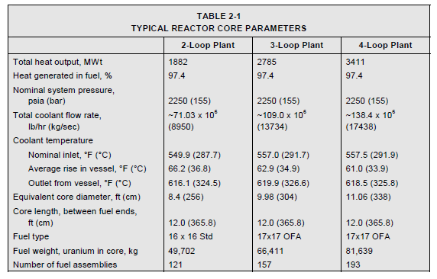
Notes:
You’ll find multiple key parameters at PWRs (temperature, pressure, delta T) remain constant

Slide 8
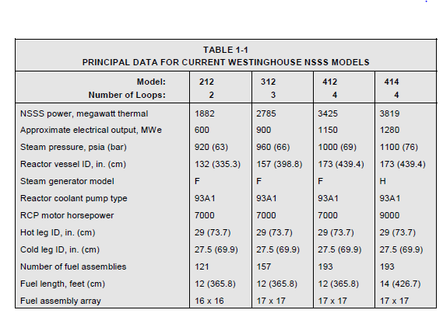
Notes:
More assemblies – more fuel – more power

Slide 9
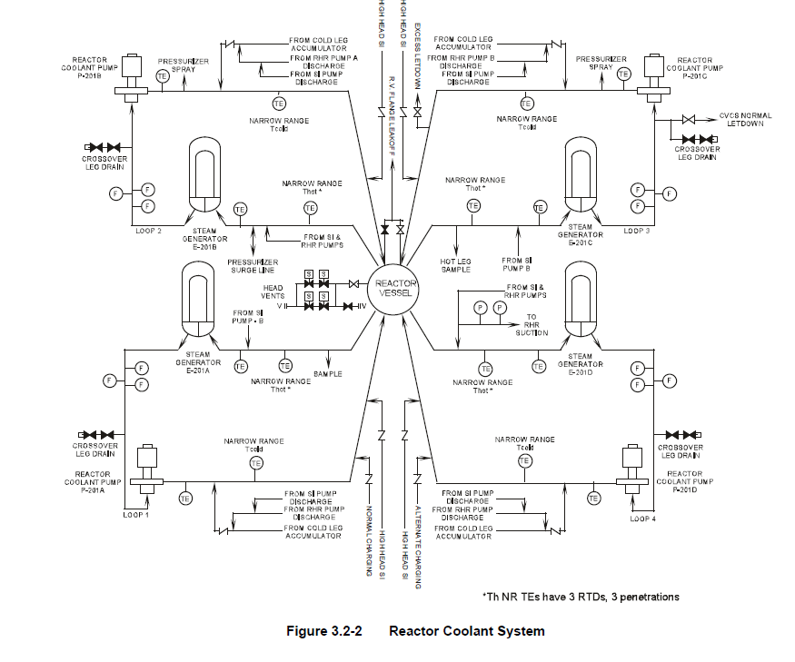
Simplified Reactor Coolant System (RCS) Diagram

Slide 10
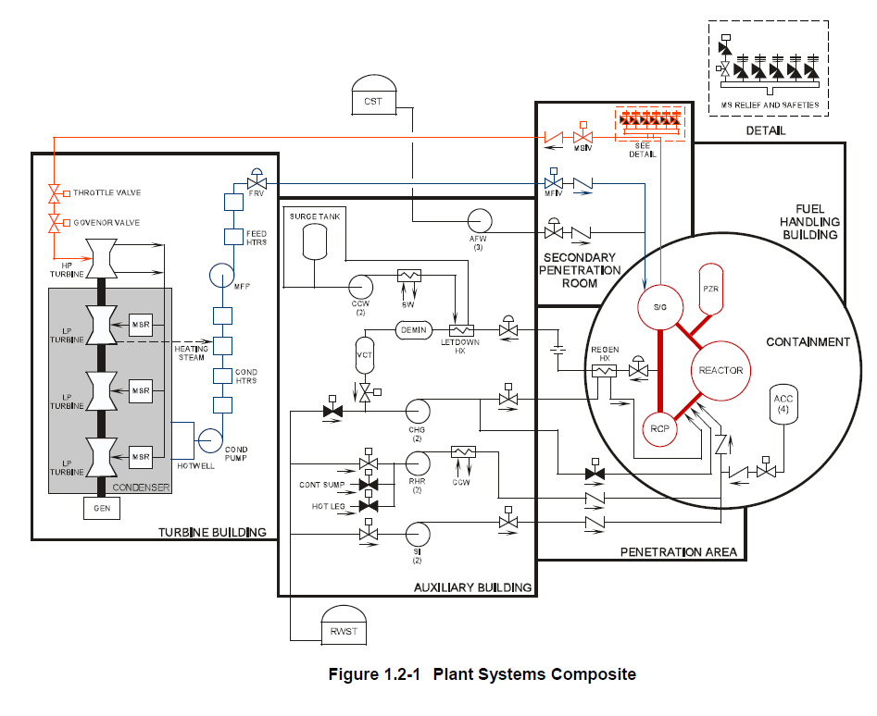
Everything tied together

Slide 11
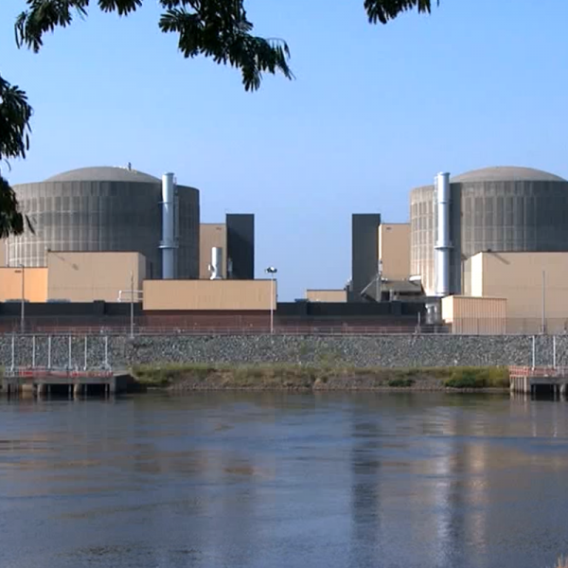
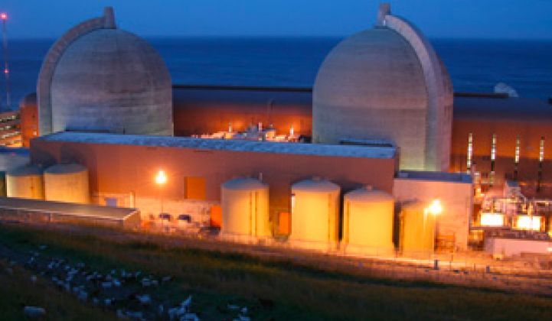
Diablo Canyon vs. McGuire: Why do you think the containment designs differ so drastically considering they are W4-LPs?
Notes:
A: McGuire, Catawba (almost identical to McGuire), Watts Bar, Sequoyah (almost identical to Watts Bar), and DC Cook have ice condenser containment. Essentially, there’s a layer of baskets filled with ice in containment designed to absorb energy during a LOCA and melt. Allows for a reduced volume in containment and smaller profile (analogues to BWR suppression pool/torus)
Q: Why was this design chosen?
A: Real Estate: at least for McGuire and Catawba the plants are on prime lake/water front real estate and they don’t crowd out the area and blend in.
My 2 cents: I get the real estate argument. Going to be WAAAAYYY more expensive in the long run to run the electricity to keep the ice frozen than using more concrete. Always support a passive/simple design vs. an engineered solution. (Not to mention those plants have been the subject of way more scrutiny during accident scenarios and NOT maintaining the baskets well). WithWBN and SQN too, it’s weird since they have giant ‘classic’ cooling towers.

Slide 12
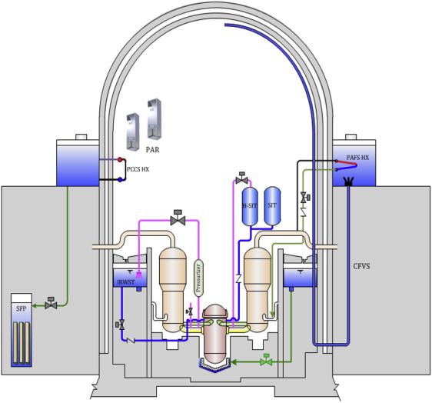
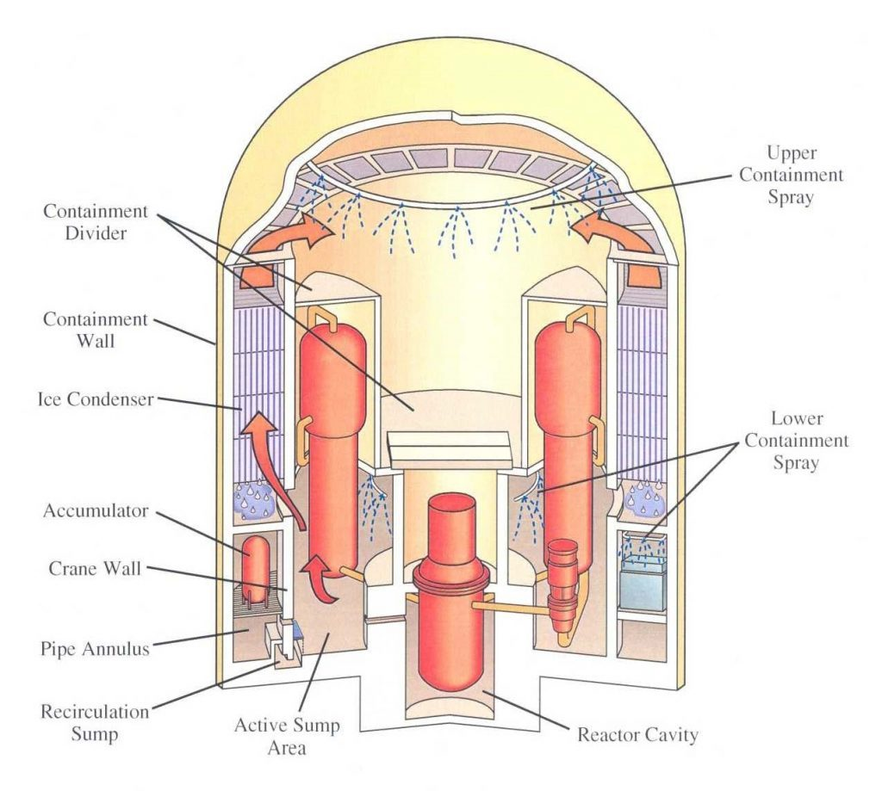
“Typical” PWR containment vs. Ice Condenser Containment
Notes:
Different companies covered the so-called tendon studs in different ways. Byron/Braidwood/Zion can/did get a lot of snow. Diablo Canyon does not got snow for example
Designed to handle the energy during a LOCA
Closer to a BWR primary containment with the torus or suppression pool water
All about quenching LOCA energy

Slide 13
What’s the most important part of a nuclear power plant?
Might think it’s the turbine-generator since that’s where we generate electricity
Might think it’s the people since w/o qualified folks the plant can’t run
It’s Nuclear Safety
Notes:
If you take nothing else away from this lecture, know nuclear safety is the most paramount thing we take seriously.

Slide 14
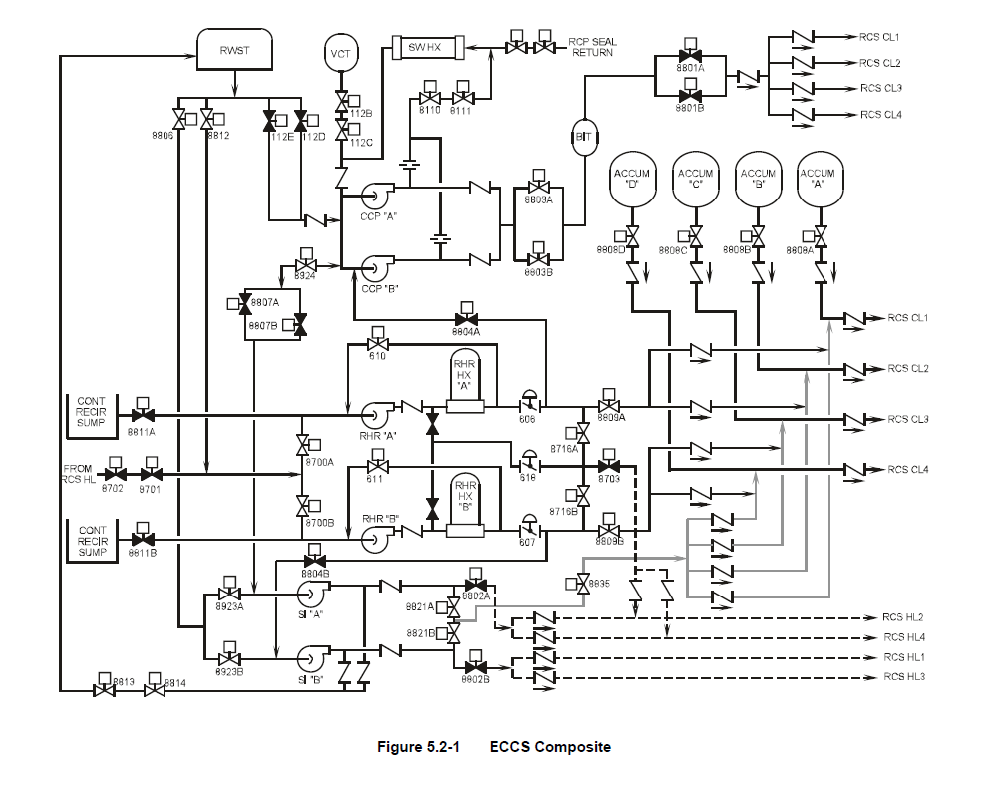
Simplified diagram of ECCS
Notes:
Q: Why do we have ECCS?
A: Residual heat
Q: why did we choose such complicated setups and systems?
A: partially because that was the technology and analytical methods we had at the time. Also due to increased power. Economics favored powered ECCS systems for larger units (larger decay heat). Some of the smaller plants have more passive ECCS (when they have ECCS)
Remember, the rules for systems and safety were not codified yet during construction of plants in the 50s, 60s, and early 70s
Example: Nine Mile Point-1 (1969): emergency condensers are tanks of water that dump water into the reactor when needed. Couple sets of valves, very simple
Nine Mile Point-2 (1986/post TMI): high pressure core spray. 1 pump powered by a single emergency diesel generator

Slide 15
All plants employee ‘Defense in Depth’ and Redundancy
Multiple trains of safety systems in the event one fails
  On-site diesel generators in protected enclosures in the event we lose power from the grid
Due to high pressure/temperature of the plants after shutdown, employee different safety systems at different conditions
  High pressure ECCS: pumps used for low flow, high pressure
  Intermediate pressure ECCS: pumps used for intermediate flow, intermediate pressure (passive accumulator tanks w/ check valves opened once pressure lowers below a threshold)
  Low Pressure ECCS: pumps used for high flow, low pressure
    Residual Heat Removal (RHR) pumps used for this. Normally only used during outages
  Overall goal is to keep the core covered in the event of a line break or valve opening
  Containment spray also used to reduce temperature, pressure, and potential airborne radionuclides in containment
  Two is one, and one is none

Slide 16
Why do we care so much?
We use FEET of concrete and steel for our containment
We train all our workers on safety first and emergency response
We spend millions every year on inspections, preventative maintenance, and training
  Most regulated industry/entity in the country
We share operational experience (OPEX) between all U.S. plants; regardless of whether they are in Exelon
  One negative incident can affect the entire industry
Bottom line, we can’t have another Chernobyl, Fukushima, etc.
  We have to keep the health and safety of the public at the forefront of everything we do, and meet our societal obligations
  Perception is Reality
Notes:
Q: Why do we use concrete and steel in conjunction together?
A: Same reason as other buildings; steel and concrete have similar thermal expansion/contraction characterizes. Bother are VERY good under compressive load as well

Slide 17
Push for newer plants has been back to passive safety systems
AP1000: less piping, less valves, less motors, less ‘stuff’
  Easier to maintain, less things to fail
Station Blackout: no power from the grid, no power from the diesels, no power from batteries
  Toughest situation to cope with; most plants only analyzed for a few hours w/o any worker action
  AP1000: up to 72 hours w/ only passive safety systems before action required
    Gravity, natural convection, and condensation make this possible
Small Modular Reactors (SMR) are working to make their plants ‘walk away safe’
  You could theoretically walk away, the plant shuts down, stays shutdown, and remains in a safe configuration
  NuScale design will employee some of these concepts
Notes:
Westinghouse brochure (take it as you will): https://www.westinghousenuclear.com/Portals/0/New%20Plants/AP1000/AP1000%20Station%20Blackout.pdf?timestamp=1404842353431
Ask about radiation release

Slide 18
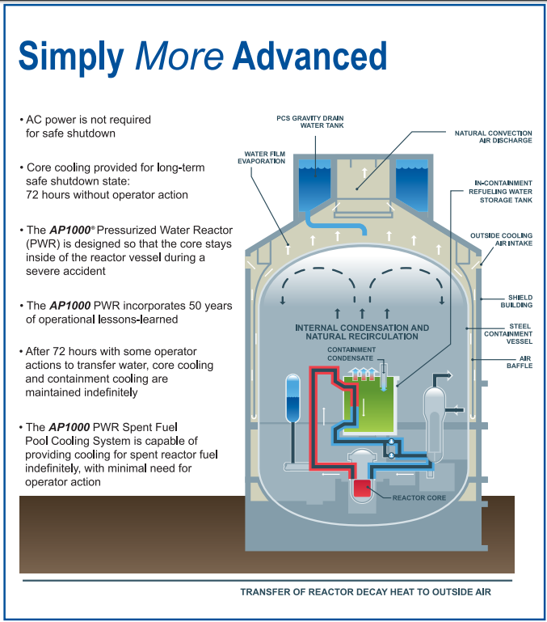
Illustration of the AP1000 containment and passive functions

Slide 19
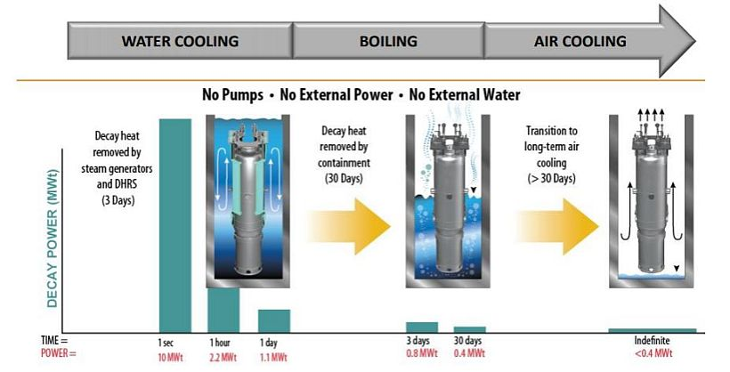
Good illustration I found for how the NuScale SMR will function w/o power

Slide 20
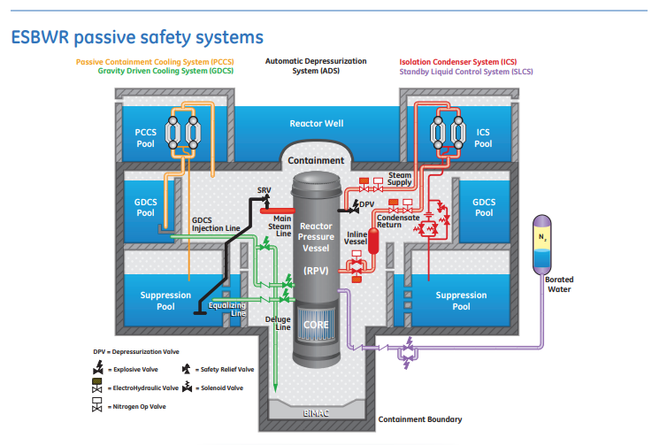
Economically Simplified Boiling Water Reactor (ESBWR)
Notes:
Approved for building in the U.S.
Likely will never be built in this country
U.S. NRC approval is the gold standard across the world so potential will be built in over-seas markets

Slide 21
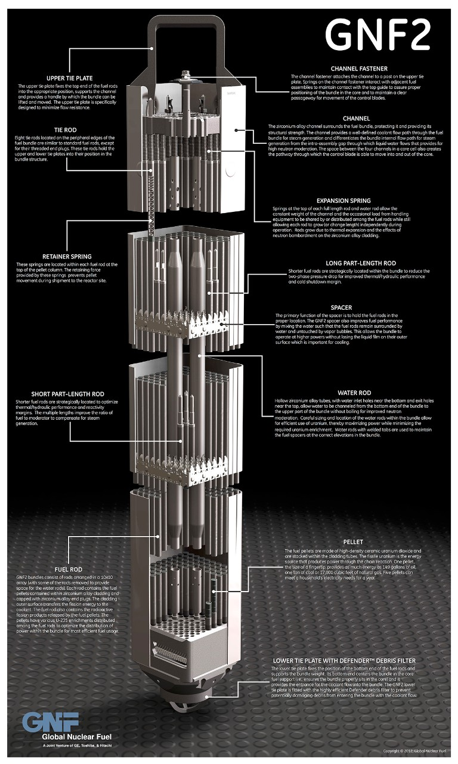
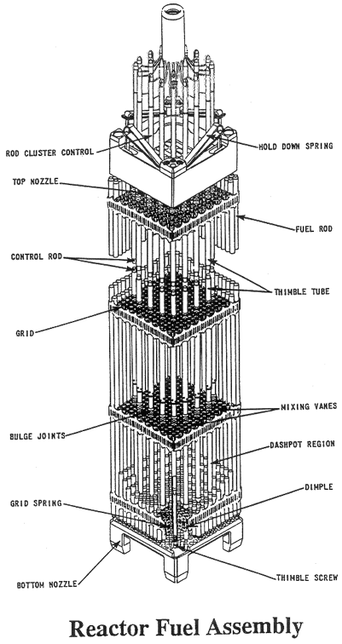
BWR vs PWR fuel
Notes:
https://nuclear.gepower.com/fuel-a-plant/products/gnf2-advantage
https://www.nrc.gov/reading-rm/basic-ref/students/for-educators/reactor-fuel-assembly.html
Q: What do you notice is different about the BWR assembly compared to the PWR assembly?
A: Fuel channeling

Slide 22
Organizations I love!
U.S. Women in Nuclear: https://www.winus.org/
Mothers for Nuclear: https://www.mothersfornuclear.org/
American Nuclear Society: https://www.ans.org/

Slide 23
Further Reading
NRC PWR Systems Overview: https://www.nrc.gov/reading-rm/basic-ref/students/for-educators/04.pdf
NRC BWR Systems Overview: https://www.nrc.gov/reading-rm/basic-ref/students/for-educators/03.pdf
Accident Tolerant Fuel: https://www.energy.gov/ne/articles/these-accident-tolerant-fuels-could-boost-performance-today-s-reactors ; https://www.energy.gov/ne/articles/5-things-you-should-know-about-accident-tolerant-fuels
U.S. Energy Information Administration: https://www.eia.gov/
Westinghouse Technology Systems Manual: https://www.nrc.gov/docs/ML2005/ML20057E160.pdf
Books
Atomic Accidents: A History of Nuclear Meltdowns and Disasters: From the Ozark Mountains to Fukushima: https://www.amazon.com/Atomic-Accidents-Meltdowns-Disasters-Mountains-ebook/dp/B00HVPI1IA
The Nuclear Express: https://www.amazon.com/Nuclear-Express-Thomas-C-Reed-ebook/dp/B004GJVXL6/ref=sr_1_1?dchild=1&keywords=nuclear+express&qid=1601911943&s=digital-text&sr=1-1
The Girls of Atomic City: https://www.amazon.com/Girls-Atomic-City-Untold-Helped-ebook/dp/B008J4GTU4/ref=sr_1_1?dchild=1&keywords=girls+of+atomic+city&qid=1601911990&s=digital-text&sr=1-1
The Grid: The Fraying Wires Between Americans and Our Energy Future: https://www.amazon.com/Grid-Fraying-Between-Americans-Energy-ebook/dp/B01DM9Q6CQ/ref=sr_1_1?dchild=1&keywords=the+grid&qid=1601912010&s=digital-text&sr=1-1
Notes:
EIA is a really nifty website. Lot of cool tools and data on there. Useful for graph building, historical reference, projects, etc.

Slide 24
Quick history of reactors
1951: First reactor to make electricity, EBR I (sodium cooled)
1954: First PWR, USS Nautilus (Navy submarine)
1957: First demonstration PWR, Shippingport (near Pittsburgh, close to site of modern Beaver Valley Plant)
1960: First commercial PWR, Dresden-1 (near Chicago). Dresden-2 and 3 continue to operate
1971: First nuclear power plant in the Southeast opens, Robinson (near Hartsville, SC)
1973/74: First 1000 MWe plants come online
  Browns Ferry-1: BWR/4 near Huntsville, AL
  Zion-1: Westinghouse 4-Loop near Chicago, IL
Since then, multiple units of multiple types have come online in the U.S.
  Only light water reactors (LWRs) only
  U.S. has operated several gas cooled and sodium fast reactors though for commercial uses (Fermi-1, Peach Bottom-1, Fort St. Vrain)
Notes:
Note: these are U.S. milestones
Fun fact: Peach Bottom-1 has been de-coned and the turbine building/shipping/maintenance area has been reconfigured into a training building

Slide 25
Brief History of PWRs
Westinghouse built small, single unite PWRs (less than 600 MW_{e}) in New England prior to standardization of their ‘Loop’ plants
  2-Loop (Ginna), 3-Loop (Robinson), 4-Loop (Zion)
  Technology was exported to South Korea and France which now have standardized designs
    Most plants (except Byron and Braidwood to a degree) are custom built
Fun Facts:
  Robinson was the 1st nuclear plant built in the Southeast and at the time it was built was the most powerful single generating plant in the world (generator wise)
  Zion (since closed outside Chicago) was the ‘reference’ W4-LP for the NRC with regards to accident and containment codes
  There are approximately as many W4-LPs operating the U.S. as there are total BWRs
    ~1/3 W4-LPs, 1/3 BWRs, 1/3 other PWRs
Combustion Engineering and Babcock & Wilcox have also built units in the country
  B&W units unique for their steam generators which can produce slightly superheated steam as opposed to saturated steam at the other plants
Why did the designs evolve the way they did?
  Scale of economy. You can run a 600 MW_{e} unit with 600 people or two 1200 MW_{e unit} with 800 people
Notes:
Joke: in America there are 3 types of cheese and 100 types of reactors. In France there are 3 types of reactors and 100 types of cheese

Slide 26
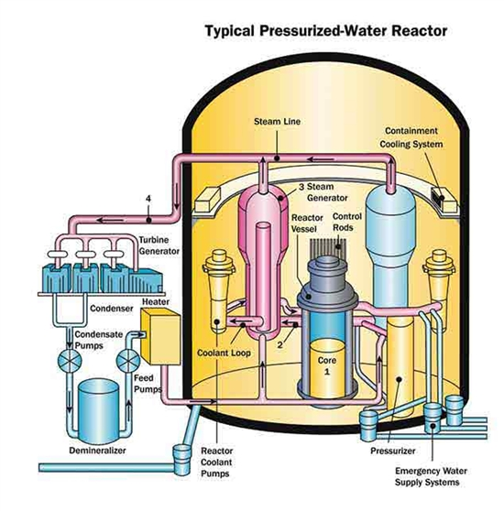
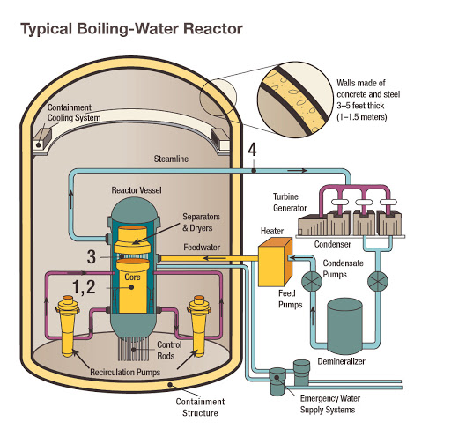
PWRs vs BWRs
Notes:
PWR: https://www.nrc.gov/reactors/pwrs.html
BWR: https://www.nrc.gov/reactors/bwrs.html

Slide 27
The plants have fundamental differences in operation
PWRs
BWRs
~2200 PSIA operation in the primary side
  ~1000 PSIA on secondary/power side
‘Clean’ feedwater and steam; no radioactive products
Single phase flow in the primary side
Control rods located on the top of the core
Containment not accessible at power
Large dry volume for steam containment
Use of boron for reactivity control
~1000 PSIA operation in the primary side
‘Dirty’ feedwater and steam; steam driven predominantly by N-16 in the steam
  Shielding needed around the turbine building
Easier to perform load-following maneuvers (power changes to meet grid demand)
Two-phase flow in the core; tougher to model
Control blades located on the bottom of the core
Secondary containment accessible at power
Mass of water inside primary containment for quenching/cooling steam during loss of coolant accident (LOCA)
Boron only used for emergencies
Notes:
Balance of plant sides are very similar. Steam spins a turbine-generator, waste heat removed by a condenser, some steam diverted for feedwater heating, water purification, etc.
I don’t know about y’all, but I tend to trust gravity
If you borate a BWR, you probably aren’t starting it back up. If you are, lot of time and $$$ to do so

Slide 28
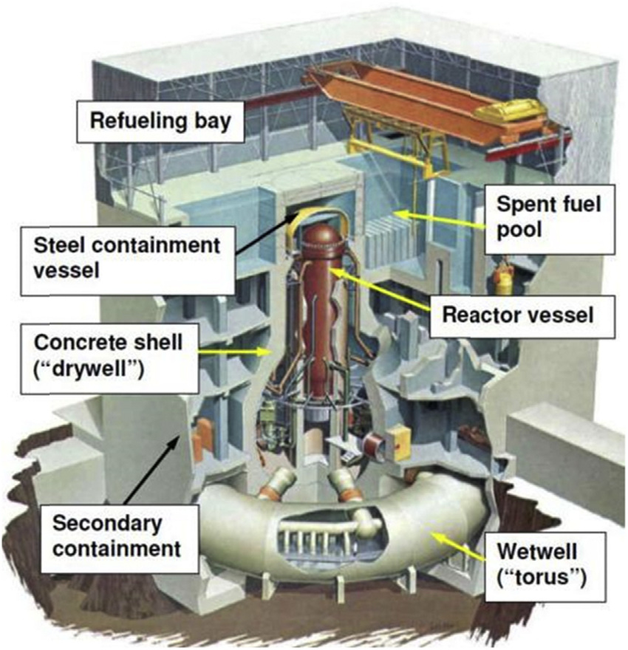
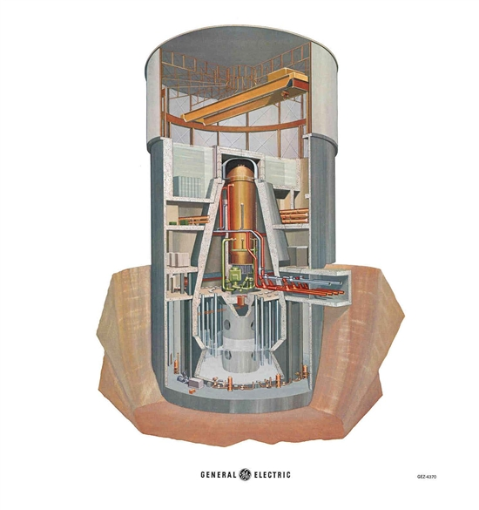
BWR Mark 1 vs. Mark 2 Containment

Slide 29
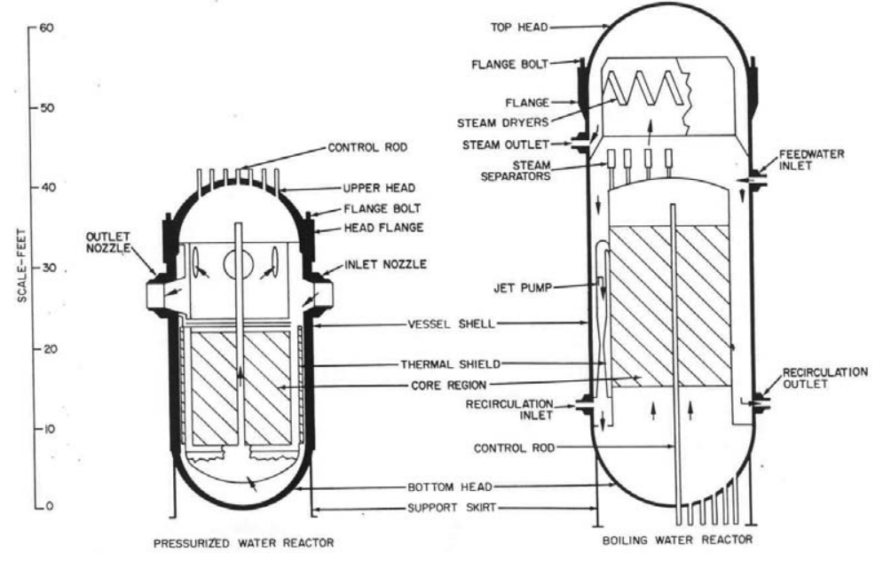
The Reactor Pressure Vessel difference between reactor types is impressive
Notes:
https://www-pub.iaea.org/MTCD/Publications/PDF/Pub1382_web.pdf
BWR vessel bigger to accommodate higher number of fuel assemblies as well as steam separator and steam dryer
BWRs have numerous penetrations on the lower portion of the vessel for control blade insertion

