Slide 1
Primer on PWRs, BWR/PWR Comparison, and Nuclear Fuel
NSE 4130 - Introduction to Nuclear Science and Engineering
Price Collins: Exelon Generation
Nuclear Fuels – Fuel Reliabilty Engineer
1

Slide 2
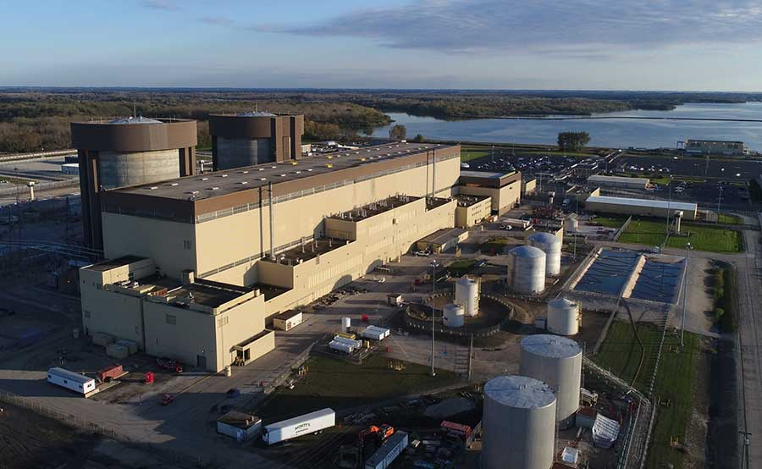
Pressurized Water Reactors (PWRs)
Notes:
Pictured: Braidwood Generating Station
Type: Duel Unit Westinghouse 4-Loop PWR
Size: 2389 MWe (enough generation for over 2 million people)
Location: Braceville, IL (~60 miles south of Chicago)
Note: NRC ‘reference’ plant for PWRs is the W4-LP
Note: Presentation is primarily geared towards the W4-LP

Slide 3
Brief History of PWRs
First commercial PWR was the Shippingport plant outside Pittsburgh, PA
  Scaled up version of the U.S. Navy core for the USS Nautilus
Westinghouse built small, single unite PWRs (less than 600 MW_{e}) in New England prior to standardization of their ‘Loop’ plants
  2-Loop (Ginna), 3-Loop (Robinson), 4-Loop (Zion)
  Technology was exported to South Korea and France which now have standardized designs
    Most plants (except Byron and Braidwood to a degree) are custom built
Fun Facts:
  Robinson was the 1st nuclear plant built in the Southeast and at the time it was built was the most powerful single generating plant in the world (generator wise)
  Zion (since closed outside Chicago) was the ‘reference’ W4-LP for the NRC with regards to accident and containment codes
  There are approximately as many W4-LPs operating the U.S. as there are total BWRs
    ~1/3 W4-LPs, 1/3 BWRs, 1/3 other PWRs
Combustion Engineering and Babcock & Wilcox have also built units in the country
  B&W units unique for their steam generators which can produce slightly superheated steam as opposed to saturated steam at the other plants
Why did the designs evolve the way they did?
  Scale of economy. You can run a 600 MW_{e} unit with 600 people or two 1200 MW_{e unit} with 800 people
Notes:
Joke: in America there are 3 types of cheese and 100 types of reactors. In France there are 3 types of reactors and 100 types of cheese

Slide 4
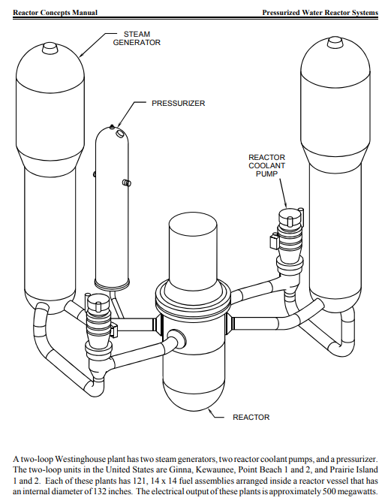
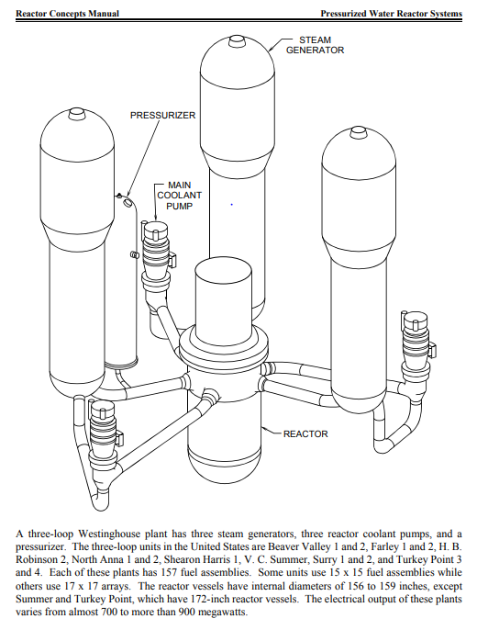
Westinghouse 2-Loops and 3-Loops
Notes:
Note: the listing of reactors in the NRC reference materials are, unfortunately, out of date as multiple units have shut down for primarily economic or large project failures (San Onofre, Crystal River)

Slide 5
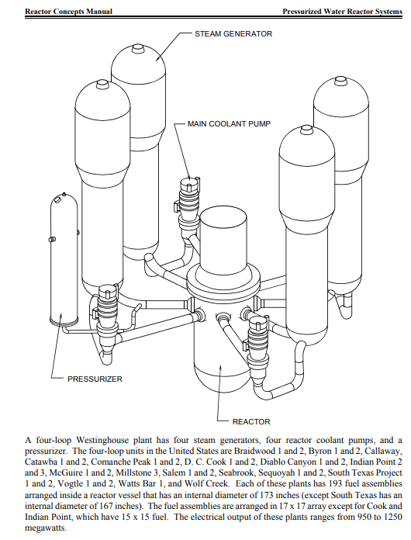
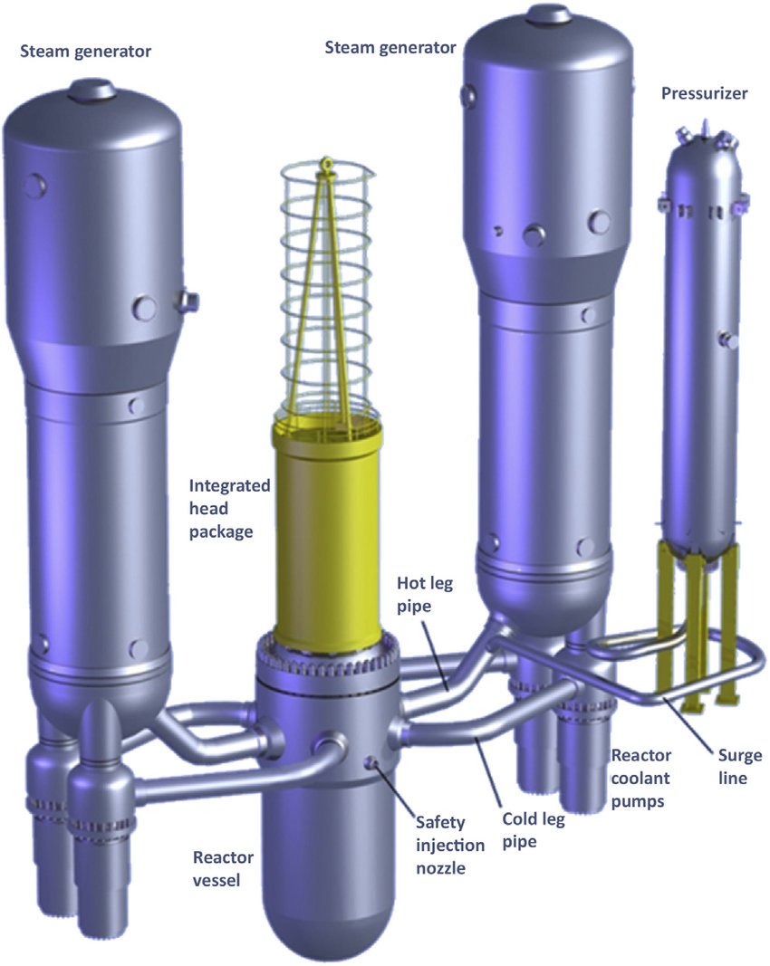
Westinghouse 4-Loop and AP1000
Notes:
Advanced Passive

Slide 6
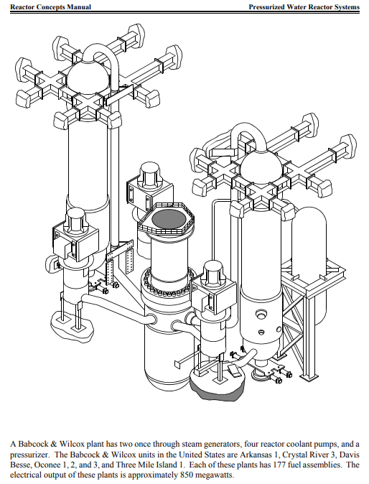
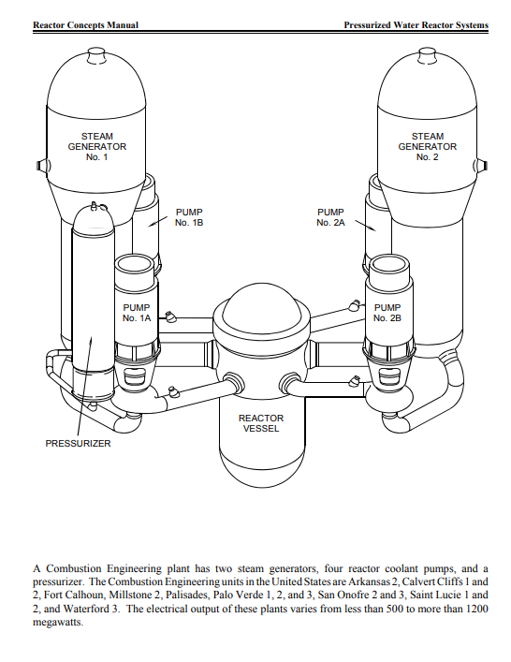
B&W Unit and Combustion Engineering designs
Notes:
CE got into the nuclear business in the 60s as demands for reactors outpaced the foundry capability of Westinghouse and General Electric (BWRs). Before that they made pressure vessels for the fossil industry, hence Combustion.
The NMP1 and Oyster Creek vessels were both poured at the CE foundry in Chattanooga, TN

Slide 7
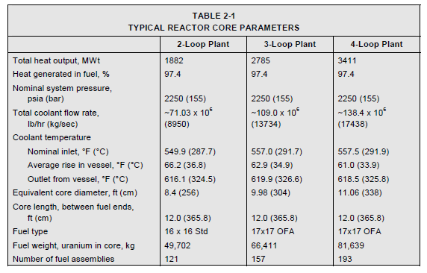
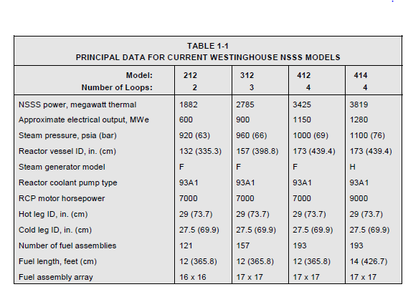

Slide 8
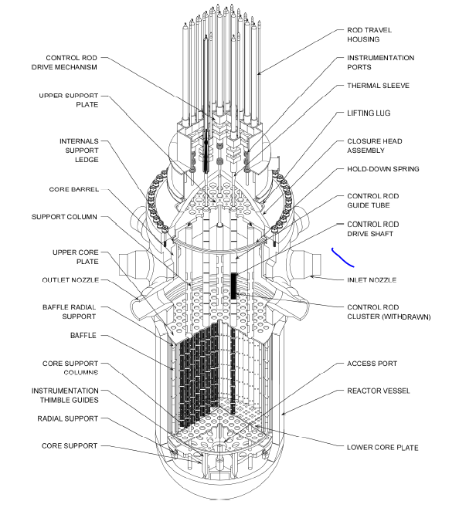
Representative Reactor Pressure Vessel (RPV) w/ notable penetrations

Slide 9
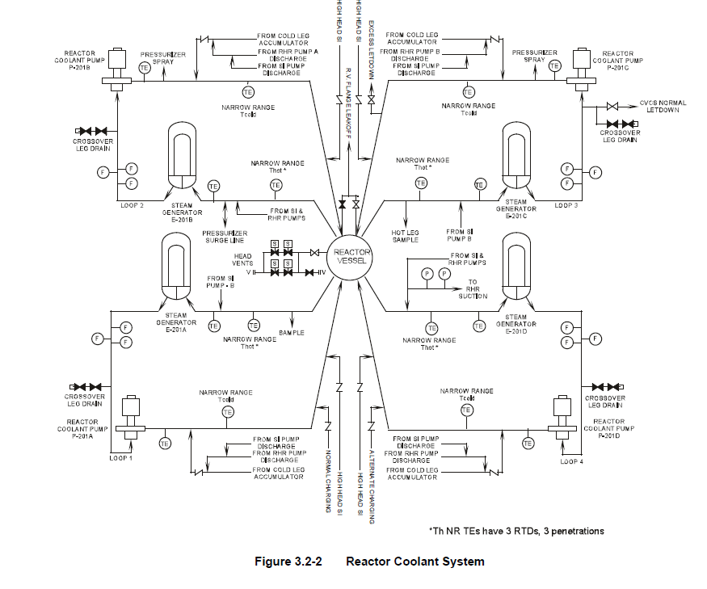
Simplified Reactor Coolant System (RCS) Diagram

Slide 10
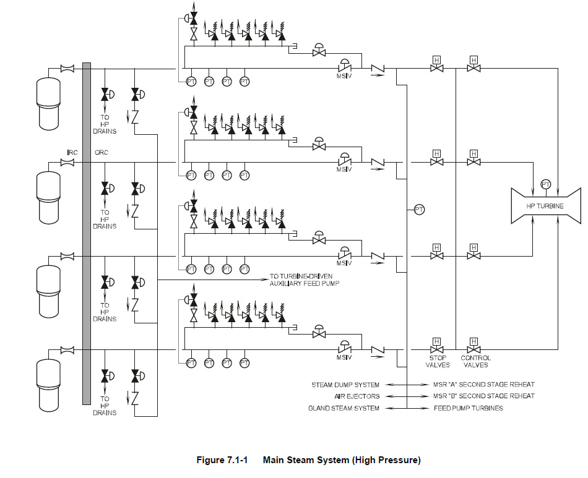
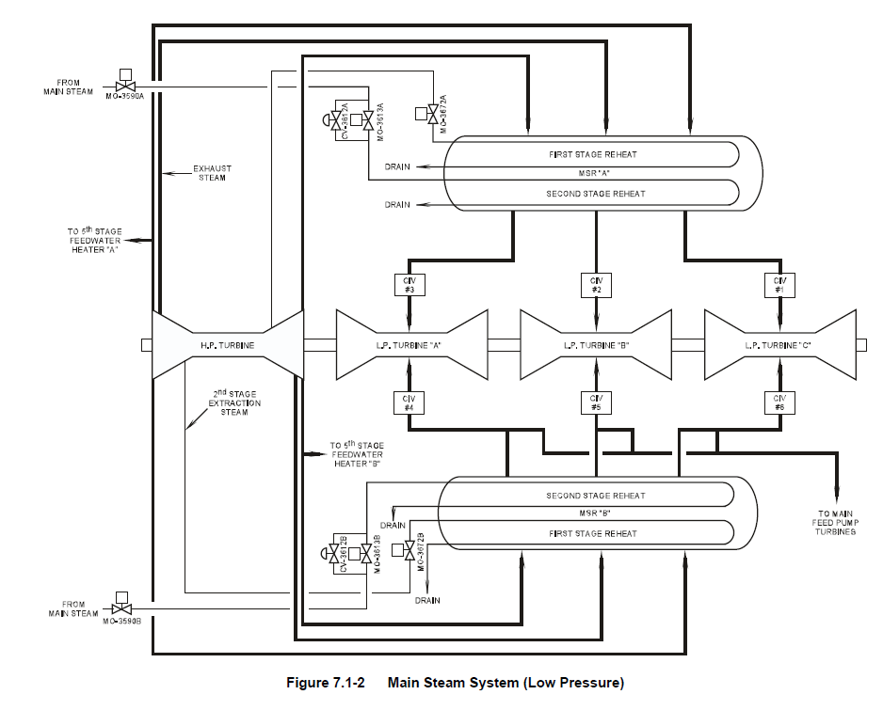
The Main Steam System connects to the Generator (not shown)
Notes:
Where we make our electricity
Clean steam and turbine deck. Can stand right next to all the equipment with simple personal protective equipment (PPE)
On the one side of the turbine deck of Diablo Canyon, you have a great view of the Pacific Ocean

Slide 11
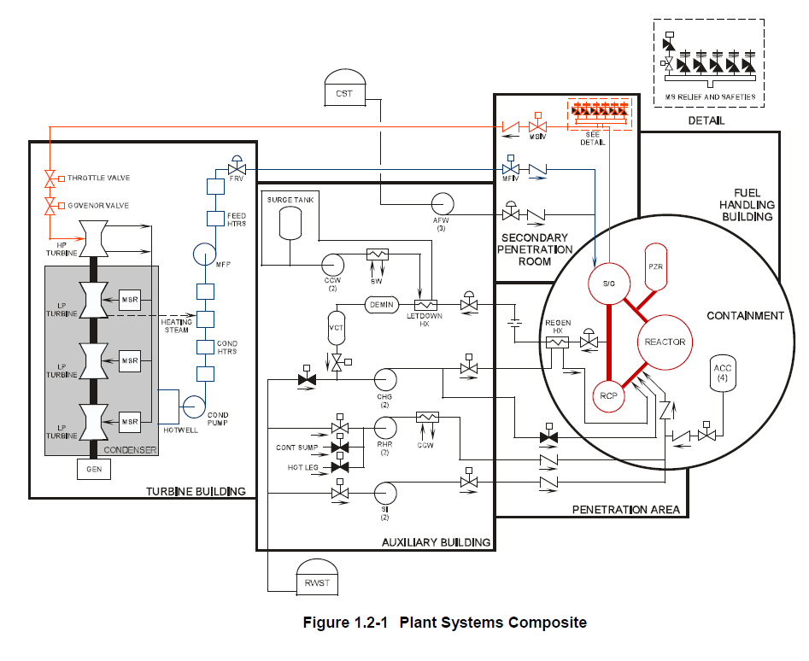
Everything tied together

Slide 12
What’s the most important part of a PWR plant?
Might think it’s the turbine-generator since that’s where we generate electricity
Might think it’s the people since w/o qualified folks the plant can’t run
It’s Nuclear Safety
Notes:
If you take nothing else away from this lecture, know nuclear safety is the most paramount thing we take seriously.

Slide 13
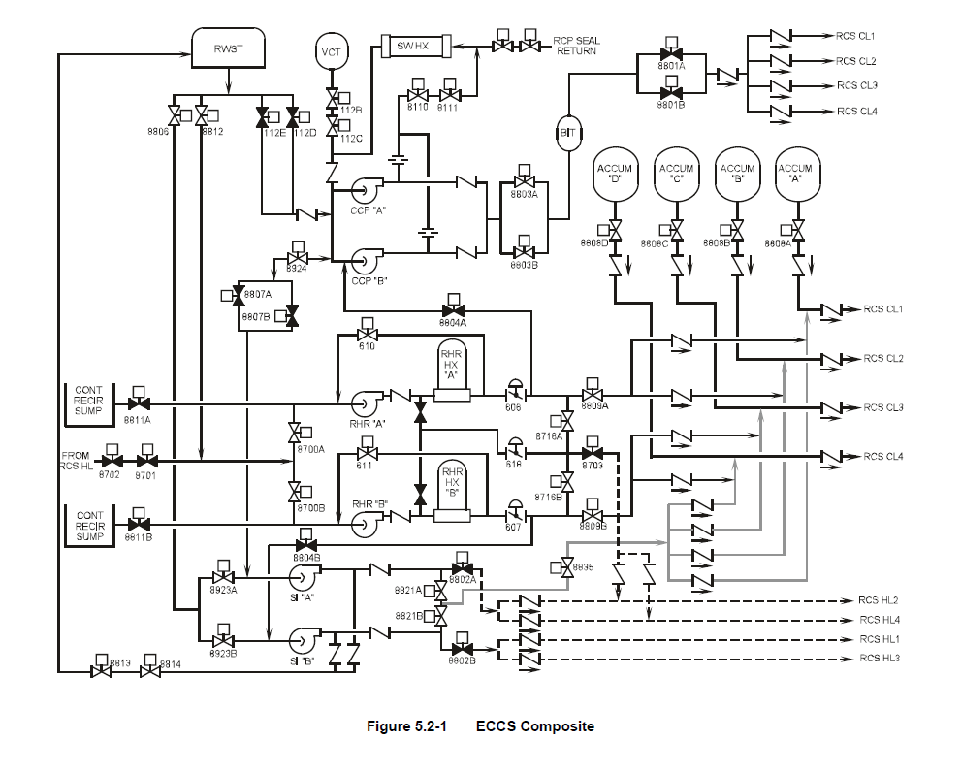
Simplified diagram of ECCS
Notes:
Q: Why do we have ECCS?
A: Residual heat

Slide 14
All plants employee ‘Defense in Depth’ and Redundancy
Multiple trains of safety systems in the event one fails
  On-site diesel generators in protected enclosures in the event we lose power from the grid
Due to high pressure/temperature of the plants after shutdown, employee different safety systems at different conditions
  High pressure ECCS: pumps used for low flow, high pressure
  Intermediate pressure ECCS: pumps used for intermediate flow, intermediate pressure (passive accumulator tanks w/ check valves opened once pressure lowers below a threshold)
  Low Pressure ECCS: pumps used for high flow, low pressure
    Residual Heat Removal (RHR) pumps used for this. Normally only used during outages
  Overall goal is to keep the core covered in the event of a line break or valve opening
  Containment spray also used to reduce temperature, pressure, and potential airborne radionuclides in containment
  Two is one, and one is none

Slide 15
Why do we care so much?
We use FEET of concrete and steel for our containment
We train all our workers on safety first and emergency response
We spend millions every year on inspections, preventative maintenance, and training
  Most regulated industry/entity in the country
We share operational experience (OPEX) between all U.S. plants; regardless of whether they are in Exelon
  One negative incident can affect the entire industry
Bottom line, we can’t have another Chernobyl, Fukushima, etc.
  We have to keep the health and safety of the public at the forefront of everything we do, and meet our societal obligations
  Perception is Reality
Notes:
Q: Why do we use concrete and steel in conjunction together?
A: Same reason as other buildings; steel and concrete have similar thermal expansion/contraction characterizes. Bother are VERY good under compressive load as well

Slide 16
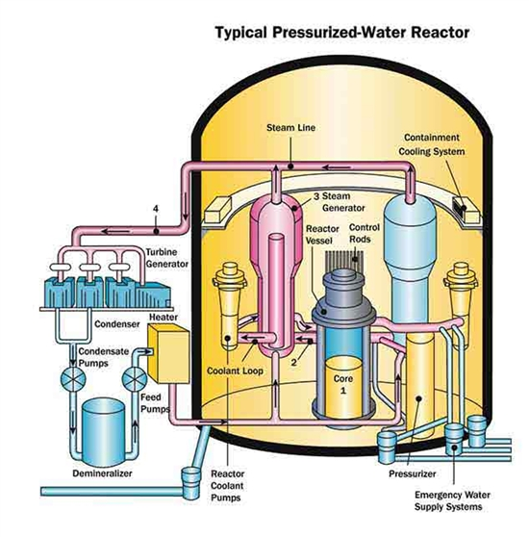
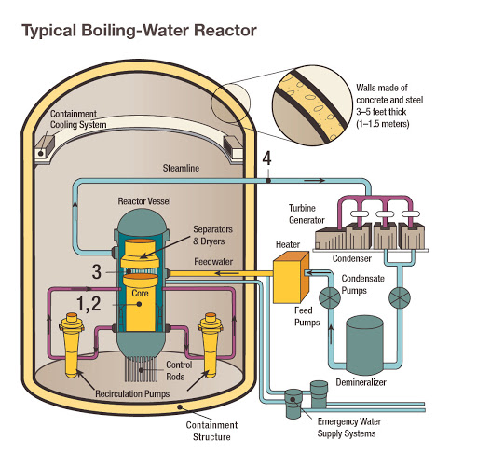
PWRs vs BWRs
Notes:
PWR: https://www.nrc.gov/reactors/pwrs.html
BWR: https://www.nrc.gov/reactors/bwrs.html

Slide 17
The plants have fundamental differences in operation
PWRs
BWRs
~2200 PSIA operation in the primary side
  ~1000 PSIA on secondary/power side
‘Clean’ feedwater and steam; no radioactive products
Single phase flow in the primary side
Control rods located on the top of the core
Containment not accessible at power
Large dry volume for steam containment
Use of boron for reactivity control
~1000 PSIA operation in the primary side
‘Dirty’ feedwater and steam; steam driven predominantly by N-16 in the steam
  Shielding needed around the turbine building
Easier to perform load-following maneuvers (power changes to meet grid demand)
Two-phase flow in the core; tougher to model
Control blades located on the bottom of the core
Secondary containment accessible at power
Mass of water inside primary containment for quenching/cooling steam during loss of coolant accident (LOCA)
Boron only used for emergencies
Notes:
Balance of plant sides are very similar. Steam spins a turbine-generator, waste heat removed by a condenser, some steam diverted for feedwater heating, water purification, etc.
I don’t know about y’all, but I tend to trust gravity
If you borate a BWR, you probably aren’t starting it back up. If you are, lot of time and $$$ to do so

Slide 18
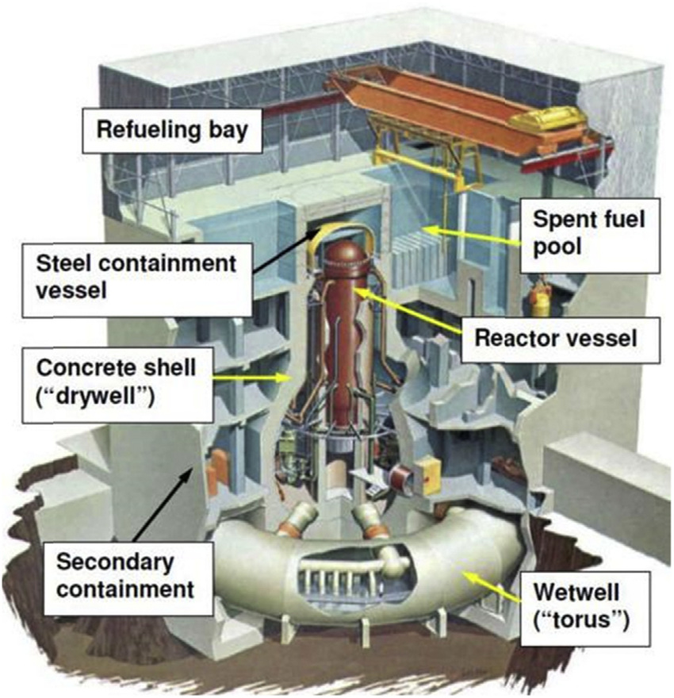
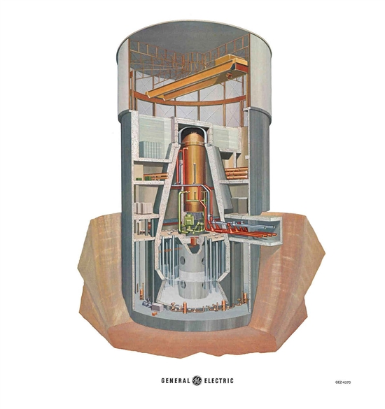
BWR Mark 1 vs. Mark 2 Containment

Slide 19
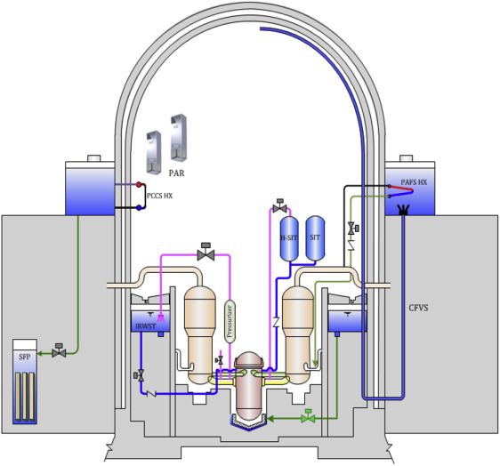
“Typical” PWR containment
Notes:
Containment on the Braidwood slide is pretty typical. Steel skeleton on outside shared between Byron, Braidwood, and Zion Designs. Diablo Canyon I would call ‘classic’ 4-LP containment
Different companies covered the so-called tendon studs in different ways. Byron/Braidwood/Zion can/did get a lot of snow. Diablo Canyon does not got snow for example

Slide 20
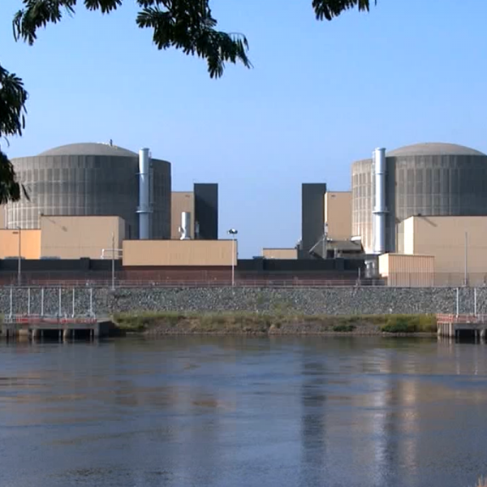
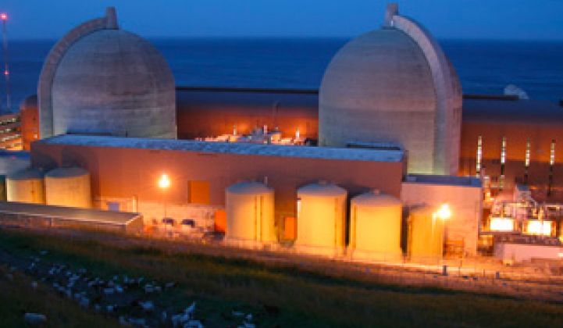
Diablo Canyon vs. McGuire: Why do you think the containment designs differ so drastically considering they are W4-LPs?
Notes:
A: McGuire, Catawba (almost identical to McGuire), Watts Bar, Sequoyah (almost identical to Watts Bar), and DC Cook have ice condenser containment. Essentially, there’s a layer of baskets filled with ice in containment designed to absorb energy during a LOCA and melt. Allows for a reduced volume in containment and smaller profile (analogues to BWR suppression pool/torus)
Q: Why was this design chosen?
A: Real Estate: at least for McGuire and Catawba the plants are on prime lake/water front real estate and they don’t crowd out the area and blend in.
My 2 cents: I get the real estate argument. Going to be WAAAAYYY more expensive in the long run to run the electricity to keep the ice frozen than using more concrete. Always support a passive/simple design vs. an engineered solution. (Not to mention those plants have been the subject of way more scrutiny during accident scenarios and NOT maintaining the baskets well). WithWBN and SQN too, it’s weird since they have giant ‘classic’ cooling towers.

Slide 21
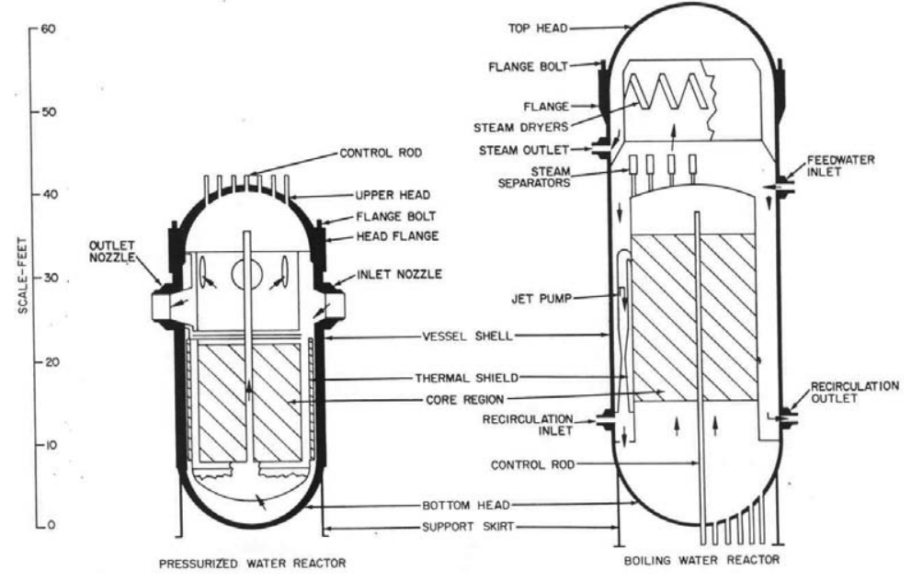
The Reactor Pressure Vessel difference between reactor types is impressive
Notes:
https://www-pub.iaea.org/MTCD/Publications/PDF/Pub1382_web.pdf
BWR vessel bigger to accommodate higher number of fuel assemblies as well as steam separator and steam dryer
BWRs have numerous penetrations on the lower portion of the vessel for control blade insertion

Slide 22
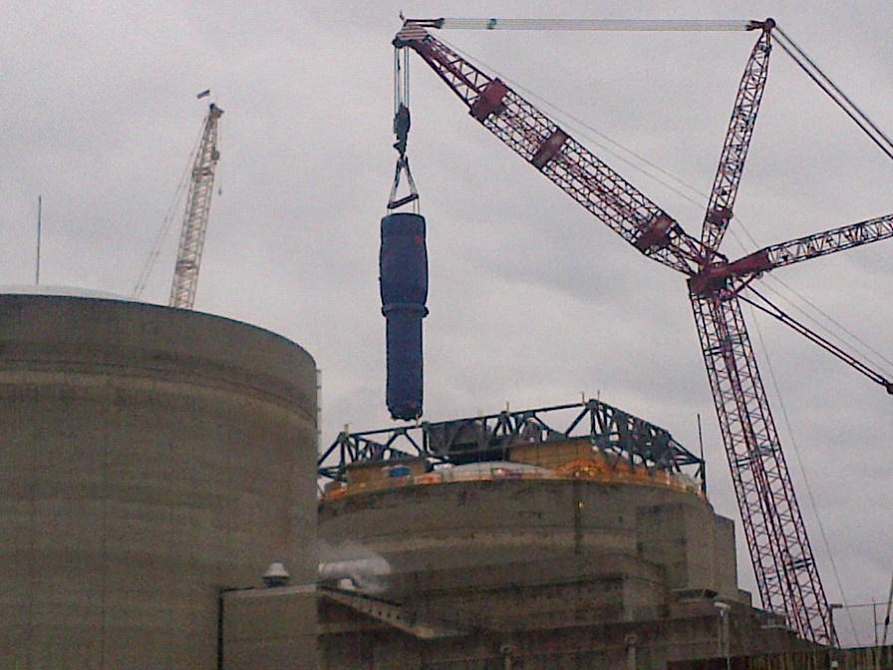
Why did some utilities/municipalities choose BWRs over PWRs?
Notes:
Steam Generator replacement. Tough evolution where you have to cut a segment out of containment and replace
Easier to load follow with recirculation pump flow changes
Familiarity with fossil steam plants
What they could get a deal on

Slide 23
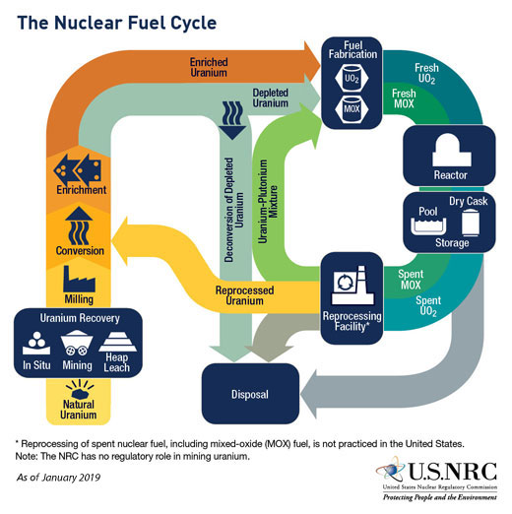
Nuclear Fuel
Notes:
https://www.nrc.gov/materials/fuel-cycle-fac/stages-fuel-cycle.html

Slide 24
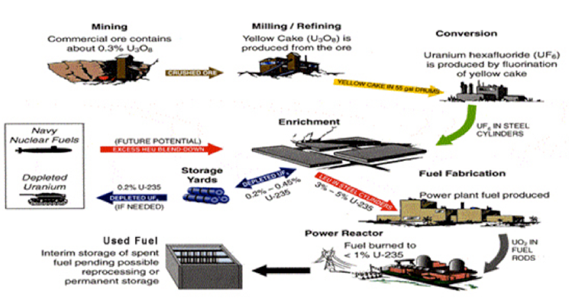
The general fuel cycle is the same for PWR and BWR fuel
Uranium containing ore mined, processed to pure U₃O₈, converted to UF₆, enriched, converted to UO₂ powder
Powder is compressed into pellets and may be mixed with other additives, then sintered in a furnace
Pellets are placed into metal cladding with upper and lower end plugs, He backfilled (heat transfer purposes), springs (transport), then completed with upper and lower end fittings
  Coolant travels through the bottom of the assembly to remove nuclear heat
  Fuel bundles have debris filters to prevent debris from impacting cladding and causing damage
Notes:
https://www.energy.gov/ne/fuel-cycle-technologies/uranium-management-and-policy/nuclear-fuel-cycle
Q: Why would a breach of cladding from debris be an issue?
A: Release of gaseous fission products, washout of soluble products into coolant, potential exposure to workers and the public, list goes on

Slide 25
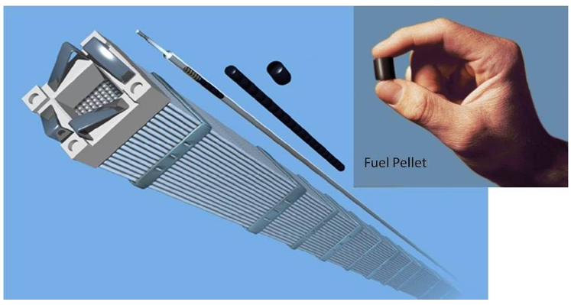
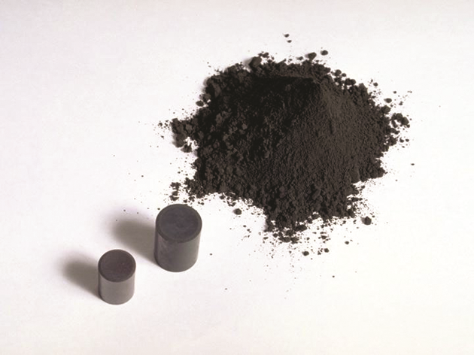
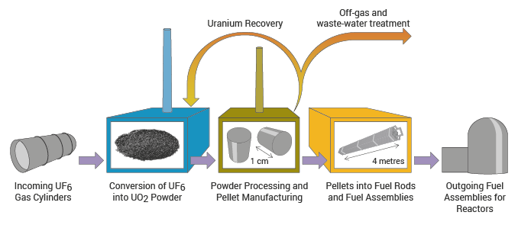
Fabrication/Assembly is similar between fuel types and vendors, with propriety methods employed at each
Notes:
https://www.world-nuclear.org/information-library/nuclear-fuel-cycle/conversion-enrichment-and-fabrication/fuel-fabrication.aspx
https://www.world-nuclear.org/nuclear-essentials/how-is-uranium-made-into-nuclear-fuel.aspx
https://nuclear.duke-energy.com/2014/02/11/do-we-have-enough-nuclear-fuel

Slide 26
Materials composition of BWR and PWR fuel is very similar
Low enriched (> 5% U²³⁵) Uranium fuel max
  Administratively limited to 4.95% to allow for measurement uncertainty
  Differences lie in enrichment levels axially (vertically) and in fuel pins
    Most common PWR fuel is a 17x17 grid while BWR fuel is a 10x10 grid
    PWR fuel is taller and wider than BWR
    Standard Westinghouse 4-loop has 193 fuel assemblies
    BWR vary across generations, with the larger units having 764 assemblies
  Zirconium Alloy (Zircalloy) cladding
    Chosen due to balance of heat transfer characteristics, cost, neutron absorption, accident capability
    GNF (General Electric), Westinghouse, and Framatome use proprietary blends of Zircalloy
  Burnable absorbers mechanically blended in some fuel pellets
    Gd₂O₃ powder added to UO₂ powder prior to pellet creation
    Other absorbers (Erbium, Boron) used as well

Slide 27
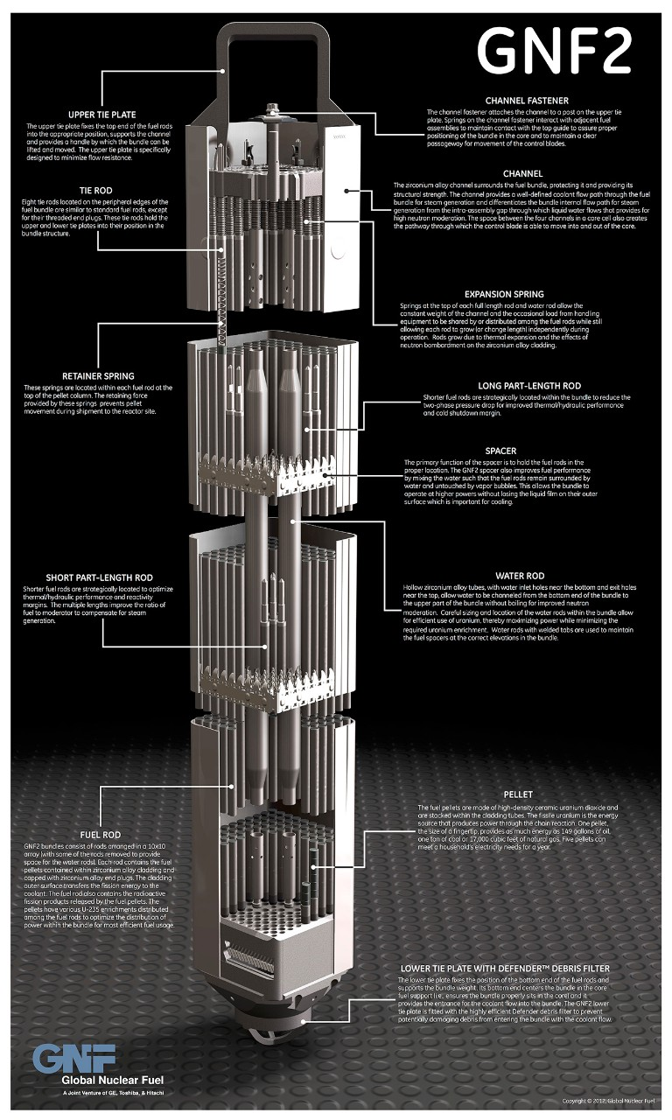
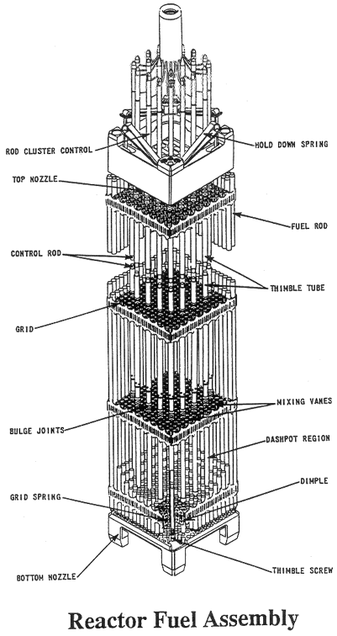
BWR vs PWR fuel
Notes:
https://nuclear.gepower.com/fuel-a-plant/products/gnf2-advantage
https://www.nrc.gov/reading-rm/basic-ref/students/for-educators/reactor-fuel-assembly.html

Slide 28
Further Reading
NRC PWR Systems Overview: https://www.nrc.gov/reading-rm/basic-ref/students/for-educators/04.pdf
NRC BWR Systems Overview: https://www.nrc.gov/reading-rm/basic-ref/students/for-educators/03.pdf
Accident Tolerant Fuel: https://www.energy.gov/ne/articles/these-accident-tolerant-fuels-could-boost-performance-today-s-reactors ; https://www.energy.gov/ne/articles/5-things-you-should-know-about-accident-tolerant-fuels
U.S. Energy Information Administration: https://www.eia.gov/
Westinghouse Technology Systems Manual: https://www.nrc.gov/docs/ML2005/ML20057E160.pdf
Books
Atomic Accidents: A History of Nuclear Meltdowns and Disasters: From the Ozark Mountains to Fukushima: https://www.amazon.com/Atomic-Accidents-Meltdowns-Disasters-Mountains-ebook/dp/B00HVPI1IA
The Nuclear Express: https://www.amazon.com/Nuclear-Express-Thomas-C-Reed-ebook/dp/B004GJVXL6/ref=sr_1_1?dchild=1&keywords=nuclear+express&qid=1601911943&s=digital-text&sr=1-1
The Girls of Atomic City: https://www.amazon.com/Girls-Atomic-City-Untold-Helped-ebook/dp/B008J4GTU4/ref=sr_1_1?dchild=1&keywords=girls+of+atomic+city&qid=1601911990&s=digital-text&sr=1-1
The Grid: The Fraying Wires Between Americans and Our Energy Future: https://www.amazon.com/Grid-Fraying-Between-Americans-Energy-ebook/dp/B01DM9Q6CQ/ref=sr_1_1?dchild=1&keywords=the+grid&qid=1601912010&s=digital-text&sr=1-1
Notes:
EIA is a really nifty website. Lot of cool tools and data on there. Useful for graph building, historical reference, projects, etc.

Slide 29
Organizations I love!
U.S. Women in Nuclear: https://www.winus.org/
Mothers for Nuclear: https://www.mothersfornuclear.org/
American Nuclear Society: https://www.ans.org/

