Slide 1


2020 Outreach Webinar
Conversations about Nuclear

Slide 2
Conversations about Nuclear our speakers
Tara Zachariah – Nuclear Matters policy advisor and Vice President, Boundary Stone Partners
Jennifer Hayden– Deputy Director and Director of Communications, National Museum of Nuclear Science & History
Kristin Waldschlager– Education Outreach Specialist, Consolidated Nuclear Security, LLC
Kelly McPharlin– Senior Manager of Content and Digital Strategy, Nuclear Energy Institute

Slide 3

TYPES OF ADVOCATES
Supporters
Prospects
Skeptics
Opposition
Notes:
It’s easier to talk with supporters and prospective supporters. We’ll focus this presentation on communicating with people who aren’t yet on board. There are two types of critics: skeptics and opposition. More often than not, you can engage with skeptics, and with opposition you might agree to disagree. In both scenarios, it can be a bit nerve-wracking. It’s important to note that oftentimes this engagement will be happing on social media channels. These unfortunately don’t offer for the best discourse, especially with opposition. There are times when you will offer your perspective but then need to just walk away, and we can talk about that.
Here are our recommendations.

Slide 4

ENGAGING SKEPTICS
Do your homework.
Ask about their criticisms to understand perspective.
Point to further resources.
Notes:
Know the common issues that give potential supporters pause about nuclear. And then be ready to answer their concerns. These commonly include safety and waste.
Asking about their perspective, and letting them fully explain it, is critical for having a productive conversation. Usually, the skepticism around nuclear is emotional, and it’s difficult to push back against emotions with facts alone. Simply beginning your response with the following can go a long way: “I understand, and that makes sense you see it that way. I too care about my family’s safety especially in such proximity to generation sources. Can I share where I’m coming from?
Share third party resources that are credible and not biased. Industry resources like NEI and WANO are good starting points, but even better are resources from academics and universities. People have high trust in scientists. You should also do a little digging into the background of your audience, because the person may be swayed more easily by supportive voices in politics, at think tanks, and even in Hollywood. Everyone loves Iron Man, right?

Slide 5

CONFRONTING OPPOSITION
Listen to criticisms to understand perspective.
Be friendly and fact-forward, not confrontational and emotional.
Avoid being dismissive.
Agree to disagree.
Notes:
This group is harder to win over. Similar tactics apply, but don’t be offended if their response is staunch opposition even after you present the best case for nuclear possible.
Staying in the friendly, fact-forward zone and avoiding any emotional baiting is crucial with opponents.
Dismissiveness is tempting, especially given the emotion-laden discussions, but don’t fall into that trap. It’s exactly what opponents are banking on to prove their preconceived notions about apologists for nuclear.
In the end, advocate for your views, but be prepared to agree to disagree.

Slide 6
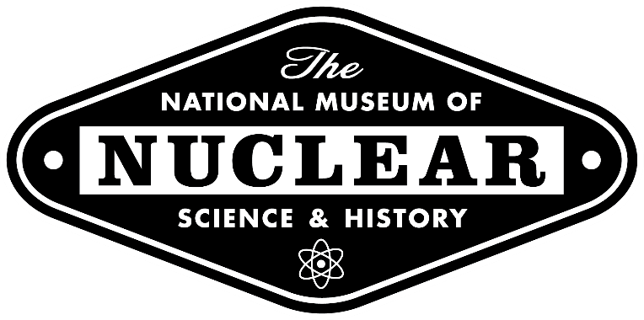
Making Nuclear More Approachable

Slide 7
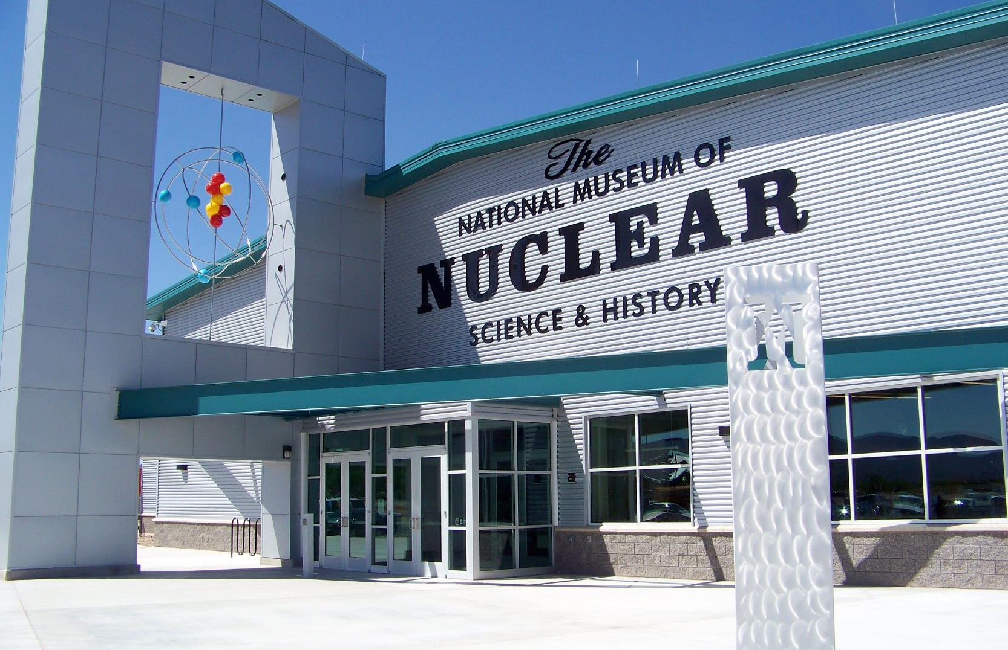

nuclearmuseum.org

Slide 8

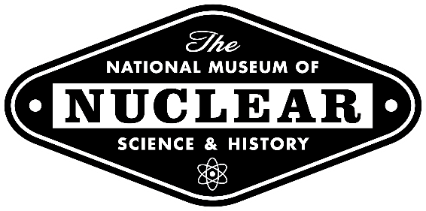
nuclearmuseum.org

Slide 9
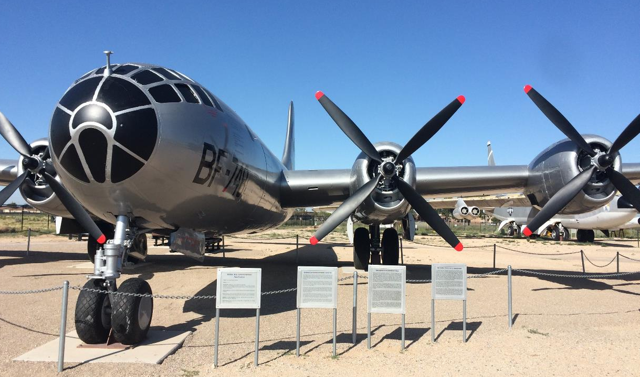
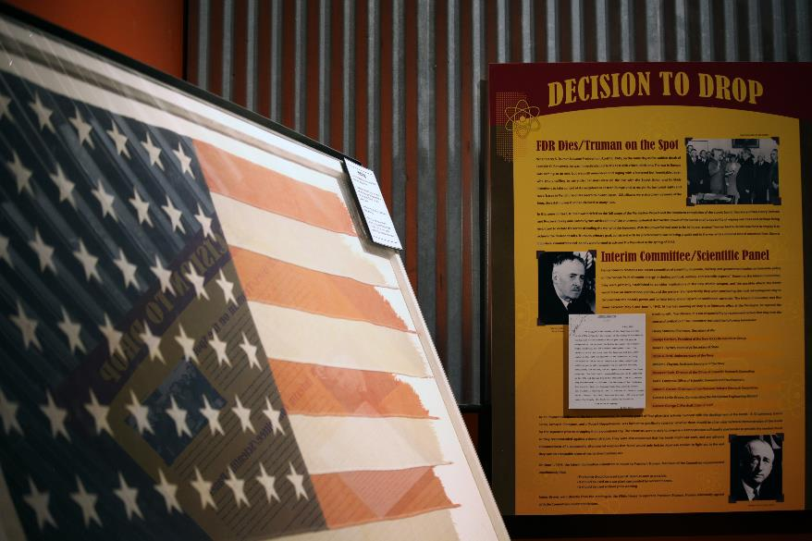
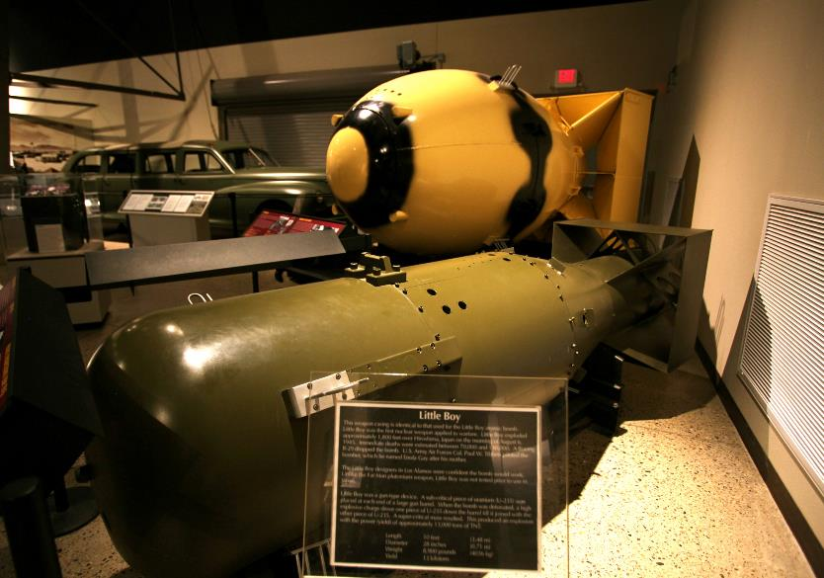

  From Early Development

Slide 10
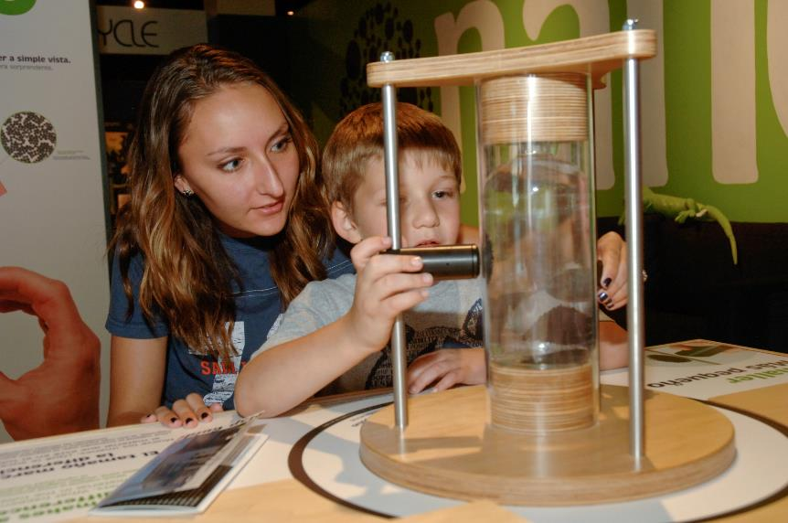
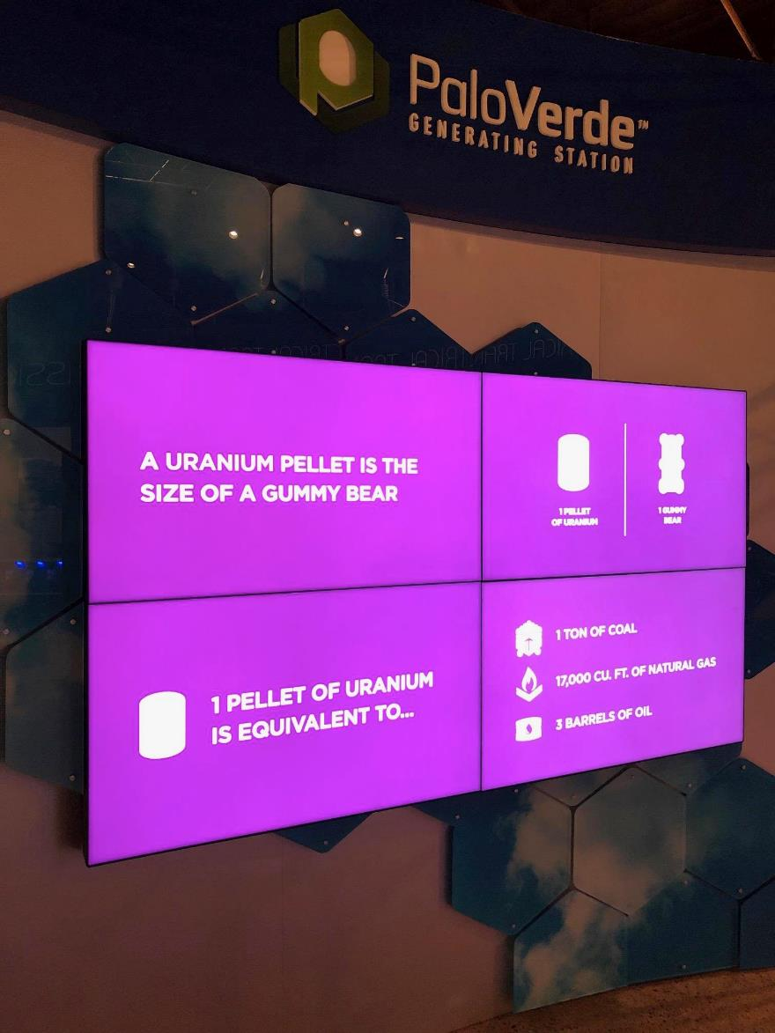
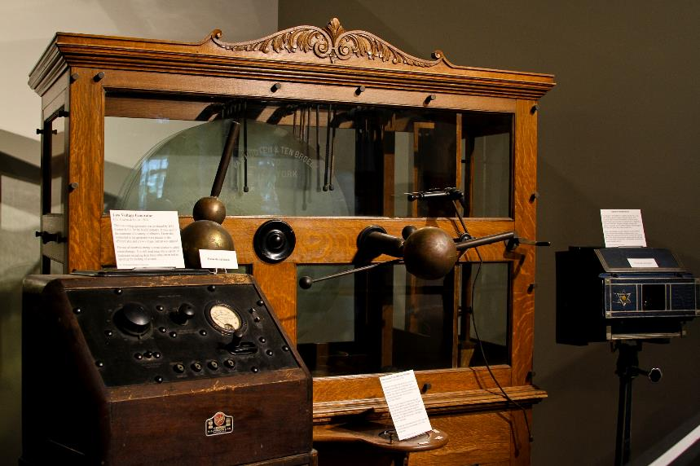
  To Today’s Peaceful Uses

Slide 11
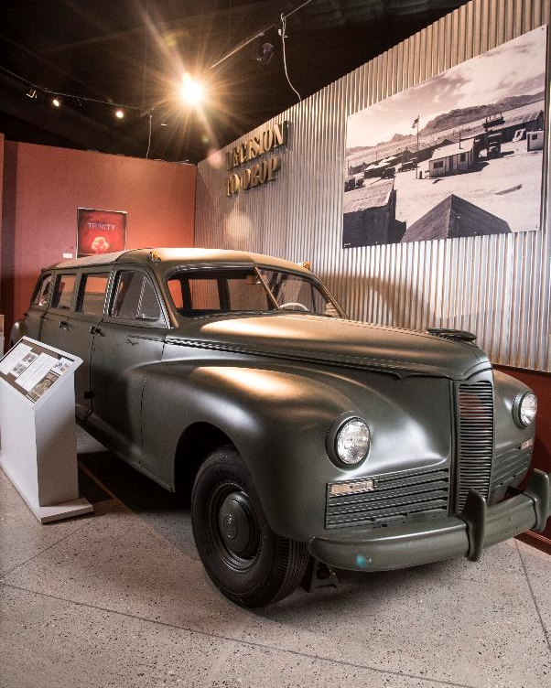
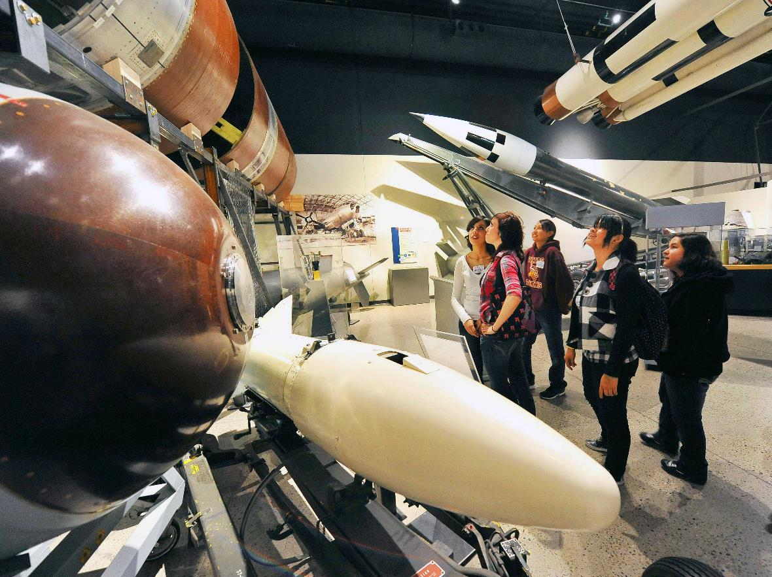
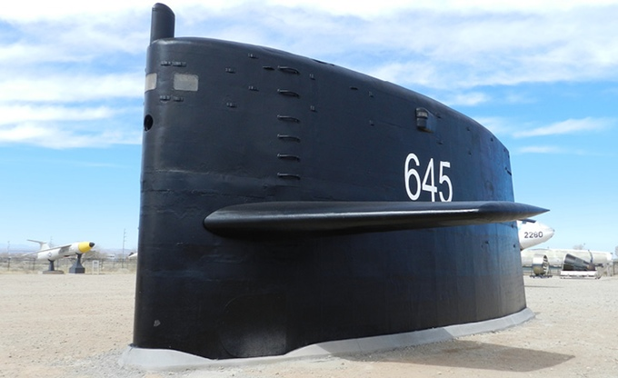
  HISTORY

Slide 12

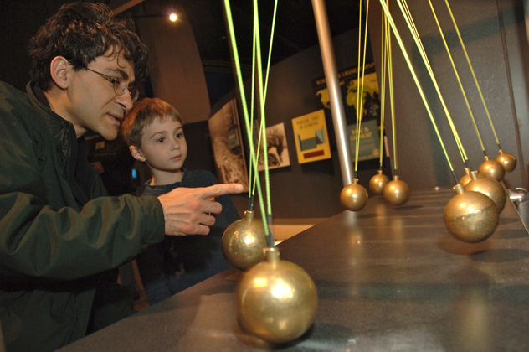
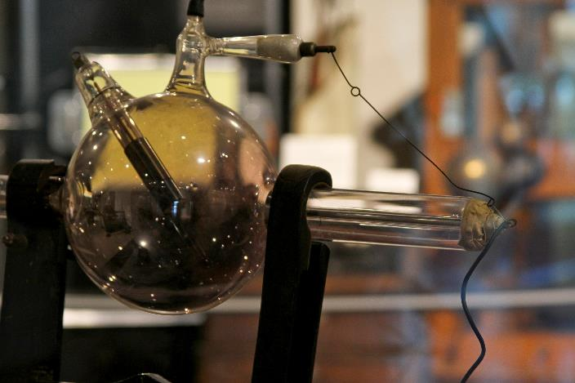
  SCIENCE

Slide 13

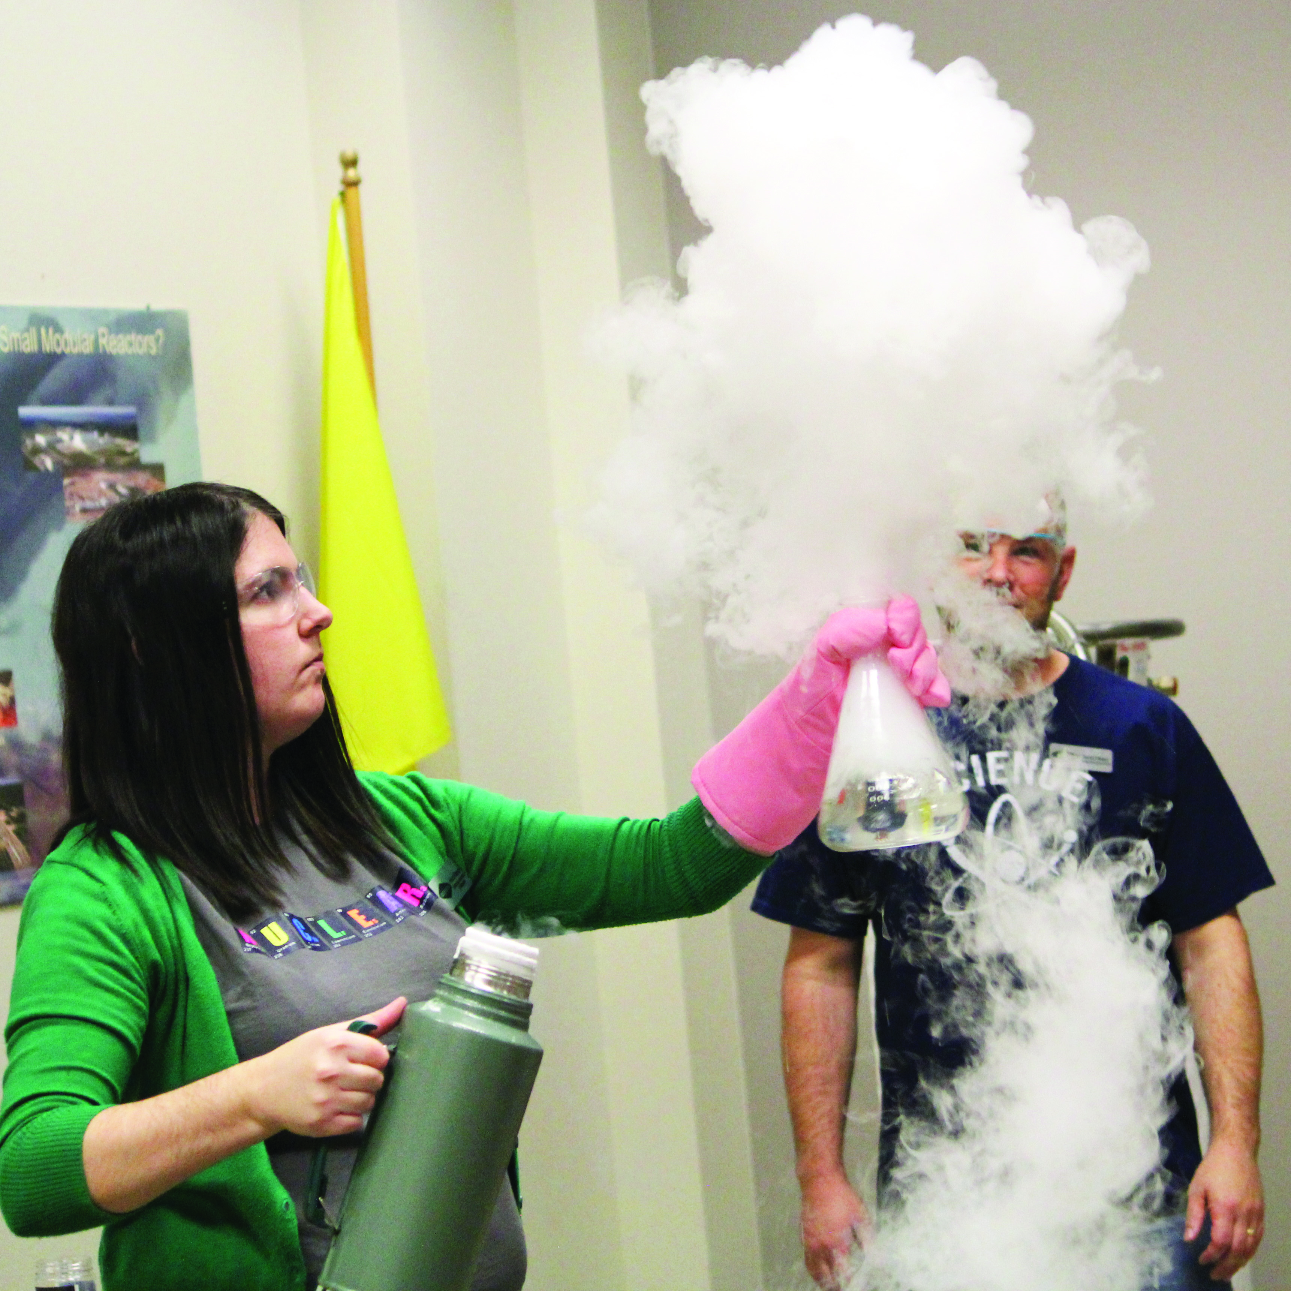
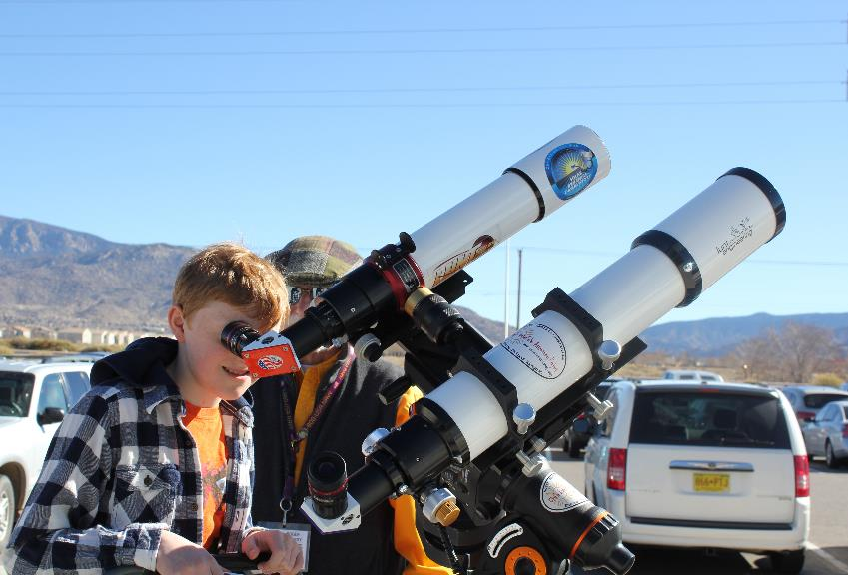
  Events at the Museum

Slide 14



  “Science is Everywhere” Camps for Children

Slide 15
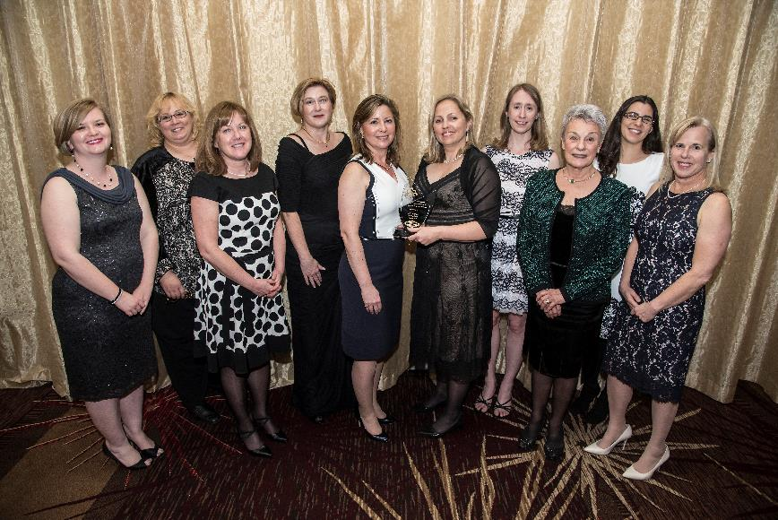
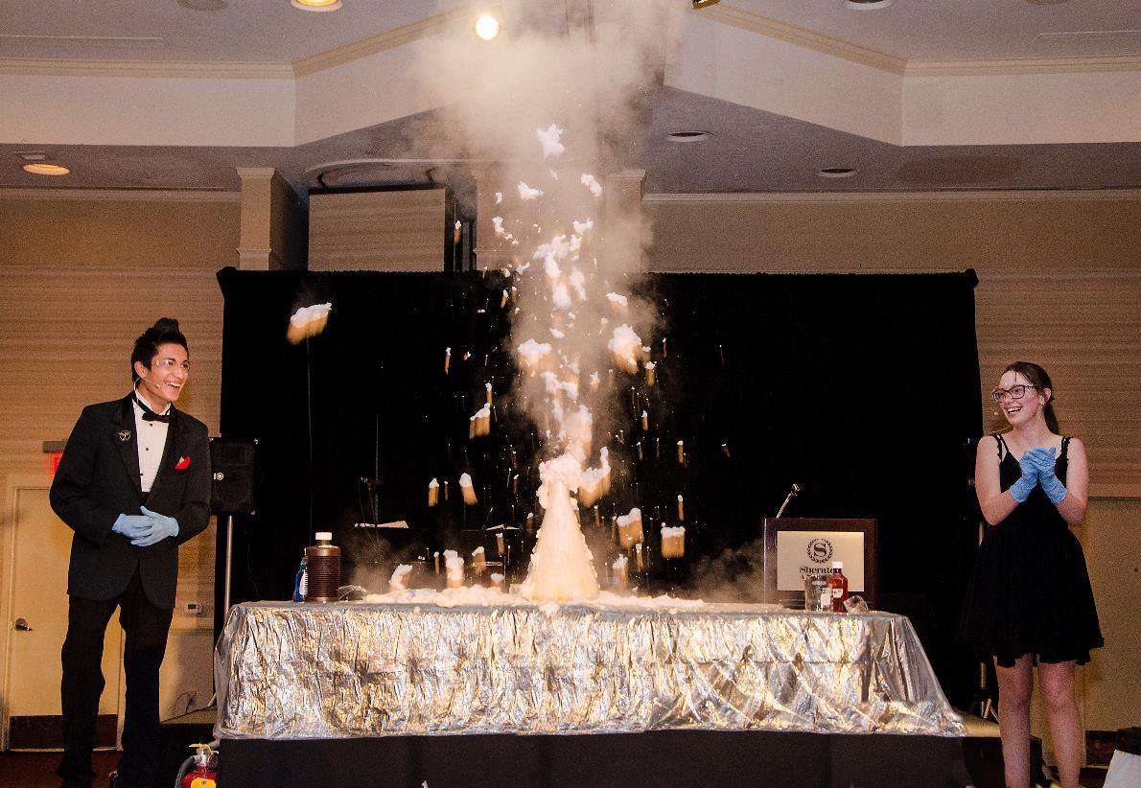
  Einstein Gala
  Past Recipients:
  US Women in Nuclear
  Nuclear Medicine Professional
  Pro-Nuclear Environmentalist
  Director of Naval Nuclear Propulsion
  Southern Company
  Theoretical Physicist
  Nobel Prize Laureate
  Co-Founder of Greenpeace

Slide 16
  nuclearscienceweek.org

Slide 17
Nuclear Science Week invites people from all over the globe to “Get to Know Nuclear” and participate in a week-long celebration that advances education, stimulates participation and generates communication that provides insight and visibility for the achievements of the nuclear sciences.

Slide 18

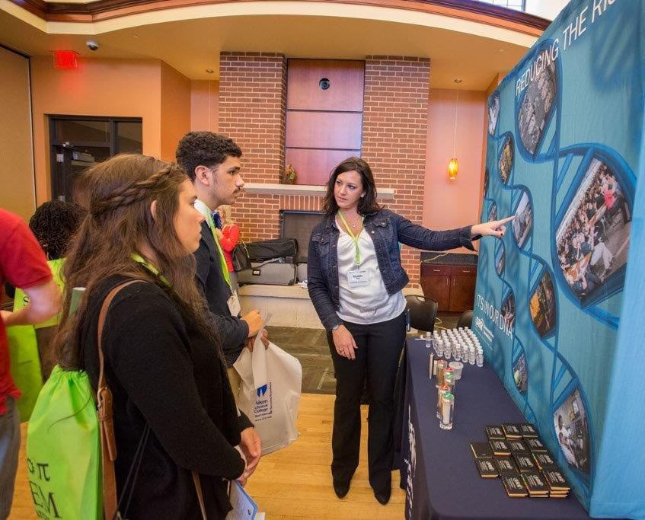

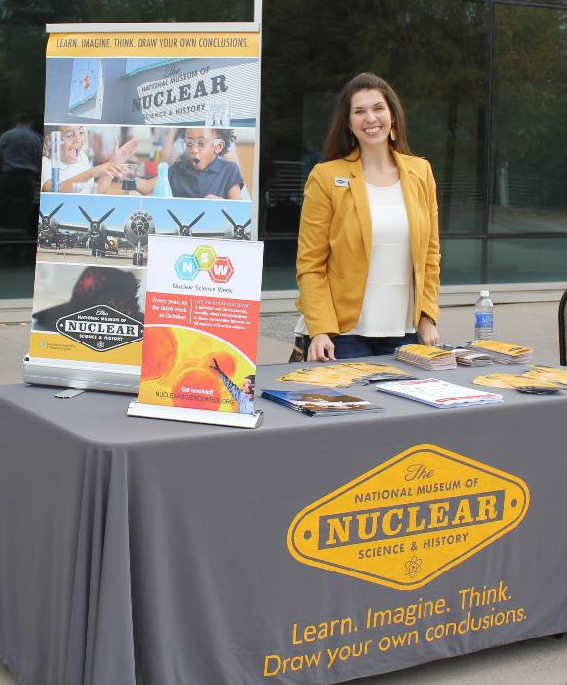

Slide 19
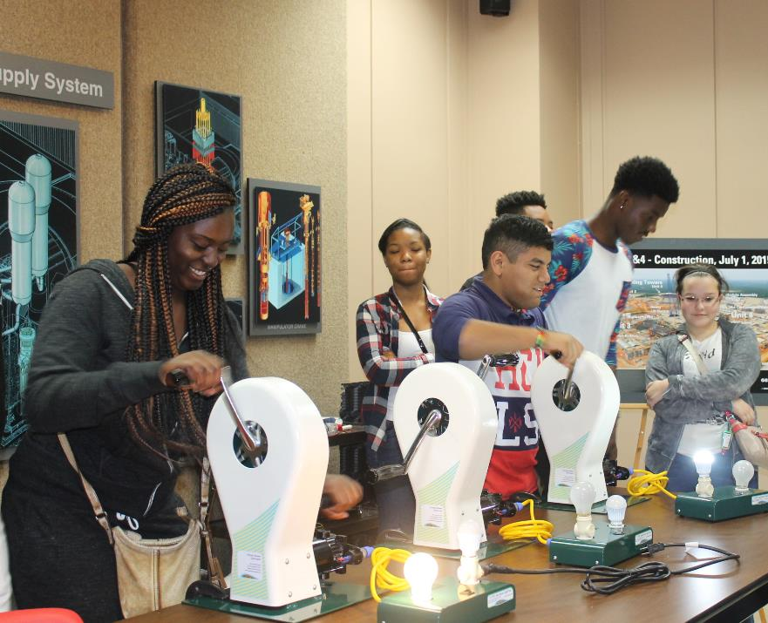
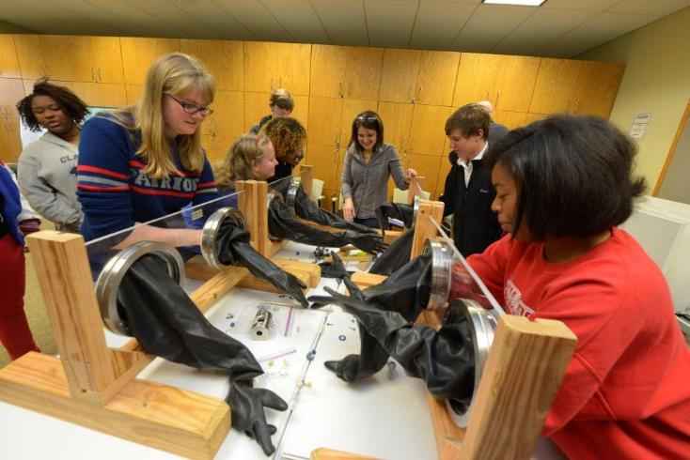
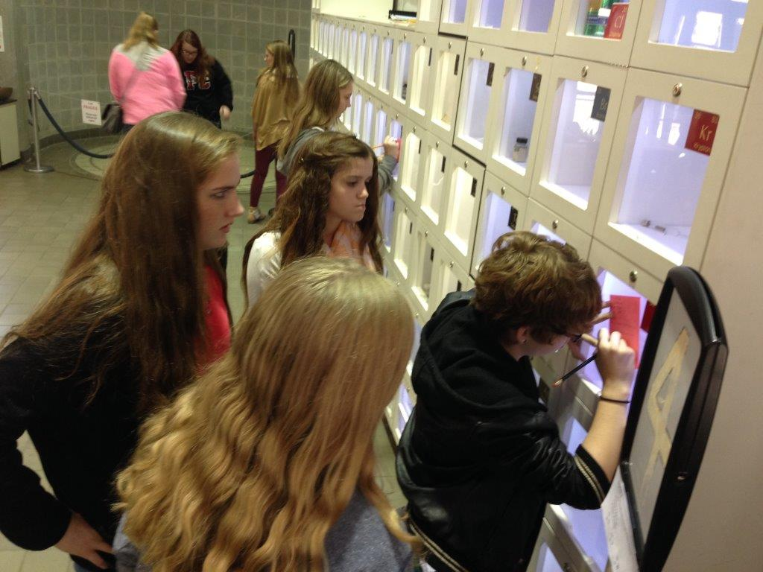
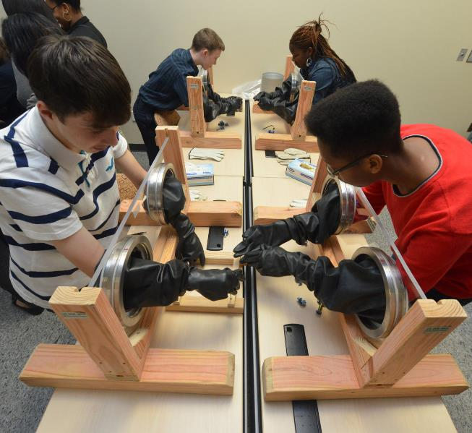

Slide 20



Slide 21
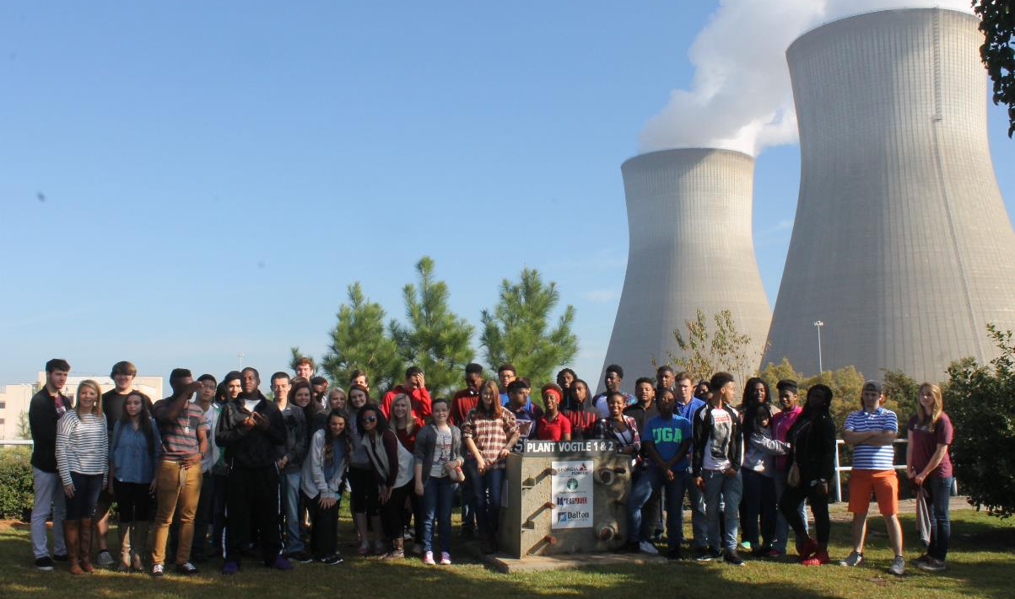
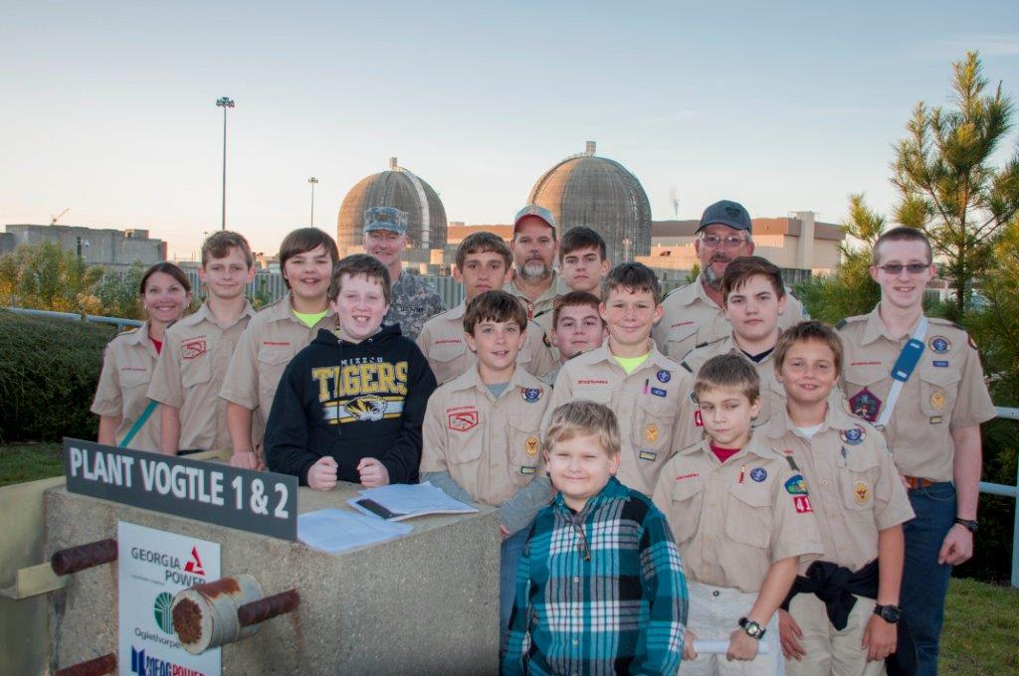
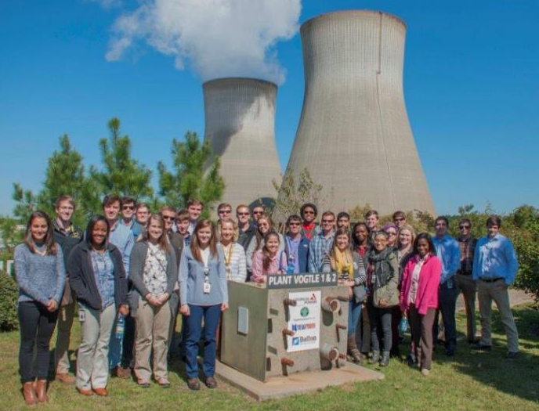

Slide 22
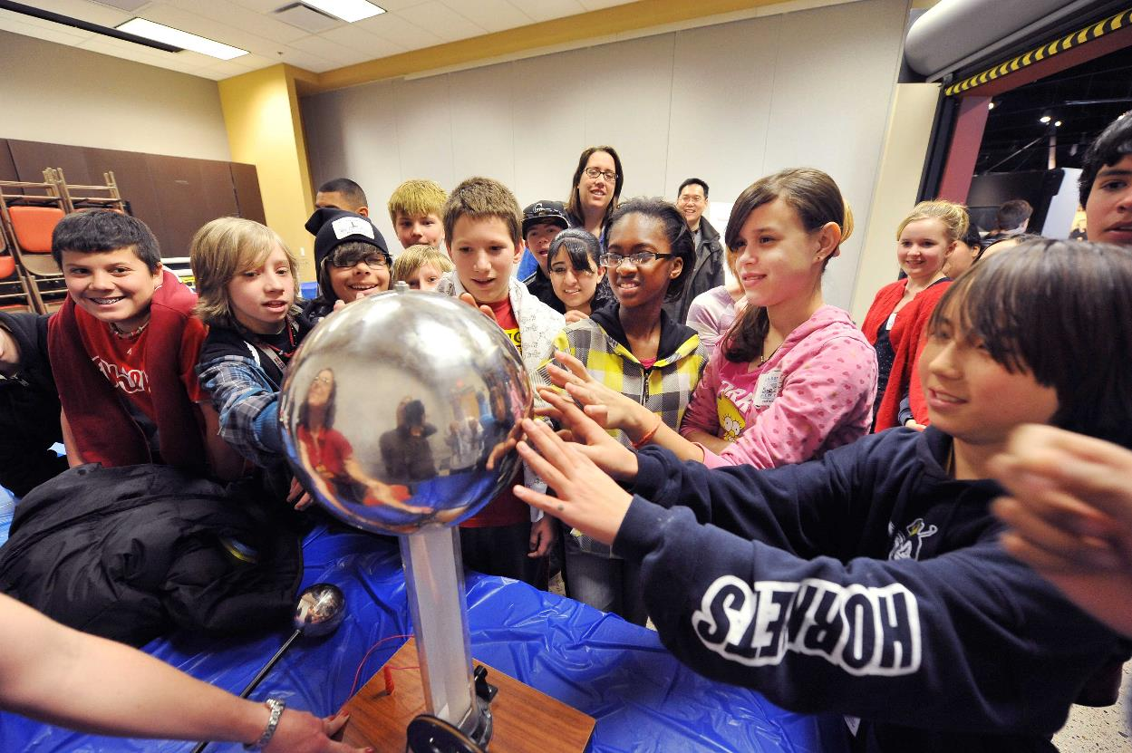
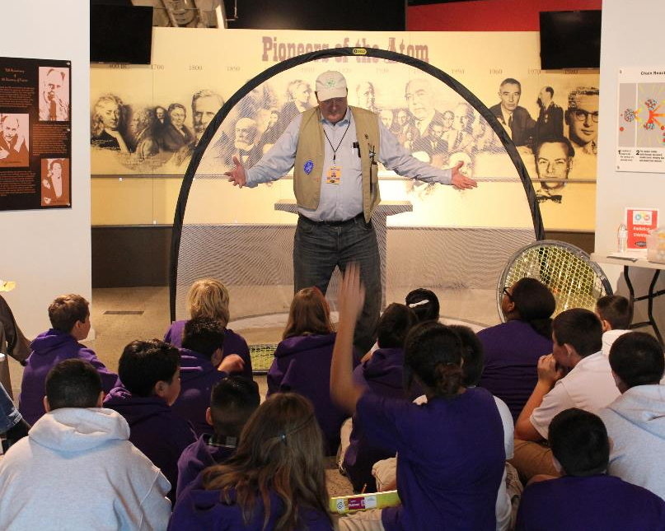


Slide 23
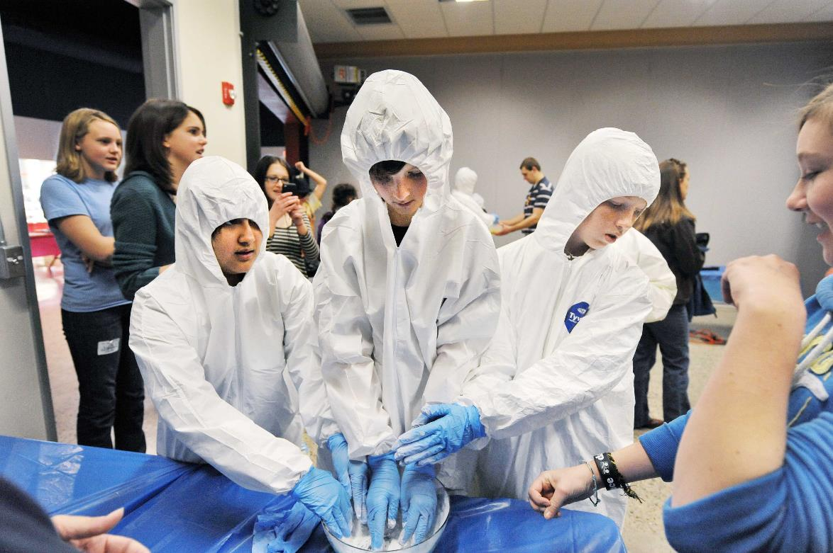
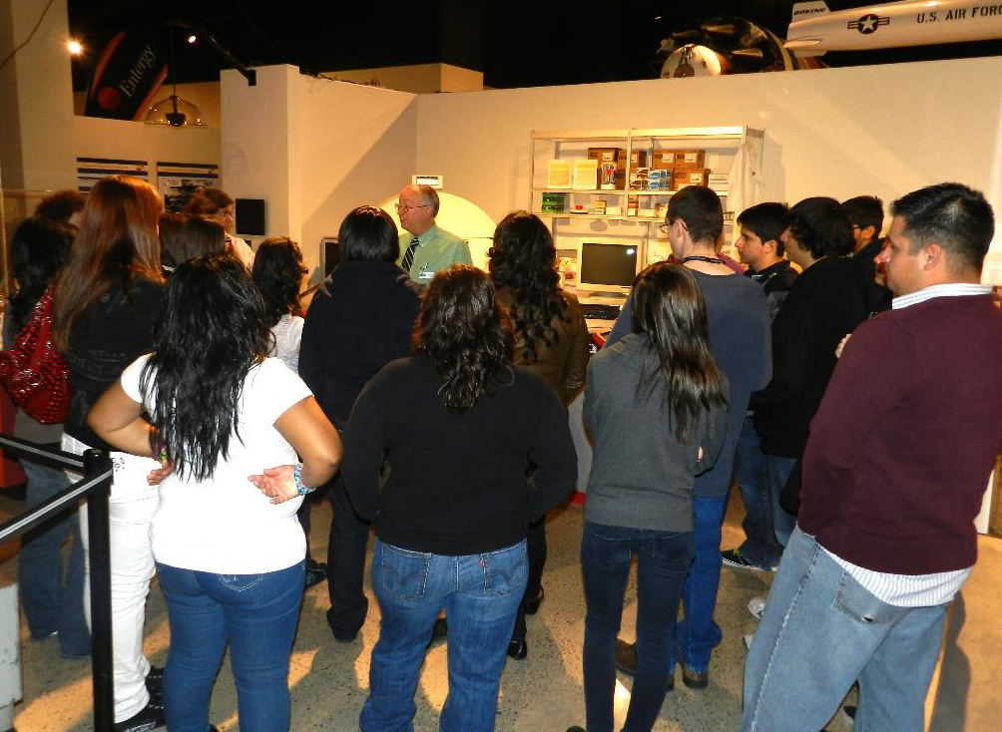
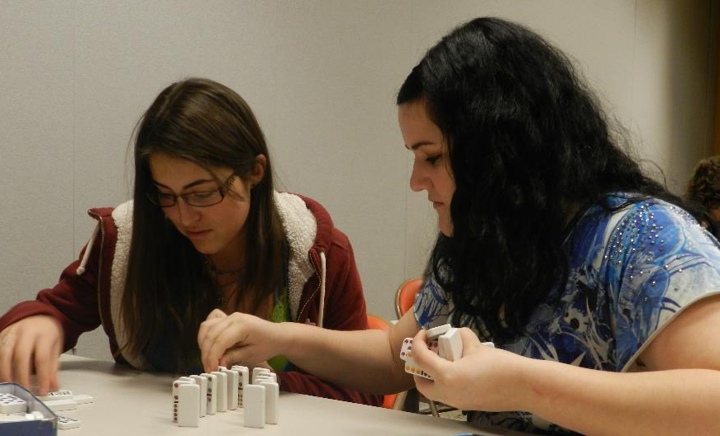

Slide 24
Frequently Asked Questions
Answers to some of our most commonly received questions about the nuclear industry

Slide 25
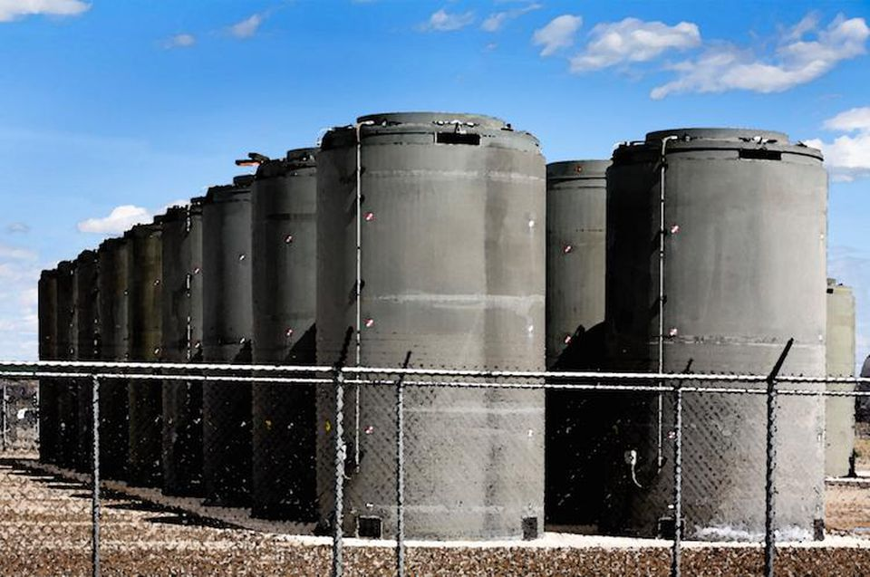
“How is radioactive waste dealt with? Doesn’t it pose an environmental concern?”
Notes:
Nuclear plants produce waste while generating electricity, but it’s not glowing green goo like you see in the movies or The Simpsons.
The waste issue dates back decades ago when the federal government agreed to take ownership of nuclear waste and find a solution to permanently store it. Unfortunately, the politics on how best to manage it led to a stalemate, leaving nuclear plant owners responsible for managing it at the expense of tax payers.
What’s frustrating is this issue has already been solved. Scientific research says the most viable solution is to store used fuel at a geological repository like Yucca Mountain. But to move forward with Yucca Mountain, Congress must grant funding to complete the process.
In the meantime, the nuclear industry knows exactly where its waste is, and it’s securely and safely contained (which can’t be said for all energy sources). Nuclear plant owners store their used fuel on-site based on stringent requirements set by the government. Plus, there isn’t much used fuel out there. Nearly seven decades of waste from using nuclear power would only cover a football field to a depth of less than 10 yards.
Ultimately, losing nuclear power—the largest source of carbon-free electricity in the United States—because of a political issue would set us back in reaching our climate goals.

Slide 26
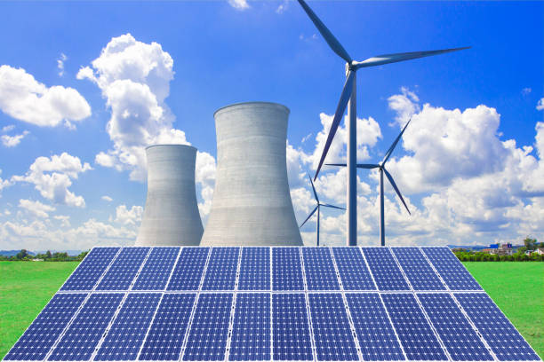
“Shouldn’t we use solar and wind instead of nuclear power?”
Notes:
A diverse group of organizations such as the UN climate body, the World Resources Institute and the Union of Concerned Scientists have all said nuclear energy is necessary if we are going to lower carbon emissions in time to protect the climate.
On top of that, nuclear energy is responsible for nearly 55 percent of the country’s carbon-free electricity. Replacing that much clean power with enough renewable generation would be extremely difficult. According to a report by the Center for Climate and Energy Solutions, “finding a dependable, zero-emitting, cost-effective alternative to nuclear power is challenging."
An all of the above approach that combines intermittent low-carbon sources, such as wind and solar, with around-the-clock sources, such as nuclear energy, is the most effective approach to reduce carbon emissions.
Even better, advanced nuclear designs, several originating in the United States, are being developed and deployed around the world specifically to pair with renewables more efficiently that existing reactors.

Slide 27
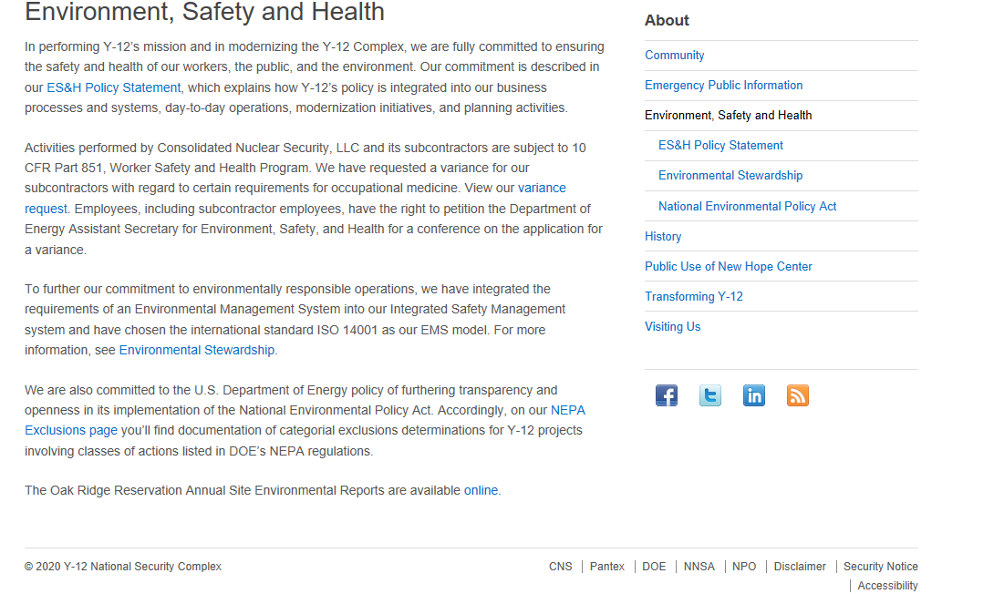
“Is nuclear power dangerous?”

Slide 28
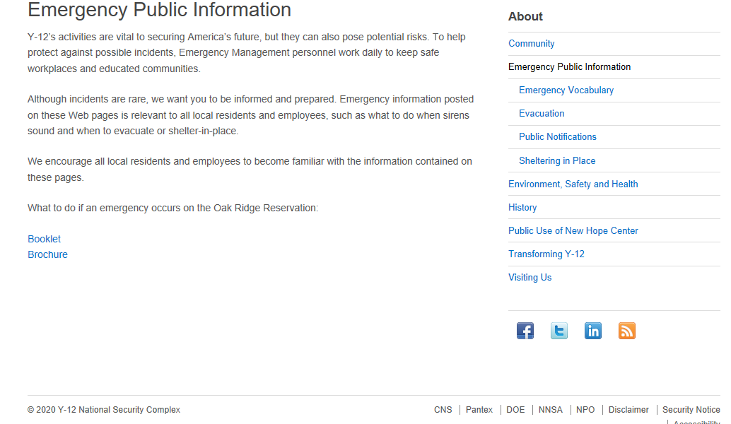
“How will I know if there is an emergency at my local plant and what would I do to respond?”

Slide 29
“You work in a nuclear industry. Shouldn’t you be glowing green?”
Control operators do not work by themselves.
Commercial nuclear spent fuel is not a liquid.
Nuclear waste is safely stored.
Nuclear power plants do not cause mutations.
https://www.energy.gov/ne/downloads/ultimate-fast-facts-guide-nuclear-energy

Slide 30
Mythbuster Minutes

Slide 31
“Nuclear plants emit radioactive material into the atmosphere.”
“Don’t swim in the lake near the plant or you’ll get contaminated!”
“Nuclear waste is destroying our environment.”
“We don’t need nuclear if we have wind and solar.”
“Nuclear power is more expensive than other forms of energy and increases our taxes.”

Slide 32
How to respond?
State the basic facts.
Then pivot to larger points on nuclear’s benefits.
Share your story or perspective.
Listen.

Slide 33
Questions???

Slide 34
Conversations about nuclear
Contact Information
Tara Zachariah – tara@boundarystone.com
Jennifer Hayden – jhayden@nuclearmuseum.org
Kristin Waldschlager – Kristin.Waldschlager@cns.doe.gov
Kelly McPharlin – klm@nei.org

Slide 35
Conversations about nuclear
Additional Resources
What Happens to Nuclear Waste in the U.S.?
The Future of Nuclear Energy in a Carbon-Constrained World
The Ultimate Fast Facts Guide to Nuclear Energy

