Slide 1
Region 1 Workshop Innovate, Educate, Motivate!

Slide 2
Social Media
Tweet @WomenInNuclear
Live tweet today using #WINROCS
Join the US Women in Nuclear LinkedIn group
Like US WIN on Facebook

Slide 3
Agenda

Slide 4
Icebreaker – Build a Tower
Objective: Work as a group to build the tallest freestanding tower using the materials provided
Time: 20 minutes

Slide 5
Tower Build- Rules
Only use the materials provided in the bag
Tower has to be freestanding (cannot be taped to table exc)
Group with tallest freestanding tower wins!

Slide 6
Tower Building – Rule Change
Change of plans!!
The doll needs to be on top of the freestanding tower---measurements will be taken from top of the doll to the base

Slide 7
Tower Building Debrief
Did you assume that by group I meant table?
What was the reaction when your group received the doll half way through?
If collaborated: How did group make decision to collaborate? Was it unanimous?
If no collaboration: Why not? What would have been possible if you did collaborate?

Slide 8
Educate!
Maria Korsnick
Chief Operating Officer NEI

Slide 9
Delivering the Nuclear Promise: Advancing Safety, Reliability And Economic Performance
Maria Korsnick
Chief Operating Officer
Women in Nuclear Region I Workshop
August 26, 2016 • Rochester, New York

Slide 10
Nuclear Energy’s Full Value Proposition
Nuclear energy’s value
Supports grid stability
Provides electricity price stability
24/7 electricity production
Prevents carbon emissions
Provides clean air compliance value
Contributes to fuel & technology diversity
Anchors the local community: jobs, tax base

Slide 11
Recognizing Nuclear Energy’s Carbon-Free Value
Nuclear energy
Is the largest source of carbon-free electricity
Hydropower
provides the second-largest amount
62.4%
19.3%
Wind, solar and geothermal
together provide 18.3% of America’s carbon-free electricity
18.3%
Few people know that nuclear energy provides 62 percent of America’s carbon-free electricity.
Source: Environmental Protection Agency, Energy Information Administration

Slide 12
Creative Collaboration Among Partners
Creative collaboration among utilities, suppliers, labor and industry organizations is critical to generate fresh ideas to advance safety and efficiency
Integrates industrywide commitment to ingenuity, greater efficiency and generating additional value for nuclear power plants

Slide 13
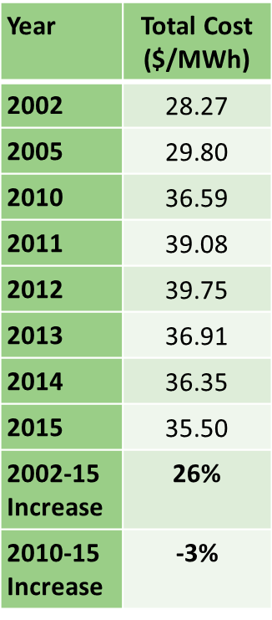
Major Industry Challenges
Electricity demand is expected to remain flat or show marginal growth
Nuclear plant costs increased as electricity markets were deluged with natural gas at historically low prices
Solar and wind continue to expand thanks to state, federal policy support
Flawed electricity markets fail to recognize and value nuclear energy’s key attributes
Nuclear Plant Costs

Slide 14
Declining Wholesale Electricity Prices
$45-75/MWh
Price Range
$30-50/MWh
Price Range
$30-42/MWh
Price Range
Forward Prices
Notes:
Electricity prices have fallen considerably over the last decade and they are expected to persist looking forward.
Prior to the recession that hit in 2008, power prices across many of the major competitive regions such as Massachusetts, New York, Pennsylvania and Illinois saw average prices in the range of $45 - $75/MWh. These prices fell off sharply with the economic contraction and have stayed in the range of $30 - $50/MWh since 2009.
Electricity can be purchased in advance as a means of hedging uncertainty in the market and these forward prices fall in a range from $30 - $42/MWh through 2020.

Slide 15
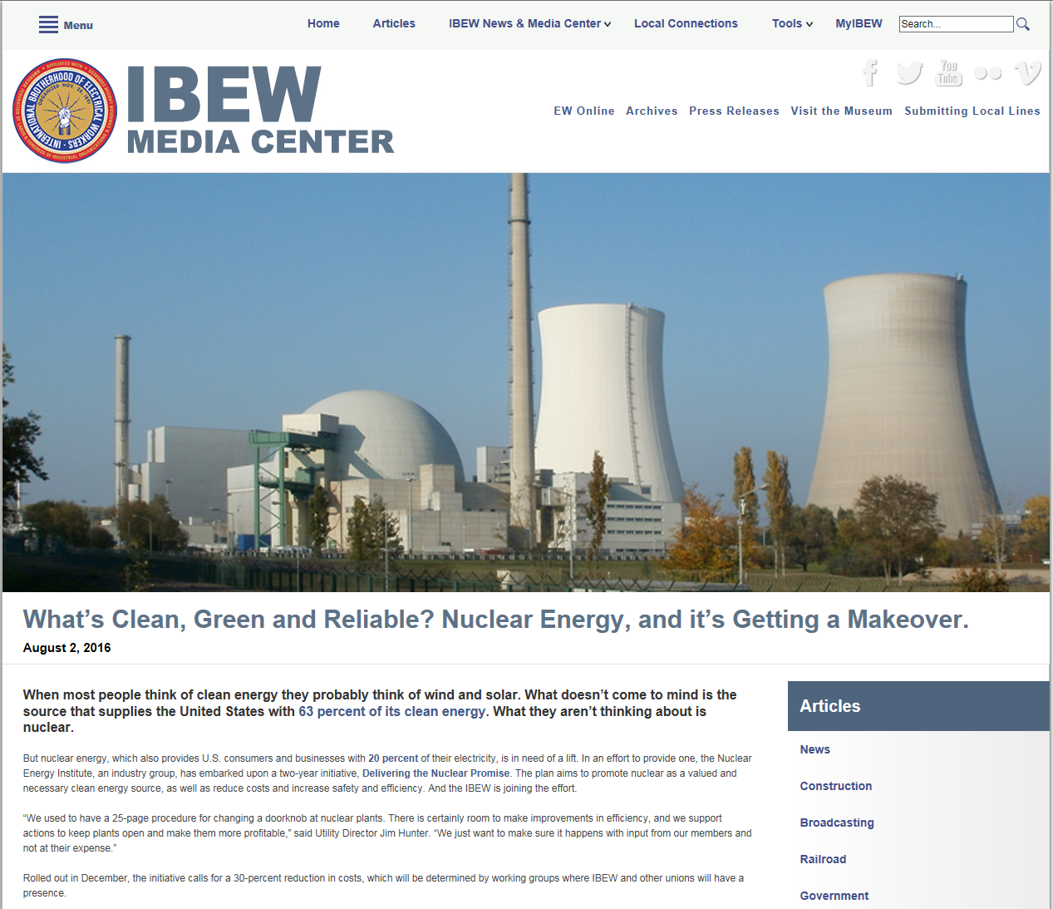
Part of the Solution: Delivering the Nuclear Promise
Sustain high levels of safety and reliability
Identify opportunities to re-design plant processes, drive innovation to improve efficiency and effectiveness
Gain greater value for nuclear energy in electricity and clean air policy
Goal: Average cost of electricity is $28 per megawatt-hour

Slide 16
Four Building Blocks
Analysis and Monitoring Objective: Analyze plant cost drivers and identify opportunities to improve efficiency
Value Recognition Objective: Leverage federal and state policies to ensure recognition of nuclear energy’s value
Process and Program Redesign Objective: Re-design nuclear plant processes to improve efficiency while advancing the fundamentals of safe, reliable operation
Strategic Communications Objective: Implement a communications strategy to ensure industry engagement and stakeholder awareness

Slide 17
Building Block: Analysis and Monitoring
CNO-led teams identified priority areas
Including improvement opportunities in work management, radiation protection, training, security and preventive maintenance
Completed analysis of plant cost drivers
Identified opportunities for efficiencies to be gained and administrative burden reduced…
While maintaining safety and reliability
Steering committee identified implementation “windows”
Pace and scope of site implementation to be determined by the company that owns and operates plant

Slide 18
Teams and CNO Leads
Corrective Action Program Danny Bost, Southern Nuclear
Engineering Tim Rausch, Talen Energy
In-Processing Bill Pitesa, Duke Energy
Oversight and Assessment Mano Nazar, NextEra Energy
Preventive Maintenance Templates Neil Wilmshurst, EPRI
Radiation Protection Fadi Diya, Ameren Missouri
Regulatory Efficiency Mano Nazar, NextEra Energy
Risk-Informed Operations Bob Bement, Arizona Public Service
Security Bryan Hanson, Exelon
Training Randy Edington, Arizona Public Service
Transform Organization Tim O’Connor, Xcel Energy
Work Management Preparation Dennis Koehl, South Texas Project
Supply Chain Adam Heflin, Wolf Creek Nuclear Operating Corp.

Slide 19
Building Block: Process and Program Redesign
21 efficiency bulletins being implemented
90% implementation rate across the industry
Enabled savings approaching $275 million
Emphasizing need for cultural change
Efficiency must take its place with hallmarks of safety, reliability
More autonomy for certain low-risk activities (self-briefs, etc.)
Encouraging innovation at all levels
Anticipating and addressing emerging regulatory or technological issues
NRC action needed to implement some efficiency bulletins

Slide 20
Building Block: Value Recognition
Increasing value recognition for existing reactors
Earning monetary value for clean air attributes
New York’s new clean energy standard facilitates FitzPatrick sale
Upstate nuclear plants to receive appropriate compensation
Precedent for other state, regional policy
Advocating changes in electricity markets for additional value:
Capacity pricing
Energy price formation
Pursuing changes at FERC and RTOs
Clean Power Plan implementation plans should recognize value of nuclear energy

Slide 21
Driving Industry Success
Efficiency in training expected to reduce initial training time
Streamlining industry oversight processes
Eliminating management review time of personnel contamination events and allowing workers to return to the job sooner
“As the culture change occurs, as we drive these efficiencies, it is going to spark the workers themselves to look for more opportunities to save and become more efficient.” Eric Olson, Entergy DNP Coordinator
Notes:
Let me give you some examples of where we are achieving efficiency through the initial efficiency bulletins:
In training, 5 EBs are expected to result in a decrease of 10% initial training time.
As these changes are incorporated into overall training, we should see a 3% overall reduction of training from these EBs and there is more to come.
In radiation protection, 99% of all Personnel Contamination Events are of low consequence and should be treated as such per EXISTING industry guidance.
By adhering to this guidance, efficiencies and, ultimately, the industry will save costs due to reduced management time for each PCE and allowing highly trained professionals to re-enter radiation control areas far sooner.

Slide 22
Driving Industry Success
Some suppliers eliminating unneeded administrative work and better understanding customer needs
Allows employees to perform self-briefs on radiological conditions, helps employees get to work faster
Reduced walk downs of simple maintenance items
Streamlines CAP requirements: most significant issues are addressed in the CAP process, less significant issues using other approved processes
“I’ve seen good morale changes. The efficiency bulletins we’ve implemented so far have really felt that they were a long time coming.” Greg Ferrigno, STPNOC’s Health Physics General Supervisor
Notes:
On the supplier side, may suppliers are enhancing communication with their customers, streamlining this process to eliminate unneeded administrative work and also to better understand their customer needs.
We also are implementing a graded approach to walk-downs.
Experienced technicians who have years of training and experience will be able to undertake repetitive maintenance tasks without multiple walk downs.
Those tasks requiring a greater amount of planning and review will have more walkdowns.

Slide 23
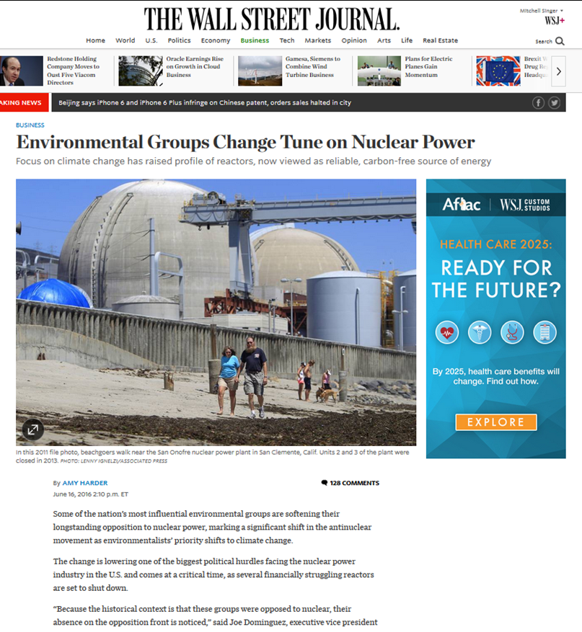
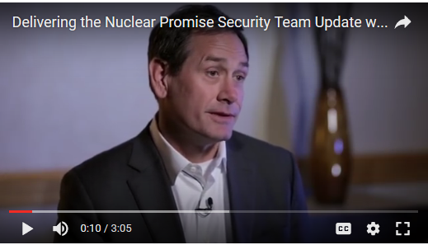
Building Block: Strategic Communications
Employee communications
Industry survey shows 72% of industry workers “strongly agree” or “agree” that they have a good understanding of Delivering the Nuclear Promise
Communications emphasizing industry’s effort to enhance efficiency, need for value recognition
Advocating greater value for nuclear power plants in electricity and clean air markets
Notes:
Employee communications
Industry survey shows 72% of industry workers “strongly agree” or “agree” that they have a good understanding of Delivering the Nuclear Promise
External communications
Emphasizing industry’s effort to enhance efficiency and need for greater value recognition
Industry has briefed unions, regulators and policymakers on initiative to inform and educate
Advocating greater value for nuclear power plants in electricity and clean air markets

Slide 24
Key Takeaways
Industrywide initiative will make us more efficient and effective
We will not sacrifice safety to reduce costs
3 strategic goals: Maintain operational focus, increase value, improve efficiency
Stakeholder outreach to industry workforce, unions and NRC
21 efficiency bulletins implemented; 6 more in process
Transformative ideas that will alter fundamental processes are in the works

Slide 25
Innovate!
Joan Knight
Exelon Innovation Director

Slide 26
Innovation creates our future
August 2016
Joan Knight
Innovation Director

Slide 27
Changing Energy Landscape
Centralized Grid
Distributed Generation
Demand Mgmt
How do we capitalize on these shifts
Dynamic Conditions & Opportunities
Innovating for the Future
~ Changing
Markets/Tariffs
~ Changing Customers
Expectations
~ Utility Consolidation
~ Stressed & Aging
Infrastructure
~ Intelligent Networks
~ Consumer Driven
Solutions
~ Leveraging New
Technologies to
Improve existing
operations
~ Increased reliability
for both the end
customer & the grid
Notes:
Landscape changing provides opportunities
Innovation and dramatic change is happening all around us
Change is affecting every industry:
Transportation systems powered by apps
Artificially intelligent computer systems diagnosing patients
Credit card payments from smartphones
Governments opening up decision-making to the public
Cars being developed through crowdsourcing
Wearable technologies that change how we interact with the physical and digital work
3D printing
Forces affecting our industry as well, as shown here
Rather than just get frustrated, this is an opportunity, and an imperative, to jump ahead and capitalize on these shifts

Slide 28
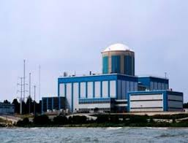
Real Trends in the world
450 M users on
>1.71 B on
240 M queries every hour
>10 B objects connected to the internet; by 2020 it will be 20B
Over two thirds of US adults own a smartphone (1Q16)
85% of US young adults own a smart phone
13 reactors have been prematurely shutdown since 1990; 4 in 2013 alone
At least 8 reactors (>6300MW of capacity) are at risk of closing for economic reasons
Millennials will have 10-14 jobs by the age of 38
The industry must hire 20,000 new workers in the next 4 years
69 reactors under construction around the world
NEI estimates 39% of the workforce will be eligible for retirement by 2018
Notes:
The world is changing rapidly around us. You may have heard the concept that the pace of change we are currently experiencing is the slowest we will see in the remainder of our lifetime.
Go thru each
100M more on linked in from last year
1.44B facebook
-linkedin
-facebook
-google
-fundamental shifts being created by the internet of things or the industrial internet (think about all the things in your personal/consumer life – this is real in the industrial world now, too
-workforce shifts: dramatic factors stressing our workforce
We are, in many cases, inseparable from our mobile phones. How many of you sleep with your phone within arms length? (if you didn’t raise your hand, I think you are either lying or not paying attention)
Industry economic stressing plants, including several of our units

Slide 29
What do these organizations have in common?
Notes:
These are companies that did not lead or at least keep up with the dramatic shifts occurring in their industries and the world around them.
Kodak actually invented digital photography (in 1975). Initial corporate reaction: But it was filmless photography, so management’s reaction was, ‘that’s cute—but don’t tell anyone about it. Their management was unable to see digital photography as a disruptive technology for decades.
Sears: hasn’t been able to remain relevant to consumers (its customers). People don’t have a reason to go to Sears (like they do to go to Starbucks or Wal-Mart). They have not invested in improvement (and are not) investing in the future.
Sony remains somewhat stubbornly focused on its electronics business despite multiple years of declining profit or losses in this area. (posting net losses in 6 of the last 7 years).
Pitfalls: Companies that believed their strategic and tactical positions meant that they were immune to the changes happening around them, or “our industry is different”
On the flip side: Competitors or upstarts in the marketplace were innovating to create a different future for themselves. (Amazon, Apple, Netflix)

Slide 30
Major Industry Challenges
Electricity demand is expected to remain flat or show marginal growth
Nuclear plant costs increased as electricity markets were deluged with natural gas at historically low prices
Solar and wind continue to expand thanks to state, federal policy support
Flawed electricity markets fail to recognize and value nuclear energy’s key attributes
Nuclear Plant Costs

Slide 31
Declining Wholesale Electricity Prices
$45-75/MWh
Price Range
$30-50/MWh
Price Range
$30-42/MWh
Price Range
Forward Prices
Notes:
Electricity prices have fallen considerably over the last decade and they are expected to persist looking forward.
Prior to the recession that hit in 2008, power prices across many of the major competitive regions such as Massachusetts, New York, Pennsylvania and Illinois saw average prices in the range of $45 - $75/MWh. These prices fell off sharply with the economic contraction and have stayed in the range of $30 - $50/MWh since 2009.
Electricity can be purchased in advance as a means of hedging uncertainty in the market and these forward prices fall in a range from $30 - $42/MWh through 2020.

Slide 32
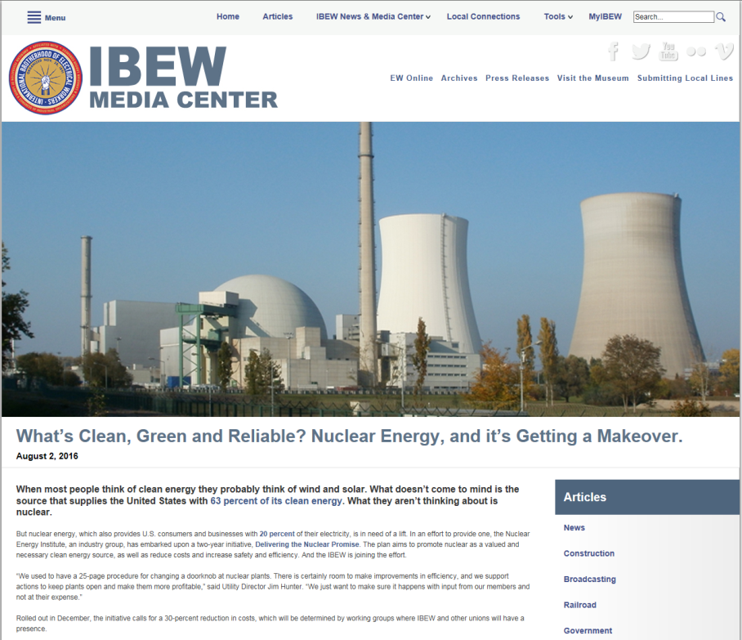
Part of the Solution: Delivering the Nuclear Promise
Sustain high levels of safety and reliability
Identify opportunities to redesign plant processes, drive innovation to improve efficiency and effectiveness
Gain greater value for nuclear energy in electricity and clean air policy

Slide 33
What is Innovation?
Merriam-Webster defines innovation as:
A new idea, device, or method
The act or process of introducing new ideas, devices or methods
New: not used by anyone else previously
ASQ and Wikipedia define continuous improvement as:
Continuous improvement: …with a more specific focus on linear, incremental improvement within an existing process.
How does your organization define Innovation?
Is that definition broadly understood?
Does it include Continuous Improvement or not?
How much does your company currently value innovation as a driver for overall company success?
Do the actions of the leaders match their words?
Notes:
Before we go any further, Let’s get on the same page with what is Innovation?
Different definitions of Innovation:
First, we want to differentiate innovation from continuous improvement – linear, incremental improvement within an existing process
Innovation is defined within Exelon policy documents covering innovation
Read the 5 bullets

Slide 34
Innovation Definitions
Exelon
Be novel to Exelon & business impactful
Be more than incremental from the current solution, product, or process
Have higher reward & increased learning velocity
Potentially add market value to Exelon
Be perceived by customers or stakeholders as innovative
Cargill
Innovation is converting knowledge and insight into new products and services that create distinctive value and profitable growth for our customers
Hallmark
New products, services or solutions that satisfy an unmet or unarticulated consumer need and do so in a different and better way than what’s currently in the marketplace.
Notes:
Before we go any further, Let’s get on the same page with what is Innovation?
Different definitions of Innovation:
First, we want to differentiate innovation from continuous improvement – linear, incremental improvement within an existing process
Innovation is defined within Exelon policy documents covering innovation
Read the 5 bullets

Slide 35
Knowledge and engagement check
Get out your mobile phone
No referring to a laptop or iPad for help
No checking with your neighbor
Responses are anonymous
You will send a unique code corresponding to your answer to the same number (22333) for each question
Notes:
OK –
We are moving to the audience participation portion.

Slide 36
Consider these Innovation Thoughts
Innovation is not about saying yes to everything. It’s about saying NO to all but the most crucial features. - Steve Jobs
If you want something new, you have to stop doing something old. - Peter F. Drucker
For good ideas and true innovation, you need human interaction, conflict, argument, debate. - Margaret Heffernan
Where all think alike, there is little danger of innovation. - Edward Abby, Desert Solitaire
If at first the idea is not absurd, then there will be no hope for it. - Einstein
In a world of change, the learners shall inherit the earth, while the learned shall find themselves perfectly suited for a world that no longer exists. - Eric Hoffer
There is no innovation and creativity without failure. Period. - Brene Brown
Innovation basically involves making obsolete that which you did before. - Jay Abraham
Notes:
Peter Drucker: considered by many to be the founder of modern corporate management (dec. 2011)
Edward Abby: philosophical / polictical author (dec. 1989)
Steve Jobs: pioneer of Apple (dec. 2011)
Margaret Heffernan: Business workman and author (1955 - )
Eric Hoffer: Social philosopher (dec – 1983)
Jay Abraham: Corporate strategy consultant (1949 - )
Einstein: theoretical physicist ( dec. 1955)
Brene Brown: Research professor in area of social work at Univ of Houston (1965 - )

Slide 37
What’s different about Innovation?
More ambiguity
Final solutions are not apparent at first
More risk
Trials & failures will occur
Messy
Creativity is not neat and tidy
Takes time
Dedicated efforts are required
Failures are expected and needed
Many things tried/started will not have value when investigated
Notes:
Susan
“How many of you had to look twice at that piece of fruit on this slide?”
Innovation must involve ambiguity and risk or its not innovative….
Henry Ford said if “I had asked people what they wanted, they would have said faster horses.”
Failures are supposed to occur, or you are not really innovating.
Paint a picture of all the things that nuclear leaders are NOT comfortable with, and you have a pretty good picture of innovation.
But that doesn’t mean we can’t innovate….just need to learn how to behave differently.

Slide 38
What’s different about Innovation?
Iteration is required
Finding the best solution requires repeated attempts
It won’t just happen
Follow-up and leadership are needed
Works best in groups
Diversity of perspective yields better results
Needs different metrics
Measure progress and learning, not just end results
Notes:
Susan
Really developing something innovative doesn’t happen on the first try.
You can’t just “tell” someone to go innovate. A team needs purpose / direction, support and follow-up.
Groups / diversity were what made the development of the computer happen. Many different people had their “hands” in that over many years.
Perhaps the hardest to accept, we need to recognize progress as a series of “learnings” or needed changes toward a valuable end. And these incremental steps need to be rewarded, even though the “value” isn’t visible yet.

Slide 39
Creating a Culture of Innovation
What is culture?
Essential Conditions for Culture of Innovation:
Strong Leadership
Creative Abrasion
Acceptance of Failure
Openness to Question Everything
Bias to Experimentation
Seeking Unique Combinations
“There is no science to creativity. It is about taking intelligent risks, tolerating mistakes, respecting boundaries, and more important, having the right people in place to make the right choices.”
-- Bob Iger, CEO Disney
Notes:
Joan
One of our objectives was to develop a deeper understanding of what drives and stifles a culture of innovation.
The discussion of culture is not new to our organization. We can define culture as “the way we do things around here, including your organization’s beliefs, values and behavioral norms.”
Bring up Disney quote and read.
In the pursuit of innovation for creation of new value, organizational culture has been shown to be a driver that has a larger impact on success than things like resources or processes.
There are some essential conditions:
Strong leadership – earlier Susan talked about the direct role of leaders in innovation teams
Creative abrasion: this is where a more challenging problem or greater conflict leads to superior solutions
Acceptance of failure: Thomas Edison once said: I have not failed, I have just found 10,000 ways that won’t work.
Openness to question everything (by anyone)
Bias to experimentation: since we learned that innovation involves needed failures, the more experiments / prototyping you can do, the more positive eventual results you will obtain.
Seeking unique combos: these are the more likely success stories now that the traditional “inventions”

Slide 40
Creating a Culture of Innovation
Can it be stifled?
Cultural antibodies:
Recurrent use of the word “but”
Over regulation / specification
Asking for preciseness
Lack of an appetite for miscues
Historical baggage
Not tied to operations
“Big ideas are little ideas that no one killed too soon. “
– Seth Godin
Notes:
Joan
On the flip side, there are certain things that can stifle innovation, and quickly:
I like this quote: ‘big ideas….” Consider for a moment how quickly a new idea is killed in your org or at your site (and by whom)
Here are some sure-fire ways to stifle innovation:
Instead of “but”, use “yes, and”
Providing too many specifications or rules
Asking for preciseness (when not needed)
Miscues
Baggage: “when we tried that….”’ I know that will never work., etc
keeping innovation disconnected from your normal operation.

Slide 41
Knowledge and engagement check
Get out your mobile phone
No referring to a laptop or iPad for help
No checking with your neighbor
Responses are anonymous
You will send a unique code corresponding to your answer to the same number (22333) for each question
Notes:
OK –
We are moving to the audience participation portion.

Slide 42
What should you do?
Understand what your company expects from innovation
What business problems should it be focused on?
Do these vary by location, functional area or discipline?
Educate yourself on innovation: process & techniques
Recognize and reward innovative behaviors
Lead by example
Use whatever process or framework you have to champion innovative ideas
Take appropriate risks with good ideas
Don’t let one “No” derail an idea

Slide 43
Exelon’s Innovation Strategy
“At Exelon, identifying technologies that are about to emerge and leading the change
– rather than reacting to them –
is at the core of our mission.”
- Chris Crane
EEI March/April 2015

Slide 44
Leaders Foster Innovation (What TO do…)
Avoid premature judgments when evaluating new options
Create frequent opportunities for blue-sky thinking
Demonstrate an appetite for unconventional ideas
Recognize innovators no matter the outcome
Personally mentor or sponsor innovation teams
Free up time and money for innovation Hire and promote for creativity
Work to eliminate bureaucratic impediments to innovation
Experiment to learn through a series of fast, cheap and low-risk prototypes
Tell stories to engage others in the ideas and to help build them
Diversify the team to leverage breadth of perspectives
Be open to possibilities, ideas, concepts, learning.
Say “Yes, and…” not “No” or “But…”
Embrace the messiness, abstraction and ambiguity of innovation
Tap into the passion of teams and they will do everything within their power to succeed
Dream big and then figure out ways to get there
Mine insights through observing, exploring and networking
Break mental models to discover new understanding and possibilities
Co-create with existing and potential customers, strategic partners and other stakeholders
Use different criteria and metrics to evaluate innovation opportunities
Give people permission to learn (i.e. fail)

Slide 45
Leaders Foster Innovation (What NOT to do…)
Don’t jump right from problem statement to actions
Don’t be the one to say “that will never work”
Don’t assume the way we have always done it is best
Don’t judge innovative ideas with the same filters as capital projects
You can’t delegate innovation
A list of actions won’t create a culture of innovation
Don’t let pilots, trials and other innovation funding be the first budget cuts
Don’t assume you know the best way to improve
Don’t always go to the same people for solutions
Stop saying “That won’t work.”
Don’t lose patience when the first try doesn’t work
Don’t think innovation will just happen
Business planning is not the same thing as innovation
Don’t let one “No” stop the effort
Don’t rely on process alone to solve your big problems
Don’t let the risk averse culture take over everything
Repeatability and predictability are not your friends in innovation
Don’t let innovation become a fad or flavor of the year

Slide 46
Questions?

Slide 47
Speed Networking

Slide 48
What advice would you have liked to have heard when you were starting out?
What skills have you found essential for success in your occupation?
What are some of the challenges you face in your position?
How did you decide to do what you do?
What is a typical day like?
What does ideal work/life balance look like to you in your life?
What helps you get the most out of your networking?
Where Are Your Favorite Places to Get Work Done?
What is on your reading list?
Networking Workshop

Slide 49
Motivate!
Elisabet Rodriguez Dennehy
President of Rodriguez and Associates, LLC

Slide 50
Thank you!

