Slide 1
Nuclear Energy
Fundamentals
Everett Redmond
202-739-8122 elr@nei.org

Slide 2
Overview
Nuclear Power Plant
Nuclear Process
Major Components & Systems

Slide 3
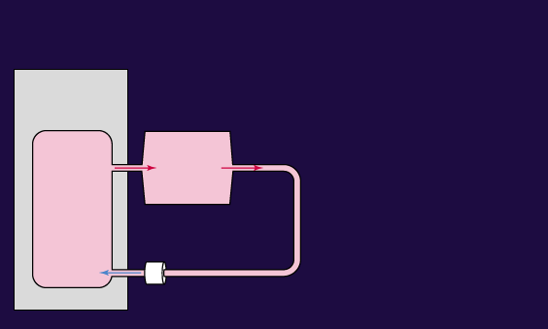
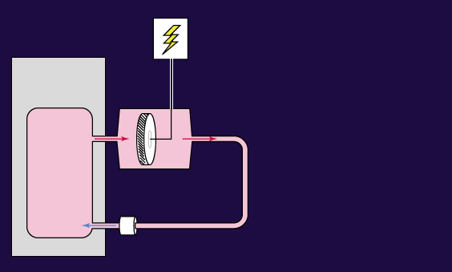
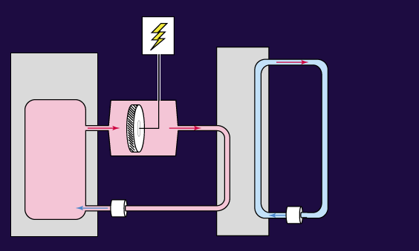

Thermal (Steam) Power Plant
Condenser
Heat Source
Coal, Nuclear, Natural Gas, Oil
Cooling Source
Turbine Generator
Feed Pump
Circulating Pump

Slide 4
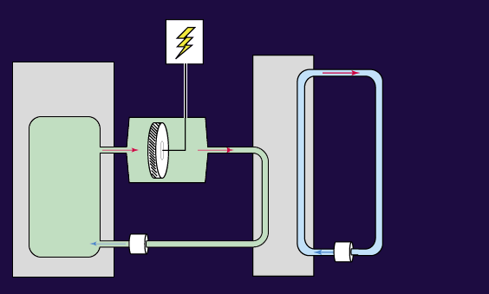
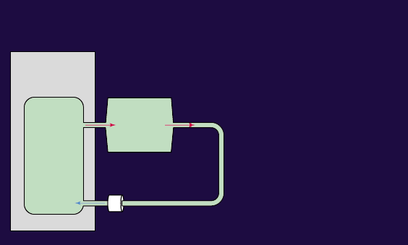
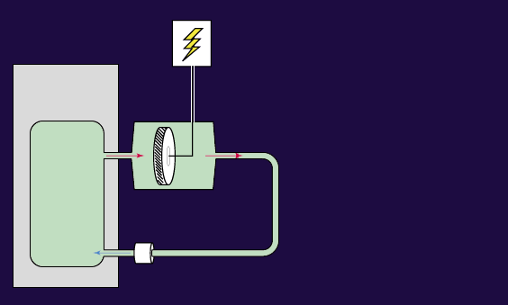
Boiling Water Reactor
Condenser
Reactor
Cooling Source
Turbine Generator
Feed Pump
Circulating Pump

Slide 5
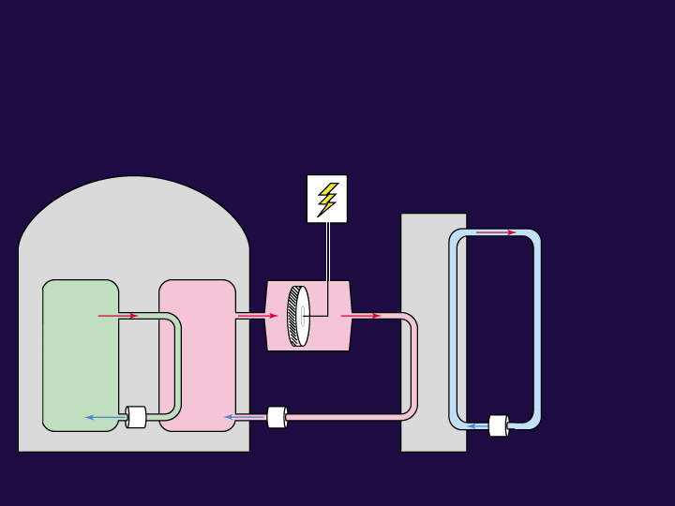
Pressurized Water Reactor
Condenser
Primary Loop
Cooling Source
Steam
Generator
Reactor
Cooling Source
Turbine Generator
Circulating Pump
Feed Pump
Circulating Pump
Main Coolant Pump
Secondary Loop

Slide 6
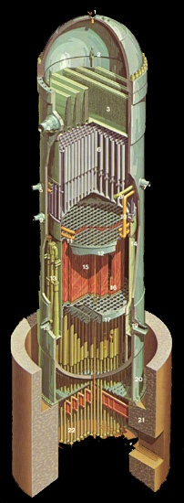
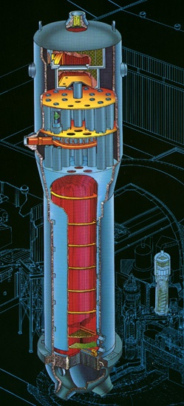
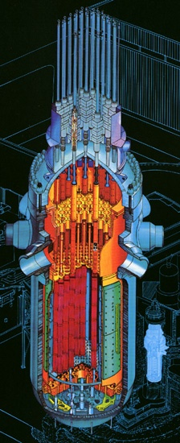
Boiling Water – Pressurized Water Reactors
BWR
PWR

Slide 7
BWR vs. PWR
Reactor Pressure Vessel
Number of Fuel Assemblies
Fuel Rod Array
Number of Control Rods
Type
Operating
Pressure
Inlet Water Temperature
Outlet Steam/Water Temp.
7.1x27.7M
23.3x90.9 ft.
624-800
8x8 – 10x10
145-205
Cruciform
73.1 Kg/cm²
1041.0 psi
215.5 C/420.0 F
287.0 C/550.0 F
4.6x15M
15.0x49.0 ft.
193-241
14x15 - 17x17
77-90
Finger
158 Kg/cm²
2250 psi
280 C/538 F
320 C/610F

Slide 8
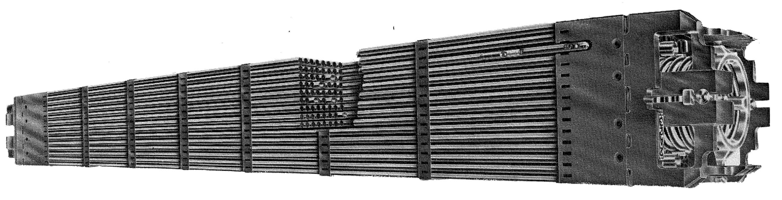
Fuel Assemblies
15x15 PWR Fuel Assembly
PWR
Fuel
Relative size of
PWR and BWR
fuel assemblies
BWR Fuel
Number of Operating
Reactors
PWR – 69, BWR – 35
~5.1 inches
~8.4 inches

Slide 9
YouTube Videos
How does a nuclear reactor work? - NEI
What is a fuel assembly? - NEI
Where do used, or spent, fuel rods go after they are discharged from the reactor? - NEI
Where do used, or spent, fuel assemblies go once the pools inside the reactor building reach capacity? - NEI
What is plutonium and where does it come from? - NEI
Spent Fuel Storage at Diablo Canyon Power Plant – PG&E

Slide 10
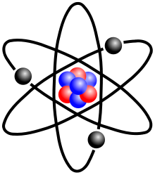
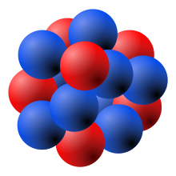
Nuclear Fuel - Uranium
Natural Uranium
  0.7% Uranium-235
  99.3% Uranium-238
Nucleus
Neutrons
Electrons
Protons

Slide 11
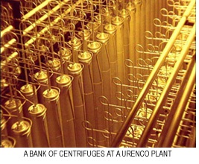
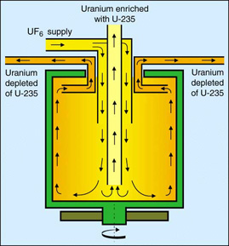
Enrichment
Bank of centrifuges at a URENCO plant

Slide 12
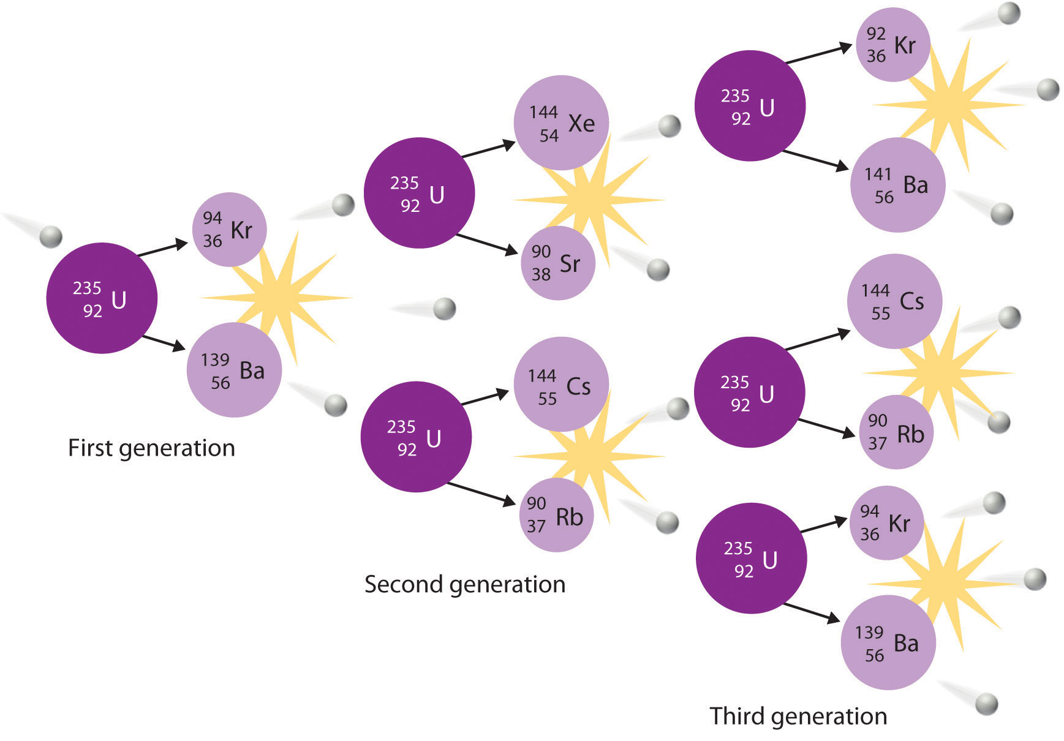
Nuclear Fission
Fission Products
Neutron
Energy

Slide 13

Moderator Present – Fission Occurs
Moderator Lost – Fission Does Not Occur

Slide 14
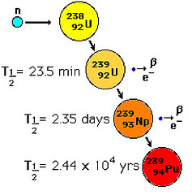
Plutonium Creation in Reactors

Slide 15
Difference in Nuclear Fuel
Isotope | Fresh Fuel | Used Fuel
U-238 | 96% | 93%
U-235 | 4% | 1%
Fission Products | 0% | 5%
Plutonium | 0% | 1%
Minor actinides neglected in this table

Slide 16
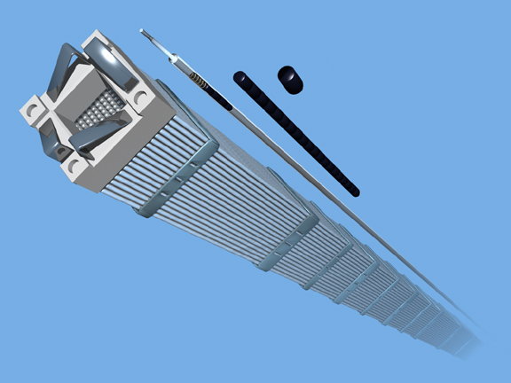
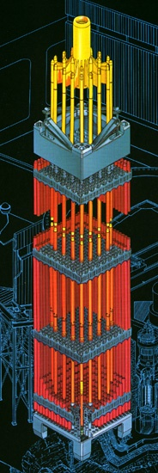
PWR Reactor Fuel/Control Rods

Slide 17
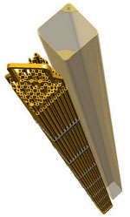

BWR Reactor Fuel/Control Rods

Slide 18
Reactor Startup
Reactor Shutdown
Reactor Power Increase
Reactor
Core
Control Rods

Slide 19
Open Fuel Cycle
Power
Plant
Electricity
Ore
Enrich
Fuel
On-Site or
Consolidated
Storage
Geologic
Disposal
Depleted
uranium

Slide 20
Enhanced Fuel Cycle
Power
Plant
Electricity
Ore
Enrich
Fuel
Interim
Storage
Recycling
Geologic
Disposal
Depleted
uranium
Fission
Products

Slide 21
Safety Principles
Defense-in-Depth
Redundancy & Diversity
Isolation & containment of radioactive material
Training
Conservative decision making at all levels with plant management setting standards
  A culture that strives for excellence

Slide 22
Defense-in-Depth

Slide 23
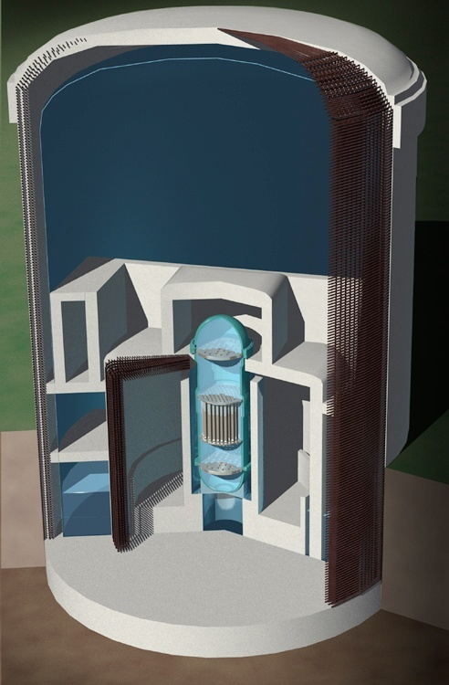
Multiple Barrier Protection
Shield Building Wall
45-inch-thick steel reinforced concrete
Containment Vessel Liner
1/4-inch-thick steel
Dry Well Wall
5-foot-thick reinforced concrete
Bio Shield
4-foot-thick leaded concrete with
1.5-inch-thick steel lining inside and out
Weir Wall
1.5-foot-thick concrete
Reactor Vessel
4- to 8-inches thick steel
Reactor Fuel

Slide 24
Safety Systems
Pressure – Temperature – Reactivity Control
Pressure
Safety Relief Valves
Primary System
Secondary System
Temperature
Reactor – Coolant Flow - Ultimate Cooling (Heat) Sink
Pumps – Control Valves – Heat Exchangers
Reactivity Control – Control Rods & Boron Injection

Slide 25
Safety Systems
Shielding
Radiation Protection
Missile Protection
Fire Protection
Physical Separation
Sprinklers & Suppression Systems
Fire Retardation Materials - Fire Doors & Walls
Control Room
Habitability -- Self-Contained
Remote Shut Down Panel
Power Supplies
Emergency Diesel Generator
Batteries

Slide 26
Power Systems
Feed & Steam Systems
Isolation Valves
Steam Control Valves
Reheaters
Piping
Generation Systems
Turbine-Generator
Hydrogen for cooling
Transformers, switchgear and Offsite Power Supplies

Slide 27
Support Systems
Fuel Handling
Fuel Handling Equipment
Spent Fuel Pool
New Fuel Storage Area
Spent Fuel Cask Area
Waste Management Area
Decontamination Area
Super Compactor for Dry Waste
Spent Fuel Resin Solidification Area
Water Purification and Clean-Up Systems
Air Conditioning and Filtration Systems

Slide 28
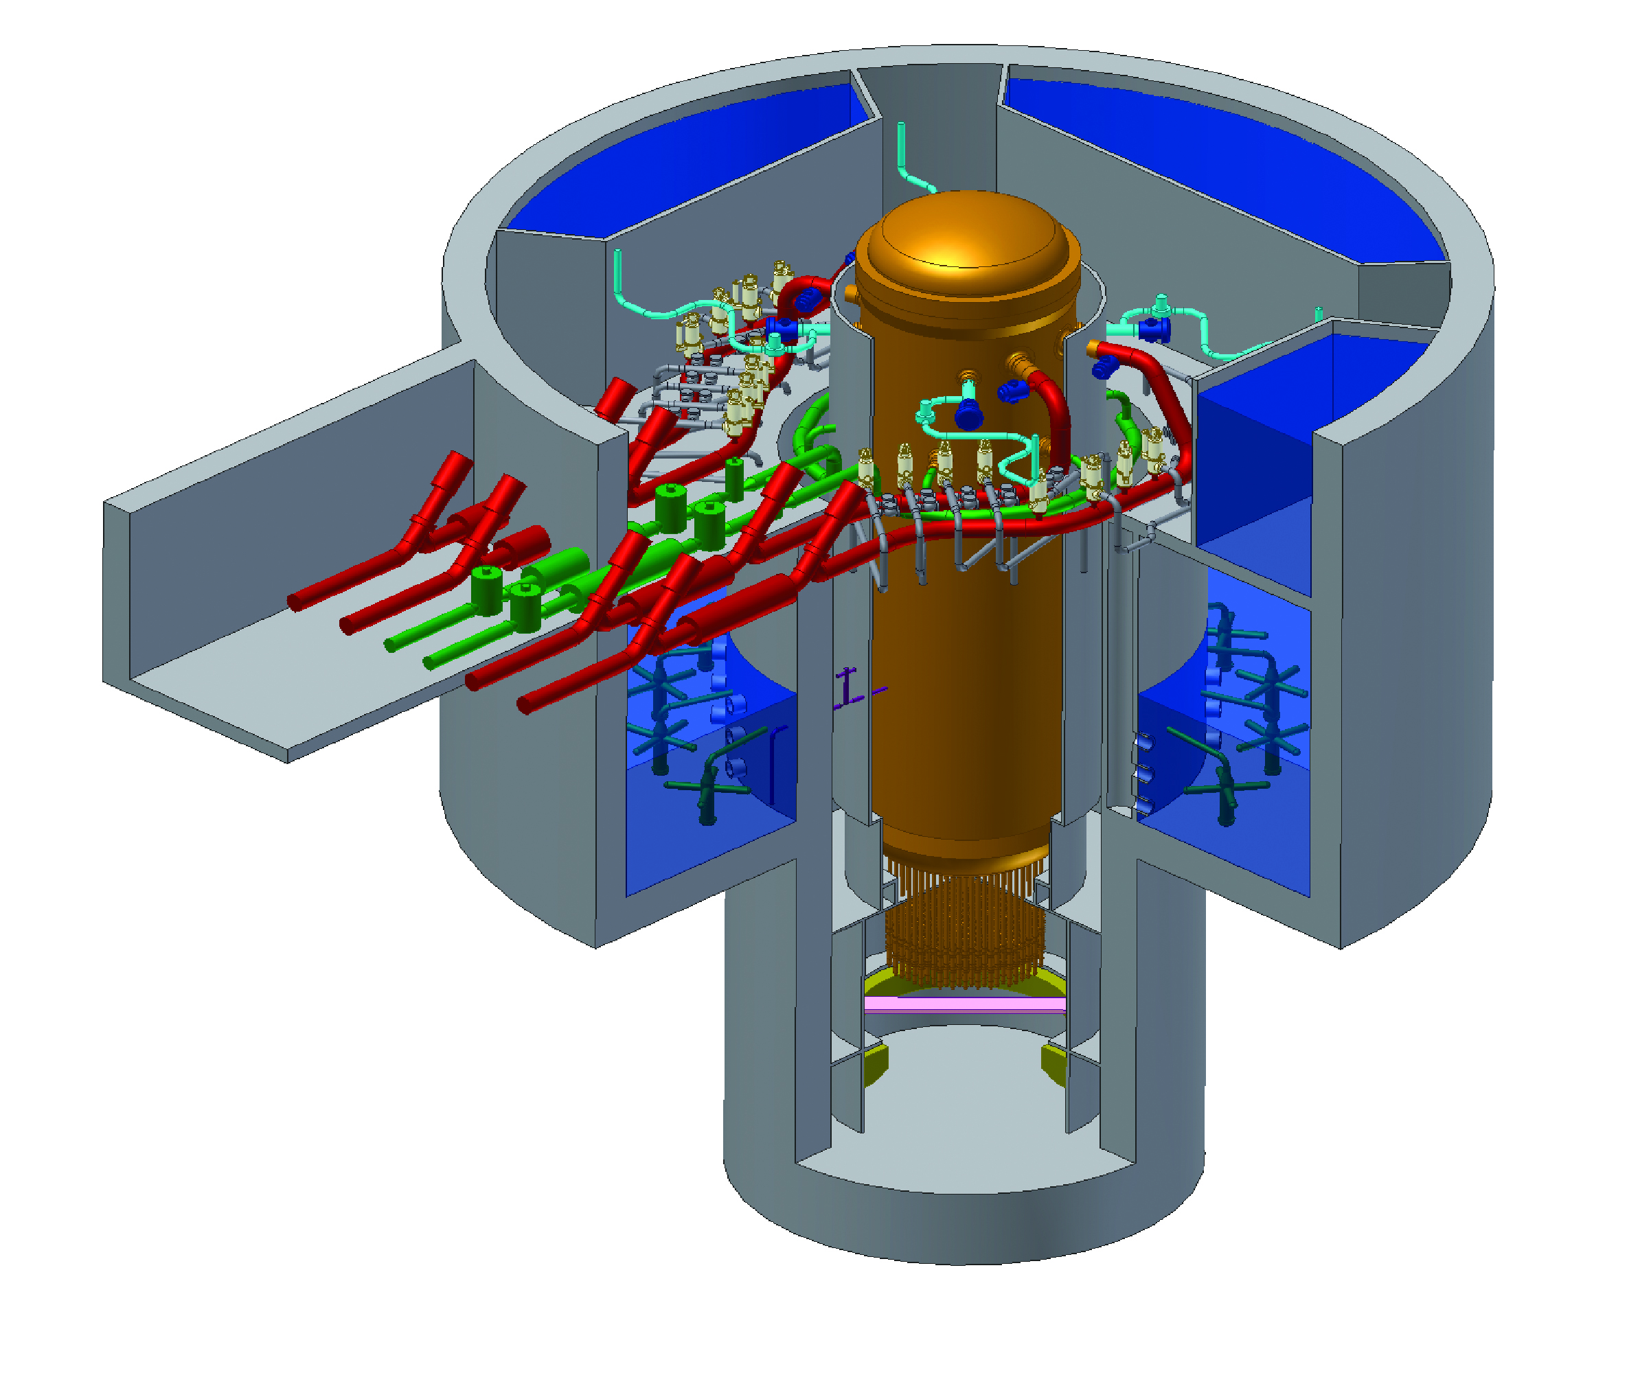
ESBWR

Slide 29
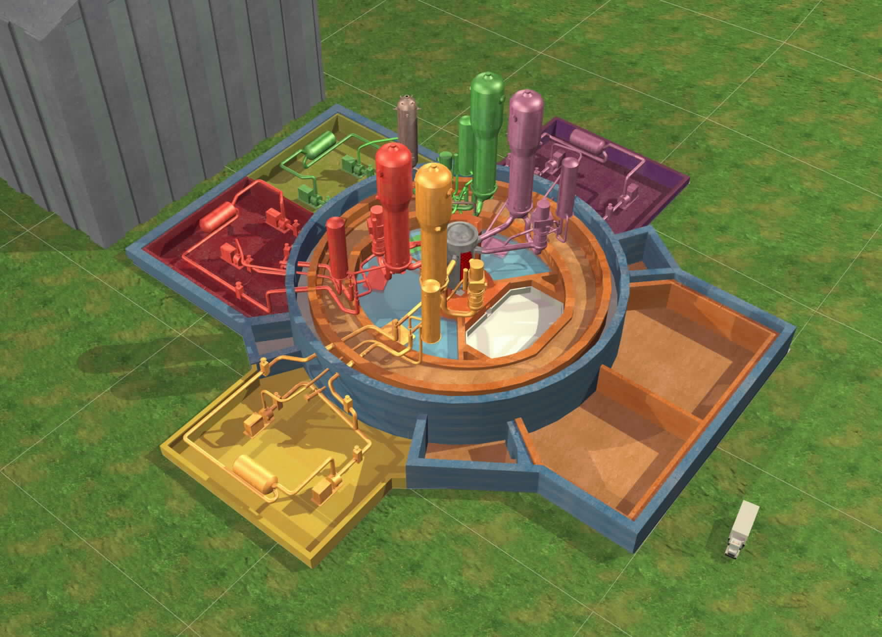
AREVA – EPR – 1600 MWe
Courtesy AREVA

Slide 31
New Design Improvement Examples
1970s 1000MW PWR
Safety Valves 2850
Pumps 280
20.8 miles, nuclear piping
1725 miles, electric cable
Pressurizer – 1400 cu. Ft
SG Tube Rupture – Operator action within 10 mins
AP1000
Safety Valves 1400
Pumps 184
3.6 miles nuclear piping
227 miles, electric cable
Pressurizer 2100 cu. Ft
SG Tube Rupture – No operator action
65% fewer welds
Use of natural phenomena: gravity, natural convection and conduction

Slide 32
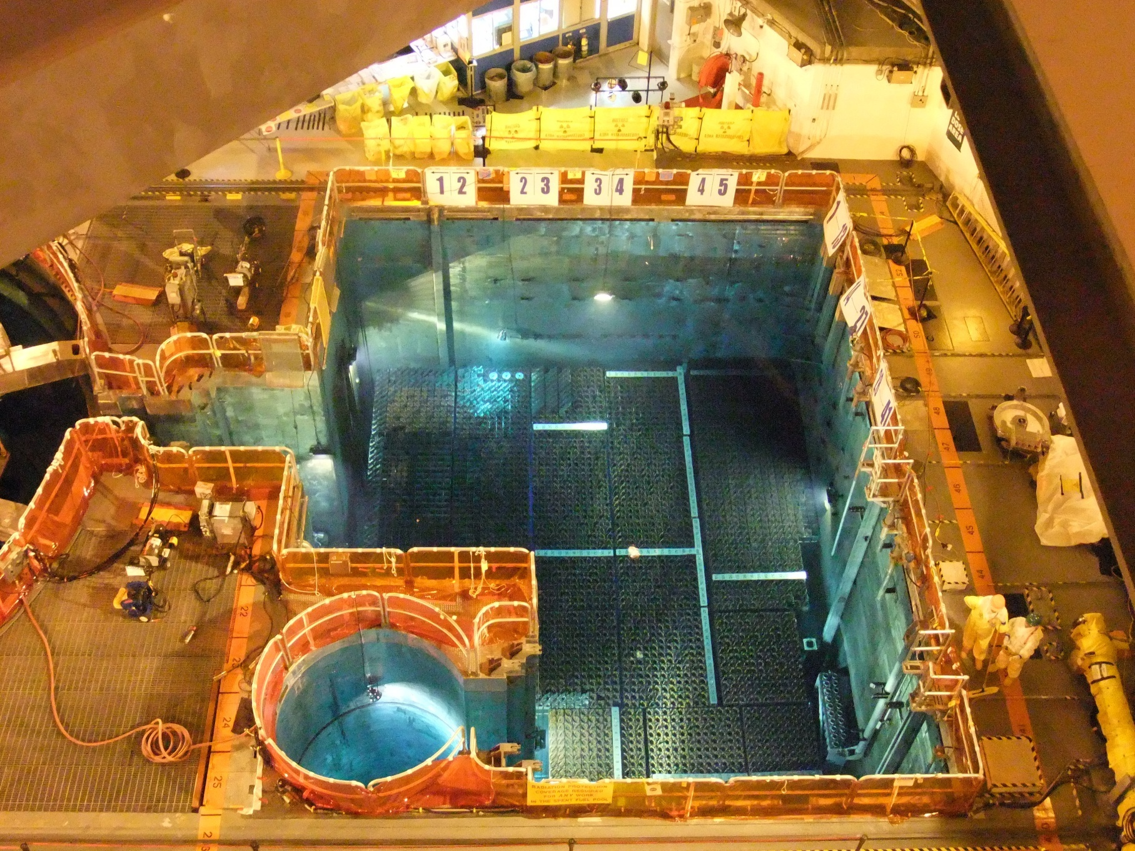
Spent Fuel Pool

Slide 33
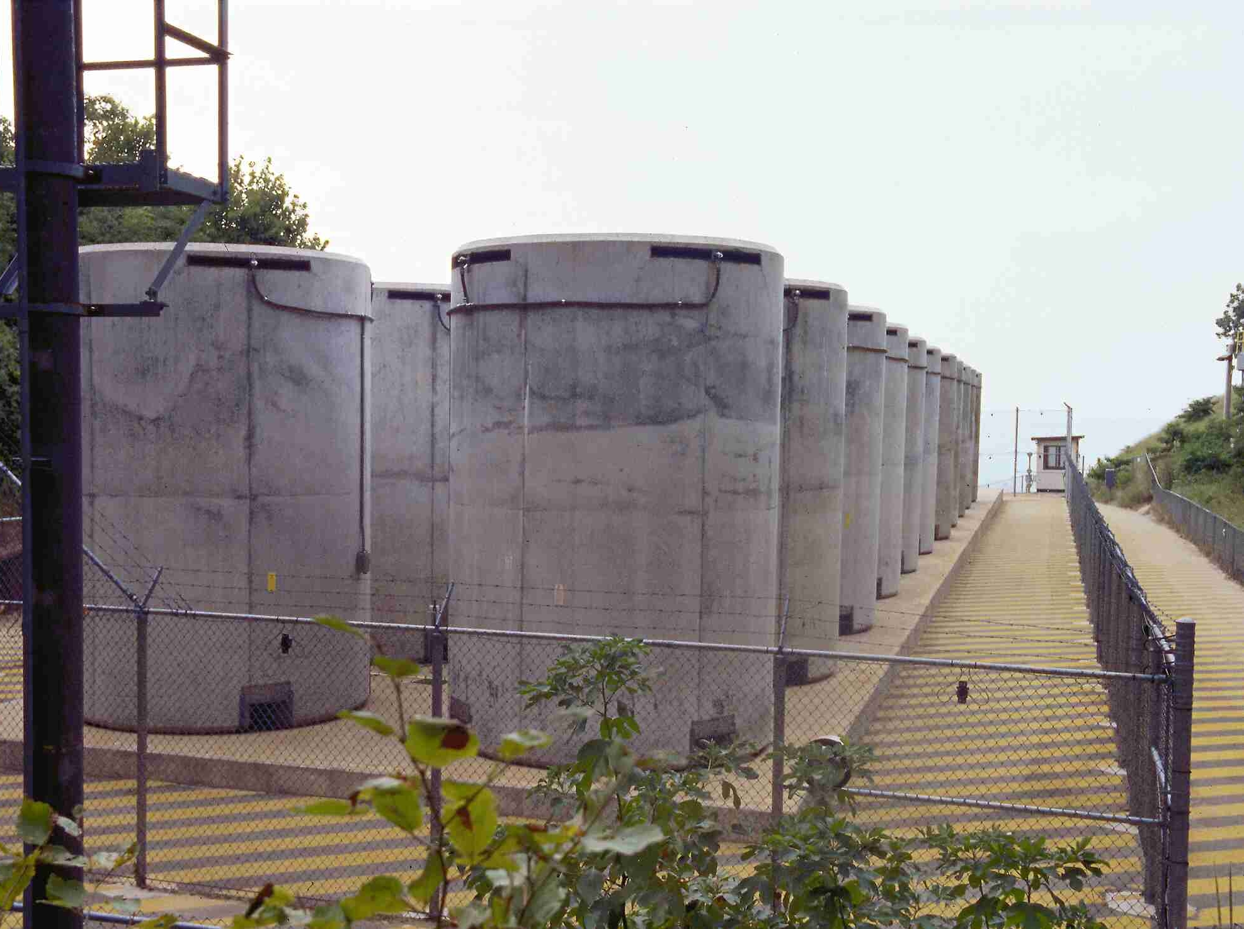
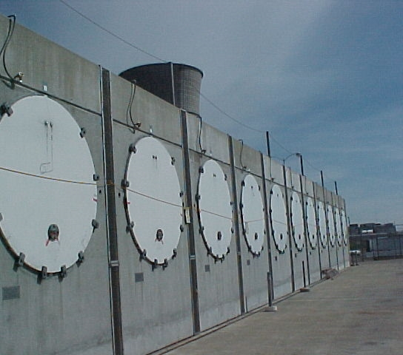
Dry Cask Storage
Vertical Storage Cask
Horizontal Storage Module

Slide 34
Dual Purpose Canister
Vertical Storage Cask
On-site Transfer Cask
Transportation Cask

Slide 35
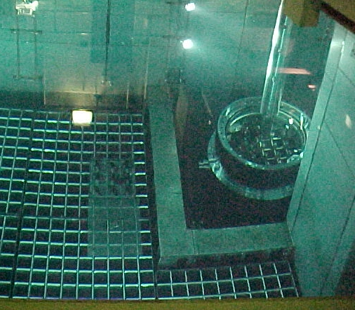
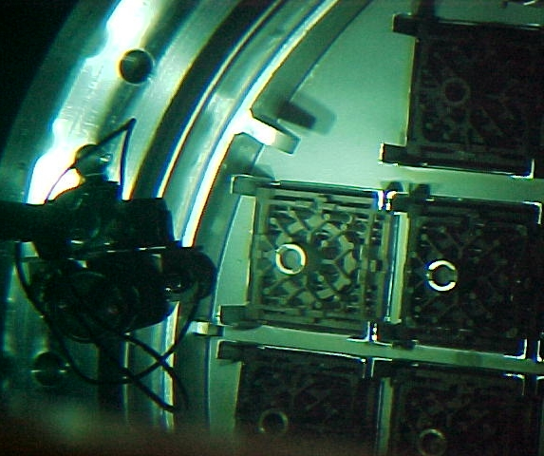
Used Nuclear Fuel Assembly Being Loaded into DPC Basket In Spent Fuel Pool at Nuclear Reactor Site

Slide 36
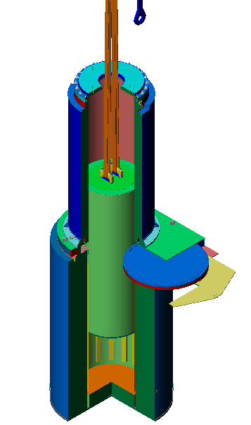
DPC Placement into Vertical Storage Cask
Transfer cask is placed atop vertical storage cask
DPC is lowered from transfer cask into vertical storage cask

Slide 37
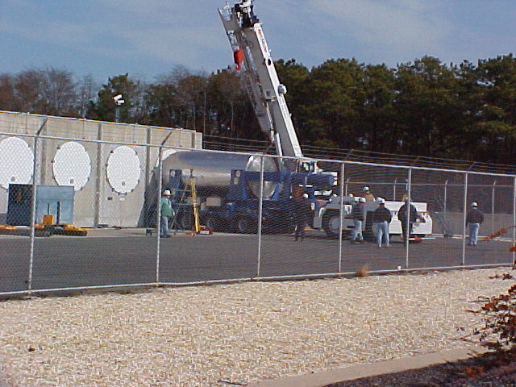
Loading Horizontal Storage Modules

Slide 38
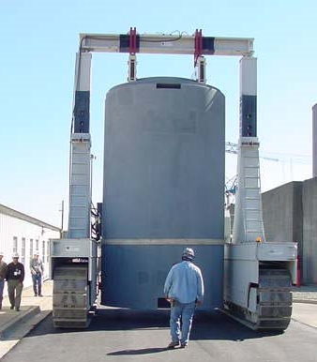
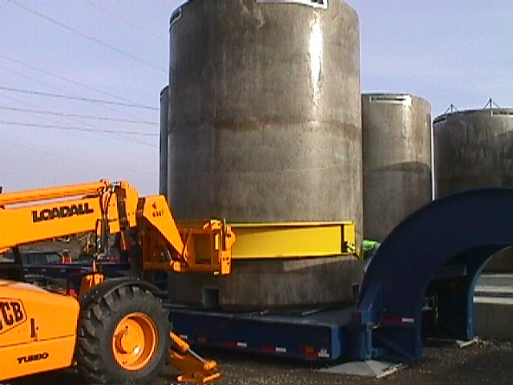
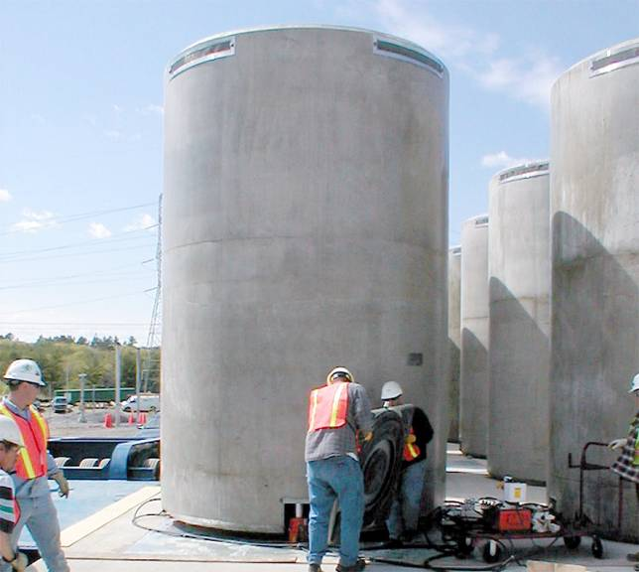
Moving Storage Casks
Trailer and
JCB Vehicle
Crawler
Air Pads

Slide 39
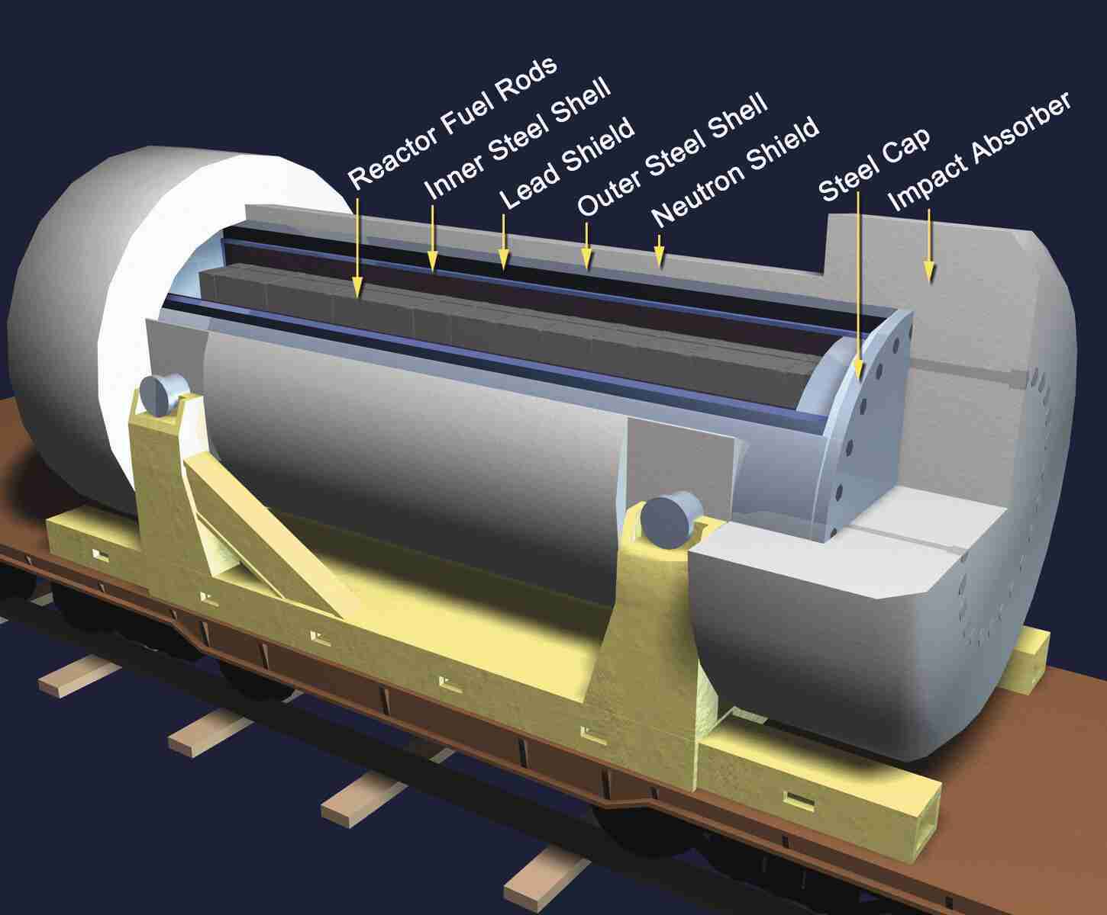
Transportation Cask

