Slide 1
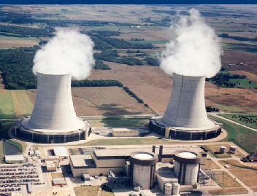
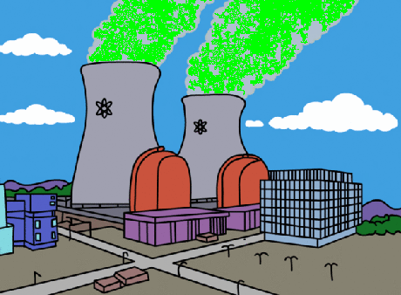
Myths
Facts or …
or …

Slide 2

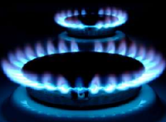
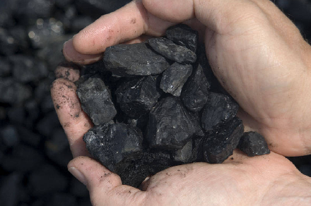

Nuclear energy provides about 20% of America’s electricity.

Slide 3
Nuclear energy provides about 20% of America’s electricity.
FACT
7%
20%
50%
20%

Slide 4
Radioactive materials escape through the cooling towers at nuclear power plants.

Slide 5
Radioactive materials do NOT escape through the cooling towers at nuclear power plants.
MYTH
Water Vapor
BONUS QUESTION: What is coming out of the cooling towers in this picture?
Notes:
BONUS QUESTION: What is coming out of the cooling towers in this picture?

Slide 6
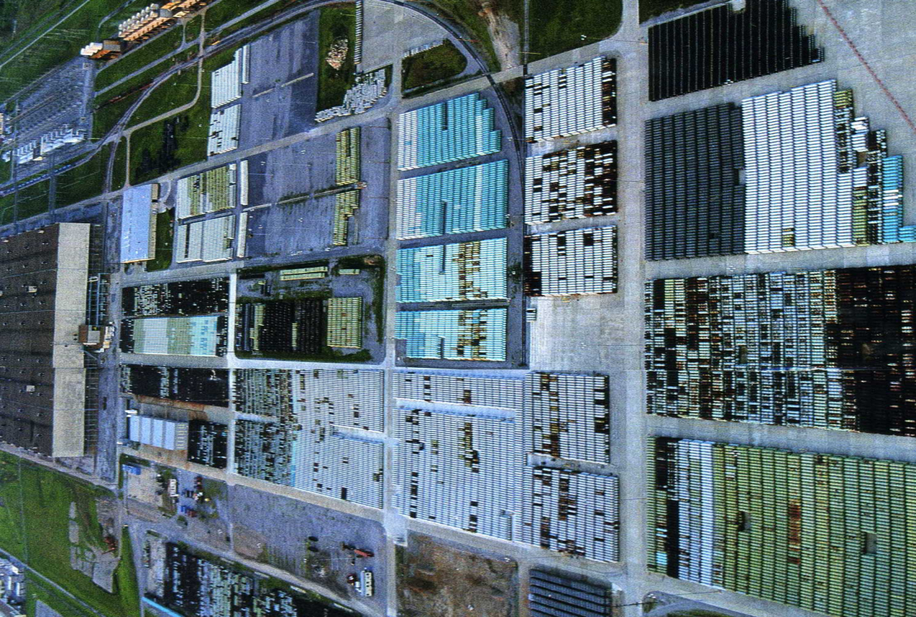
Nuclear power plants produce huge quantities of toxic radioactive waste.

Slide 7
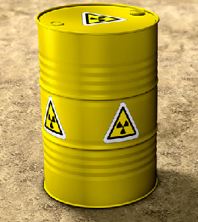
Nuclear power plants do NOT produce huge quantities of toxic radioactive waste.
MYTH

Slide 8
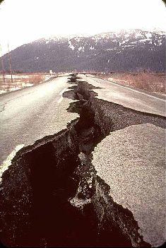
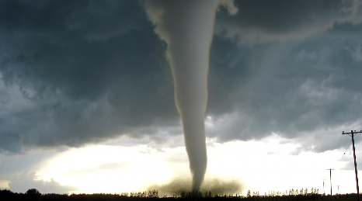
Nuclear plants are designed to safely shut down during an earthquake, tornado, flood or terrorist attack.

Slide 9
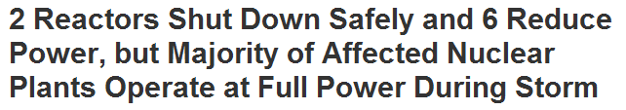
Nuclear plants are designed to safely shut down during an earthquake, tornado, flood or terrorist attack.
FACT
Newspaper title following hurricane “Irene”

Slide 10
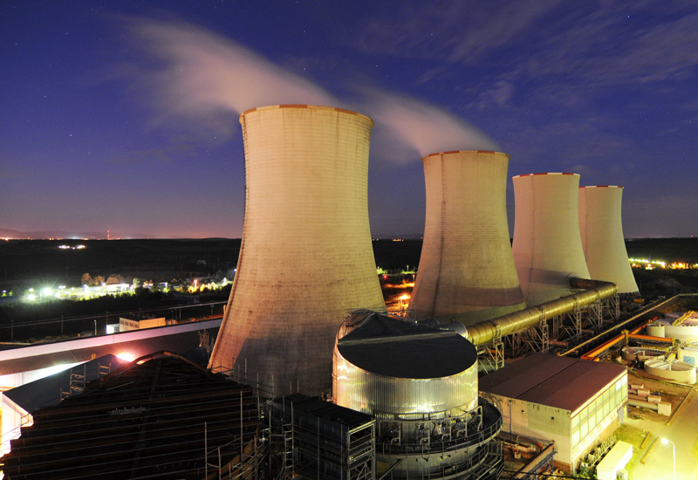
Nuclear power plants are the only plants with cooling towers.

Slide 11
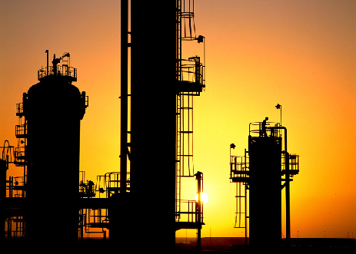
Nuclear power plants are NOT the only plants with cooling towers.
MYTH
BONUS QUESTION: Name one other type of plant that has cooling towers.
Notes:
Bonus question answer: Oil refineries, chemical plants and power stations (fossil plants) use cooling towers to transfer waste heat to the atmosphere.

Slide 12
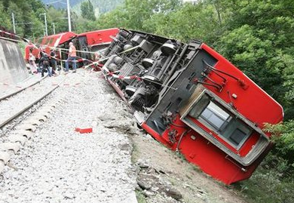
Nuclear waste cannot be safely transported.

Slide 13
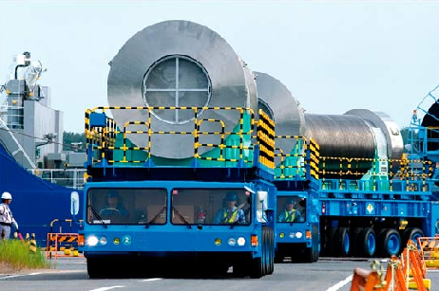
Nuclear waste is safely transported.
MYTH
BONUS QUESTION: How is nuclear waste safely transported?
Notes:
Bonus question answer: By truck, rail, and cargo ships.

Slide 14

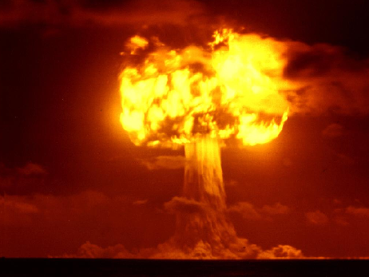
Manufacturing a nuclear weapon is different from using nuclear power to produce electricity.
=
=

Slide 15
Manufacturing a nuclear weapon is different from using nuclear power to produce electricity.
FACT
=

Slide 16

Cancer rates are higher near nuclear power plants.

Slide 17

Cancer rates are NOT higher near nuclear power plants.
MYTH

Slide 18
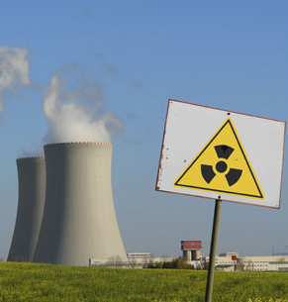

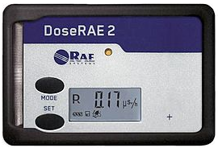
Americans get most of their yearly radiation dose from nuclear power plants.

Slide 19
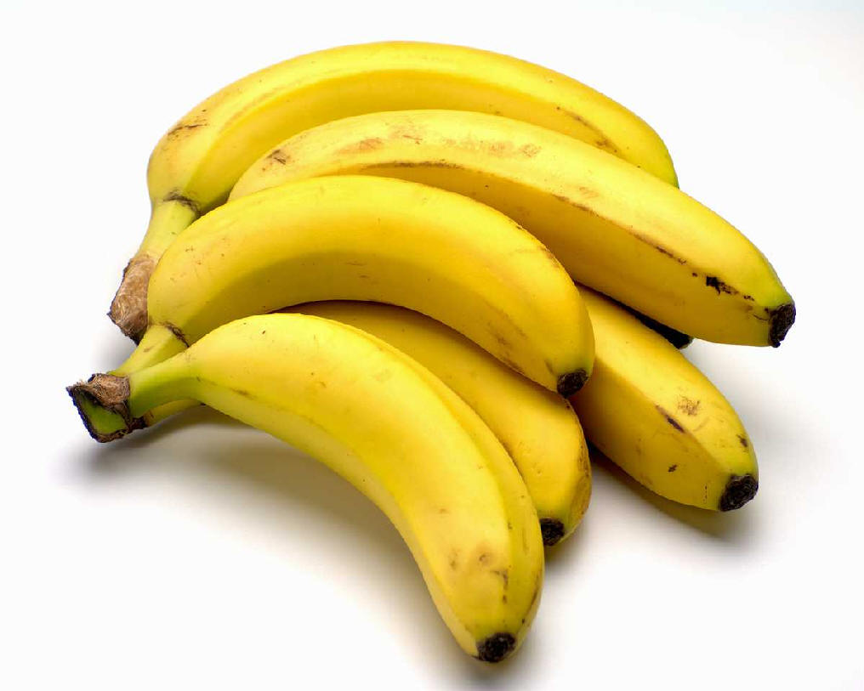
The average American's yearly radiation dose from a nuclear power plant is about the same as the one we get from eating 1 banana per year.
MYTH
BONUS QUESTION: Name a fruit that gives us a small, safe dose of radiation each time we eat it.
Notes:
Bonus question answer: banana

Slide 20

It is safer to work in a nuclear power plant than an office.

Slide 21
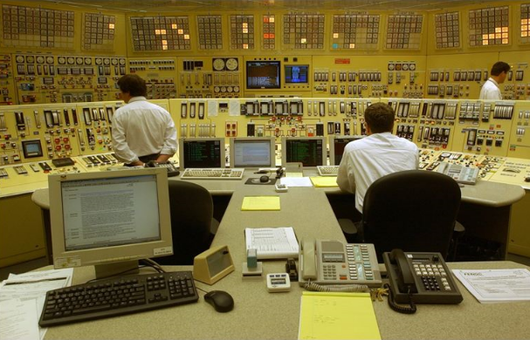
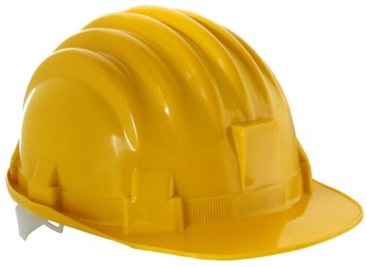

Recent studies have proven that it is safer to work in a nuclear power plant than an office*.
FACT
* NEI website
Notes:
Have to be careful just like they are in lab!

Slide 22

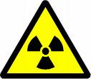
Any amount of radiation can cause death.
?
=

Slide 23
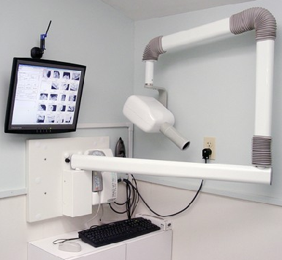
Every human being is continuously exposed to different forms of radiation every moment of their life.
MYTH
BONUS QUESTION: Name another source of radiation.
Notes:
Airports too

Slide 24
Nuclear energy produces no greenhouse gases or air pollutants.

Slide 25

Nuclear energy produces no greenhouse gases or air pollutants.
FACT

Slide 26
Nuclear weapons can be made at US commercial power plants.

Slide 27
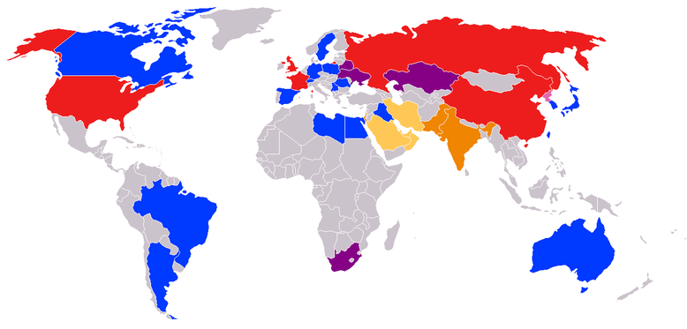
Nuclear weapons can NOT be made at US commercial power plants.
MYTH
Countries in the non-proliferation treaty.

Slide 28




QUESTIONS?

