Slide 1
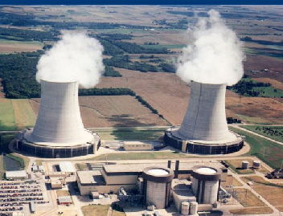
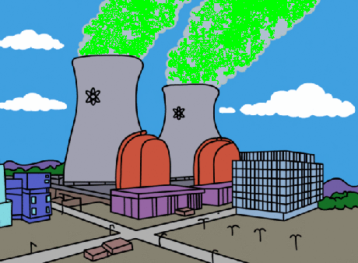
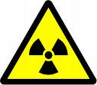
Myths
Facts or …

Slide 2
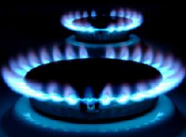
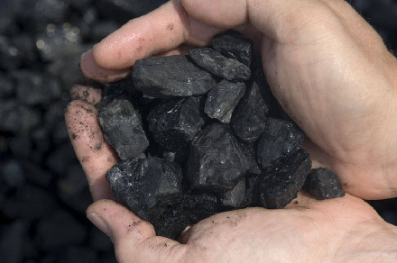
Nuclear energy provides about 20% of America’s electricity.

Slide 3
Nuclear energy provides about 20% of America’s electricity.
FACT
7%
20%
50%
20%

Slide 4
Radioactive materials escape through the cooling towers at nuclear power plants.

Slide 5
Radioactive materials do NOT escape through the cooling towers at nuclear power plants.
MYTH
Water Vapor

Slide 6
Nuclear power plants produce huge quantities of toxic radioactive waste.

Slide 7
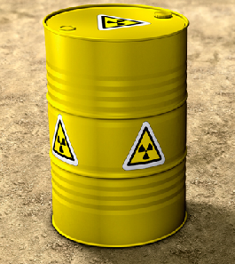
Nuclear power plants do NOT produce huge quantities of toxic radioactive waste.
MYTH

Slide 8
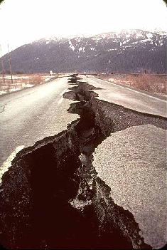
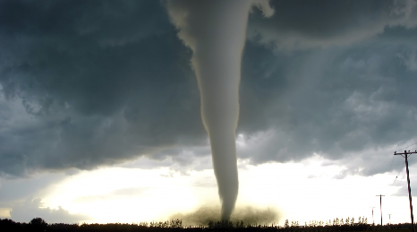
Nuclear plants are designed to safely shut down during an earthquake, tornado, flood or terrorist attack.

Slide 9
Nuclear plants are designed to safely shut down during an earthquake, tornado, flood or terrorist attack.
FACT
Newspaper title following hurricane “Irene”

Slide 10
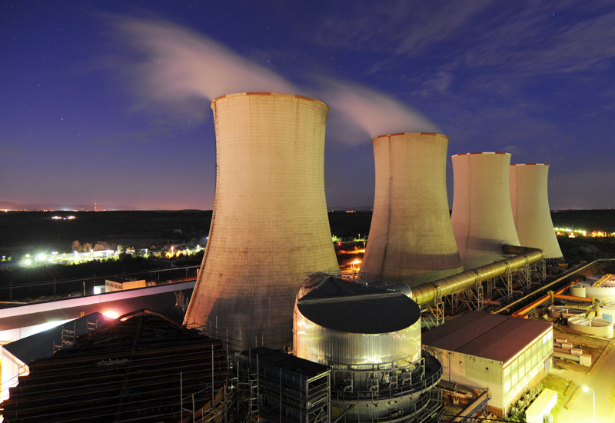
Nuclear power plants are the only plants with cooling towers.

Slide 11
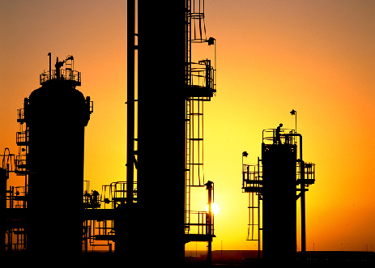
Nuclear power plants are NOT the only plants with cooling towers. Oil refineries, chemical plants and power stations use cooling towers to transfer waste heat to the atmosphere.
MYTH

Slide 12
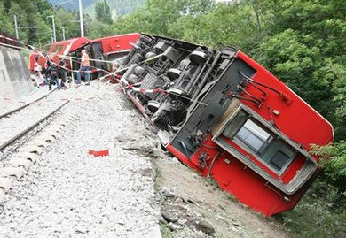
Nuclear waste cannot be safely transported.

Slide 13
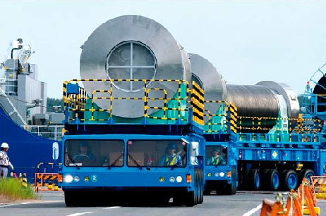
Nuclear waste is safely transported by truck, rail and cargo ships.
MYTH

Slide 14
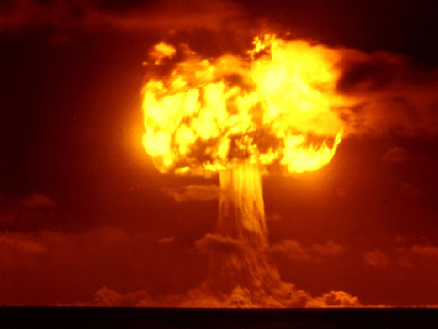
Manufacturing a nuclear weapon is different from using nuclear power to produce electricity.
=
=

Slide 15
Manufacturing a nuclear weapon is different from using nuclear power to produce electricity.
FACT
=

Slide 16
Cancer rates are higher near nuclear power plants.

Slide 17
Cancer rates are NOT higher near nuclear power plants.
MYTH

Slide 18
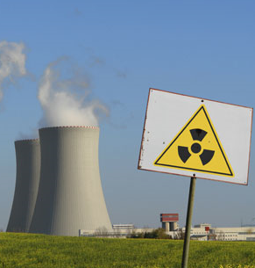
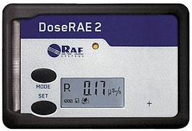
Americans get most of their yearly radiation dose from nuclear power plants.

Slide 19
The average American's yearly radiation dose from nuclear power plant is about the same as the one we get from eating 1 banana per year.
MYTH

Slide 21
Most Americans do not support nuclear power.

Slide 22
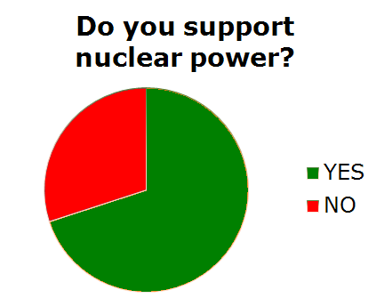
70% of Americans support nuclear power.
MYTH
NO
YES

Slide 23
It is safer to work in a nuclear power plant than an office.

Slide 24
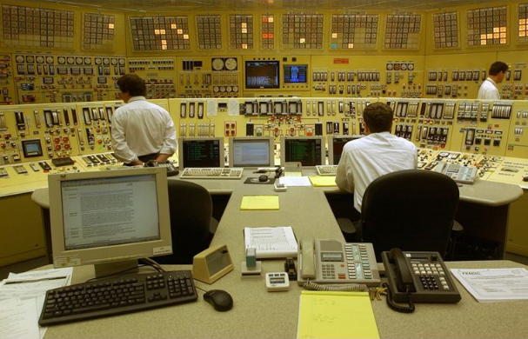
Recent studies have proved that it is safer to work in a nuclear power plant than an office*.
FACT
* NEI website

Slide 25
Any amount of radiation can cause death.
?
=

Slide 26
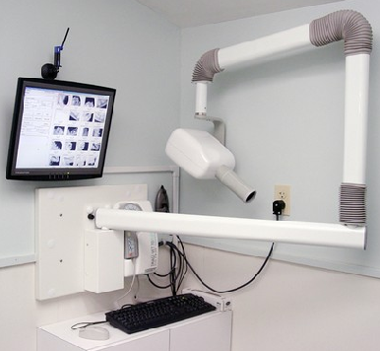
Every human being is continuously exposed to different forms of radiation every moment of their life.
MYTH

Slide 27
Nuclear energy produces no greenhouse gases or air pollutants.

Slide 28
Nuclear energy produces no greenhouse gases or air pollutants.
FACT

Slide 29
Nuclear weapons can be made at US commercial power plants.

Slide 30
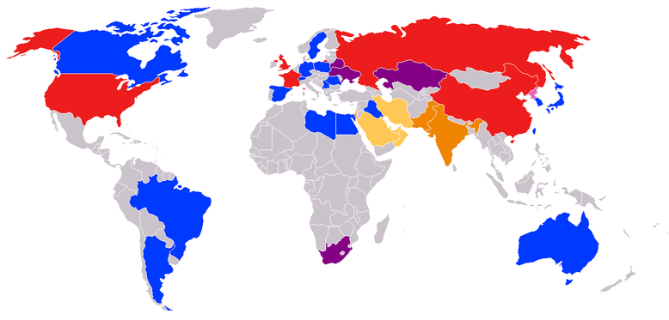
Nuclear weapons can NOT be made at US commercial power plants.
MYTH
Countries in the non-proliferation treaty.

