Slide 1
Nuclear Facts or Myths
Speaker Name
Speaker Title and Date

Slide 2
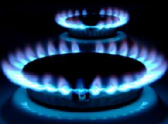
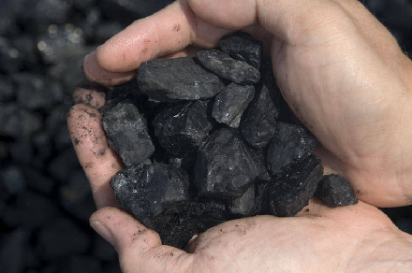
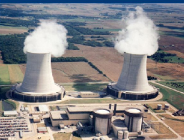
Nuclear energy provides about 20% of America’s electricity.
Notes:
Power Plants

Slide 3
Nuclear energy provides about 20% of America’s electricity.
FACT
7%
20%
50%
20%

Slide 4
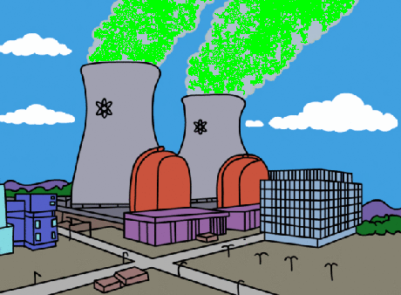
Radioactive materials escape through the cooling towers at nuclear power plants.
Notes:
Radiation

Slide 5
Radioactive materials do NOT escape through the cooling towers at nuclear power plants.
MYTH
Water Vapor

Slide 6
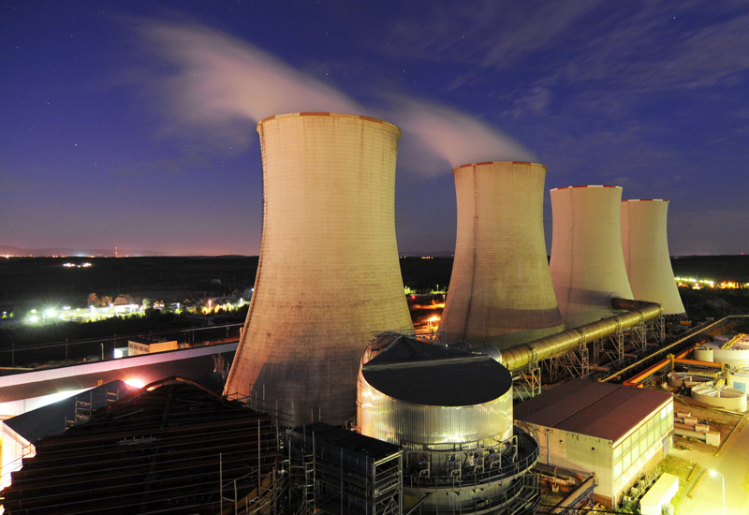
Nuclear power plants are the only sites with cooling towers.
Notes:
Power Plants

Slide 7
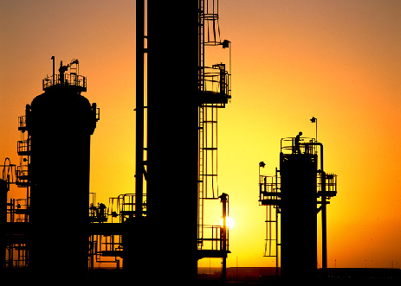
Nuclear power plants are NOT the only plants with cooling towers. Oil refineries, chemical plants and power stations use cooling towers to transfer waste heat to the atmosphere.
MYTH

Slide 8
Nuclear power plants produce huge quantities of toxic radioactive waste.
Notes:
Fuel Cycle

Slide 9
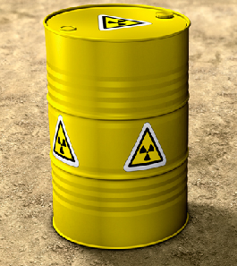
Nuclear power plants do NOT produce huge quantities of toxic radioactive waste.
MYTH
Notes:
Could improve this slide by adding in more details on quantity of waste produced

Slide 10
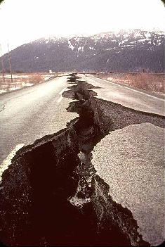
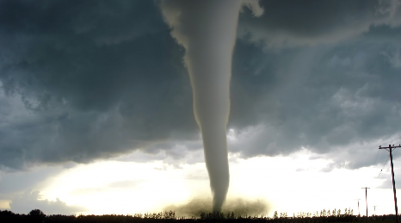
Nuclear plants are designed to safely shut down during an earthquake, tornado, flood or terrorist attack.
Notes:
delete

Slide 11
Nuclear plants are designed to safely shut down during an earthquake, tornado, flood or terrorist attack, although they cannot be designed for every imaginable scenario.
FACT
Newspaper title following hurricane “Irene”

Slide 12
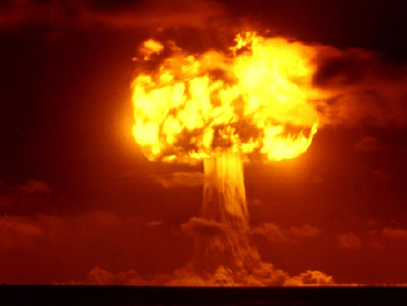
Manufacturing a nuclear weapon is different from using nuclear power to produce electricity.
=
=
Notes:
Fuel Cycle – enrichment

Slide 13
Manufacturing a nuclear weapon is different from using nuclear power to produce electricity.
FACT
=

