Slide 1
Get to Know Nuclear!

Slide 2
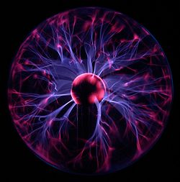
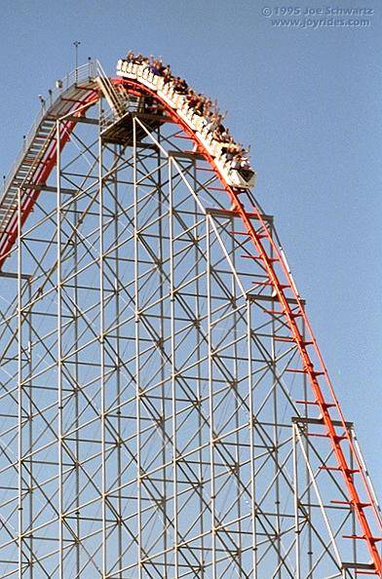
Energy
Energy is the ability to do work
Potential: stored energy
Gravity
Mechanical Energy
Chemical reaction
Nuclear reaction
Kinetic: energy of motion
Moving Object
Electromagnetic (Radiant)
Thermal
Electrical Energy
Notes:
Potential: Energy during to position (due to gravity)
Kinetic: Energy of motion
Electromagnetic energy is energy from radiation like solar power

Slide 3
Energy Transformation
Energy cannot be created or destroyed, but it changes form
Notes:
Talk about how when you each chemical energy is converted to kinetic energy
Plants turn radiant energy into chemical energy

Slide 4
Benjamin Franklin
Don’t fly a kite during lightening storm!
Notes:
Electrical Energy is moving electrons….

Slide 5
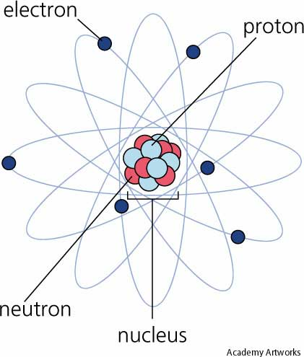
What is Electricity?
Electricity is moving electrons
This is also known as electrical energy

Slide 6
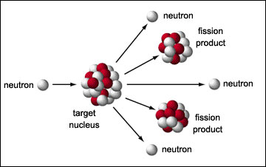
What is Nuclear Energy?
Nuclear energy is the energy released by reactions within the nuclei
Splitting Atoms = Fission

Slide 7
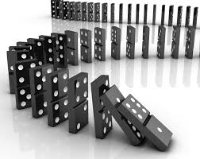
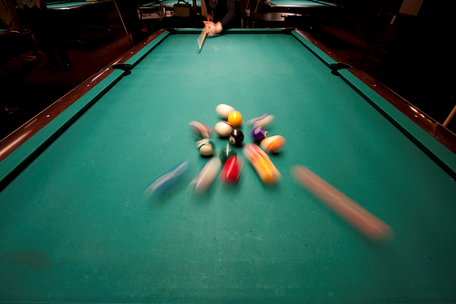
Basics of a Chain Reaction
A sequence of reactions that keeps going
Dominos
Telephone
Nuclear chain reaction caused by neutrons hitting an atom

Slide 8
The Fission Game
Notes:
Balloon exercise- have all of the participants take a balloon, hold it high and stand close. You will throw up one balloon and when it hits one of the participants, they throw up their balloon, and this continues resulting in a chain reaction.
Then ask how do you stop a chain reaction? For a nuclear power plant, you use control rods. Have one adult be a control rod and try to know down all of the balloons that are thrown in the air 3 seconds after the initial chain reaction starts.
See outreach library for full write up/instructions.

Slide 9
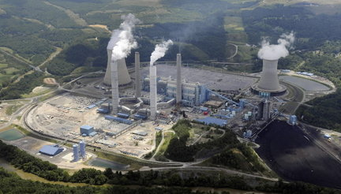
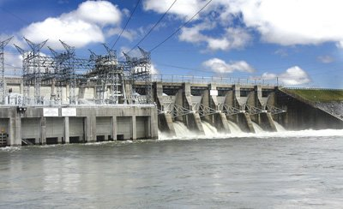
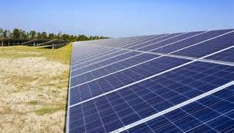
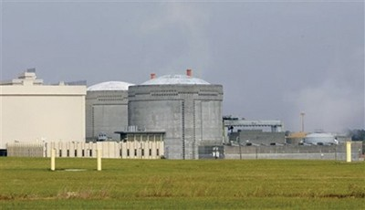
Types of Electric Plants
Plant Harris – Autaugville, AL
Logan Martin Dam – Pell City, AL
Ft. Benning, GA
Plant Farley – Dothan, AL

Slide 10
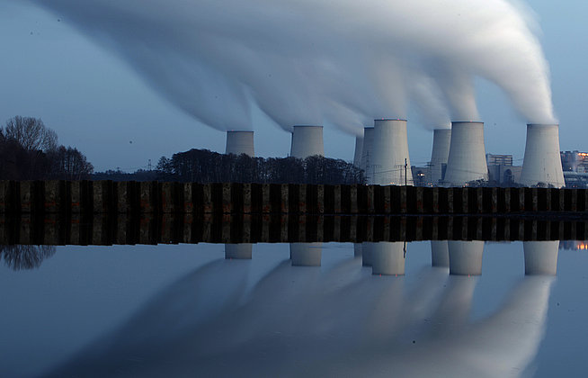
How do steam power plants work?
Notes:
Pic http://knowledge.allianz.com/?840/generate-energy-at-home

Slide 11
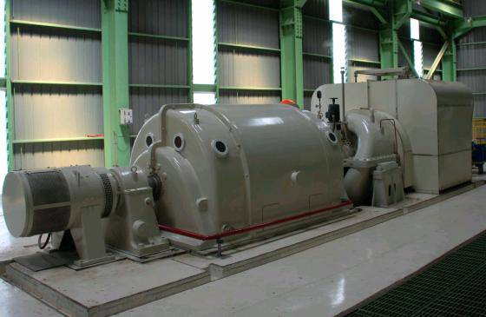
Steam
The energy in the steam from a tea kettle can spin the blades of a pin wheel
Imagine the steam inside of a power plant turning the blades of a giant turbine which spins the shaft of a huge generator

Slide 12
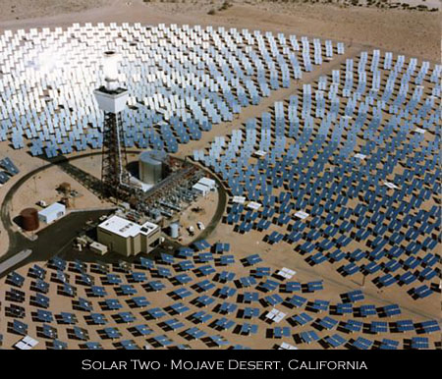
Solar Power Plant
Sunlight is reflected using mirrors to heat water
Water turns to steam
The steam turns the turbine
Notes:
Solar thermal

Slide 13
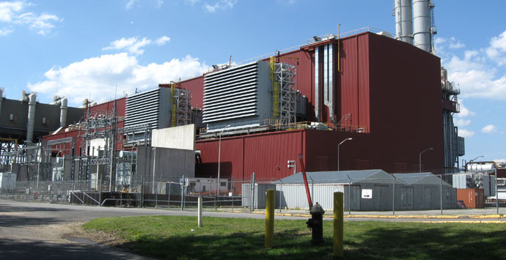
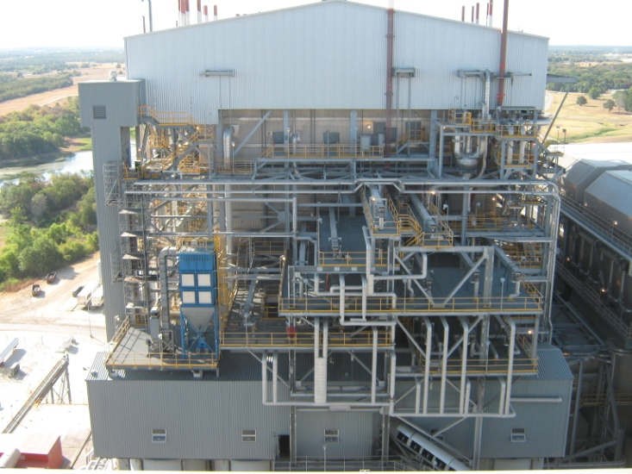
Fossil-Fueled Power Plant
Coal, gas or oil is burned to heat water in a boiler
Water turns to steam
The steam turns the turbine

Slide 14
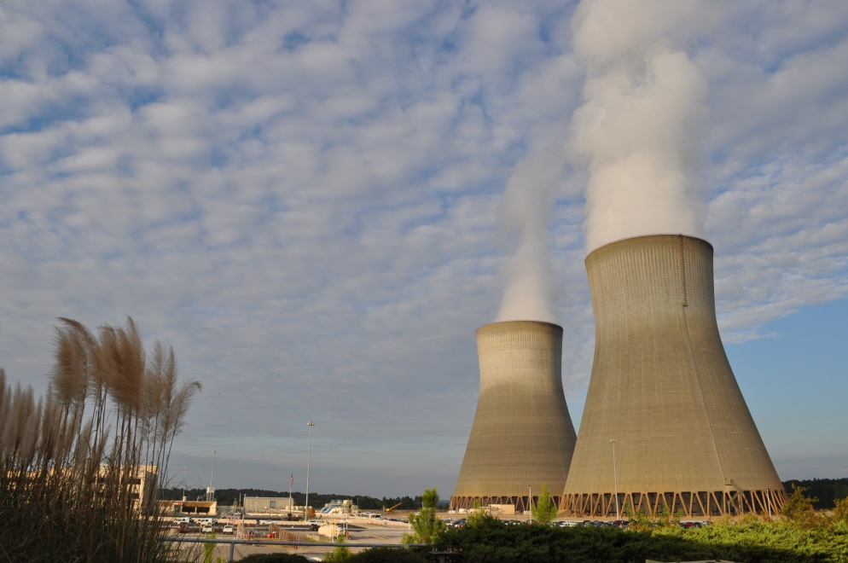
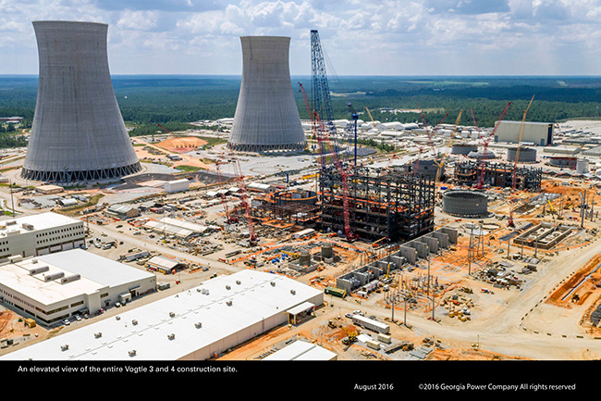
Nuclear Power Plant
Nothing is burned
Heat created by splitting atoms (nuclear reaction)
Heat turns water into steam
The steam turns the turbine

Slide 15
Power Cycle
Low Pressure Steam
Rotation
Rotation
High
Pressure
Turbine
Low Pressure Turbine
Generator
Cooled Steam
Electrical
Output
Steam
Generator
Water
Condenser
Notes:
The heat generated through the fission process is used to create steam, which is then used to generate electricity

Slide 16
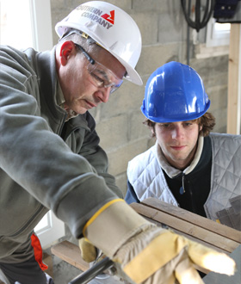
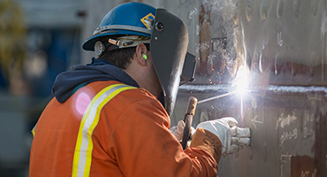
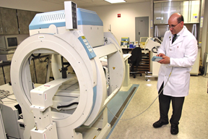
Careers
Utility
Engineers
Radiation Physics (Dose Monitoring)
Licensing
Public Communications and Advocacy
Regulation and Licensing
Lawyers
Medical Physics
Oncology
Technician
Academia
Professor
Researcher

Slide 17
References
http://www.ans.org
http://www.nei.org
http://www.eia.gov/kids
http://www.hps.org
To access the references above, right-click, open hyperlink.

