Slide 1

Elementary School Science Visit
Westinghouse-Shoreview WIN

Slide 2

Who are we?
U.S. Women in Nuclear – Westinghouse-Shoreview Chapter members
Westinghouse Electric Company
Nuclear power
Notes:
- U.S. Women in Nuclear – Westinghouse-Shoreview Chapter members
Introduce ourselves – names and positions/what we do
- Westinghouse Electric Company
We work in the nuclear power industry
You might see Westinghouse on light bulbs and TVs, but we don’t do that. We help bring electricity to your homes so you can turn on your lights and watch TV

Slide 3
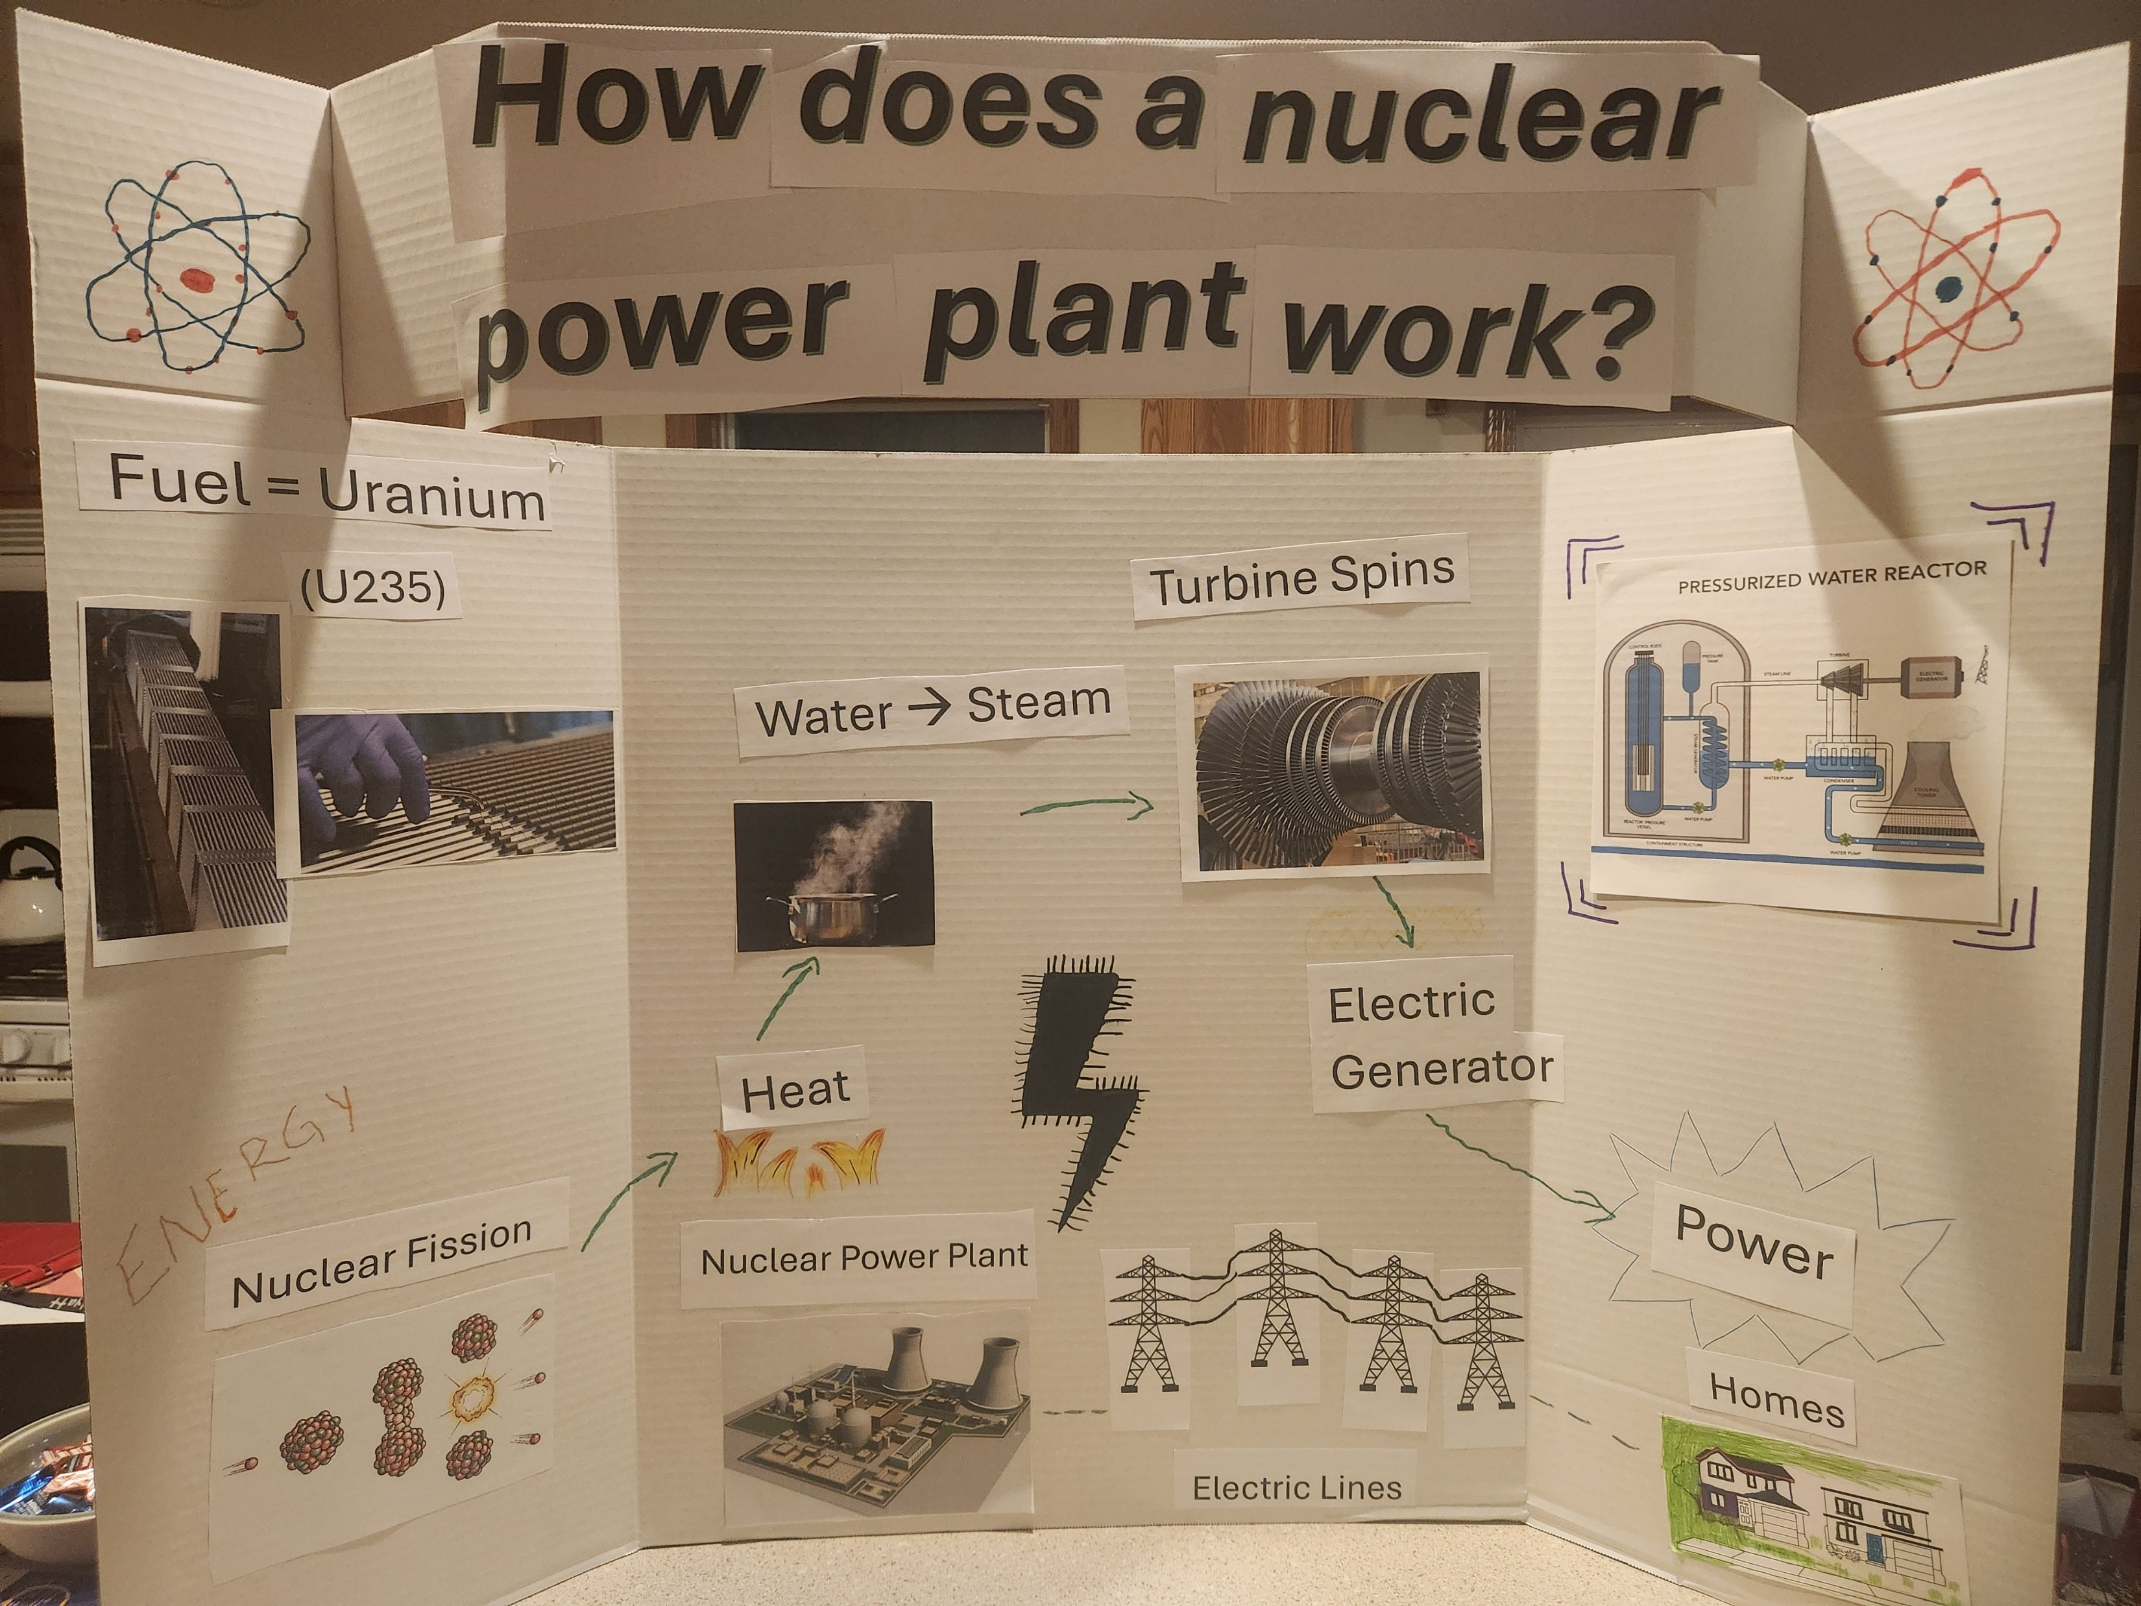
What’s nuclear power?
Notes:
A nuclear power plant does the same thing any other power plant does; it makes electricity.
It uses a special type of fuel called uranium. It doesn’t produce any smoke or pollution so it’s a clean way to make electricity.
It also is very reliable meaning the plants are producing power about 90% of the time. They only stop producing power when they have to add more fuel to the power plant.

Slide 4

Let’s Experiment
Notes:
Today we’re going to talk about water density and do a few experiments with you to explain it.

Slide 5
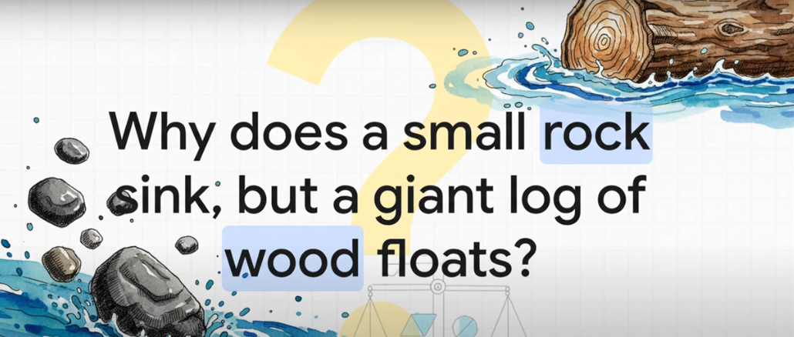
What is density?
Let’s watch…
Notes:
Stop at 3:08
So what is density? Let’s watch a short video to understand what it is and how it works.

Slide 6

Water Density
Mass + Volume = Density
Notes:
Leave this slide up during experiments
Oil and water
Ask which they think will be denser or sink to the bottom, and which will be less dense and float on the top
Bring out water-based food coloring – ask if they think it will be like the oil or similar to the water
Floating Egg
Ask if they think the egg will float or sink in plain water – add egg to water
If we add salt to the water, will that change if the egg will float or sink; will it make the water density change? Mix salt water and add egg
Objects in water
- Will they float or sink? Kids can pick an object and guess and drop it themselves

