Slide 1
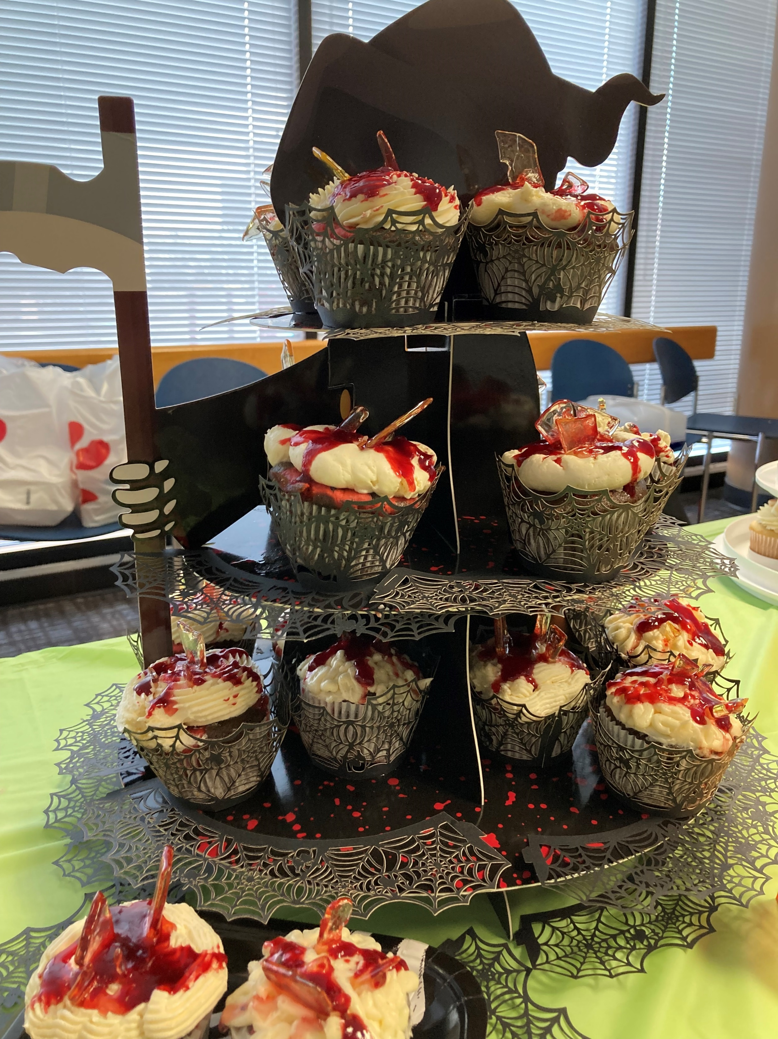
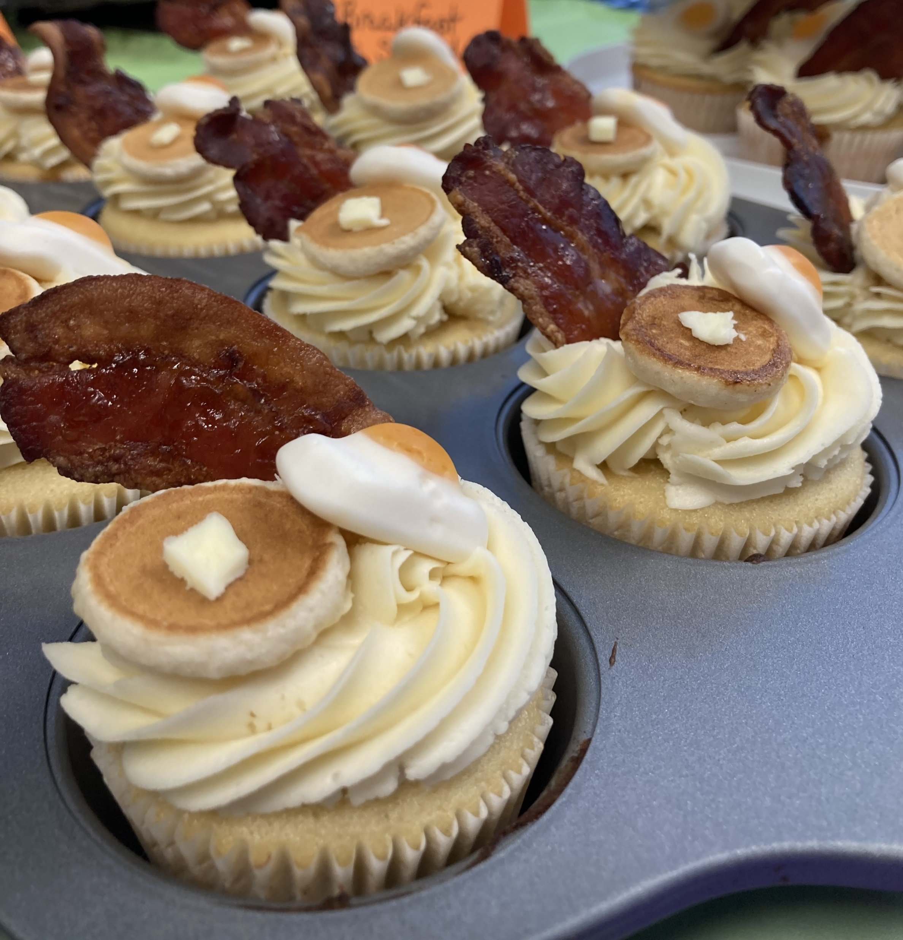
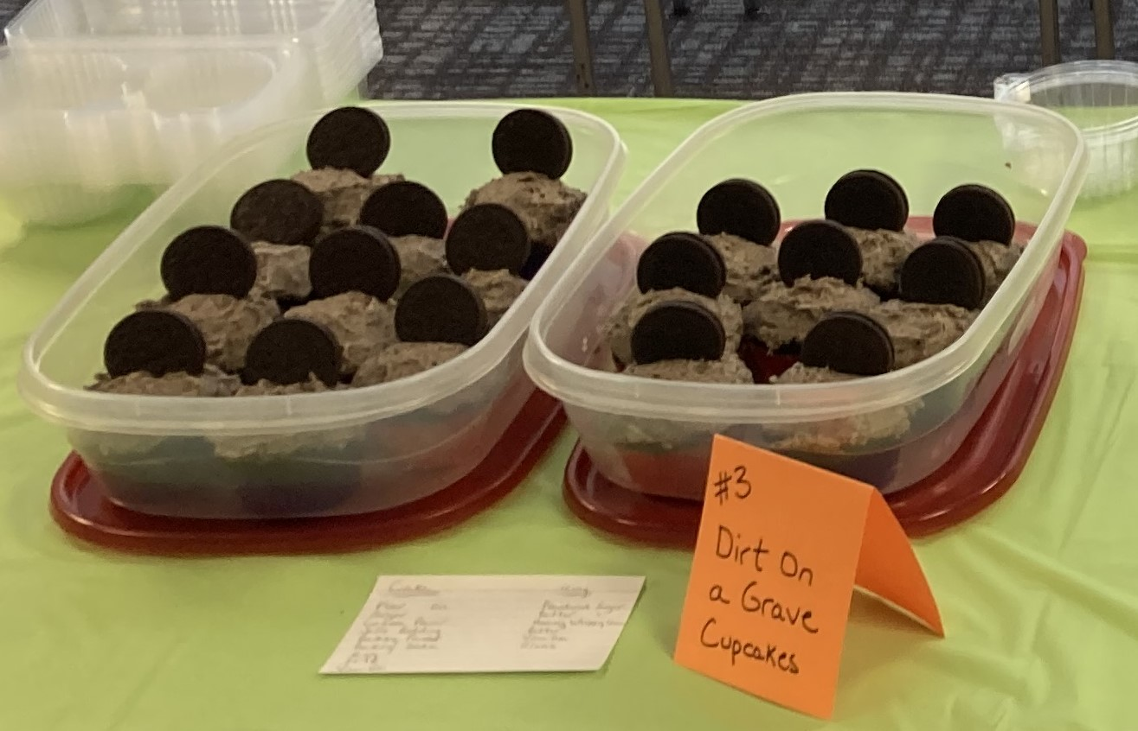
Congratulations 2023
CUPCAKE WARS
Winners!!
GRAND CHAMPION:
Nora “The Best Embert” Embert
(Chocolate Cupcake, with Cream Cheese Filling, Vanilla Swiss Meringue Buttercream and Raspberry Sauce)
BEST DECORATION:
Matt “The Better Embert” Embert
(Maple Breakfast Cupcake)
BEST TASTE:
Jessica “Not an Embert” Bailey
(Dark Chocolate Cupcake with
Cookies and Cream Buttercream)

Slide 2
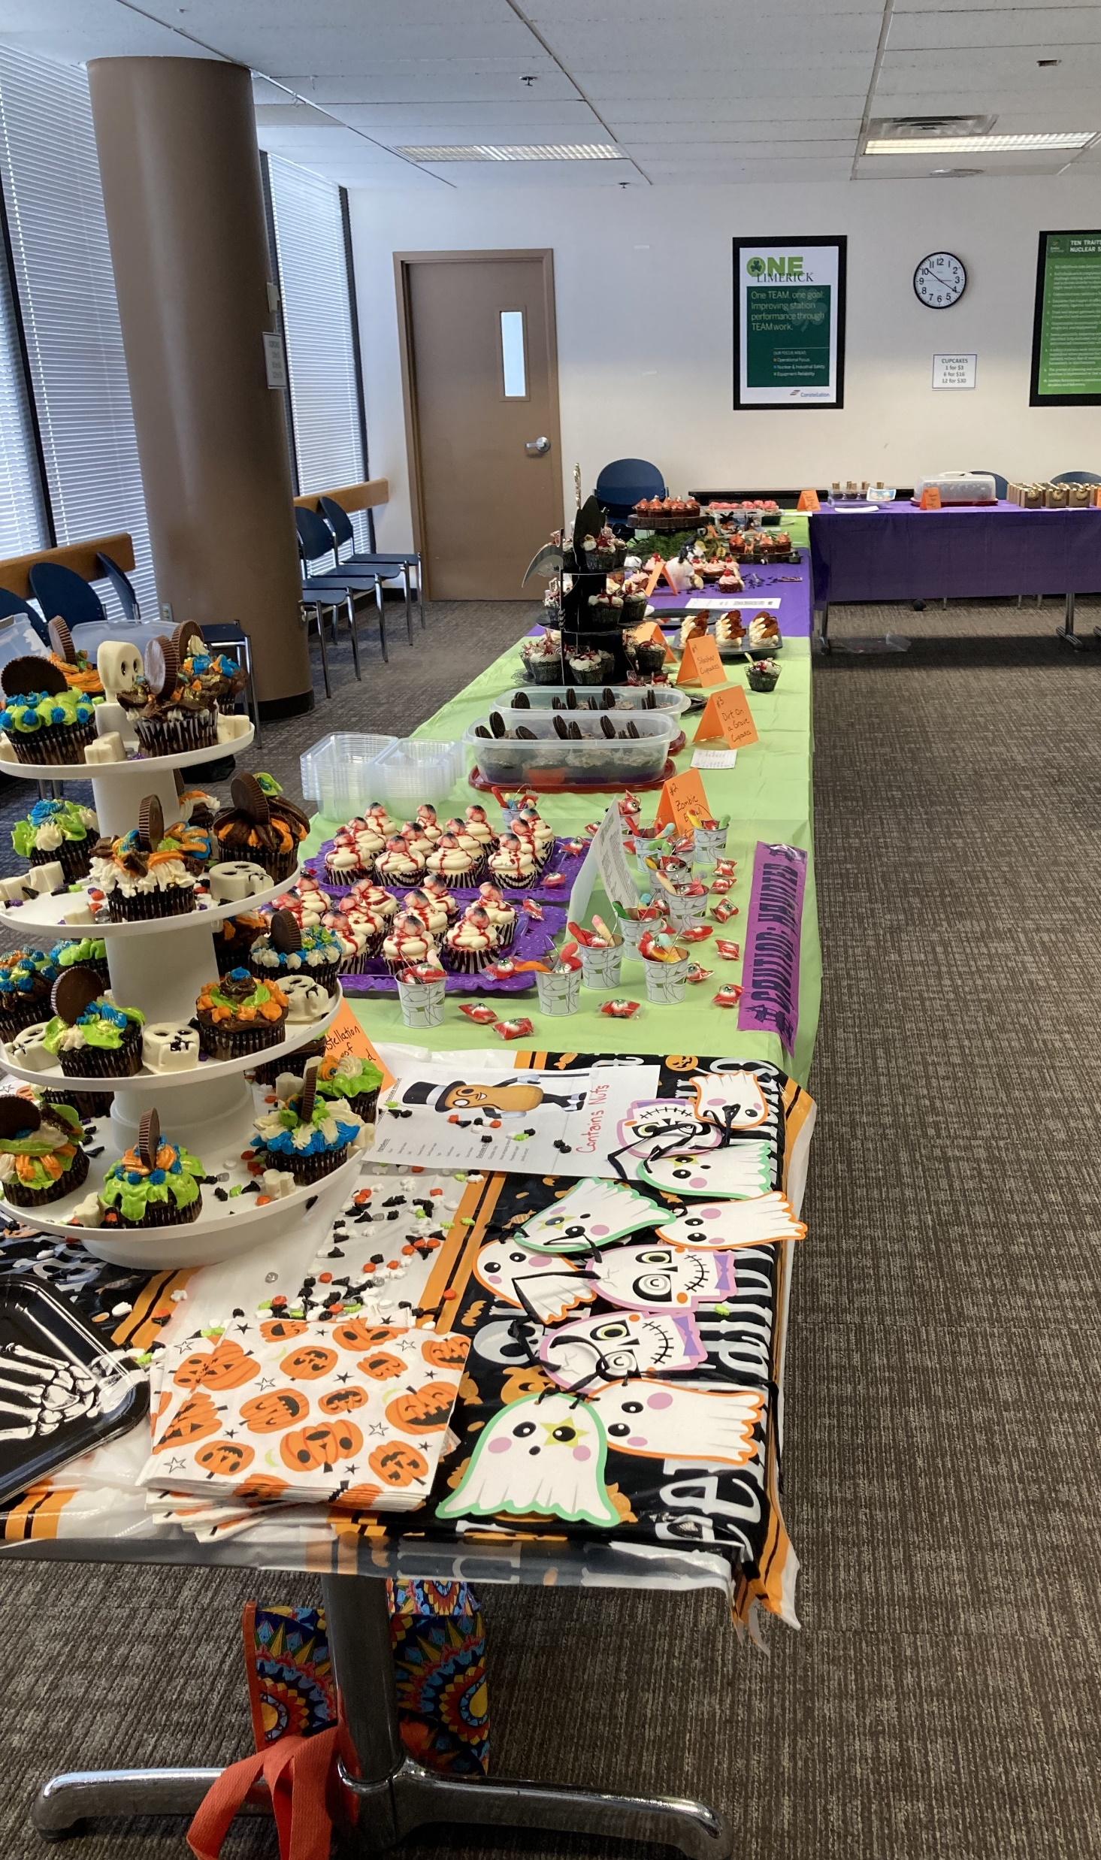
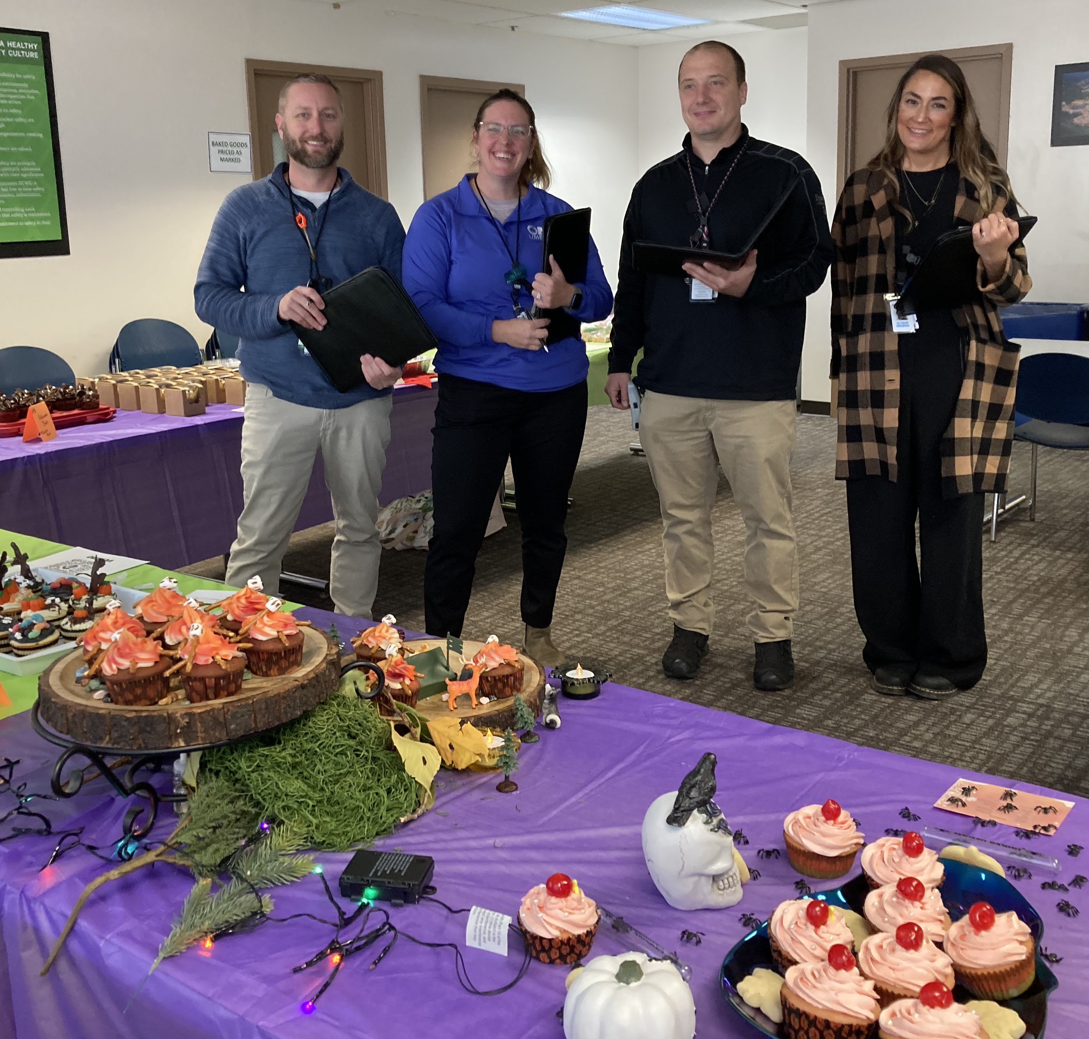
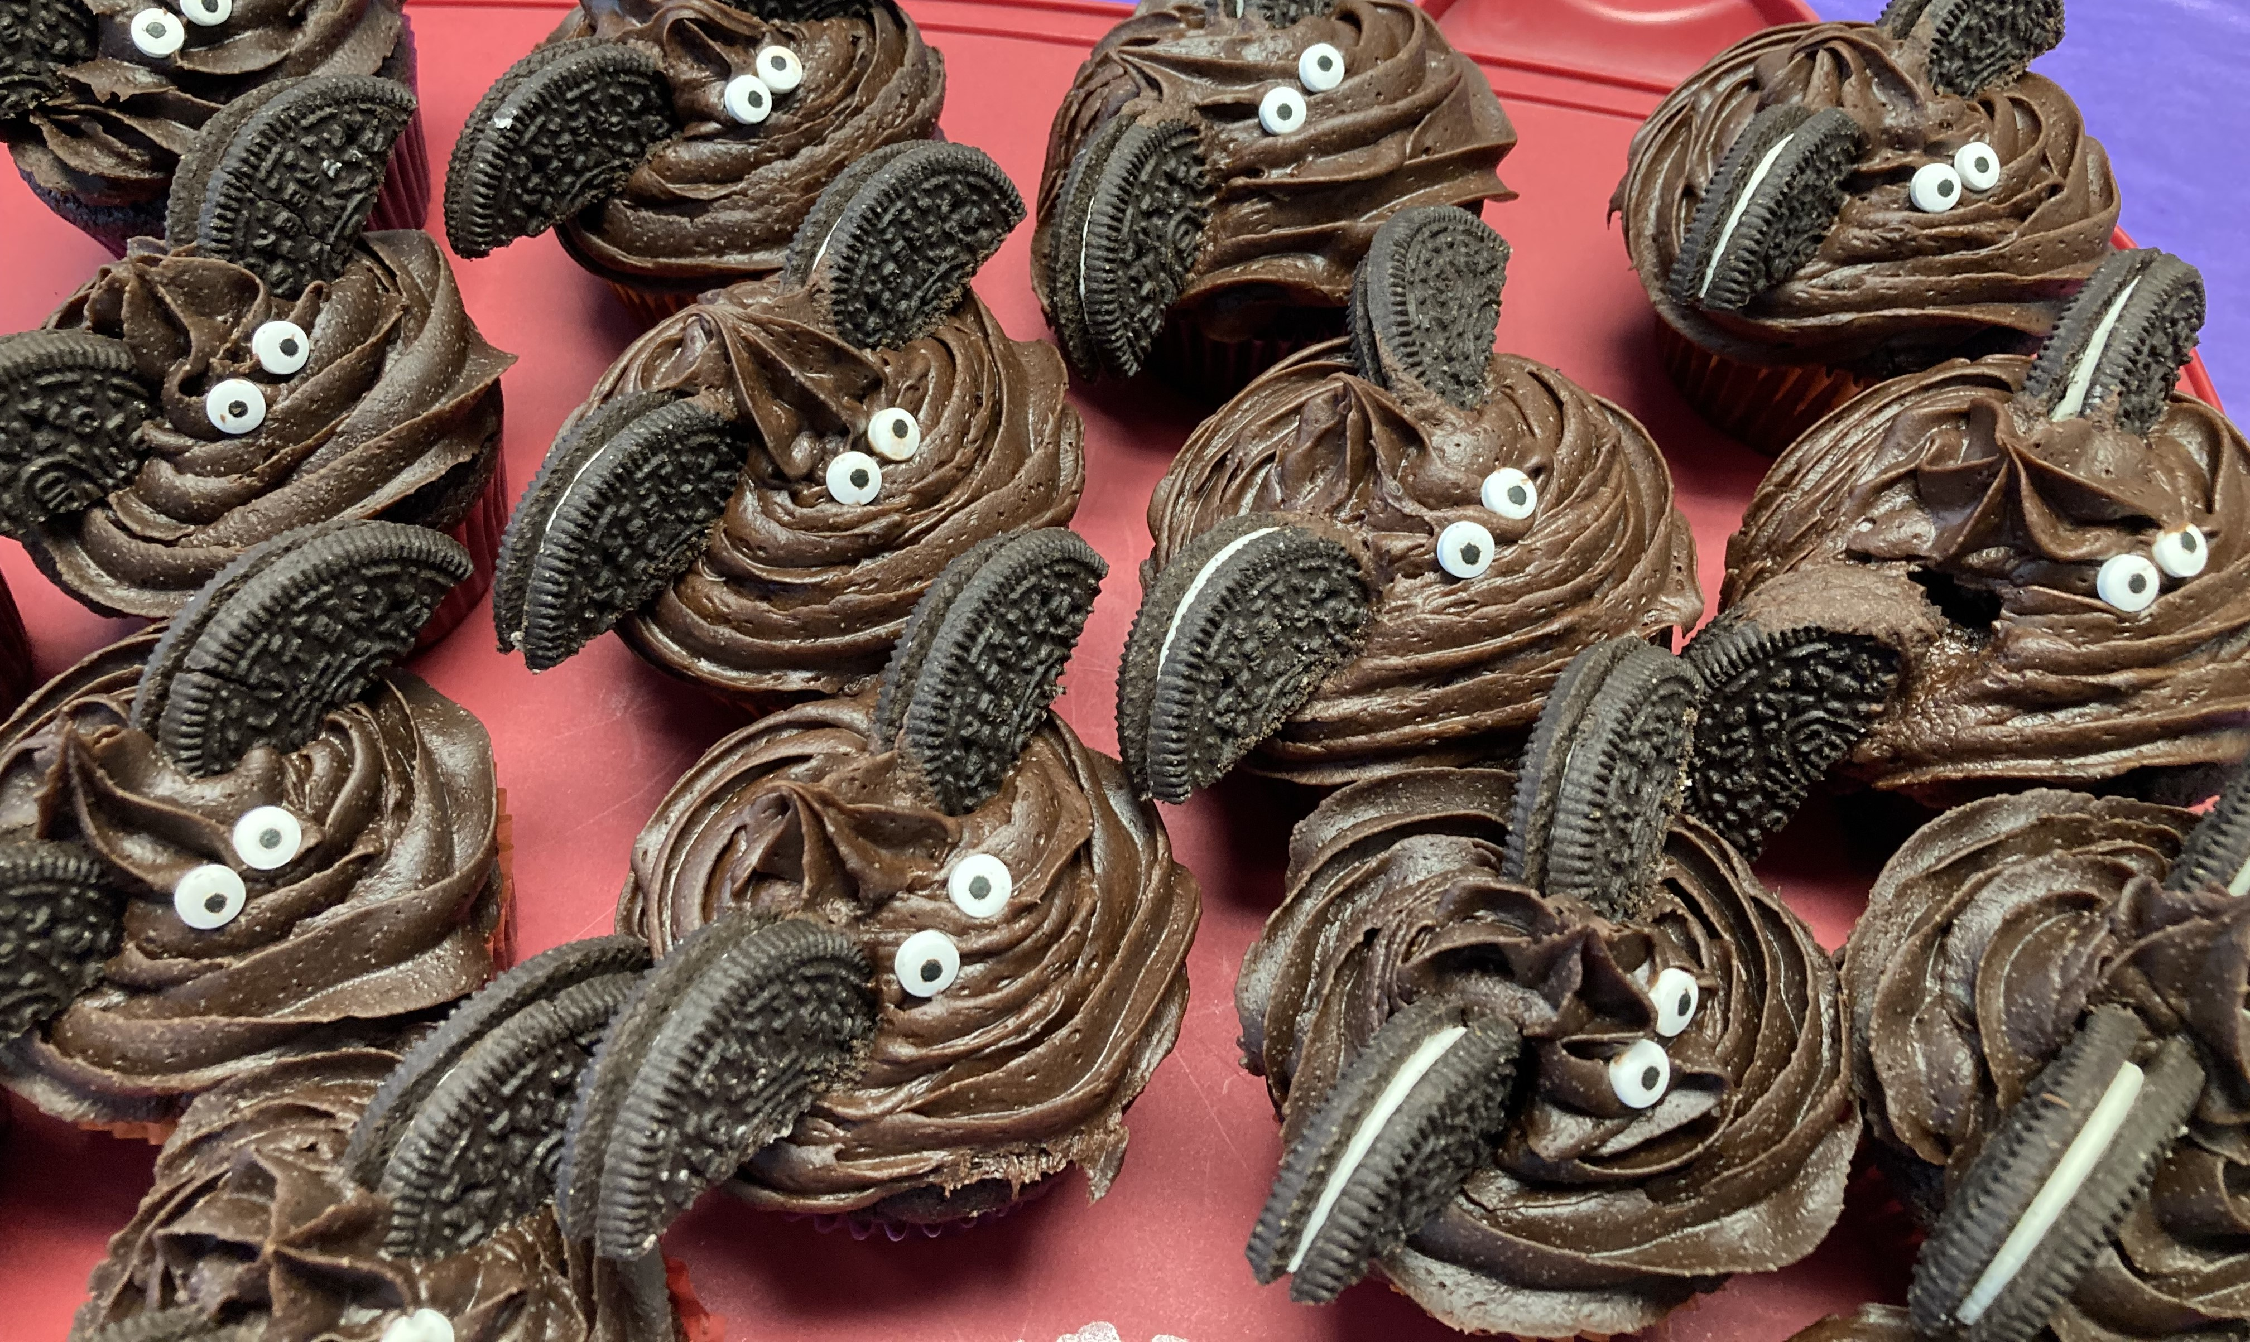
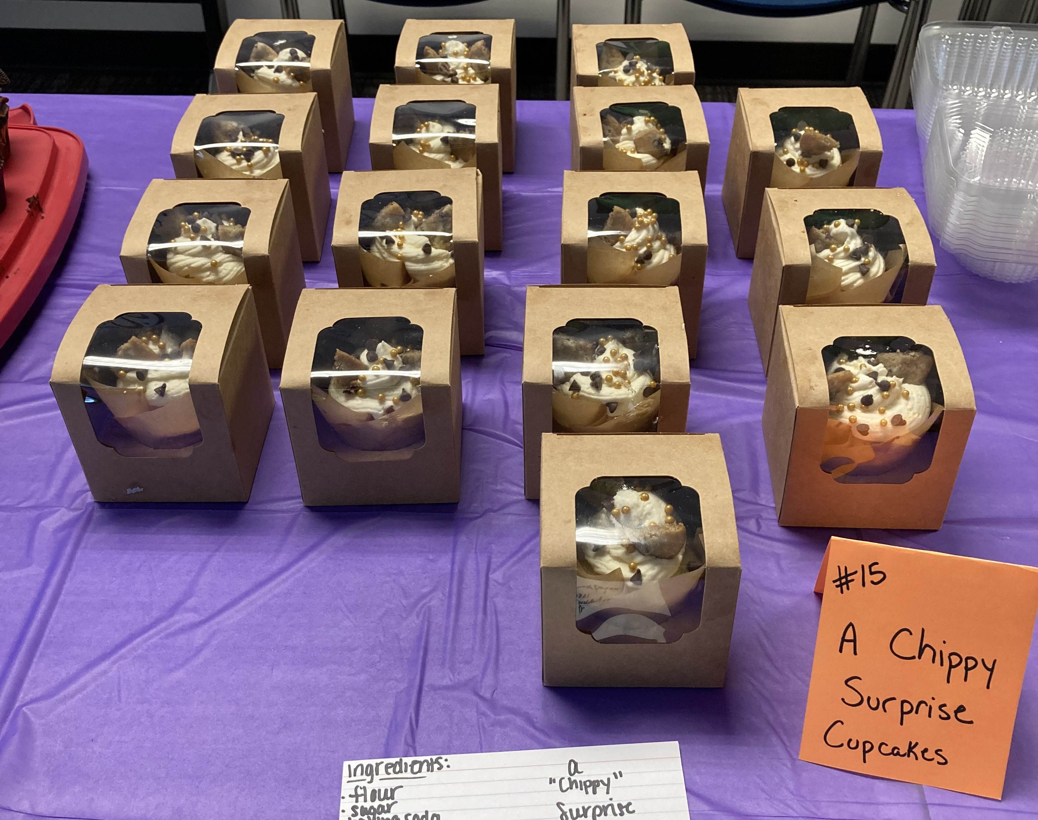
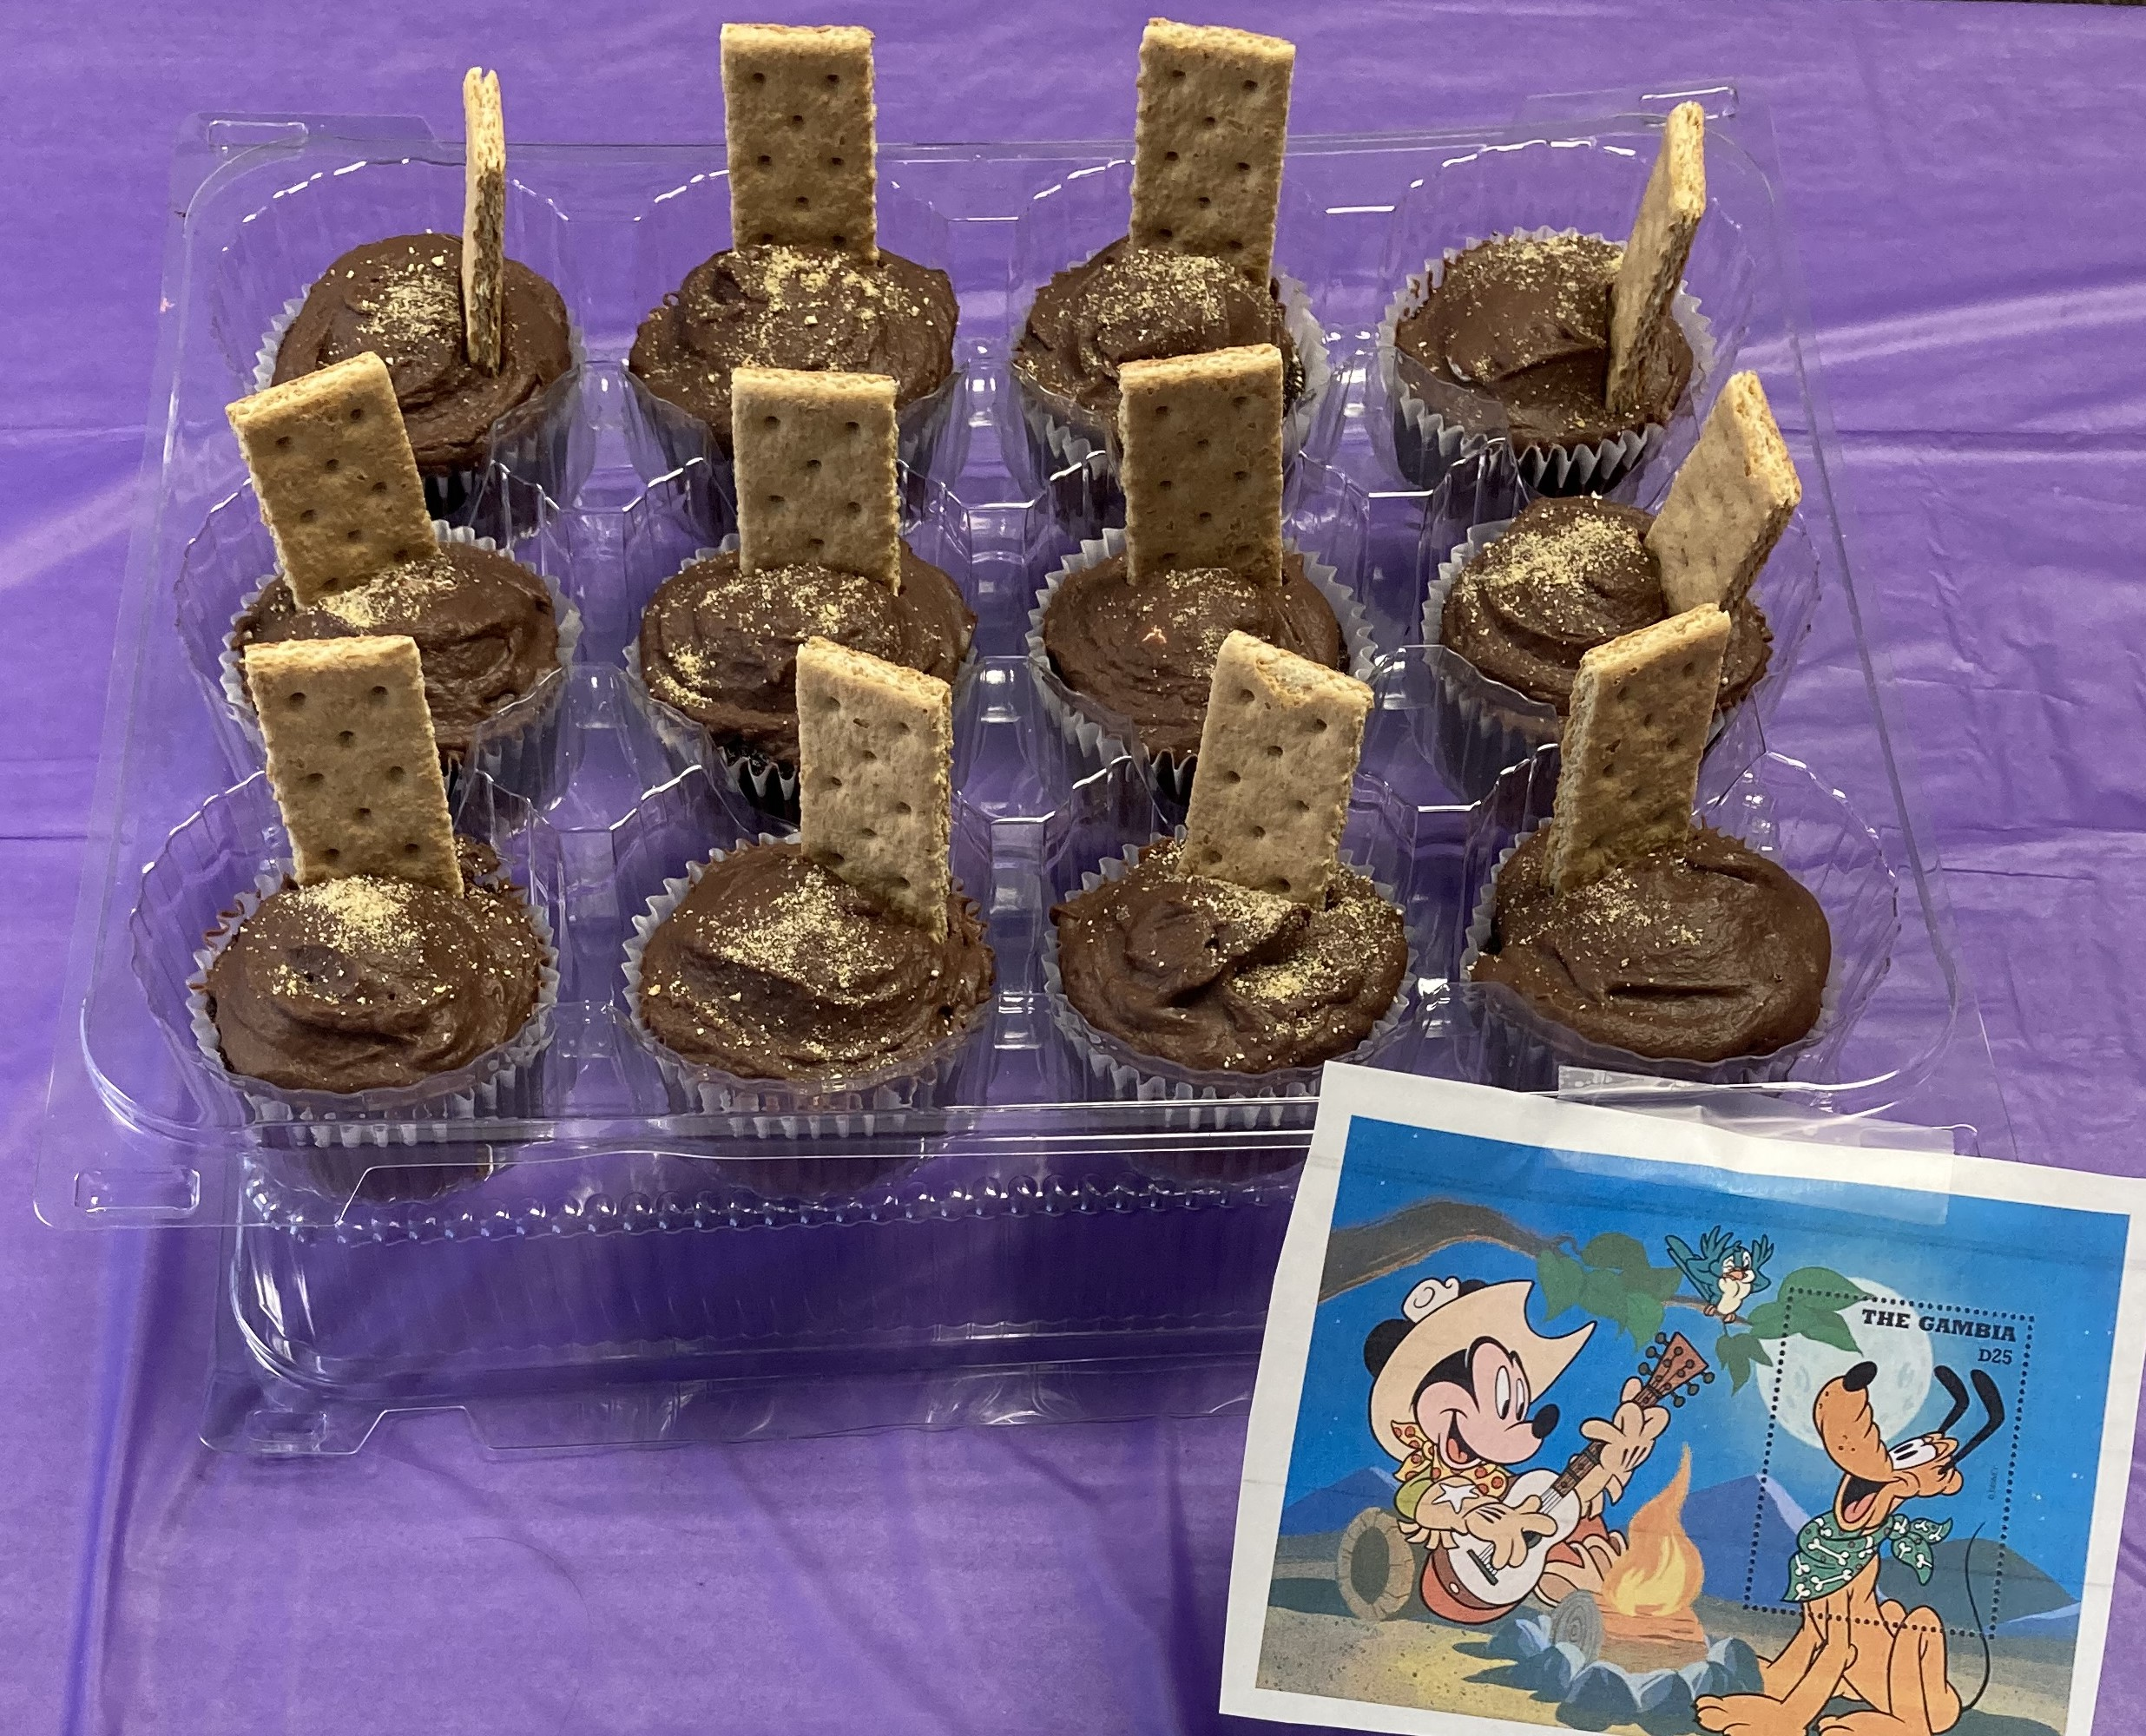
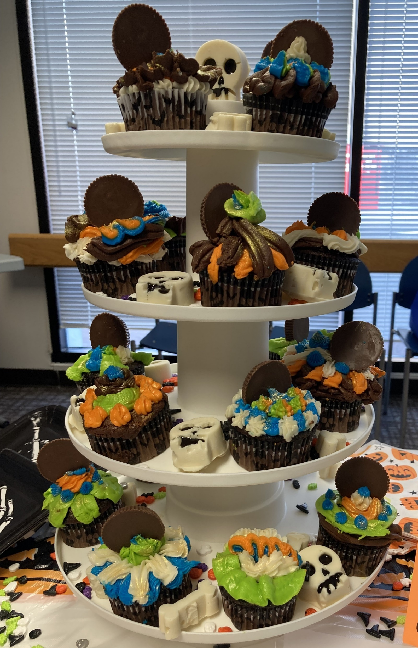
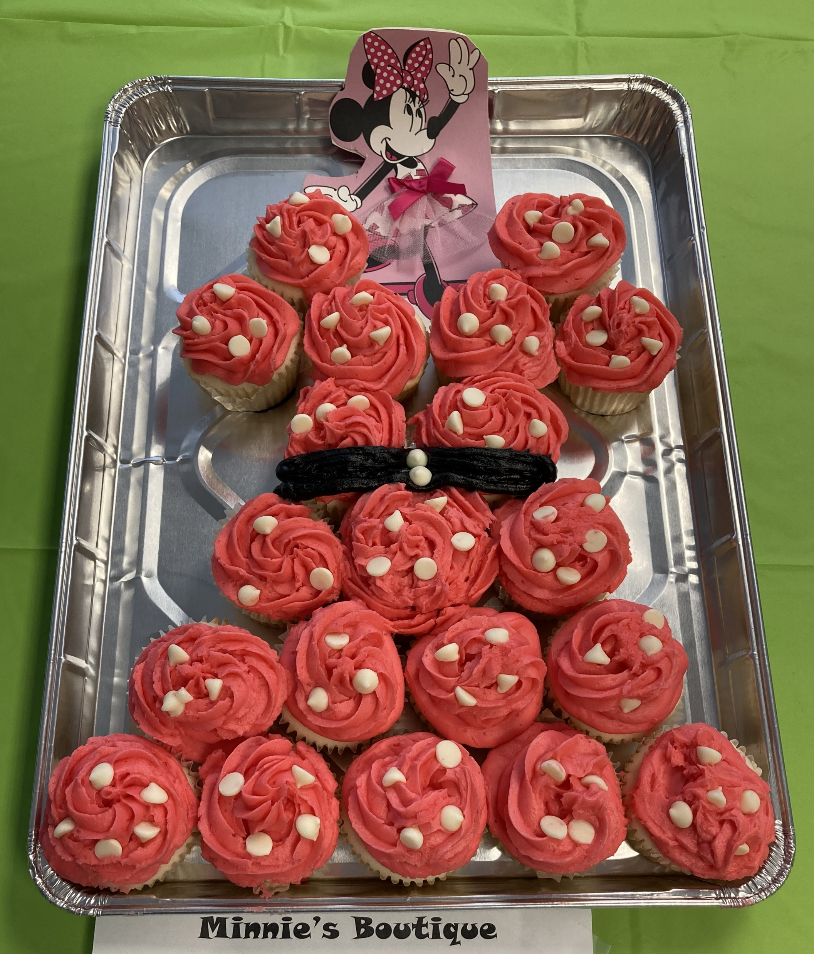
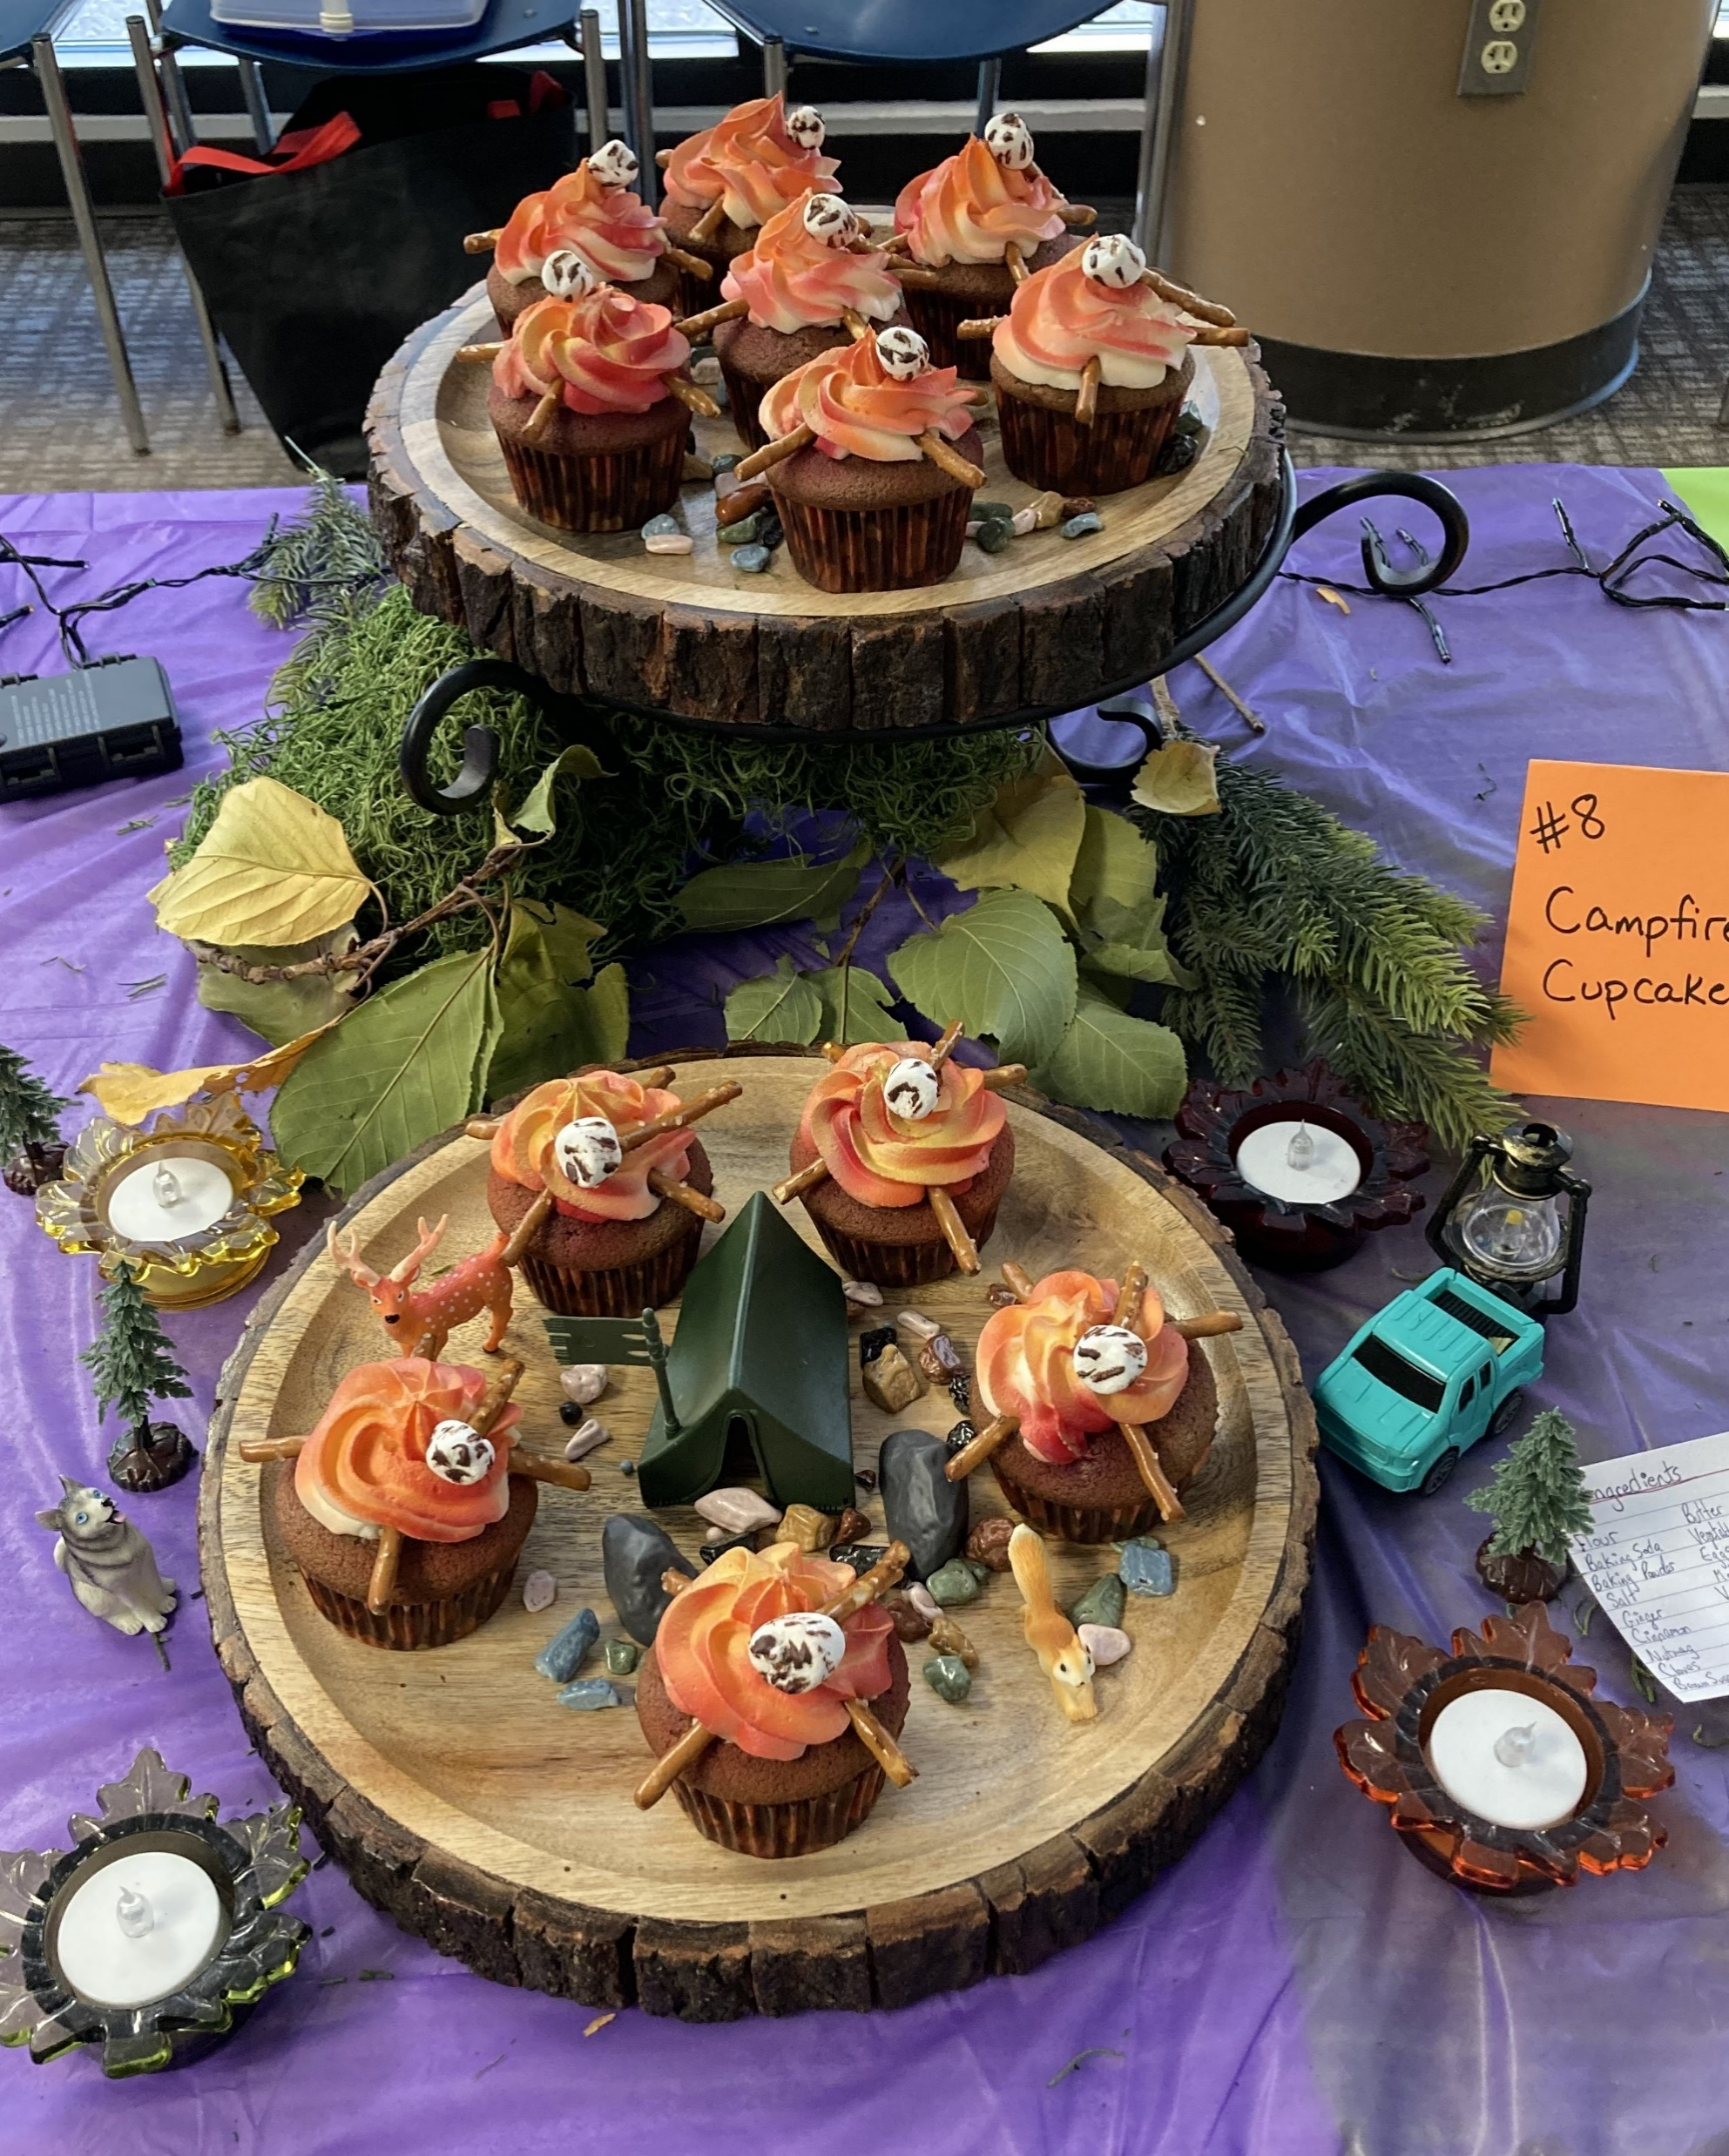
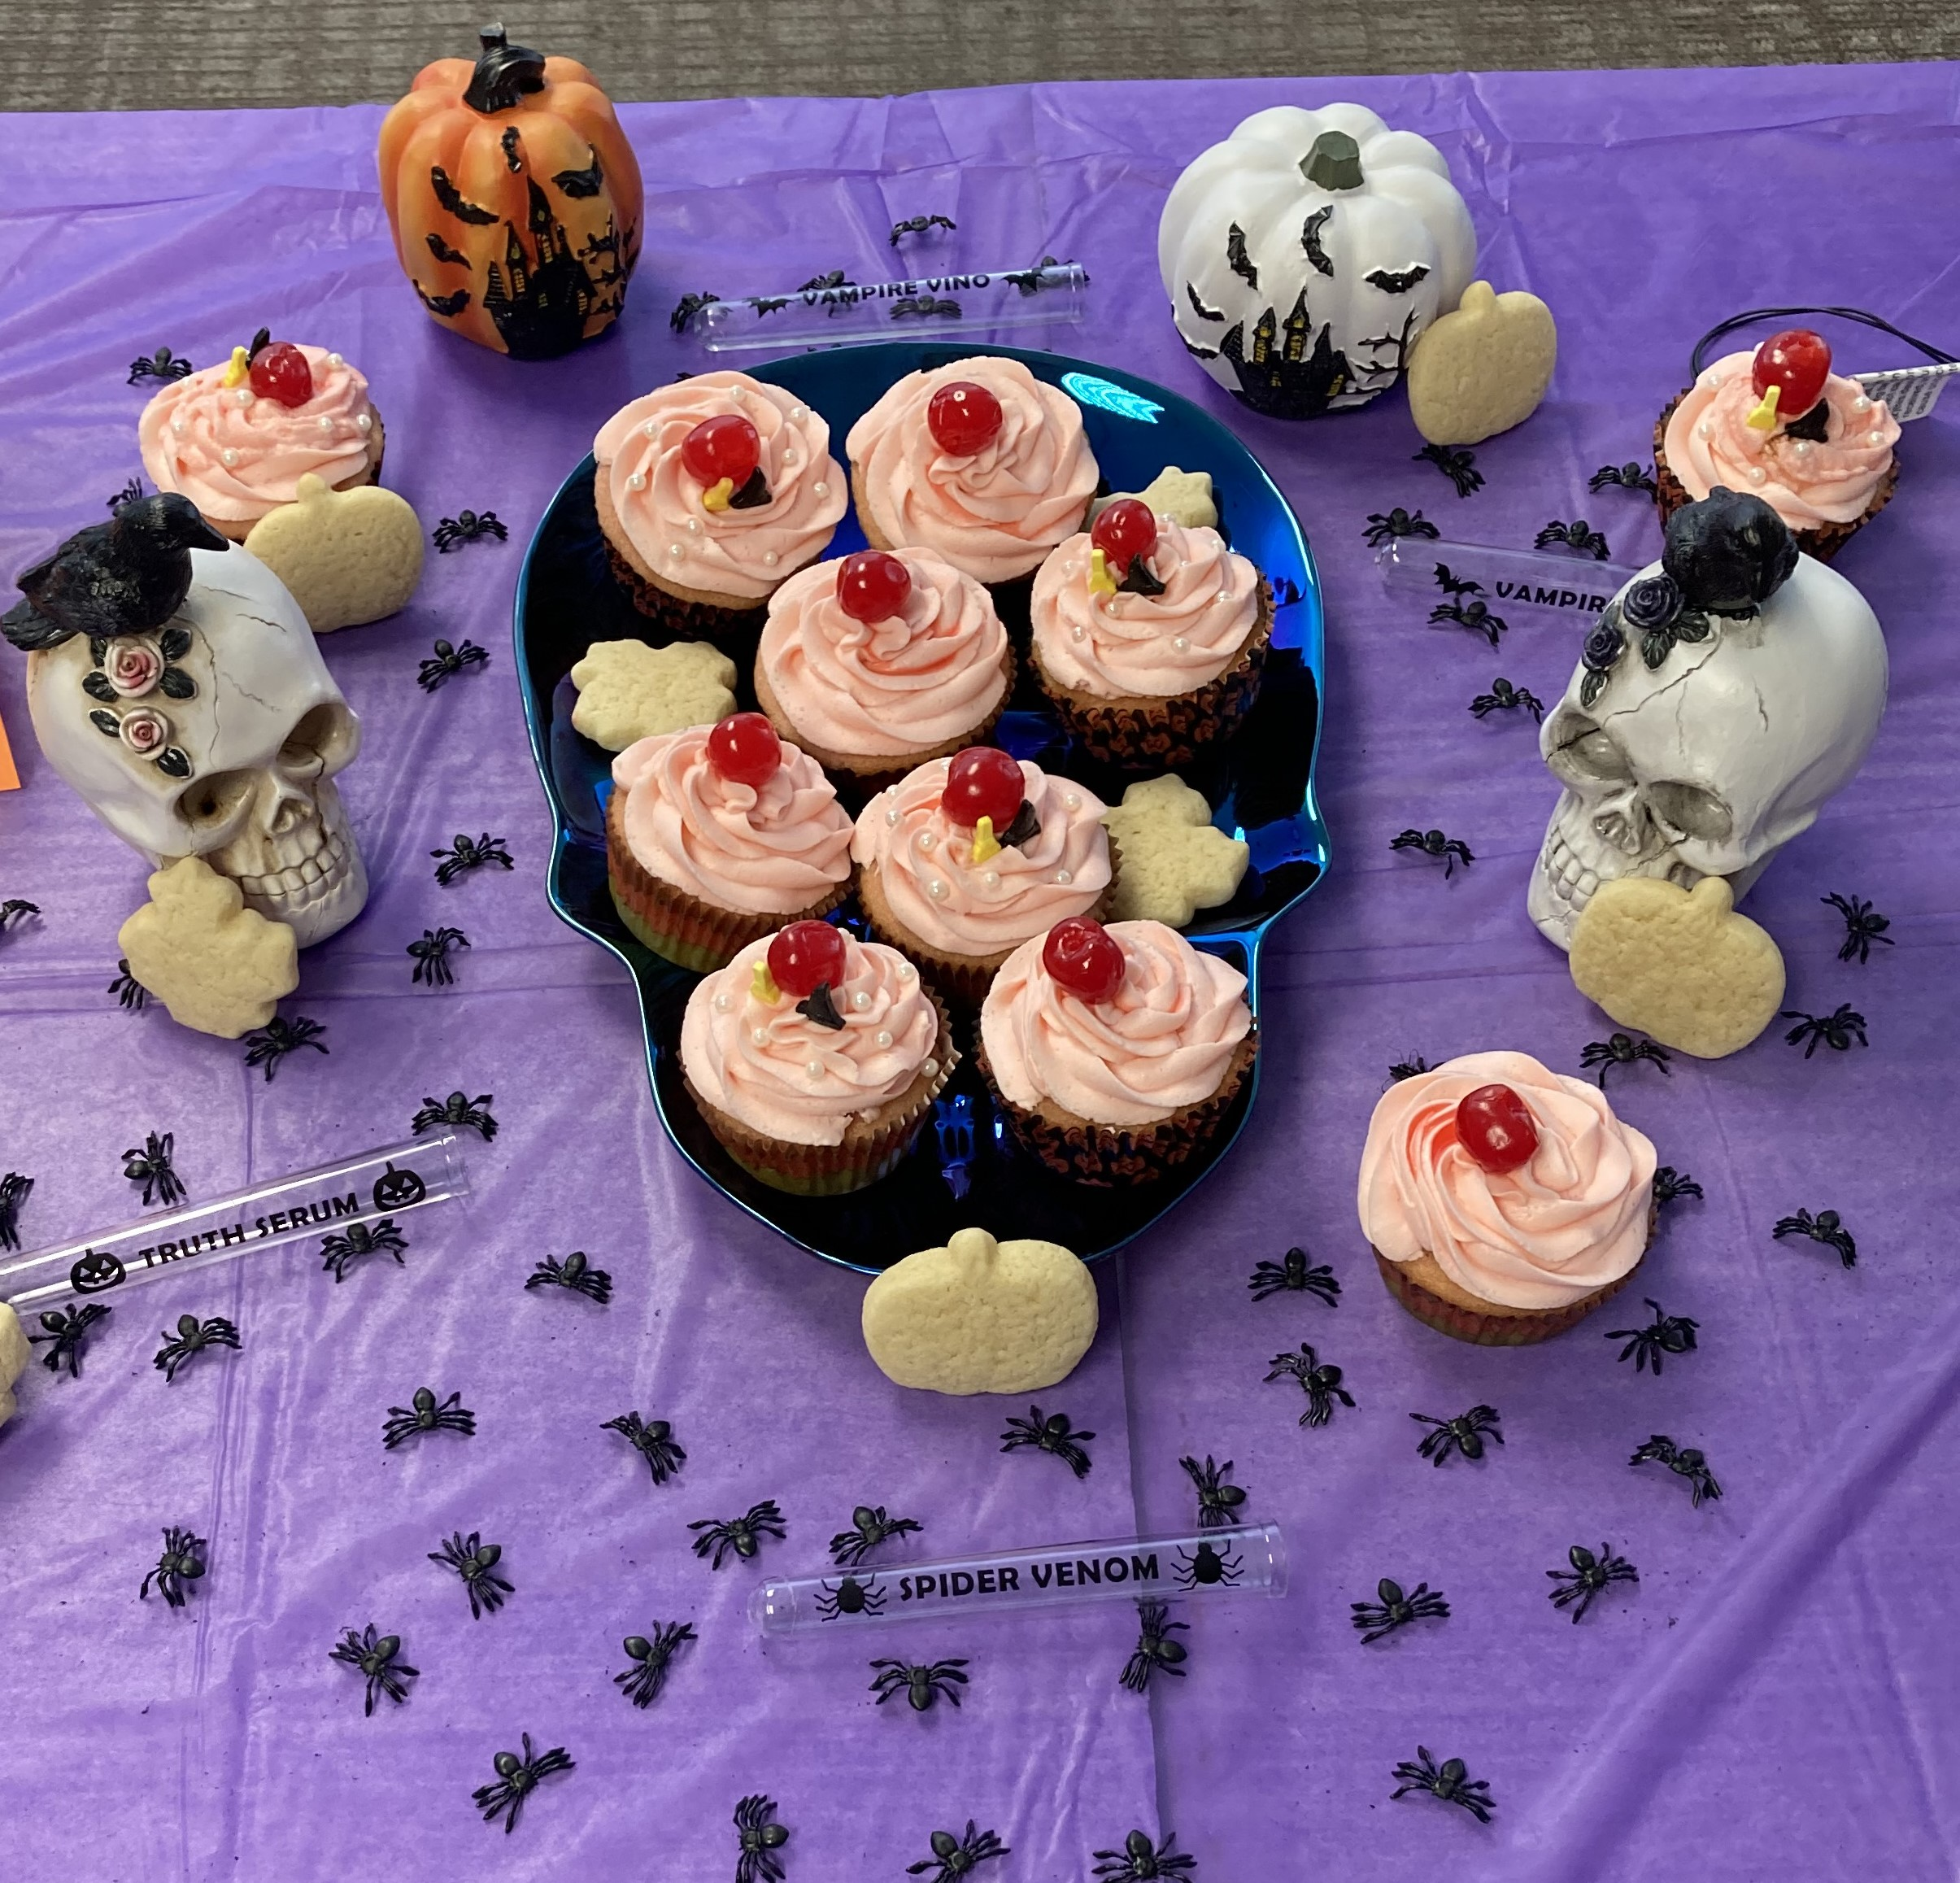
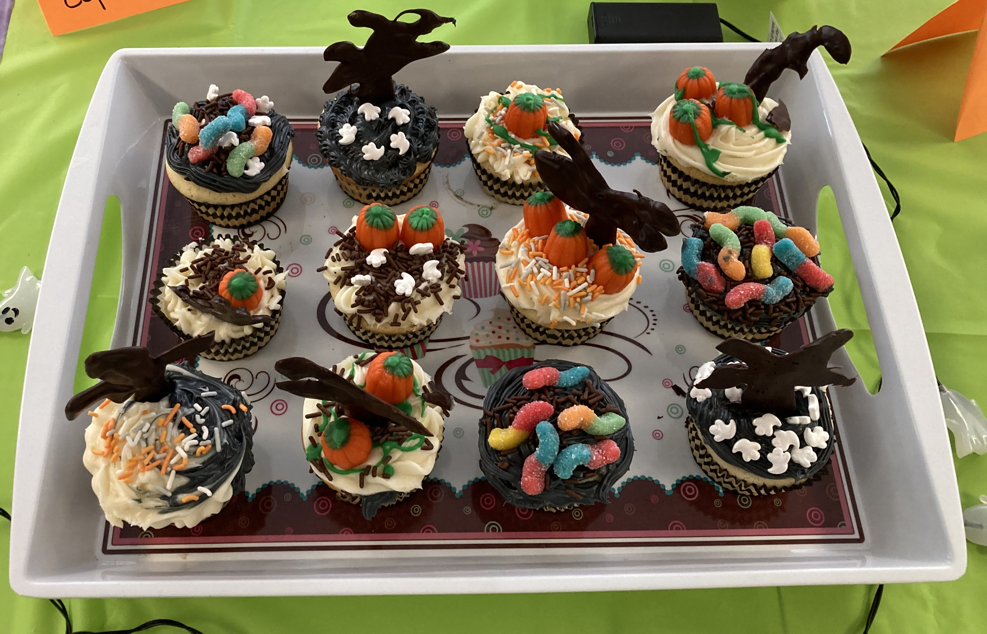
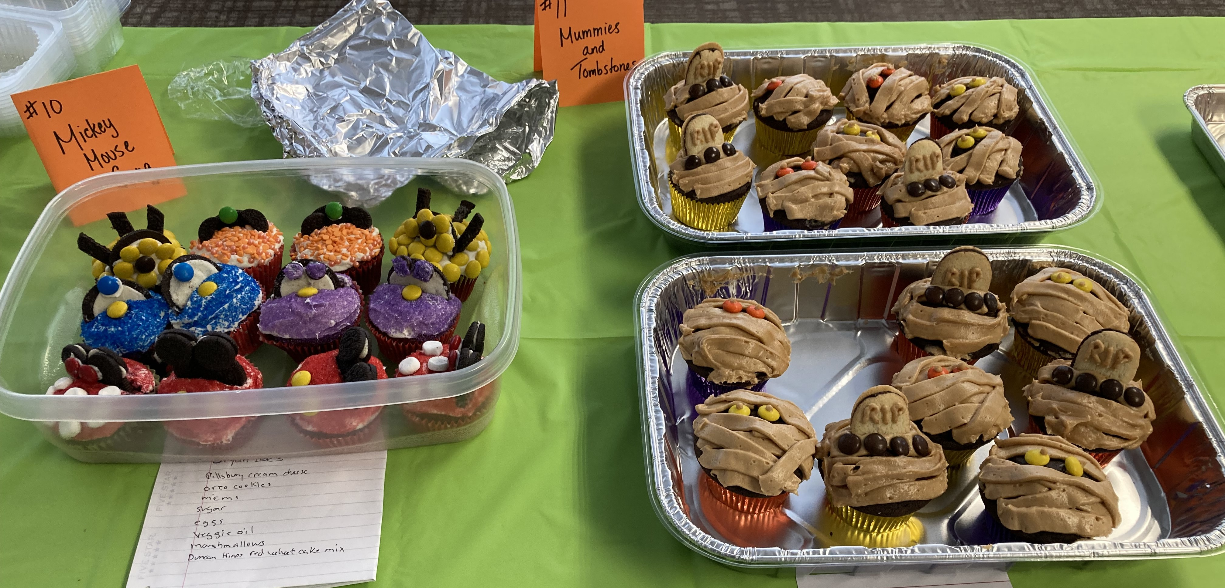
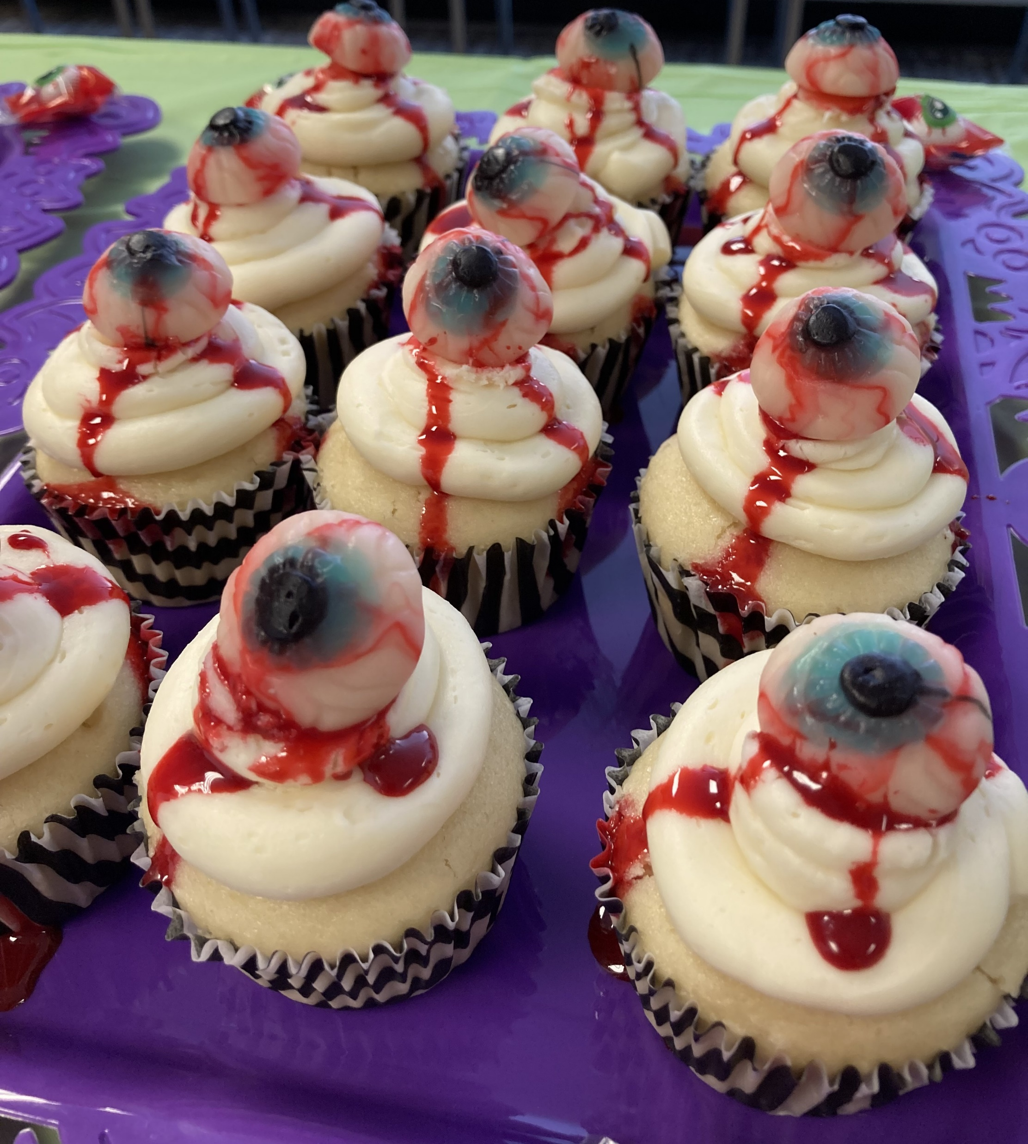
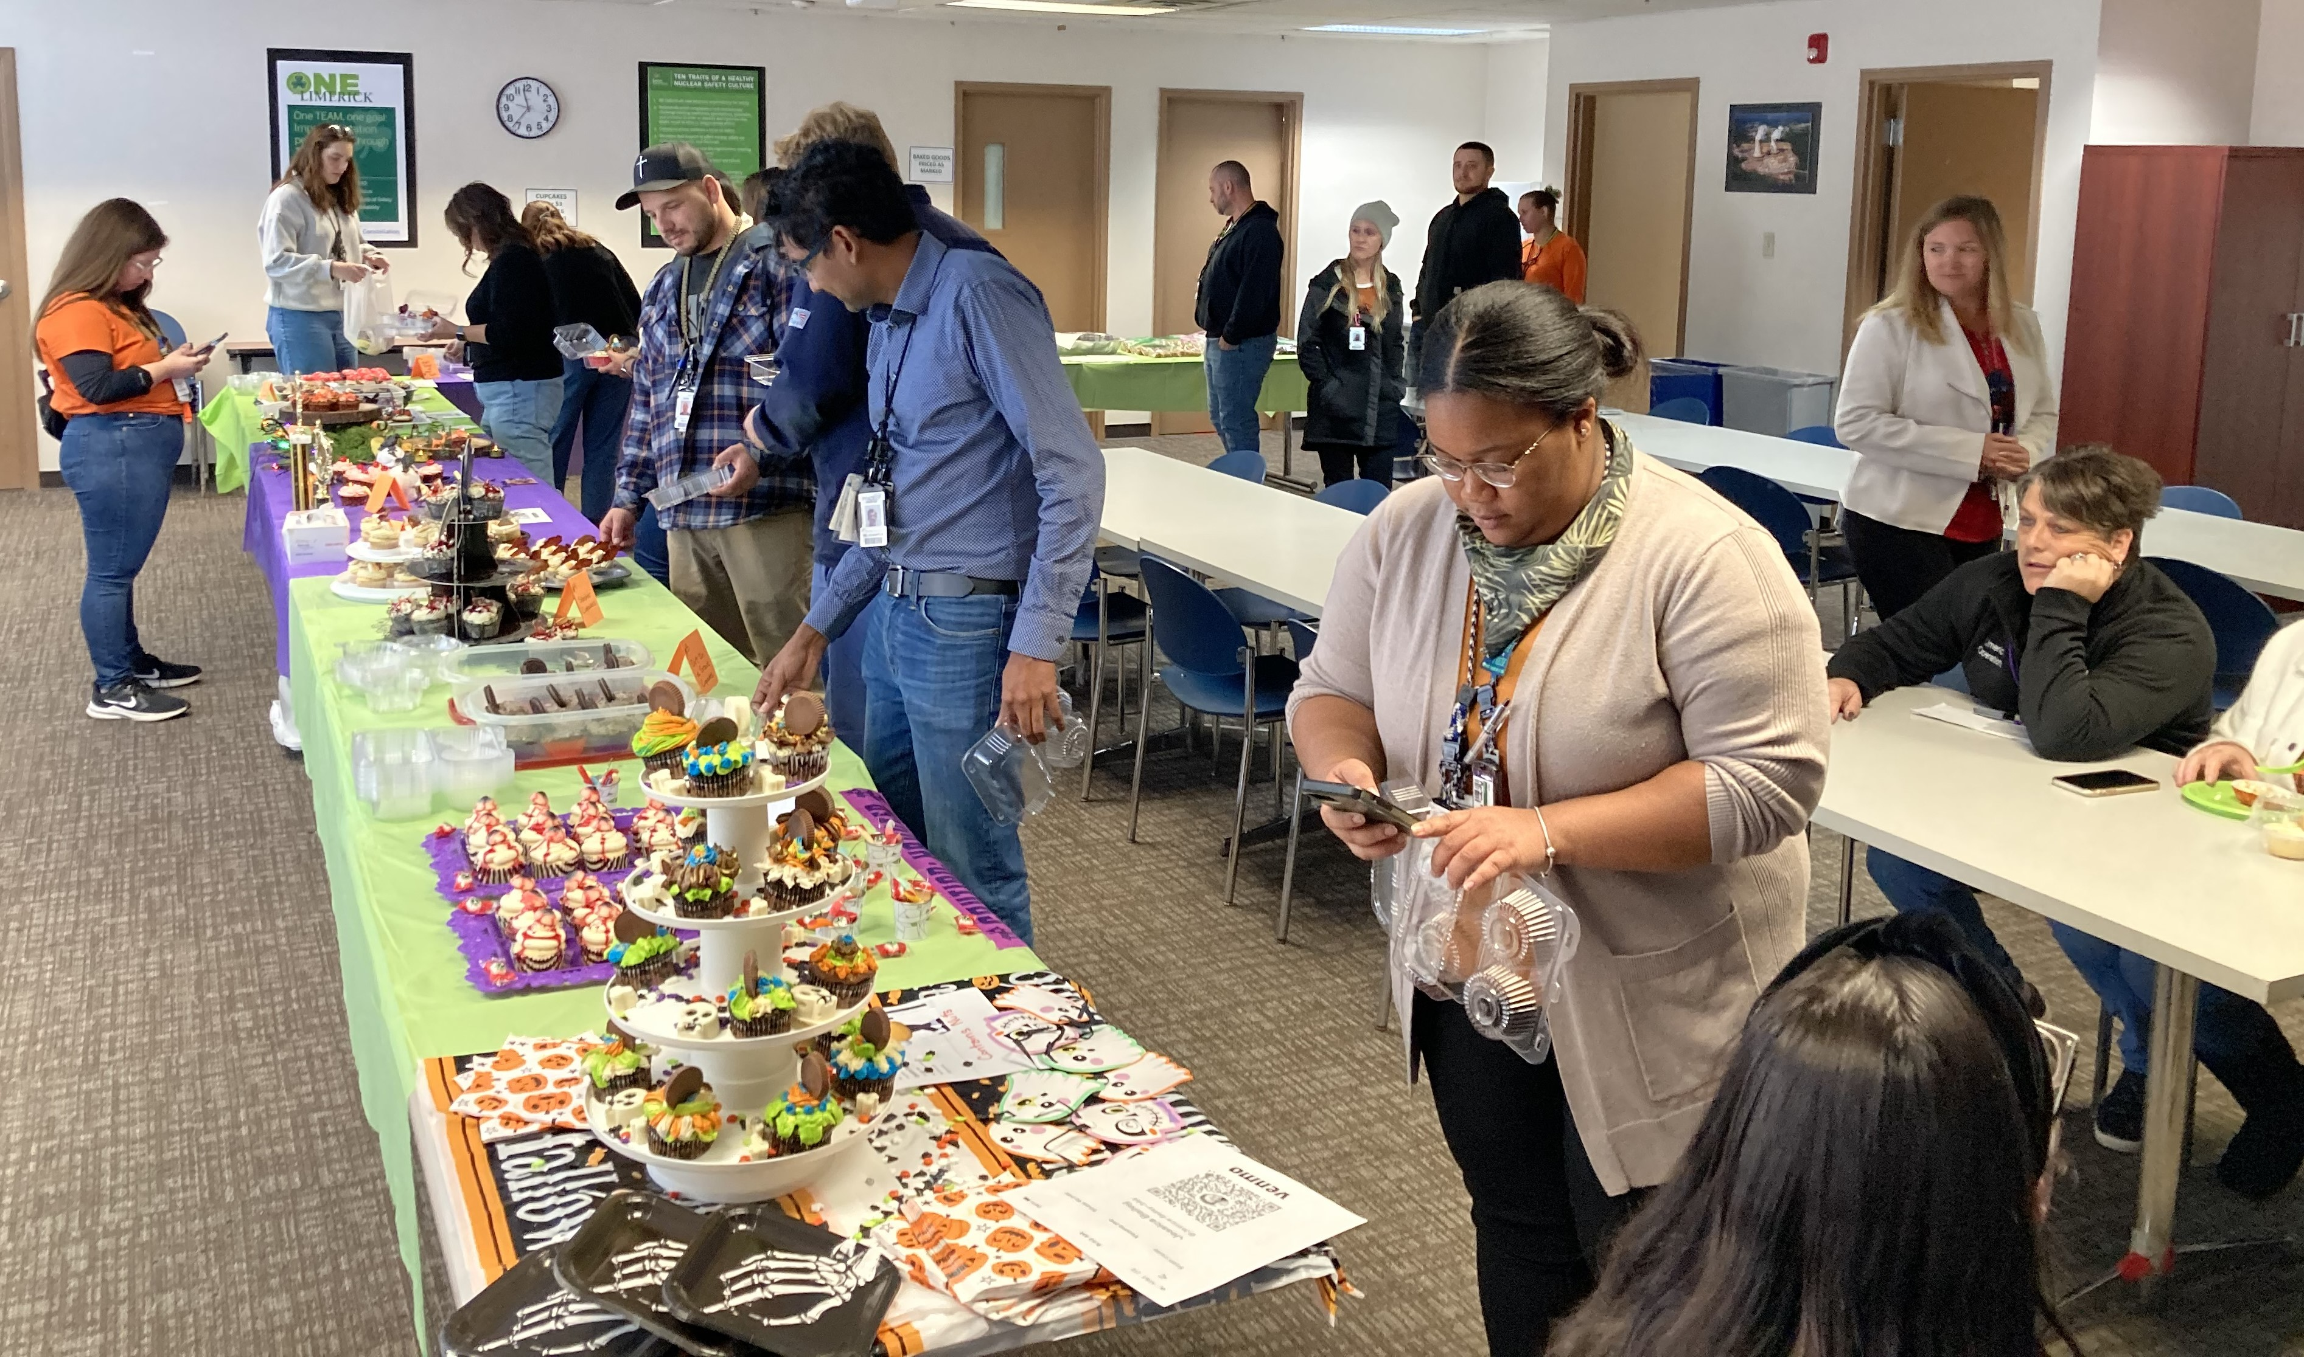
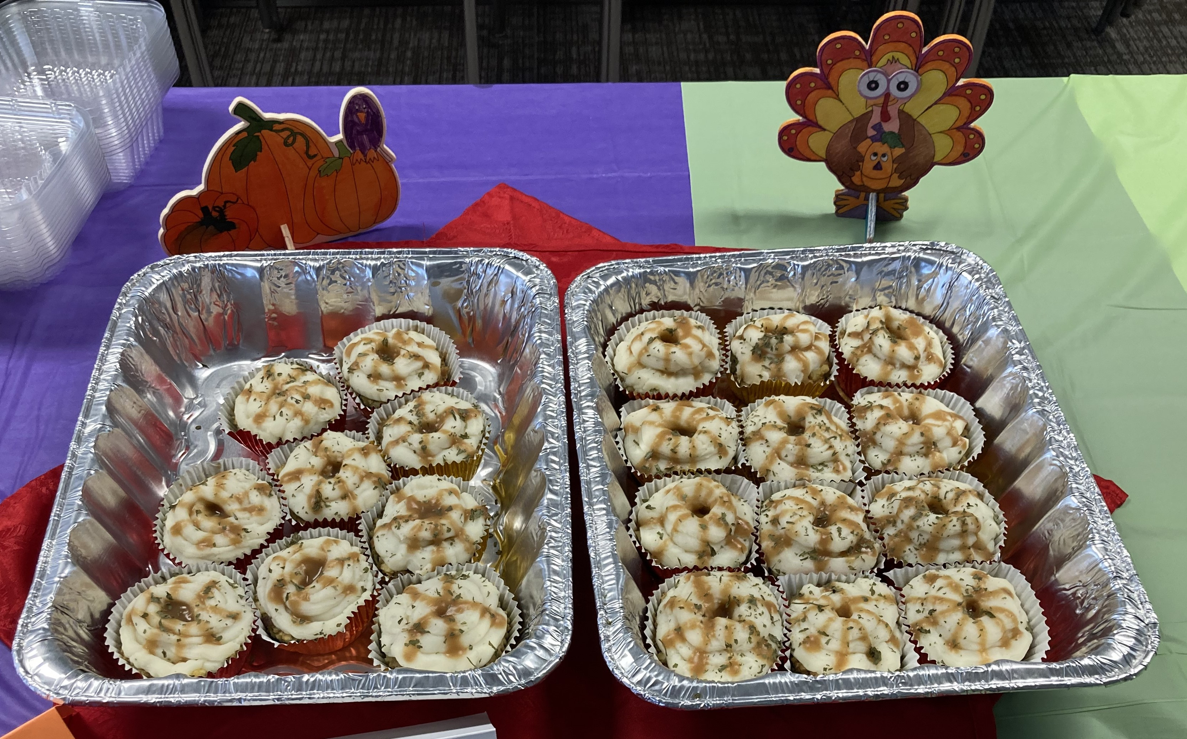
THANK YOU, LIMERICK!!
YOUR SUPPORT OF
CUPCAKE WARS
HELPED RAISE $988!!

