Slide 1
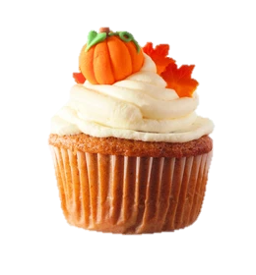
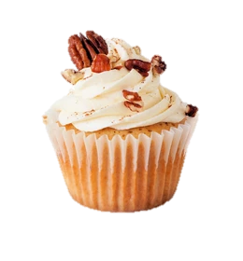
BACK BY POPULAR DEMAND
CUPCAKE WARS!!
Sponsored by NAYGN and WIN
11 Am on TUESDAY, OCTOBER 31st in ALARA #2
Contestants are asked to bring 12 to 24 cupcakes to the SSB ALARA #2 conference room the morning of the competition. Entries will be judged on taste, presentation, and creativity.
Prizes awarded to the top cupcakes!!
Judging will begin at 11AM. Following judging, the Constellation Community Campaign will be having a bake sale of the cupcakes and other baked goods from 11:30 a.m. to 2:00 p.m.
If you do not want to participate in Cupcake Wars but would like to help provide baked goods for the bake sale, those can also be dropped off in ALARA #2 that morning.
Contact Claire Mudrick or Jessica Bailey if you are interested in entering the competition OR helping to sell cupcakes after judging!
All proceeds go towards the Constellation Community Campaign

