Slide 1
CUPCAKES
1 for $3
6 for $16
12 for $30

Slide 2
BAKED GOODS
PRICED AS MARKED

Slide 3
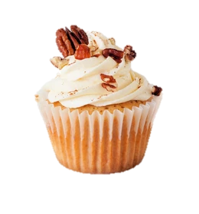
DO NOT ENTER
CUPCAKE WARS!!
JUDGING
IN PROGRESS

Slide 4
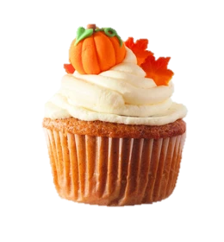
CUPCAKE WARS!!
BAKE SALE
ALARA #2
11:30-2pm

Slide 5
CUPCAKE WARS!!
BAKE SALE – TUESDAY 10/31
ALARA #2
11:30-2pm

