Slide 1
Street Fair Booth Activities

Slide 2
Street Fair Booth
4 Activities/Demonstrations for a Street Fair Booth
Information Station/Lollipops
Windmill Demonstration
Radioactive Decay Game (simple version)
Radiation Detectors & Monitors

Slide 3
Sample Event Description
An Introduction to Nuclear Energy through hands-on activities and games geared to teaching girls about electricity, nuclear energy, and radiation. Come by to learn how nuclear energy produces electricity and have fun in the process!
Exhibits include:
radiation discussion including a demonstration with a radiation monitor,
power cycle discussion illustrated with a mini-wind turbine demonstration,
radioactive half-life activity with candy, and
take-away handouts of lollipop cards with U-235 energy facts.

Slide 4
Logistics
Audience: 1st through 8th grade
Number of Students:
75-100 students/hour
If all 4 stations are set up, can handle ~20 students at a time – split equally among the different stations
Time with Each Student:
1 to 3 minutes per station, depending on engagement
4 to 12 minutes total, depending on engagement

Slide 5
Setup
3-4 long tables for activities
Table 1: Brochures, bags, pellet cards, U.S. WIN Mints, pop-up display and lollipop cards
Table 2: Windmill generator demonstration
Table 3 (or tables 3A & 3B if space): Radioactive decay activity
Table 4: radiation monitor
Arrangement of tables: The tables are either set up in a straight line or are angled to form a semi-circle. This depends on the space available and the clearance for the walkway.
Order of the tables can really be setup in what every logical flow you like. Just be sure to have a “story” to transition between tables.

Slide 6
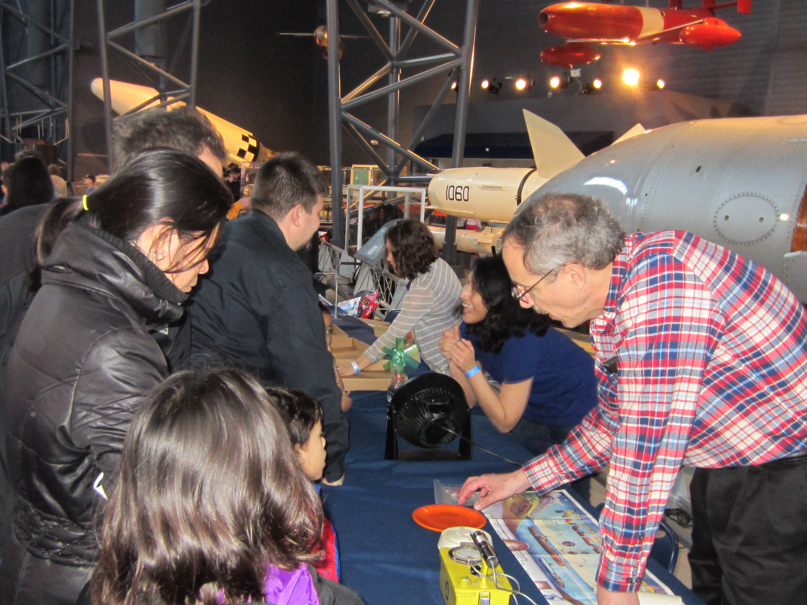
Tables for brochures & windmill beyond radiation detectors and radioactive decay tables

Slide 7
Volunteers
1 volunteer at Table 1
2 volunteers at Table 2 (one running each activity)
2-4 volunteers running the radioactive decay game and handing out lollipop cards
Optional: 3 volunteers to answer questions
1-2 volunteers handing out lollipop cards
1-2 volunteers engaging parents

Slide 8
Table 1 - Information
Brochures, bags, pellet cards, stickers, and other items to give away
Lollipop cards about Uranium-235 (See outreach library presentation titled Lollipop Handout)
Posters of nuclear power plant locations in the U.S. or your state, the nuclear fuel cycle, or how a power plant works
Pop-up display frame (vertical surface to hang posters), tape, push pins

Slide 9
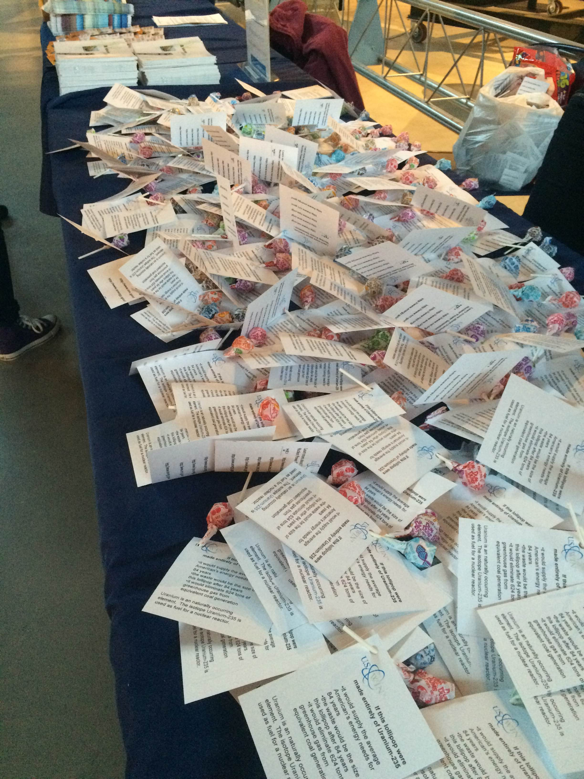
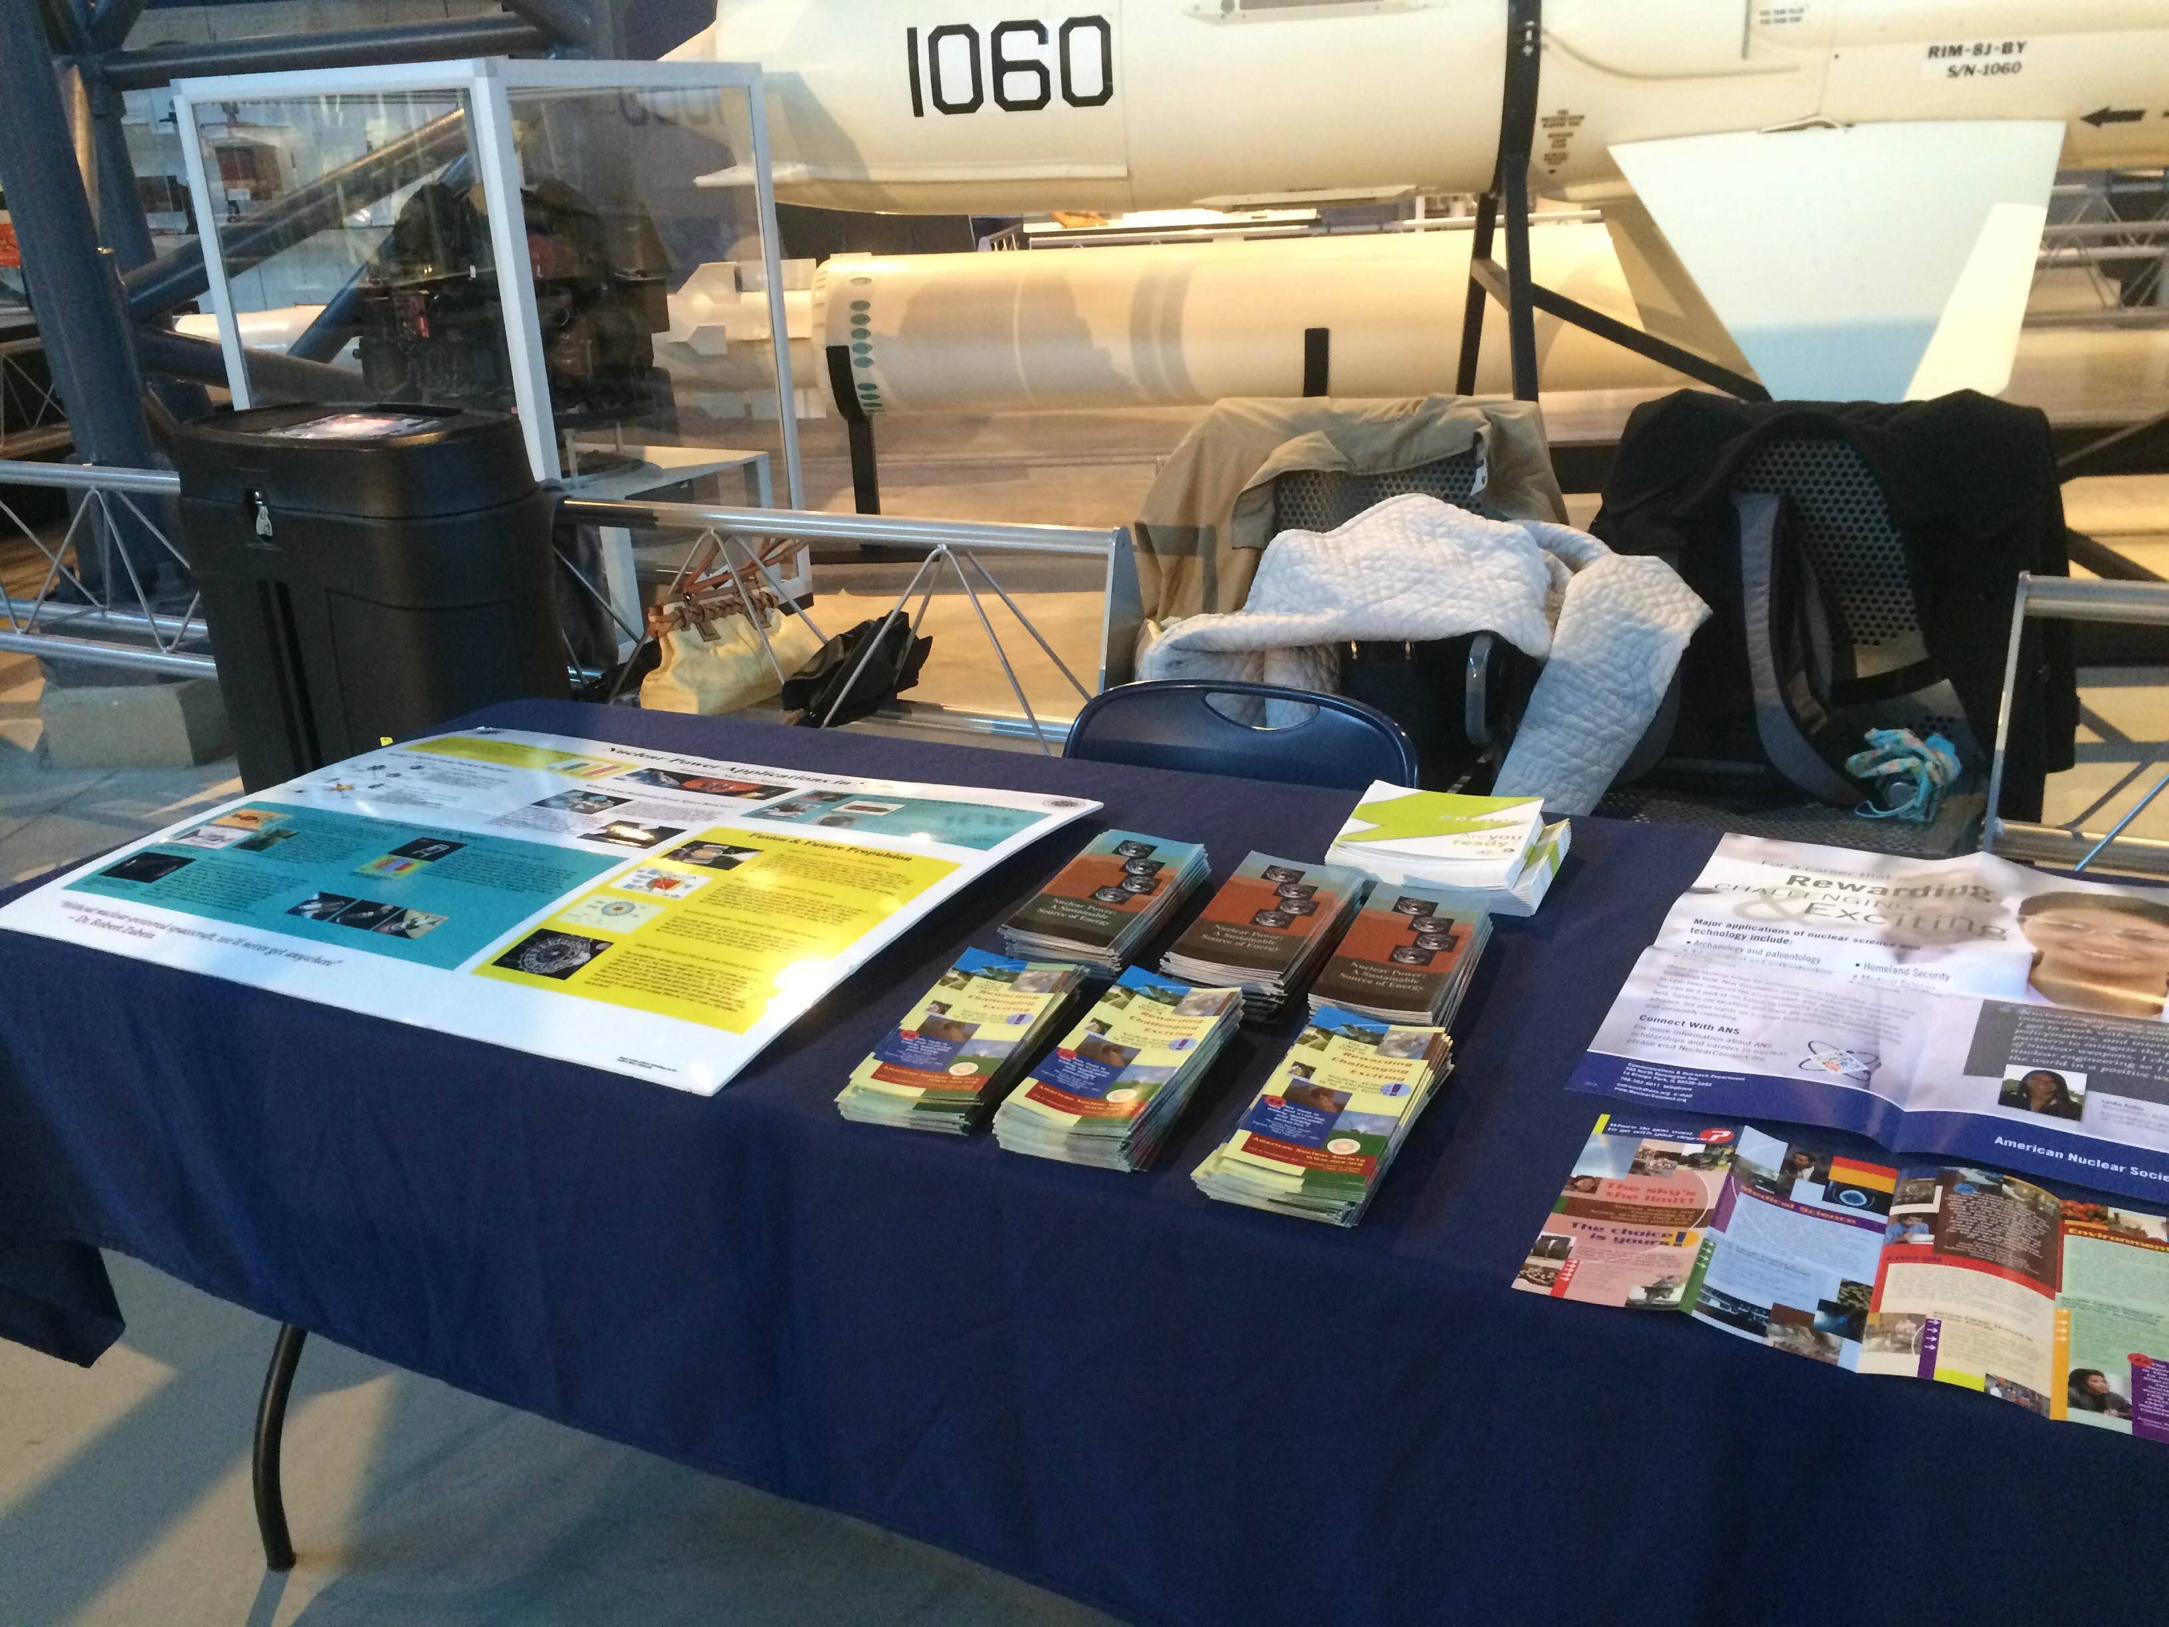
Table 1

Slide 10
Table 2 - Windmill
Windmill demonstration: Windmill Generator*, tabletop fan**, water bottle half filled with sand/water
*Green Science Windmill Generator is available at Toy-R-Us for $10-$15
**Request that organizer provides electricity or bring a battery-powered fan

Slide 11
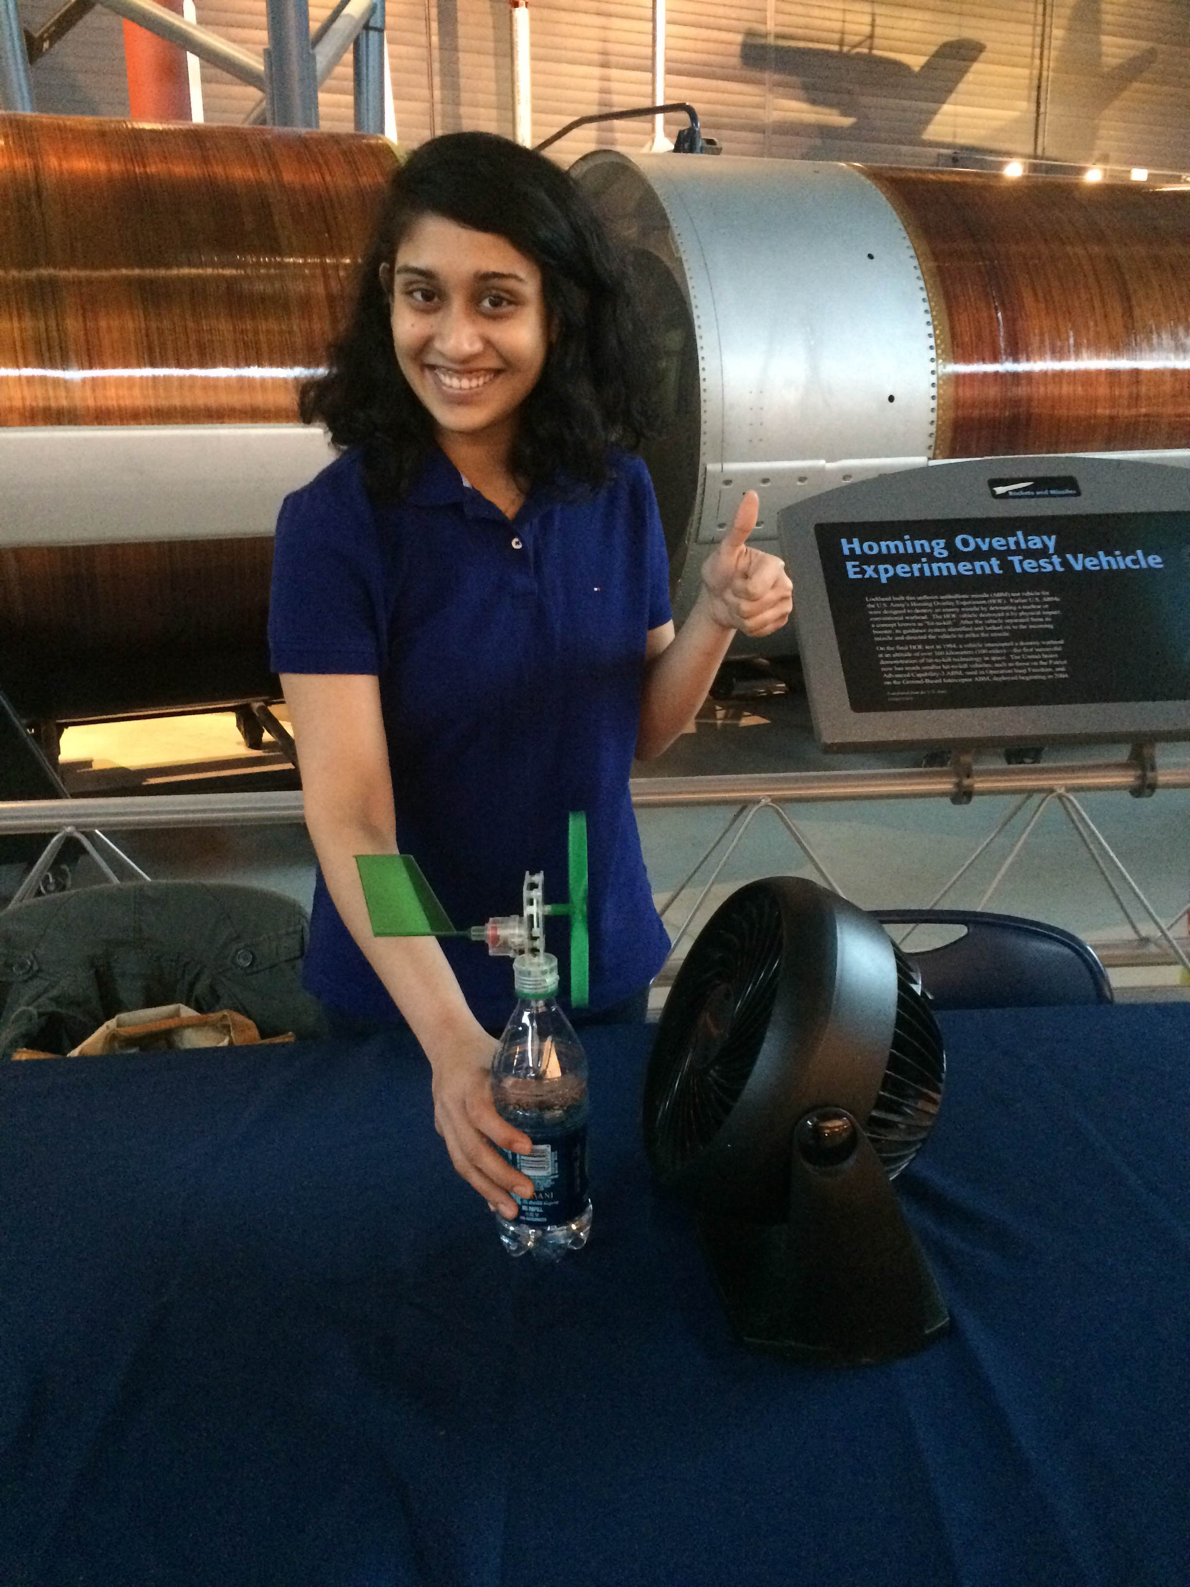
Table 2
Green Science Windmill Generator

Slide 12
Table 2
Can you see the light glowing!!!

Slide 13
Table 3- Radioactive Decay Game
Radioactive decay activity: U.S. WIN Mints***
Wrapped mints with the U.S. WIN logo
U.S. WIN Mints can be ordered from The Promo Touch (ThePromoTouch.com)
shallow box lids or trays
Simple version of the high school ANS teaching for exponential decay

Slide 14
Table 3- Radioactive Decay Game
Introduction:
Some elements are radioactive
Radioactivity is just energy leaving a body and traveling through space
To demonstrate how that happens, let’s play a game
Game:
OTHER CONCEPTS FROM KATIE AND OTHERS
Flow
Volunteer demonstrates
Kids participate

Slide 15
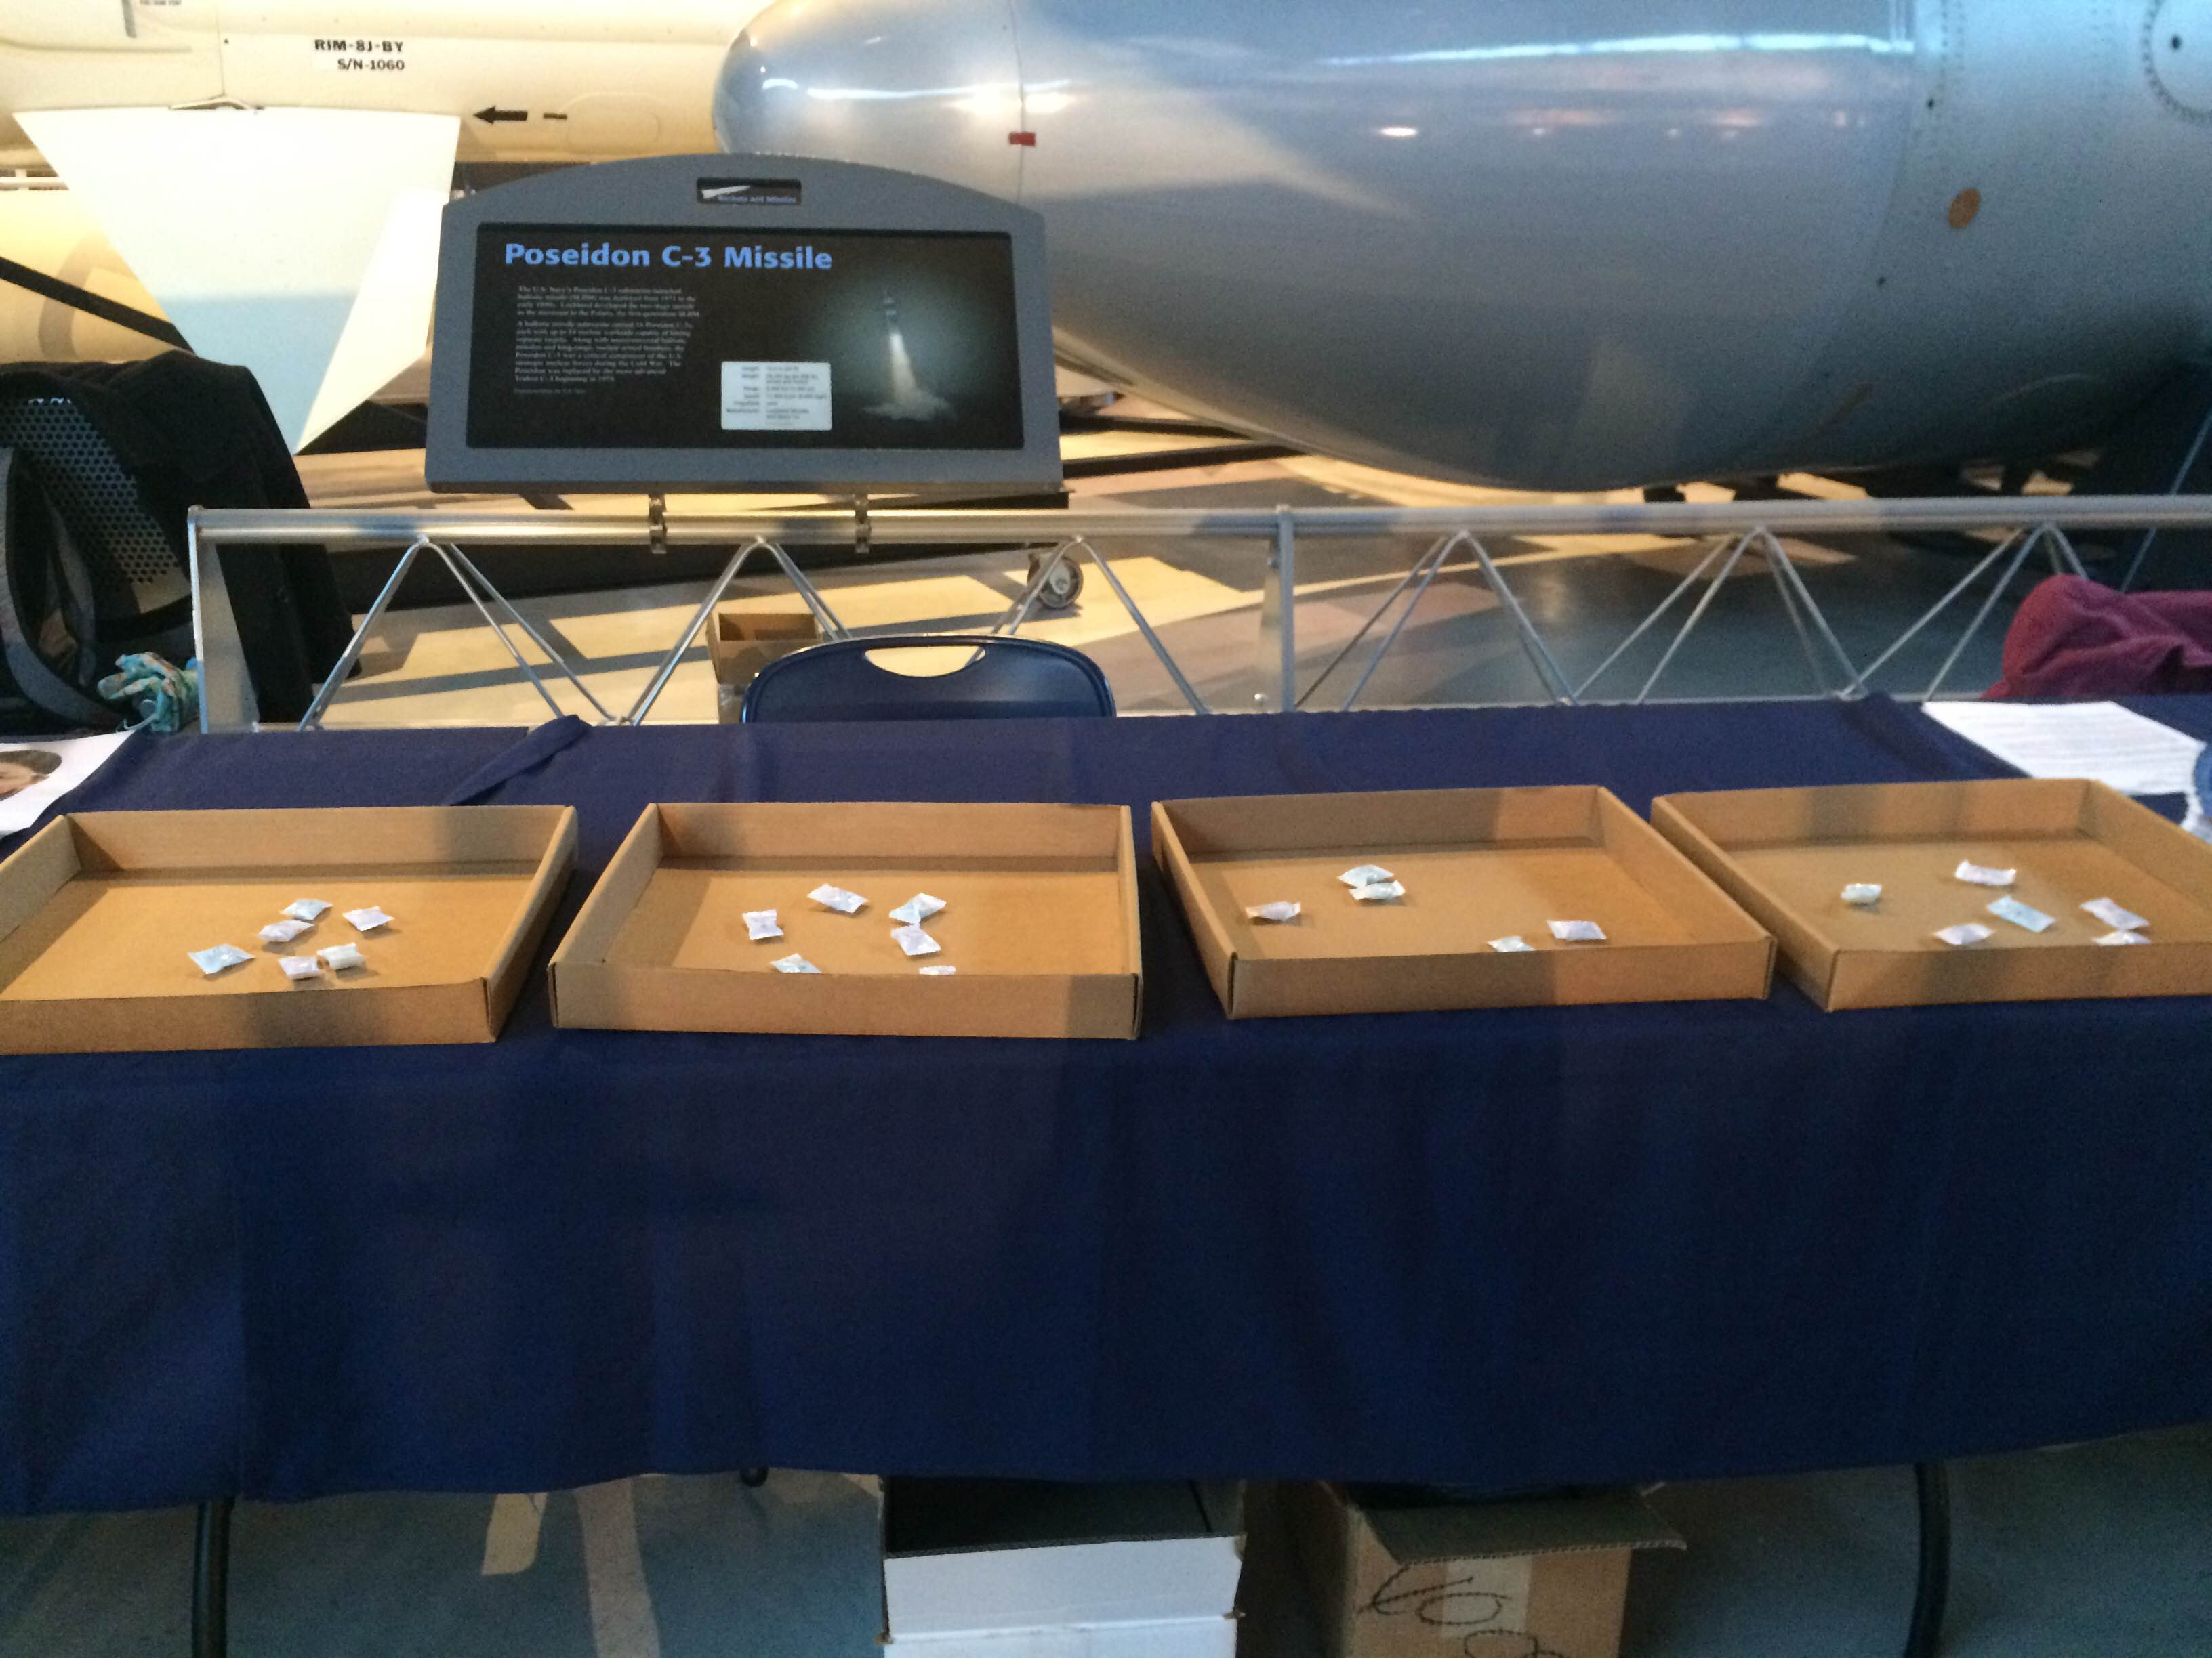
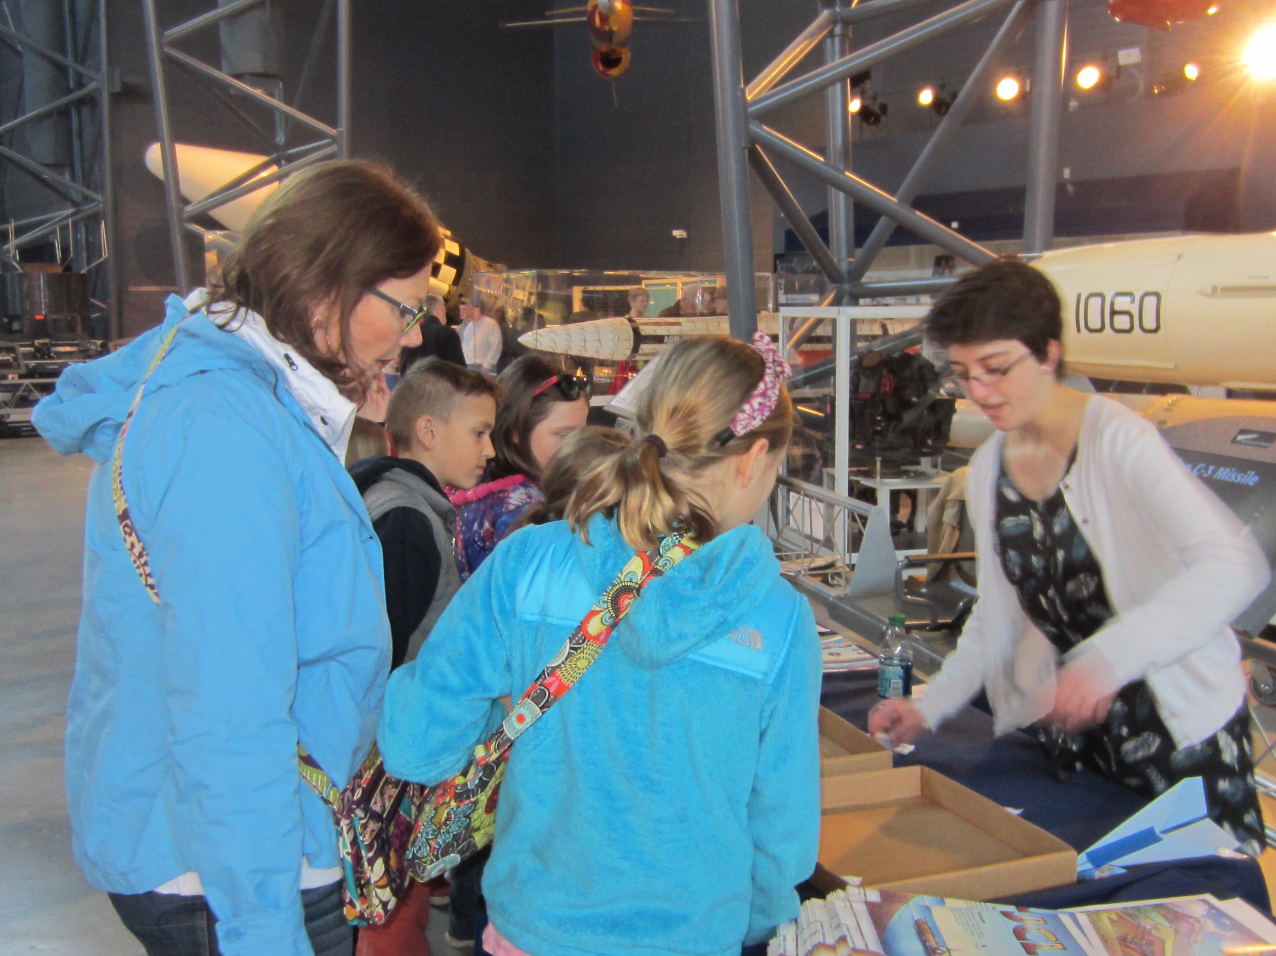
Table 3

Slide 16
Table 4- Radiation Monitors
Radiation detectors/monitor and samples
Talking points:
Explain the use of the monitors
Concept of radiation being natural occurring and all around us,
But like anything, too much of it is bad so we want to know if it’s there in too high of a level

Slide 17
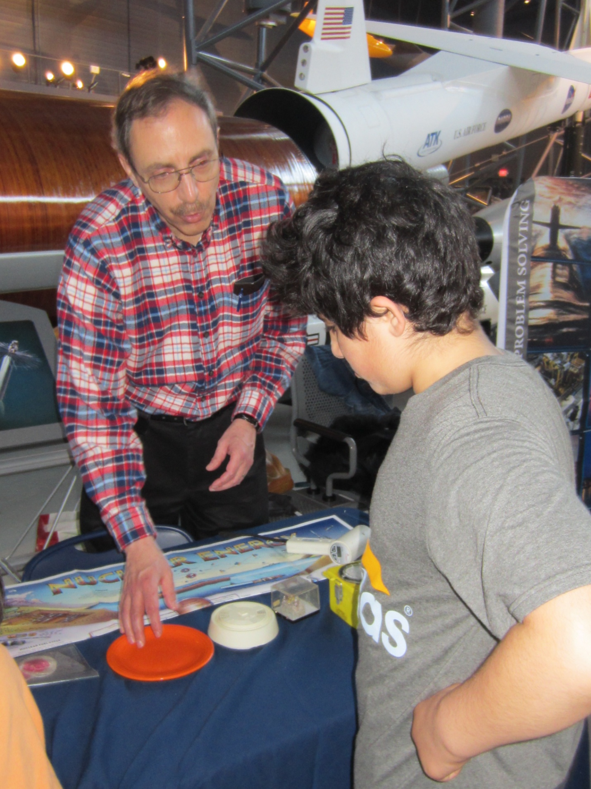
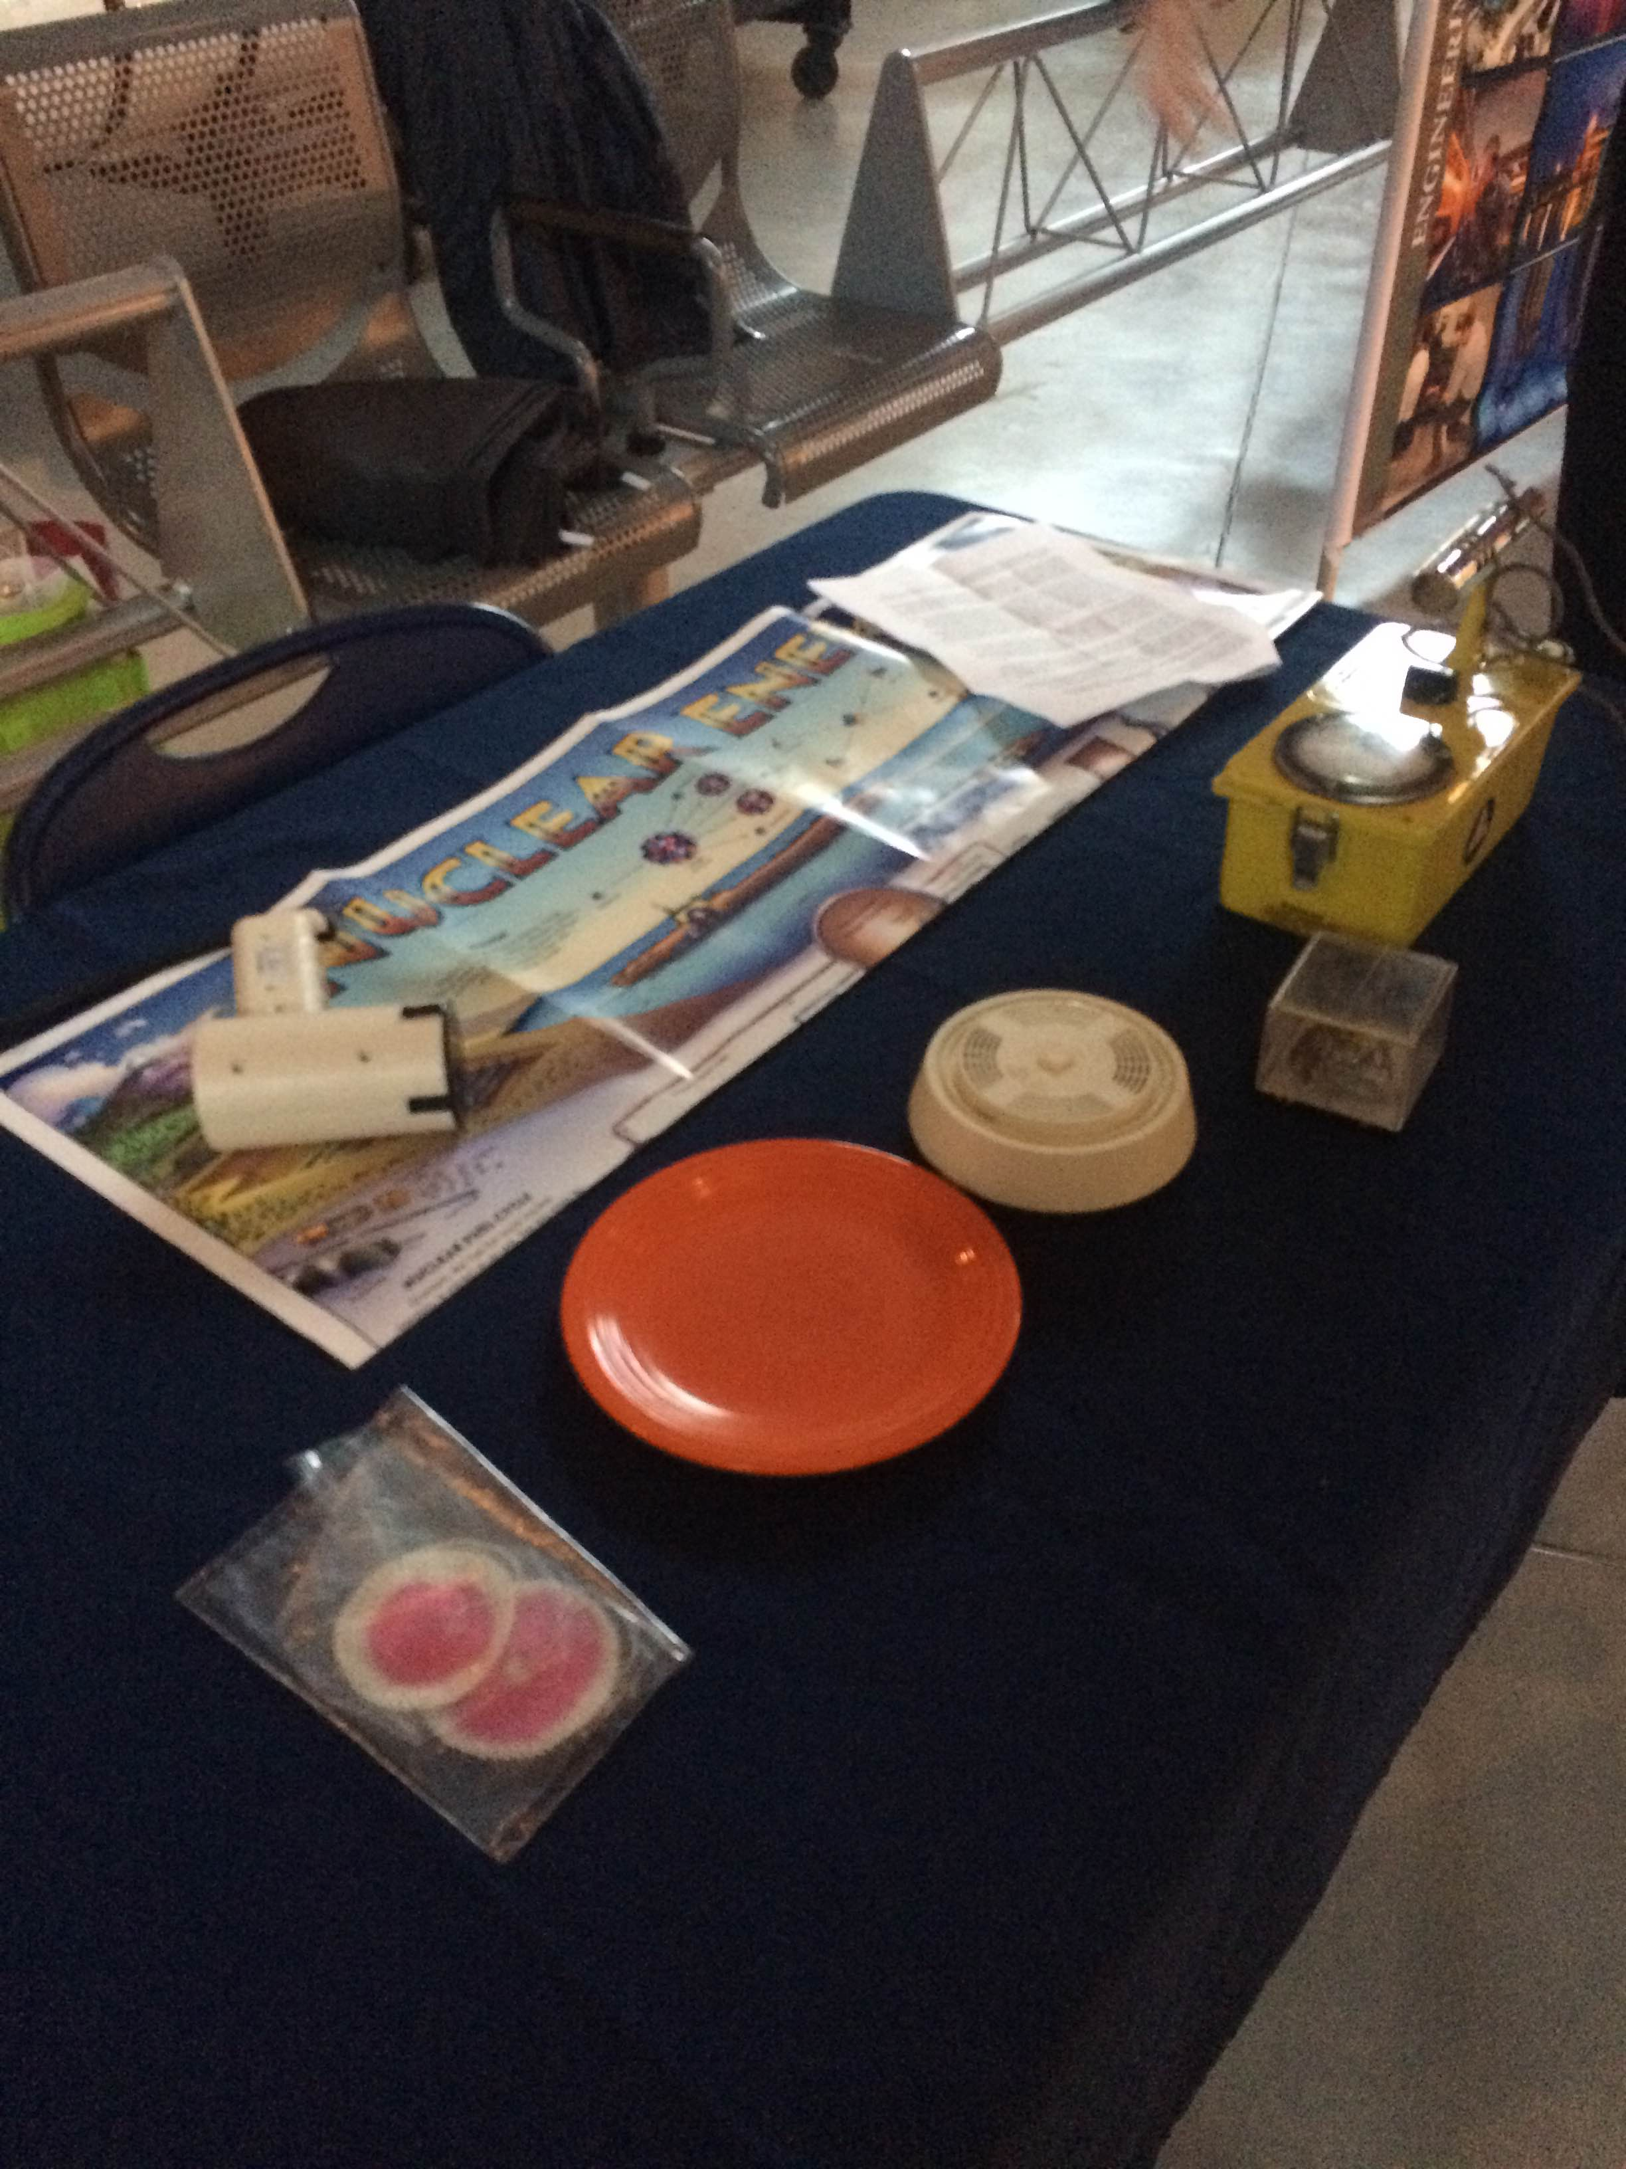
Table 4

